Slide 1
Mold-Part Defeaturing
Project Proposal
Company Partner: HP Printing Korea (Mentor: Byoungho Yoo, CAE)
Team: CleanCAD (HP2)
Team Members: Junoh Lee (Team Lead / CAD) · Hemanth Reddy Vangala (ML / Graph) · Aneela Tahir (Data) · Balcha Kidus Elias (Integration & Test)
Presentation Date: October 1, 2026
Notes:
Good morning/afternoon. We are Team CleanCAD, presenting our capstone project proposal: Mold-Part Defeaturing, developed together with HP Printing Korea. I'm Junoh Lee, team lead, and this is Hemanth, Aneela, and Elias. Over the next few minutes we'll walk through the problem, our goals, the requirements we've confirmed with HP, our system design, and our plan through the end of the semester.

Slide 2
1. BACKGROUND & PROBLEM (1/2)
Industrial Background
▪ Mold/part CAD carries manufacturing detail
  – holes, fillets, chamfers, ribs, bosses, embosses
▪ These details barely affect CAE analysis
  – but sharply increase mesh & solve time
▪ HP's problem: manual defeaturing
  – slow, repetitive, before every single analysis
  – inconsistent — depends on each engineer's experience
  – doesn't scale to high-volume simulation work
CleanCAD · Project Proposal · HP Printing Korea
Notes:
Before running CAE simulations, mold and part CAD models contain a lot of small geometric detail that manufacturing needs but analysis doesn't: holes, fillets, chamfers, ribs, bosses, embosses. These details barely change the analysis result but dramatically increase mesh generation and solve time. Today, HP's CAE engineers remove these details by hand before every analysis. It's slow, it's repeated for every part, it depends on each engineer's personal judgment so results are inconsistent, and it simply doesn't scale to HP's volume of simulation work.

Slide 3
1. BACKGROUND & PROBLEM (2/2)
Problem Reframing
▪ Not a CAD-editing problem —
  – a recognition + decision problem
▪ Core question:
  – which features are safe to remove,
  – accurately, and fast enough to replace manual work?
▪ Maps directly to our architecture:
  – Geometry layer — deterministic engineering
  – Decision layer — rule-based, then ML
CleanCAD · Project Proposal · HP Printing Korea
Notes:
From an engineering standpoint this isn't really a CAD-editing problem, it's a recognition and decision problem: can we automatically recognize shape features and decide, with high accuracy, which ones are safe to remove — while staying fast enough to actually replace manual work, and light enough to run without a GPU? That question splits cleanly into two layers, which is exactly how our architecture is organized: a geometry layer that reads, modifies, and heals CAD data deterministically, and a decision layer that learns which features matter, starting with simple rules and evolving into a trained model.

Slide 4
2. PROJECT GOALS
Technical, Quantitative & Learning Goals
Technical Goals
Quantitative & Learning Goals
▪ Automate STEP → STEP preprocessing
▪ Recognize 6 feature types; classify keep/remove
▪ Staged logic: rule-based → ML → retrain loop
▪ Decision-support only — review is mandatory
▪ Metric #1 (primary): defeaturing accuracy
▪ Metric #2: 70–90% preprocessing time cut
▪ CPU-only inference; GPU only for training
▪ Learn: B-rep/STEP, GNNs, staged AI, remote teamwork
CleanCAD · Project Proposal · HP Printing Korea
Notes:
Our technical goals: automate the full STEP-to-STEP preprocessing pipeline, recognize the six feature types HP cares about, and make keep/remove decisions in two stages — rules first, machine learning second — with a loop that retrains on corrected mistakes. Critically, the tool assists the engineer, it doesn't replace their judgment — every result goes through mandatory review. On the quantitative side, our primary success metric, confirmed with HP, is defeaturing accuracy — not analysis accuracy, which is out of scope. Our secondary metric is 70 to 90 percent reduction in preprocessing time. And because HP engineers work on regular laptops, inference has to run without a GPU; only training can use one. Beyond the deliverable, our learning goals cover CAD fundamentals, graph neural networks, staged AI system design, and working effectively as a distributed, multicultural team.

Slide 5
3. REQUIREMENTS (1/2)
Functional Requirements — Summary
Area | Requirement | Pri.
CAD I/O | STEP in/out via FreeCAD headless API | Must
Feature Recognition | Identify 6 feature types; B-rep → graph | Must
Decision Logic | Stage 1 rule-based → Stage 2 ML-based | Must
Defeaturing | Remove + heal into a watertight model | Must
Failure Handling | Store geometry + face ID on failure → retrain | Must
Reporting | Visual before/after only — no text summary | Must
Review | Engineer approval on every single result | Must
Face Highlight | Red-highlighted removal faces saved to STEP | Must
Training Data | Public datasets + self-authored shapes only | Must
Full detail: Functional Requirements Document (FRD) v1.7 · CleanCAD
Notes:
Nine functional requirement areas, all Must-priority, all confirmed with the HP mentor. CAD input and output is STEP only, through FreeCAD's headless API. We recognize six feature types and convert the geometry to a graph. Decision-making is staged: rules first, ML second. Removal always includes geometry healing to keep the model watertight. When healing fails, we don't crash — we store the geometry and the failing face ID so it can be corrected and fed back into training. The comparison report is visual only, no text summary, per the mentor's explicit request. Every single result goes through engineer review before it's final. Faces selected for removal are highlighted in red in an exported STEP file, so the engineer can check the selection. And all training data is either public datasets or shapes we author ourselves — HP's real CAD data is confidential and was never provided.

Slide 6
3. REQUIREMENTS (2/2)
Non-Functional Requirements — Summary
Category | Requirement | Pri.
Performance | 70–90% faster; CPU-only inference | Must
Reliability | Input untouched; output always watertight | Must
Portability | No NX; headless, standalone batch execution | Must
Security | Zero HP confidential data in the repository | Must
Usability | Report readable by a non-AI-expert at a glance | Must
Maintainability | Modular by pipeline stage; Git-based workflow | Must
Accuracy | Optimize for defeaturing accuracy, not CAE accuracy | Must
Full detail: Non-Functional Requirements Document (NFRD) v1.6 · CleanCAD
Notes:
Seven non-functional categories. Performance ties back to our two metrics — time reduction and CPU-only inference. Reliability means we never touch the original file and every output is a valid watertight solid. Portability means no NX license dependency and headless batch execution, not manual GUI scripting. Security is strict — no confidential HP data ever enters our public repository, only public datasets and our own authored shapes. Usability means the visual report has to make sense to a CAE engineer with zero AI background. Maintainability keeps the codebase split along the same lines as the architecture, so each team member can work independently. And accuracy is explicitly scoped to defeaturing accuracy — downstream CAE analysis accuracy is out of scope, confirmed by the mentor.

Slide 7
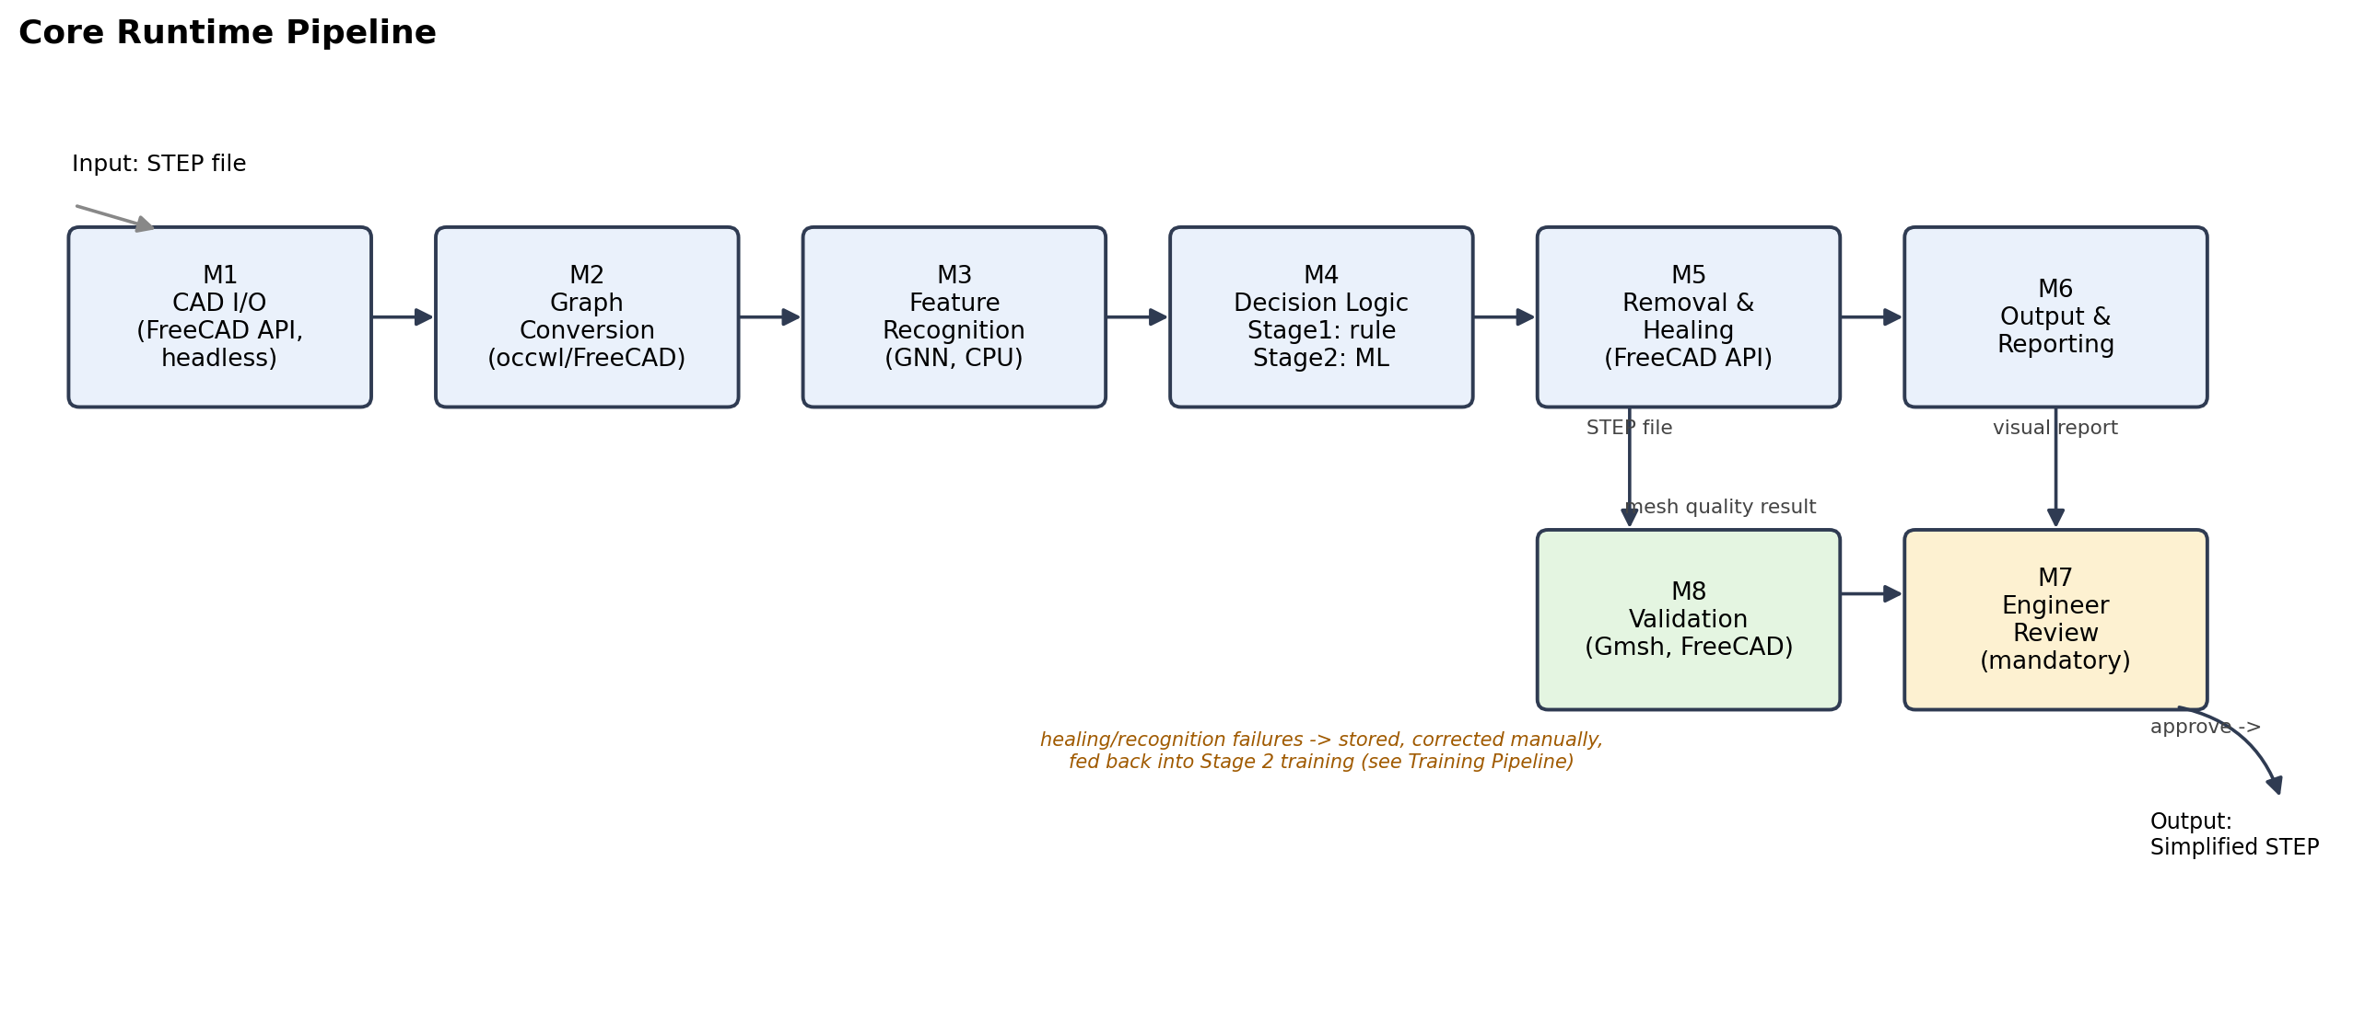
4. SYSTEM DESIGN (1/5)
Overall System Configuration
Core runtime pipeline (M1–M8). Offline training supplies the model used in M3. · CleanCAD
Notes:
This is our core runtime pipeline. A STEP file comes in, gets parsed into B-rep geometry, converted to a graph, analyzed by the GNN, and the decision logic proposes which features to keep or remove. The removal engine applies that and heals the geometry, and the output stage produces both the simplified STEP and a visual comparison report. Every result then goes through mandatory engineer review before it's finalized. Separately, mesh-quality and visual validation confirm the result meets our success criteria. The model used in the recognition step is trained offline — that's a separate pipeline we'll show next.

Slide 8
4. SYSTEM DESIGN (2/5)
Module Structure & Data Flow
Module | Responsibility | → Interface
M1 CAD I/O | Parse STEP → B-rep | In-memory shape → M2
M2 Graph Conversion | B-rep → face-adjacency graph | Graph → M3
M3 Feature Recognition | Classify each face (GNN) | Label + confidence → M4
M4 Decision Logic | Rule → ML → propose action | Removal list → M5
M5 Removal + Healing | Remove features; heal geometry | Healed shape → M6; fails → retrain
M6 Output & Reporting | Export STEP + visual report | → M7 Engineer Review
M7 Engineer Review | Mandatory human approval | Approve → final; Reject → manual
M8 Validation | Mesh quality + visual check | Metrics → success criteria
Full detail: High-Level Design Document (HLD) · CleanCAD
Notes:
Walking through each module: M1 parses STEP into an in-memory B-rep shape. M2 converts that into a graph — faces as nodes, adjacency as edges. M3 is the trained GNN, which labels each face with a confidence score. M4 is the decision logic — rule-based first, ML second — which proposes, not finalizes, a removal list. M5 executes the removal and heals the geometry; failures here are stored and routed into the retraining data instead of crashing the pipeline. M6 exports the simplified STEP and builds the visual report. M7 is the mandatory human checkpoint. And M8 independently validates mesh quality and visual correctness.

Slide 9
4. SYSTEM DESIGN (3/5)
Design Alternatives Considered
Decision | Option A | Option B | Option C (chosen)
CAD toolchain | pythonocc-core direct OCCT bind | cadquery STEP-gen only | FreeCAD API headless, full ops
Decision Logic | Rule-only fast, brittle | ML-only from day 1 slow to bootstrap | Staged rule → ML fast MVP, improves
Graph conversion | occwl built on pythonocc | Hand-written via FreeCAD API | —
See docs/step_library_comparison.md for the full comparison & mentor Q&A · CleanCAD
Notes:
We weighed real alternatives at each major decision point, not just picked the first option. For the CAD toolchain: pythonocc-core gives the most direct control but wasn't what the mentor confirmed; cadquery is fine for generating STEP files but not for full geometry operations; FreeCAD's headless API is what HP actually validated, so that's our choice. For decision logic: rule-only is fast but brittle, ML-only is too slow to bootstrap without data, so we're staged — rules now, ML layered in. And since occwl depends on pythonocc-core, which we're not using, we're building our own lightweight graph conversion directly on the FreeCAD API.

Slide 10
4. SYSTEM DESIGN (4/5)
Final Design Choice & Trade-offs
▪ Toolchain → FreeCAD headless API
  – mentor-confirmed 2026-09-18; resolves a 3-way naming conflict
▪ Decision Logic → staged (rule, then ML)
  – not a single model — lower risk, earlier demo
▪ Graph conversion → built in-house
  – occwl is incompatible with the confirmed toolchain
CleanCAD · Project Proposal · HP Printing Korea
Notes:
So, our final choices. FreeCAD's headless Python API for the whole CAD toolchain — this was directly confirmed by the HP mentor on September 18th, and it resolved a real discrepancy: our own research pointed at pythonocc-core, the mentor's own slide said FreeCAD API, and the school's server guide said cadquery. We asked directly and got a clear answer. Decision logic is staged rather than a single model — more integration work, but far less schedule risk. And graph conversion is built in-house rather than reusing occwl, because occwl is tied to pythonocc-core specifically.

Slide 11
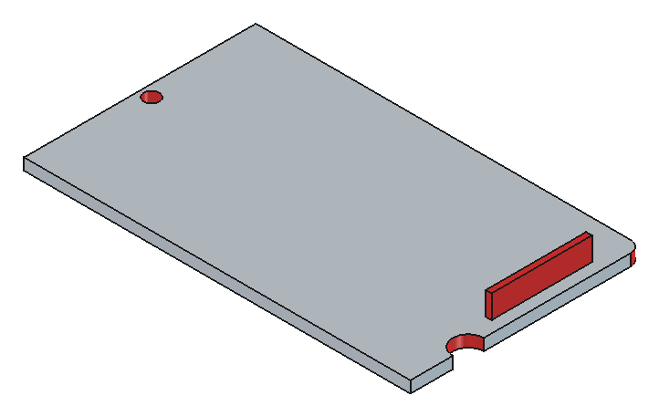
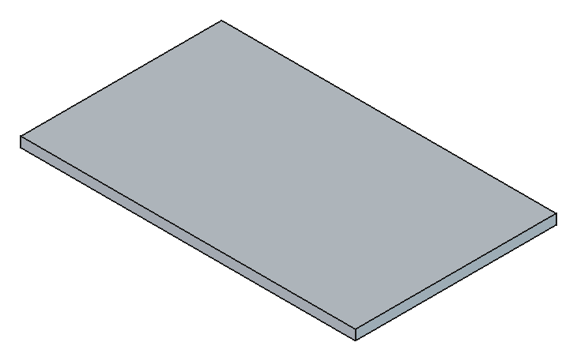
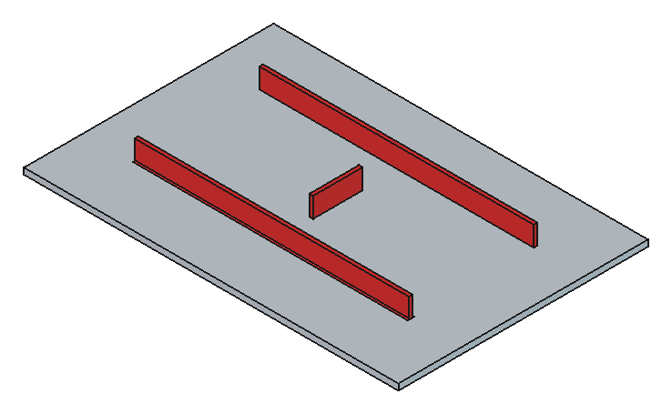
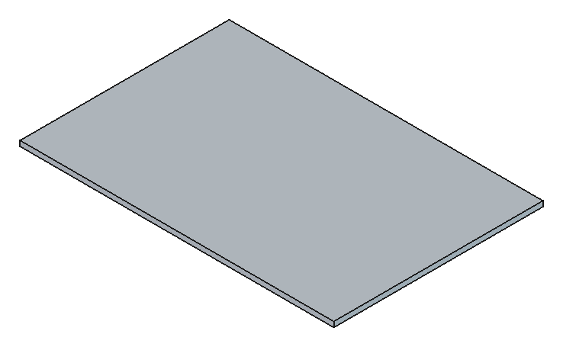
4. SYSTEM DESIGN (5/5)
Proof of Concept — The Mechanism Already Works
▪ 9 self-authored test shapes — 9/9 pass
▪ Feature-group removal + automatic healing
▪ Silent-failure detection built and verified
▪ Red-highlight STEP export validated (GUI mode)
Near-edge features — before (red = selected) → after
Rib structure — before (red = selected) → after
Live screenshots from our own FreeCAD prototype (src/) · CleanCAD
Notes:
This isn't a mockup — these are real screenshots from our own working prototype. The framework the CAD lead built groups faces into physical features, removes them, and heals the geometry, and we've verified it against nine self-authored test shapes covering all the feature types HP described, with nine out of nine passing. Here you can see two examples live: a near-edge feature case and a ribbed part — red shows what the system selected for removal, and the second image shows the healed result. To be clear: this proves the mechanism — the removal and healing engine — works. The actual judgment of *what* should be removed is the harder part, and that's the core work still ahead for the team.

Slide 12
5. DEVELOPMENT STRATEGY (1/2)
Approach & Testing Strategy
▪ Phase-based:
  – mechanism → Stage 1 rules → data scale-up → Stage 2 ML → integration → validation
▪ Parallel by role:
  – CAD (Junoh) — shared mechanism
  – ML/Graph (Hemanth) — graph + GNN, CPU-inference constraint
  – Data (Aneela) — test shapes, labeling, error analysis
  – Integration (Elias) — module contracts, automated tests
▪ Testing: headless checks vs. expected results
  – + a live visual demo mode for review
CleanCAD · Project Proposal · HP Printing Korea
Notes:
Our development strategy is phase-based: shared mechanism first, then Stage 1 rule-based integration for an early demo, then we scale up data in parallel with Stage 2 ML training, then full integration, then validation and the retraining loop. The four of us work largely in parallel along our roles — CAD mechanics, ML and graph modeling under the CPU-inference constraint, data generation and labeling, and integration and testing. Our testing strategy is already running: headless checks compare every result against expected values, and we also have a live visual demo mode for reviewing results by eye.

Slide 13
5. DEVELOPMENT STRATEGY (2/2)
15-Week Schedule & Milestones
W1–3
Definition
W4
Proposal
W5–6
HLD
W7
LLD
W8
Review
W9–11
Implementation
W12–13
Validation
W14–15
Completion
Toolchain + mechanism validated
Oct 1 — this presentation
Oct 15 — module contracts final
Oct 22 — Stage 1 pipeline integrated
Oct 29 — live demo to HP mentor
Nov 19 — core functionality complete
Dec 3 — accuracy + retrain loop
Dec 17 — final report & demo
Core functionality targeted for completion before Week 12, per course guidance.
CleanCAD · Project Proposal · HP Printing Korea
Notes:
Fifteen weeks, eight phases. We're in Definition now, wrapping up toolchain and mechanism validation. Week 4 is this proposal. HLD is due October 15th with module contracts finalized. LLD and a working Stage 1 rule-based pipeline by October 22nd. We demo that live to the HP mentor October 29th. Then weeks 9 through 11 are the heaviest implementation stretch — data scale-up, Stage 2 ML training, full integration — targeting core functionality complete by November 19th, which is before Week 12 as the course requires. The last month is validation, the retraining loop, and wrapping up the final report and demo by December 17th.

Slide 14
6. RISK ANALYSIS
Risks, Mitigation & Scope-Reduction Fallback
Silent removal failure
FreeCAD gives no exception on an un-removable face
Mitigation: Compare-and-detect after every removal; log geometry + face ID
Stage 2 (ML) underperforms
Accuracy or training time falls short
Mitigation: Stage 1 is independently demoable; ML is additive, not a blocker
Uneven team engagement
Common risk on distributed teams
Mitigation: Team lead owns critical-path modules directly
Technical
Schedule
Schedule
Red-face export needs GUI
Headless mode can't store per-face color
Mitigation: Run as an isolated GUI post-process; main pipeline stays headless
Scope creep
Trying to support every feature type
Mitigation: Prioritize HP's 3 named shape types; rest are stretch goals
Scope-Reduction Fallback
If Stage 2 (ML) isn't reliable by Week 12, ship Stage 1 (rules) + failure-case collection as the final result.
Technical
Scope
CleanCAD · Project Proposal · HP Printing Korea
Notes:
Five risks we've identified so far, tagged by type. Two technical risks come directly from what we found while prototyping: FreeCAD silently no-ops instead of raising an exception when a face can't be removed, so we built explicit before/after comparison to catch that; and the red-face STEP export the mentor asked for only works in FreeCAD's GUI mode, not headless, so we'll isolate that as its own step. Two schedule risks: ML underperforming, which we mitigate by making Stage 1 independently demoable so ML is additive rather than a blocker; and uneven engagement across a distributed team, which we mitigate by having the team lead own the critical-path modules directly. And one scope risk — trying to support too many feature types — mitigated by prioritizing the three shape types HP specifically named. Most importantly, we have an explicit fallback: if Stage 2 isn't reliable by Week 12, we ship the rule-based pipeline plus failure-case collection as our final result, rather than risking an incomplete ML system.

Slide 15
7. ROLE OF THE PARTICIPATING COMPANY
HP Printing Korea
▪ Resources: domain guidance, test-shape spec, confirmed constraints
▪ Mentoring: recurring meetings with Byoungho Yoo (CAE)
▪ Feedback: open questions per meeting → tracked into FRD/NFRD
▪ Scope split: defeaturing accuracy in scope; CAE analysis accuracy out of scope
CleanCAD · Project Proposal · HP Printing Korea
Notes:
HP provides domain guidance on how defeaturing should actually work, a concrete test-shape specification, and direct, confirmed answers on technical constraints like toolchain and deployment environment. Our mentoring is through recurring meetings with Byoungho Yoo from HP's CAE team. Our feedback loop is simple: we bring open questions to every meeting, and the answers get written directly into our FRD and NFRD with a dated revision history, so nothing gets lost or reinterpreted later. And we've been explicit about where academic scope and company interest diverge: HP cares about defeaturing accuracy and preprocessing time; downstream CAE analysis accuracy is explicitly out of scope for this project.

Slide 16
8. EXPECTED IMPACT & EXPANSION
Impact, Applicability & Future Directions
▪ Impact: 70–90% less CAD prep time; a reusable, improving model
▪ Fits HP's workflow: preprocessing step, runs on a normal laptop
▪ Future: more feature types beyond HP's initial 3
  – NX support, if licensing allows
  – Lightweight review UI beyond image + approve/reject
  – Continuously improving model via the retraining loop
CleanCAD · Project Proposal · HP Printing Korea
Notes:
The expected impact is a 70 to 90 percent cut in CAD preprocessing time, plus something more durable than a one-off script: a model that keeps improving through the retraining loop. It fits directly into HP's existing workflow as a preprocessing step, and because inference needs no GPU, it runs on a standard engineering laptop, not just a lab machine. Looking ahead: we'd like to expand feature-type coverage beyond the three HP specified, add NX support if licensing allows, build a lighter review interface than our current image-plus-approve flow, and let the retraining loop keep the model improving as more real parts are processed.

Slide 17
9. TEAM ORGANIZATION
Roles, Responsibilities & Decision-Making
CAD Geometry Engineer
Junoh Lee — Team Lead
• STEP I/O, feature removal
• Geometry healing
• Schedule & deliverables
ML / Graph Model Engineer
Hemanth Reddy Vangala
• B-rep → graph conversion
• GNN feature recognition
• CPU-inference model choice
Data Pipeline Engineer
Aneela Tahir
• Self-authored test shapes
• Labeling
• Error analysis
Integration & Test Engineer
Balcha Kidus Elias
• Module contracts
• Automated tests
• Performance checks
Decision-making: team lead approves technical decisions (with mentor input); code merges via personal branch + review.
Full detail: docs/team_rnr.md, docs/RnR_Proposal.docx · CleanCAD
Notes:
Four sub-roles, mapped directly to the four pipeline layers we described earlier. Junoh leads the team and owns the CAD geometry engineering — the shared mechanism everyone else builds on. Hemanth owns the ML and graph modeling side, including the constraint that inference has to run on a CPU. Aneela owns data — generating and labeling our own test shapes, and doing error analysis when the model gets something wrong. Elias owns integration and testing — the module contracts and automated verification that keep everyone's work compatible. Decisions go through the team lead, informed by mentor input where relevant, and all code changes go through a personal branch and review before merging.

