Slide 1
Development of a Knowledge Graph for the Canadian Milking Industry (Meeting)
https://github.com/JunshengZhu666/KBQA
1, Three types of Question Answering Methods
2, Named Entities Recognition (NER) with LSTMs
3, Relation Extraction(RE) with Attention models

Slide 2
1, Three types of Question Answering Methods
1.1 Template based (Knowledge Graph Alone)
1.2 Deep learning based
1.3 Knowledge Graph with Deep Learning

Slide 3
1, Three types of Question Answering Methods
1.1 Template based (Knowledge Graph Alone) – Procedures
(1) Manually create the entities, relationships and attributes.
(2) Upload the dataset into a graph database (like neo4j)
(3) Set the question templates, match query questions key words with entities or/and relationship
(4) Match different neo4j query with question templates
(5) Return the answers from the graph database

Slide 4
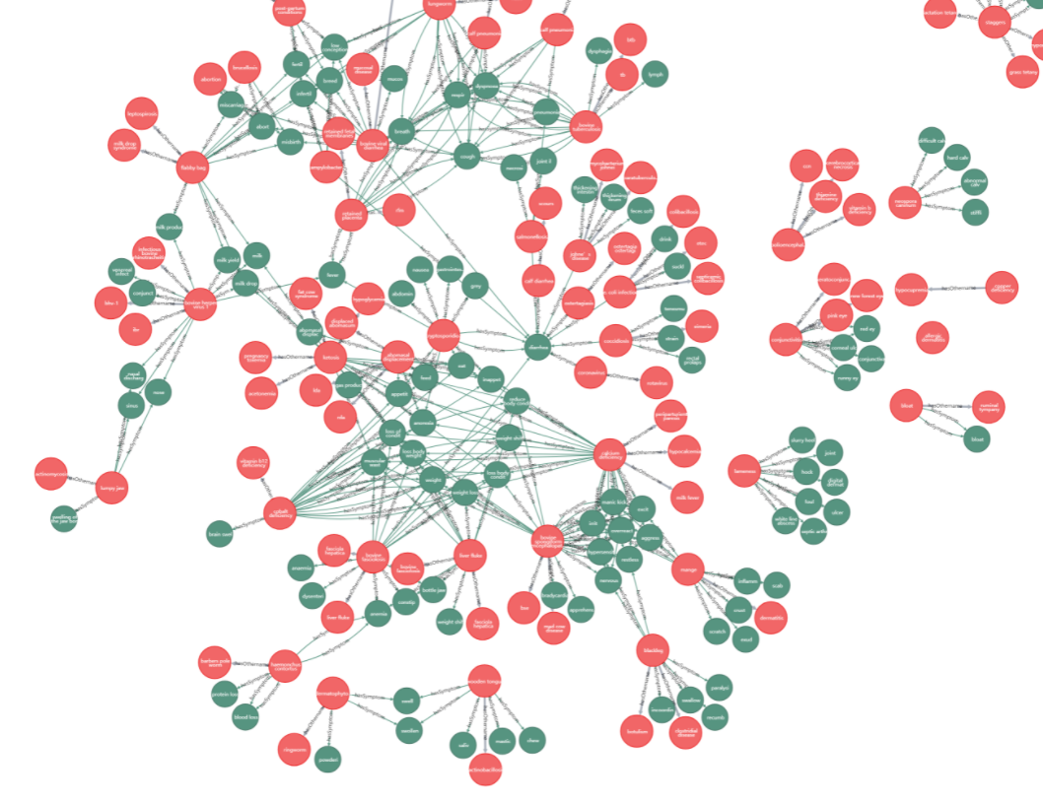
1, Three types of Question Answering Methods
1.1 Template based (Knowledge Graph Alone)

Slide 5
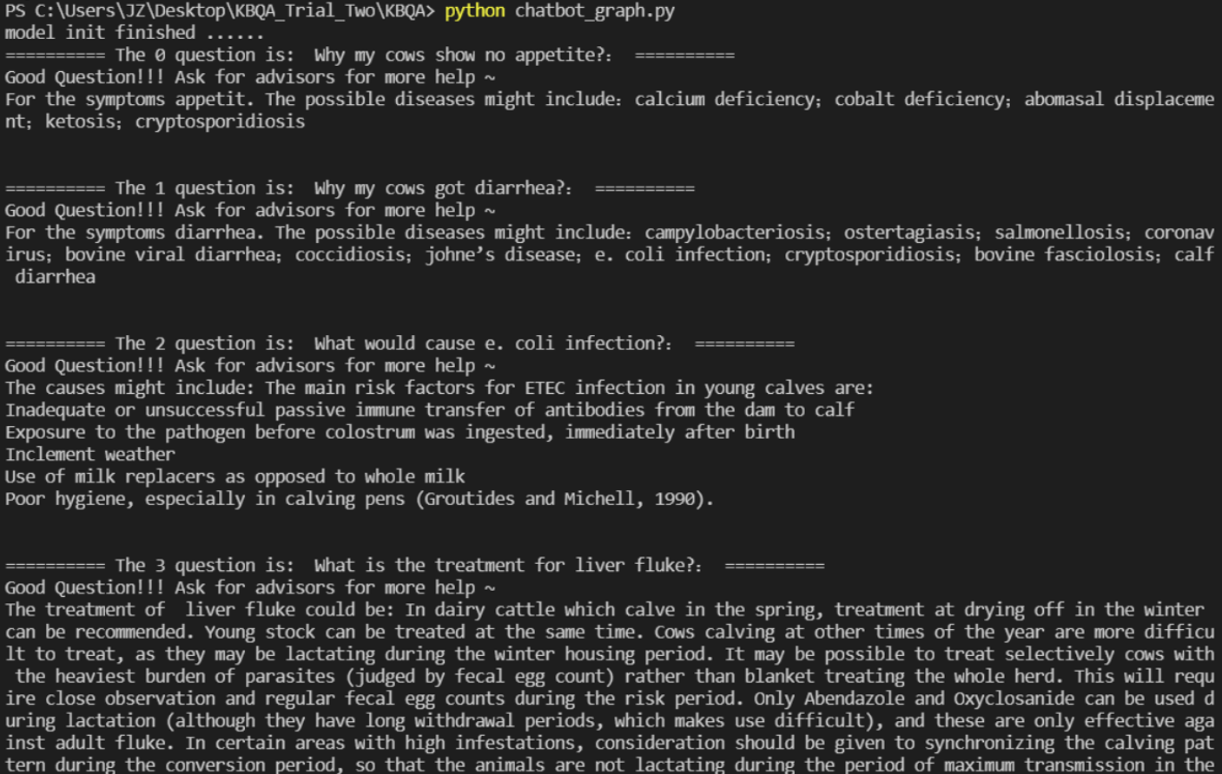
1, Three types of Question Answering Methods
1.1 Template based (Knowledge Graph Alone)

Slide 6
1, Three types of Question Answering Methods
1.1 Template based (Knowledge Graph Alone) -- Problems
Labor Intensive
(2) Not scalable, Hard to update

Slide 7
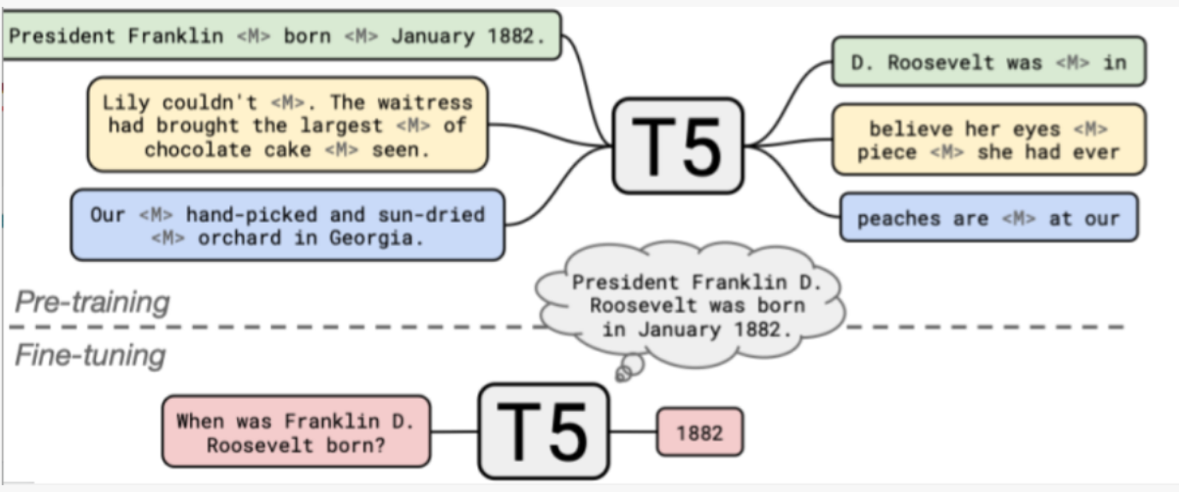
1, Three types of Question Answering Methods
1.2 Deep learning based

Slide 8
1, Three types of Question Answering Methods
1.2 Deep learning based
Requires the answer to be in the text

Slide 9
1, Three types of Question Answering Methods
1.3 Knowledge Graph with Deep Learning
Use Neural Network to help us extracting the entities and relationships from the text
Named Entities Recognition (NER) with LSTMs
Relation Extraction(RE) with Attention models

Slide 10
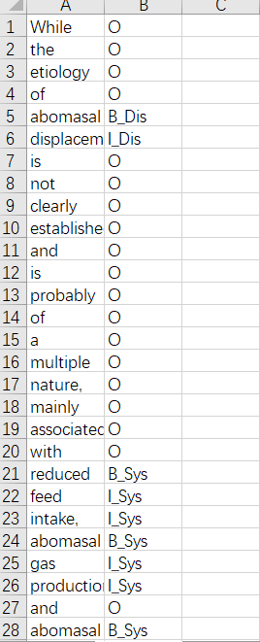
2, Named Entities Recognition (NER) with LSTMs
2.1 Dataset

Slide 11
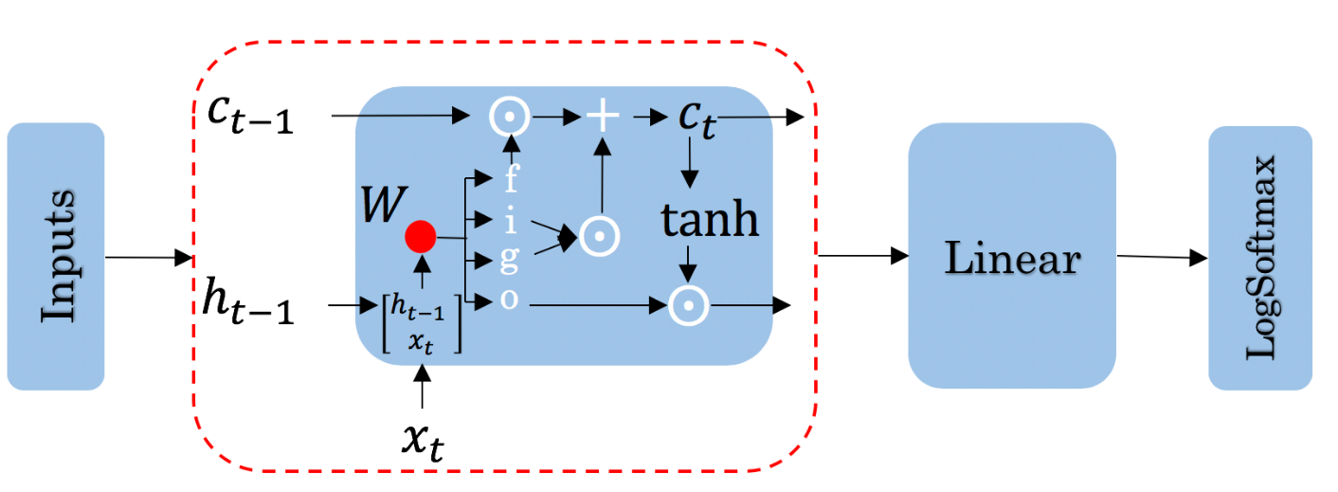
2, Named Entities Recognition (NER) with LSTMs
2.2 Model

Slide 12
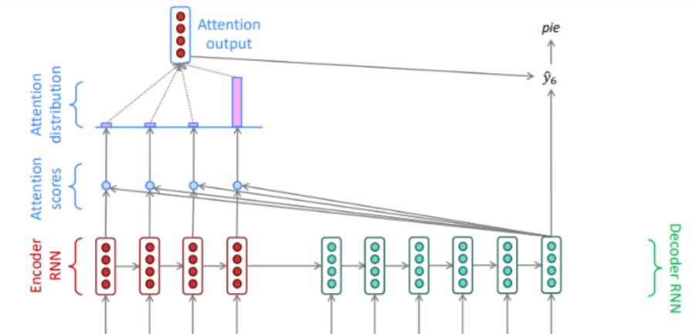
3, Relation Extraction(RE) with Attention models
3.1 Model
To extract entity-relationship-entity pairs, which sometimes show up in different sentences

Slide 13
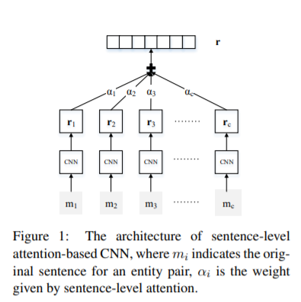
3, Relation Extraction(RE) with Attention models
3.2 Transfer learning
https://github.com/thunlp/OpenNRE

Slide 14
4, Other things worth trying
4.1 Use Bert + Bi-LSTM + CRF to jointly extract Entity-Relation-Attributes
4.1 Use Siamese Neural Network to compute question similarity (Question Ranking)

Slide 15
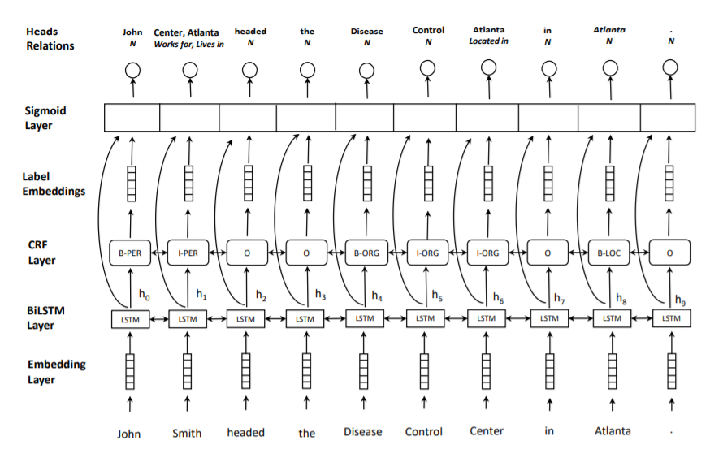
4, Other things worth trying

Slide 16
5, Selected References
AgriKG: An Agricultural Knowledge Graph and Its Applications
Neural Relation Extraction with Selective Attention over Instances
Agriculture Knowledge Graph Construction and Application
Joint entity recognition and relation extraction as a multi-head selection problem[J]. Ghent University.2018

