Slide 1
Knowledge Graph Answer Retrieval Methods
Ⅰ Information Retrieval (embedding-based)
Ⅱ Semantic Parsing (template-based)

Slide 2
Ⅰ Information Retrieval (embedding-based) – General Steps
1, The whole Knowledge Graph is embedded on a low dimension space.
2, Train the model to get the head entity and relationship embedding from the questions.
3, Receive a question:
input to the model trained in step2, get the head entity and relationship embedding
search in the Knowledge Graph vector space to find the tail entity

Slide 3
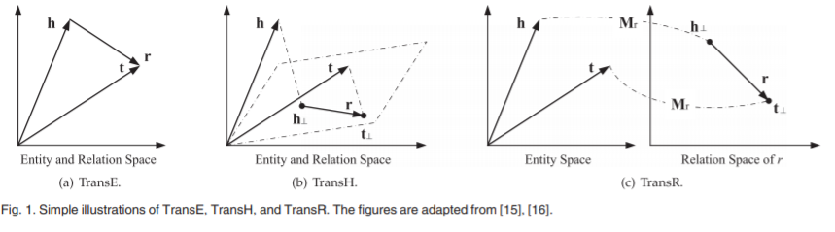
Ⅰ Information Retrieval (embedding-based) – General Steps
1, The whole Knowledge Graph is embedded on a low dimension space.
(Typical methods)
https://ieeexplore.ieee.org/stamp/stamp.jsp?arnumber=8047276&casa_token=TchwYaymsHsAAAAA:l582UzrofIMBg4sJd1VbjKc3dZlu2EAzIJzKcGqgX_XFUlXMifXKNflUl5VaJSK9sM2l6lns

Slide 4
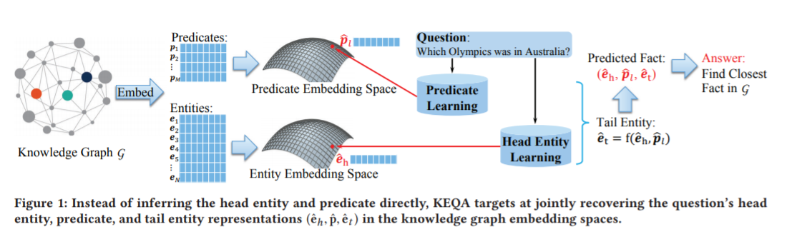
Ⅰ Information Retrieval (embedding-based) – General Steps
2, Train the model to learn to get the head entity and relationship embedding.
https://dl.acm.org/doi/pdf/10.1145/3289600.3290956?casa_token=Y38ZwnbRFKoAAAAA:szcFoBAOuRv_07qJ00wbSIYZfMmDtHap7rstVnSBOgJdnO28_QPrHeOQZm1RDZ56ZUa6IV16_F10

Slide 5
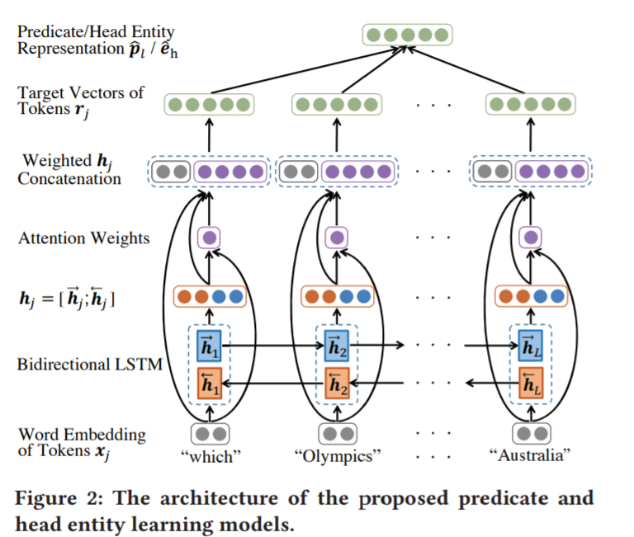
Ⅰ Information Retrieval (embedding-based) – General Steps
2, Train the model to learn to get the head entity and relationship embedding.

Slide 6
Ⅰ Information Retrieval (embedding-based) – General Steps
1, The whole Knowledge Graph is embedded on a low dimension space.
1,1 Have existing tools like TransE, TransH to embed the KG
1,2 Some areas have existing embedded KG
(e.g. general KG and medical KG)
1,3 Suitable for simple questions and general questions

Slide 7

Ⅱ Semantic Parsing (template-based)
1, Simple Question
A triple (entity – relationship – entities)
2, Complex Question (hard for most search engine to answer)
Multiple triples

Slide 8
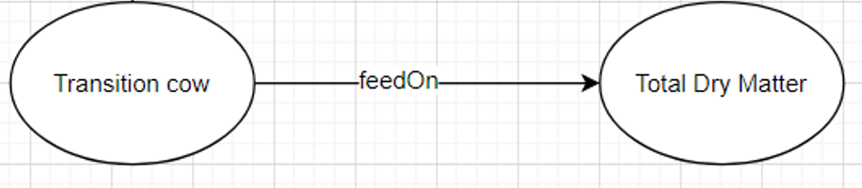
Ⅱ Semantic Parsing (template-based)
1, Simple Question
What is the suitable feed intake of a transition cow?

Slide 9
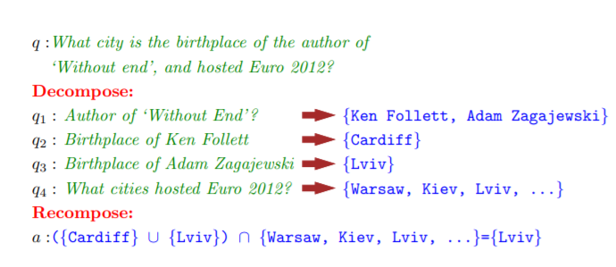
Ⅱ Semantic Parsing (template-based)
2, Complex Question – Decompose to simple questions
https://arxiv.org/pdf/1803.06643.pdf

Slide 10
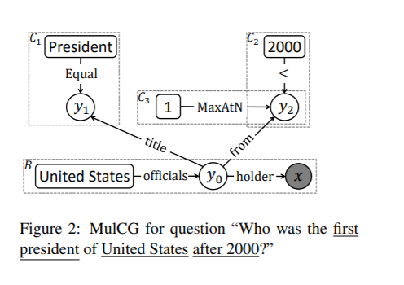
Ⅱ Semantic Parsing (template-based)
2, Complex Question – Subgraph matching & Answering Ranking
https://arxiv.org/pdf/1803.06643.pdf
https://aclanthology.org/C16-1236.pdf

Slide 11
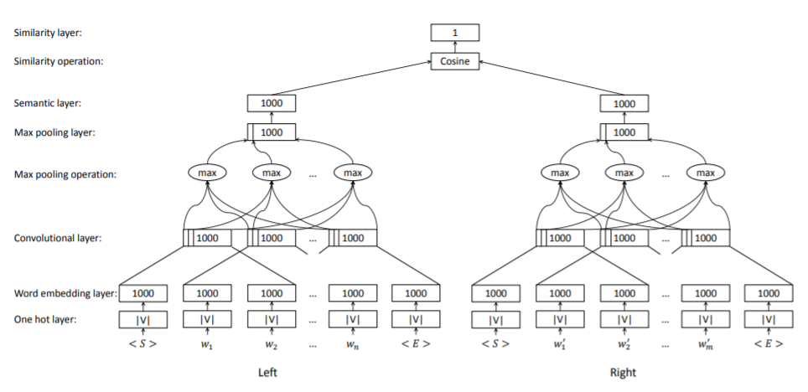
Ⅱ Semantic Parsing (template-based)
2, Complex Question – Subgraph matching & Answering Ranking
https://aclanthology.org/C16-1236.pdf

Slide 12
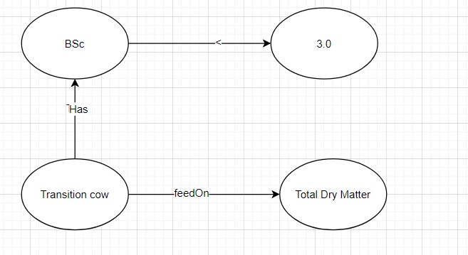
Ⅱ Semantic Parsing (template-based)
2, Complex Question
What is the suitable feed intake for a transition cow with BCs lower than 3.0?

