Slide 1
Development of a Knowledge Graph for the Canadian Milk-recording Industry

Slide 2
Outline
01
Knowledge Graphs Overview
02
Knowledge Graphs Application
03
Building Knowledge Base Question Answering (KBQA)

Slide 3
Outline
01
Knowledge Graphs Overview

Slide 4
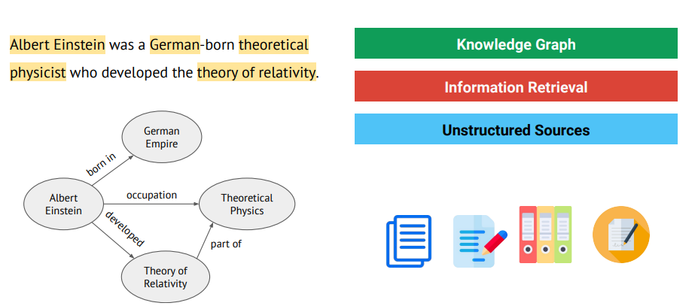
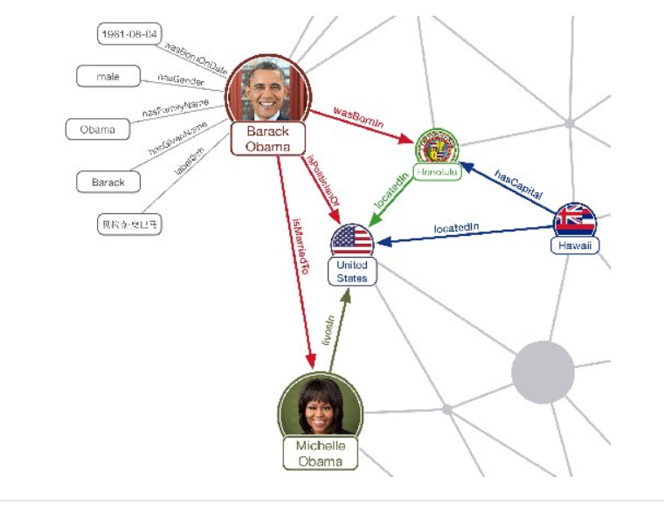
Knowledge Graphs Overview

Slide 5
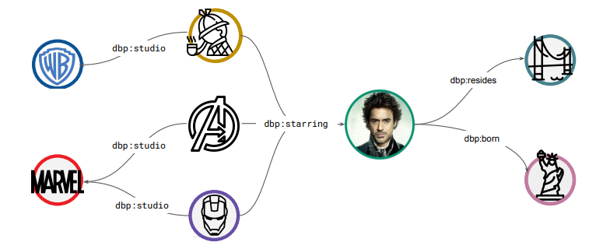
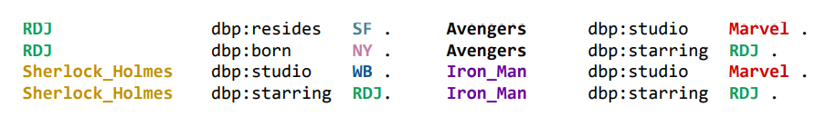
Knowledge Graphs Overview
Symbolic
Human-readable
Database
Machine-readable

Slide 6
Outline
02
Knowledge Graphs Application

Slide 7
Knowledge Graphs Application
1) Question Answering
Why do I catch a cold?
What exercise is good for my knee?
(Build from general source like webpages or books, used for general source like search engine)

Slide 8
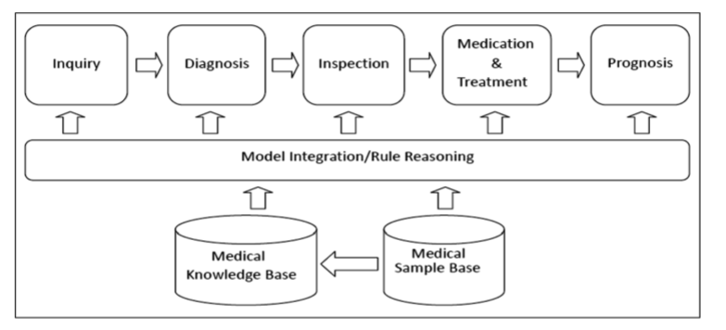
Knowledge Graphs Application
2) Decision Support

Slide 9
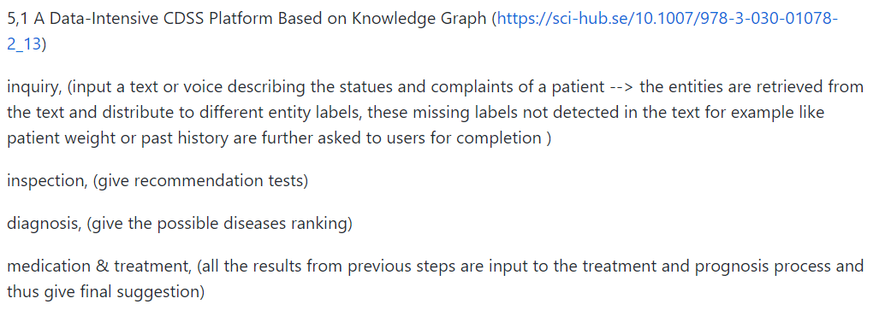
Knowledge Graphs Application
2) Decision Support
(Build from domain source like papers and medical records, used in domain like prescription)

Slide 10
Outline
03
Building Knowledge Base Question Answering (KBQA)

Slide 11
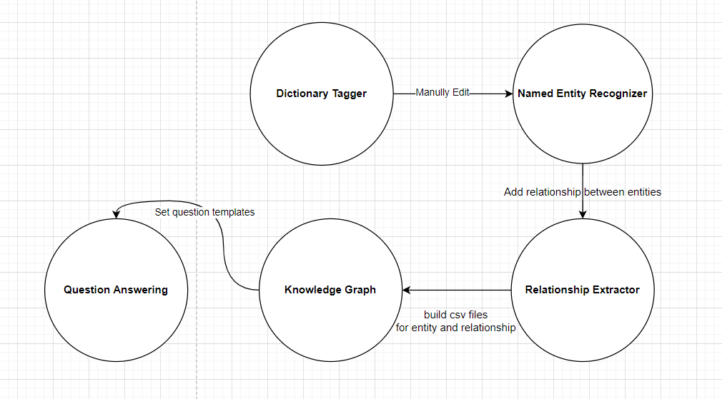
Building Knowledge Base Question Answering
Pipeline

Slide 12
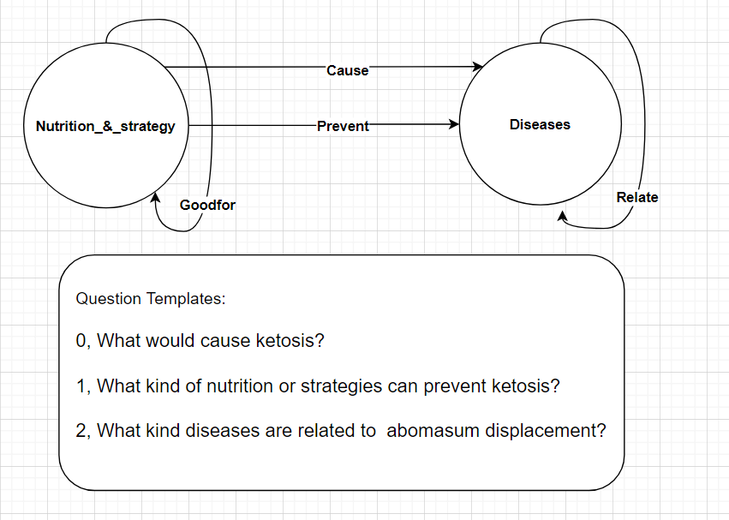
Building Knowledge Base Question Answering
Data schema

Slide 13
Building Knowledge Base Question Answering
B-NUT
I-NUT
B-DIS
I-DIS
O
Prevent
Cause
Relate
Other

Slide 14
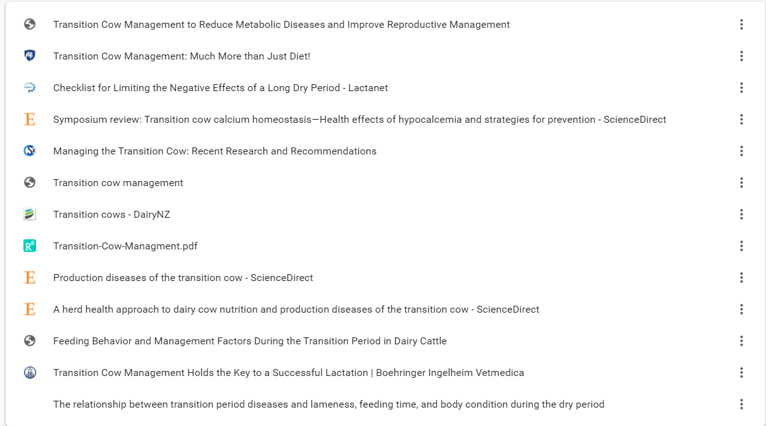
Building Knowledge Base Question Answering
(Building from 13 papers)

Slide 15
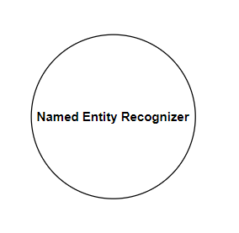
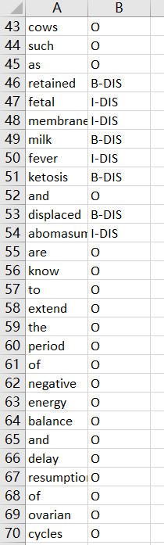
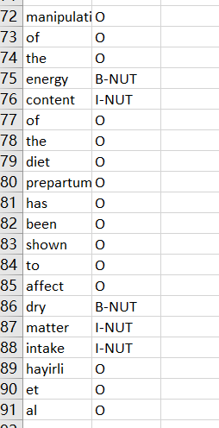
Building Knowledge Base Question Answering
Model: Long-Short Term Memory Neural Model + Glove Vector
Training: 10257 words with BIO(Begin – In – Out - Entity) Tagging

Slide 16
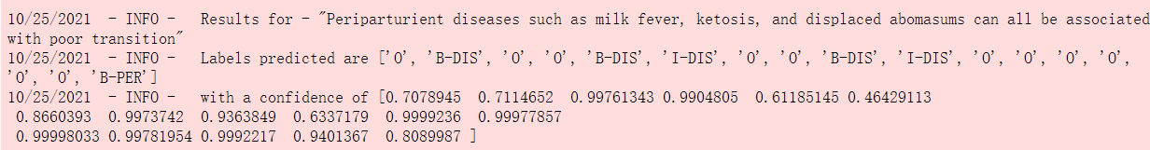
Building Knowledge Base Question Answering
Model: Long-Short Term Memory (LSTM) + Glove Vector
Prediction: Find the entities in the text

Slide 17
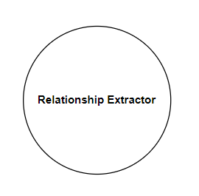
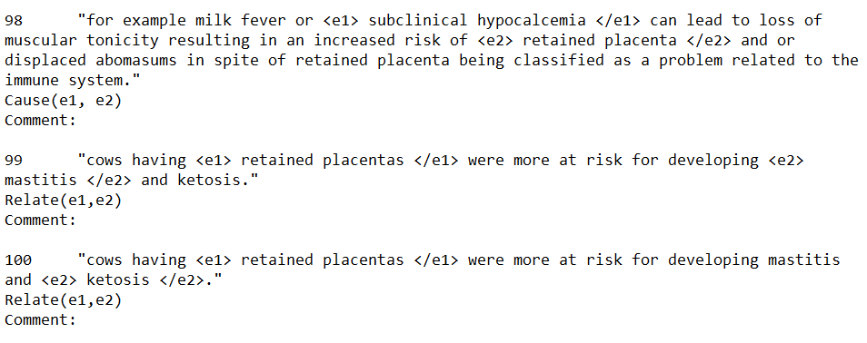
Building Knowledge Base Question Answering
Model: Bidirectional Encoder Representations from Transformers (BERT)
Training: 120 sentences labeled with relationships

Slide 18
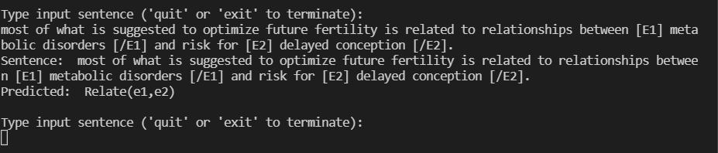
Building Knowledge Base Question Answering
Model: Bidirectional Encoder Representations from Transformers (BERT)
Prediction: Given the entities, predict the relationship

Slide 19
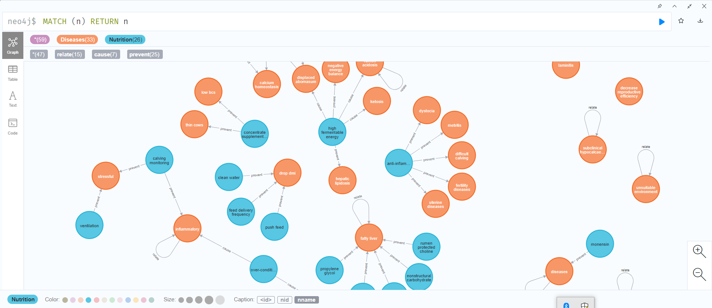
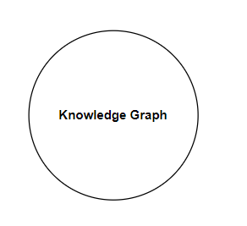
Building Knowledge Base Question Answering

Slide 20
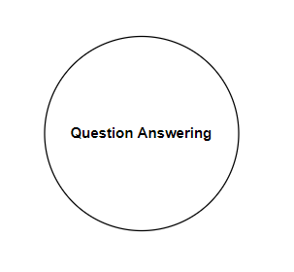
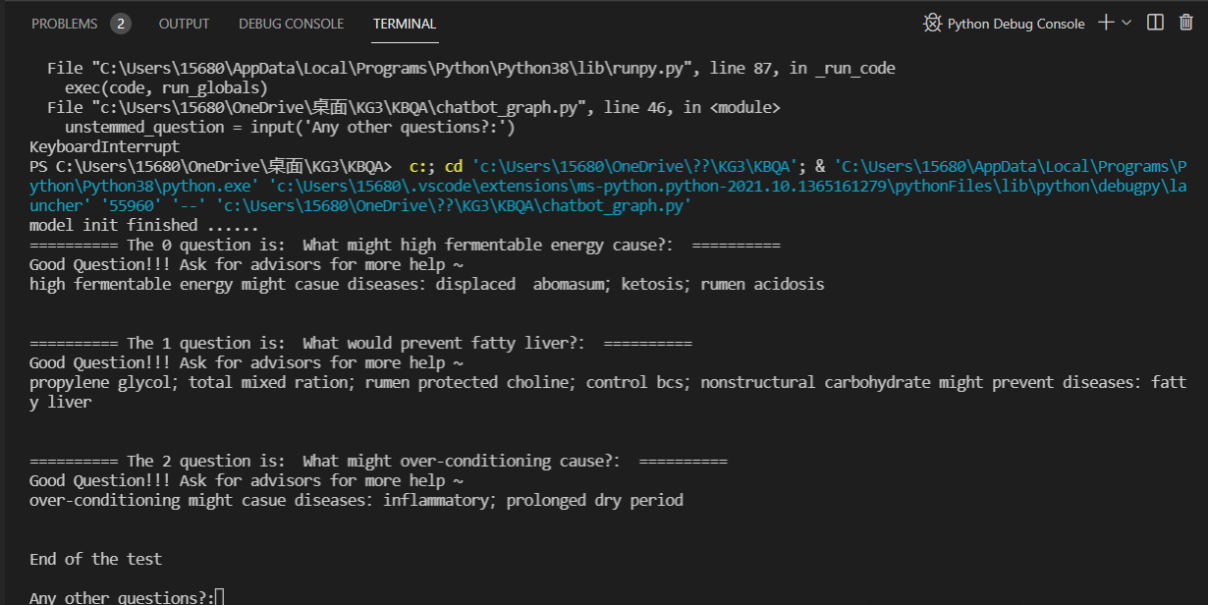
Building Knowledge Base Question Answering

Slide 21
Problems and consequently works
Haven’t fine tuning the model to give the better results
Haven’t build the data format transformation between procedures, still need to manually change the data format between each steps now
The input resources in terms of transition cow management are scarce

Slide 22
Thank you

