Slide 1
Building SPA with AngularJS
构建基于AngularJS的单页面Web应用程序

Slide 2
Agenda
First contact with Angular.js
Getting data
Routing and views
ASP.NET Web API
Real-time synchronization
Debug & Deployment

Slide 3
First contact with Angular.js
MVC framework
Single Page Application
<script src="../Scripts/angular.js"></script>

Slide 4
Demo
ng-app
A module to take care of your application
ng-controller
A function to take care of your business logic

Slide 5
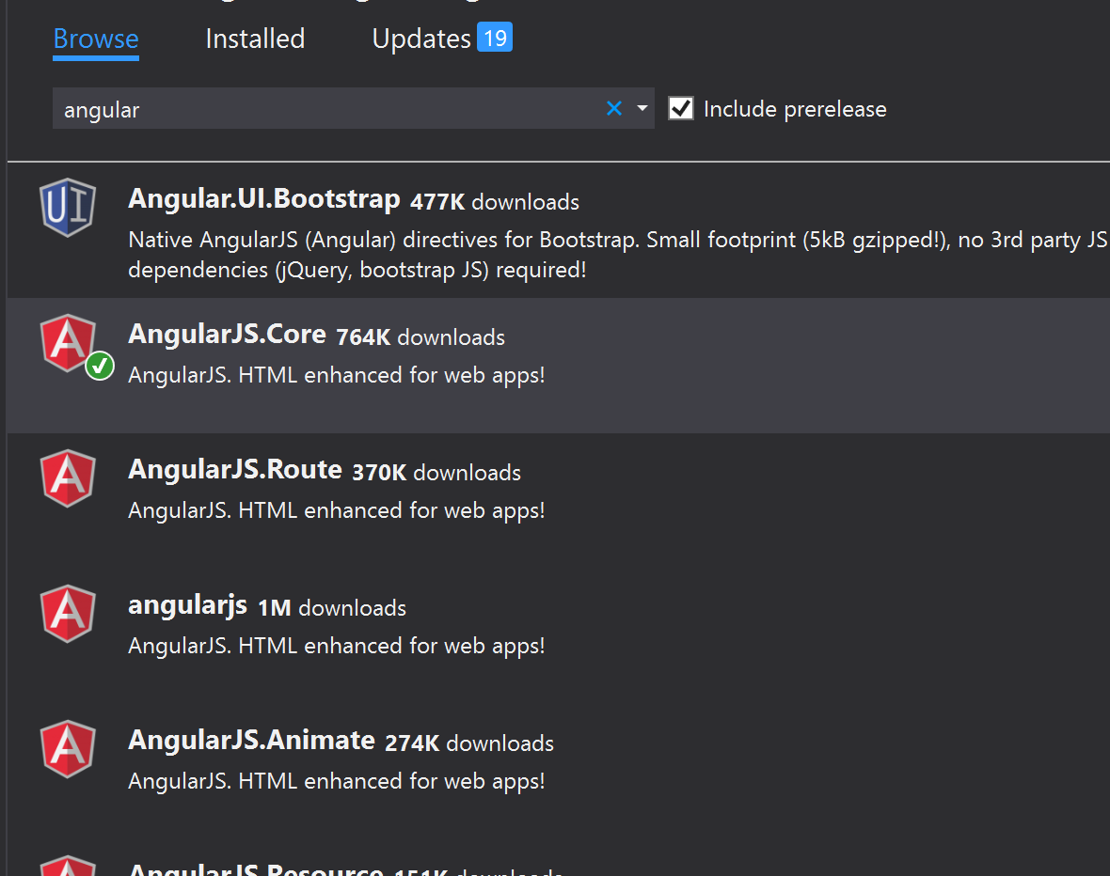
Adding angular.js
Simple: CDN script references
Bonus points: NuGet
Bower, NPM, etc.
All the meaning of those Package manager

Slide 6
Angular + ASP.NET Approaches
Static HTML
ASP.NET MVC (mini-SPA)

Slide 7
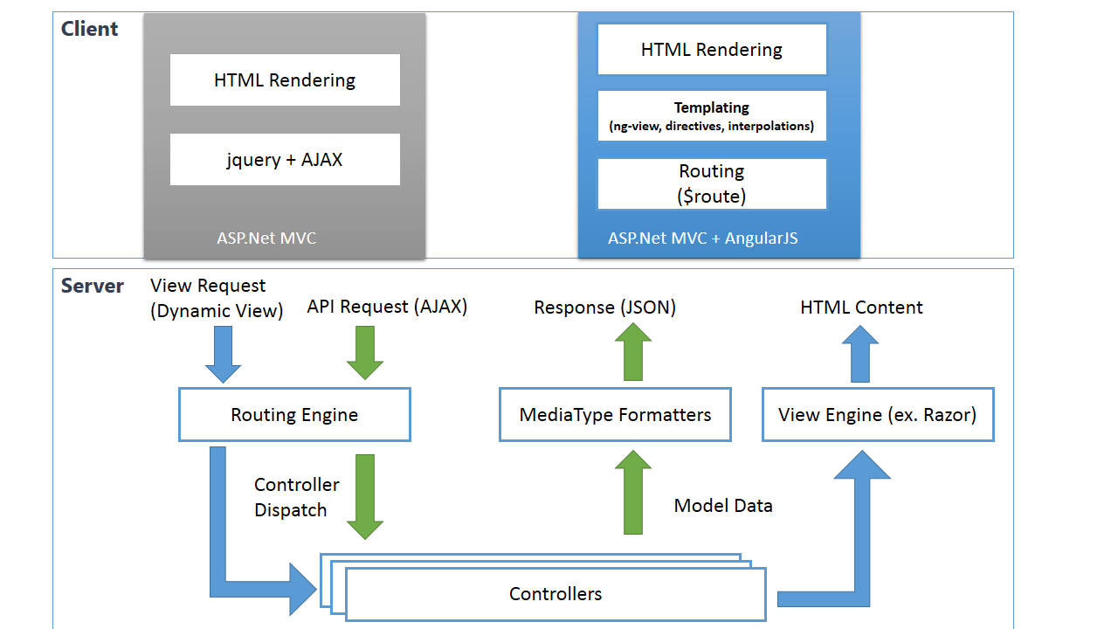

Slide 8
Angular + ASP.NET Script Reference
Bundling
Minification (watch out!)

Slide 9
Angular + ASP.NET Script Reference
Module
Controllers
Dependencies Injection

Slide 10
Demo
Register controllers to the mainApp
Register controllers’ dependencies to the mainApp

Slide 11
Getting data
$http
$resources
Filters
Promise in ES2015

Slide 12
Demo
$http
a light version of ajax method.
$resources
More RESTful way of API representation.
Filters
Custom Filters (parameters)

Slide 13
ASP.NET MVC and Web API
HTML
JSON
XML
Web Forms
Web Pages
MVC
Web API
ASP.NET Core

Slide 14
Demo
ASP.Net Web API
JSON Format CamelCase

Slide 15
Routing and views
SPA uses views to build UI
Angular.js uses routing to define views
Animations

Slide 16
Demo

Slide 17
Angular + ASP.NET Routing
Deep links in Angular can conflict with MVC Routes
Use a Catchall route
routes.MapRoute( name: "Catch all route for SPA", url: "App/{*catchall}", defaults: new{ controller = "Home", action = "Index"});

Slide 18
ASP.NET + Angular Routing
HTML from view – no problem!
HTML file – use an IIS Rewrite rule
/cards.html -> /cards

Slide 19
Demo

Slide 20
Without real-time
Got Data?
Got Data?
Got Data?
Got Data?
Client Browser
Web Server
Here’s some data!
Got Data?
Got Data?
Got Data?
Got Data?

Slide 21
With real-time
I do real time, do you?
Client Browser
Web Server
Absolutely!
Let’s Do This!

Slide 22
Basically…
Client Browser
SignalR/Socket.IO
Web Server

Slide 23
Benefits of SignalR
Abstraction over transports
Events instead of task/async
Connection management
Broadcast or target specific client

Slide 24
Demo

Slide 25
Debug and deployment
Jasmine

