Slide 1

Adversarial example generation architecture
for a Random forest based malware detector
w w w . c r y s y s . h u
Tatiana Barbova
BSc Training Project Lab
Supervisor: Levente Buttyán

Slide 2
Background and motivation
In the ICT dominated world, the threat of malware is constantly rising, and the attacks become more sophisticated and harder to notice.
As a result, automated malware detection is an important direction of cybersecurity research, especially for IoT devices, having more vulnerabilities and performance constraints.
Adversarial Examples (AEs): samples which were slightly perturbed in order for the ML model to produce desirable output

Slide 3
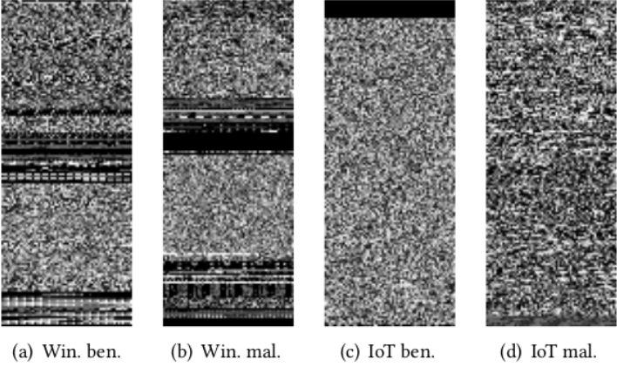
Background and motivation
Figure 1: Sample visualization of benign and malicious binaries.

Slide 4
Problem statement and objectives
Improving and examining the generality of an already existing AE generation framework to other detection models (originally used for neural networks, but those are not the only models used in malware detection)
Specific objectives:
High misclassification rate
Preserving executability
Approaches and possible issues for future generalization

Slide 5
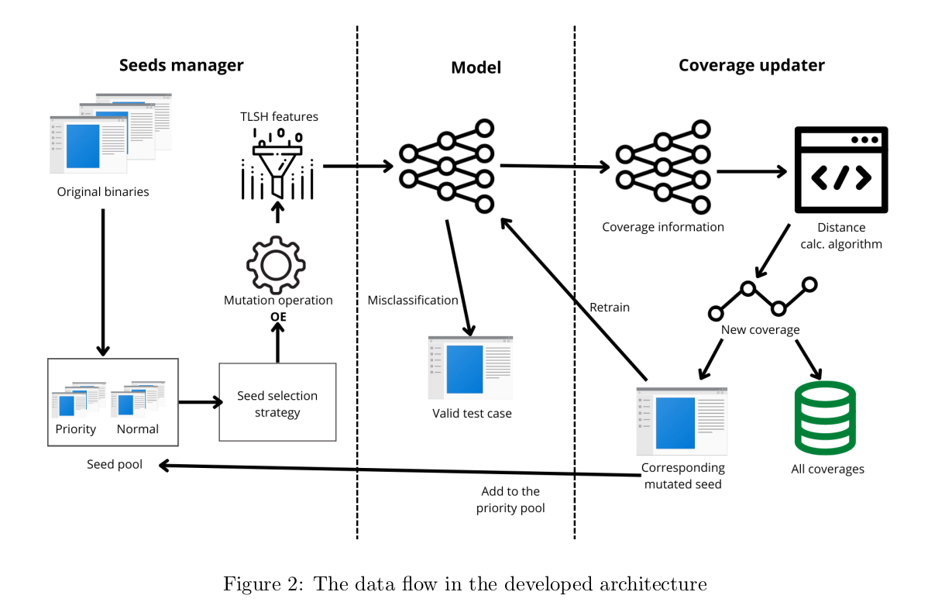
Results

Slide 6
Results
Mutation operations: Overlay Append (OA) – appending a class’ contents to the end of a binary of an another class.
(+) easy to implement and preserves the executability of the sample with a 100% probability
(-) increases the size of the application
Model: Random Forest classifier, having 10 estimators with maximum tree depth of 6 (Papp et al)
(+) relatively simple model (-) the feature selection process is more difficult

Slide 7
Results
Feature set: 132 features from TLSH hash. Will the hash keep the information delivered by the mutated bytes?
Coverage info – the decision path in a compressed sparse row matrix representing all the tree nodes.
The distance between coverages: the euclidean distance, the manhattan distance and the sum-difference. Threshold is chosen empirically.
The model is not static. Whenever a new model state is discovered, the model is retrained with the corresponding sample. Does the model become more robust if the AEs are used in training?

Slide 8
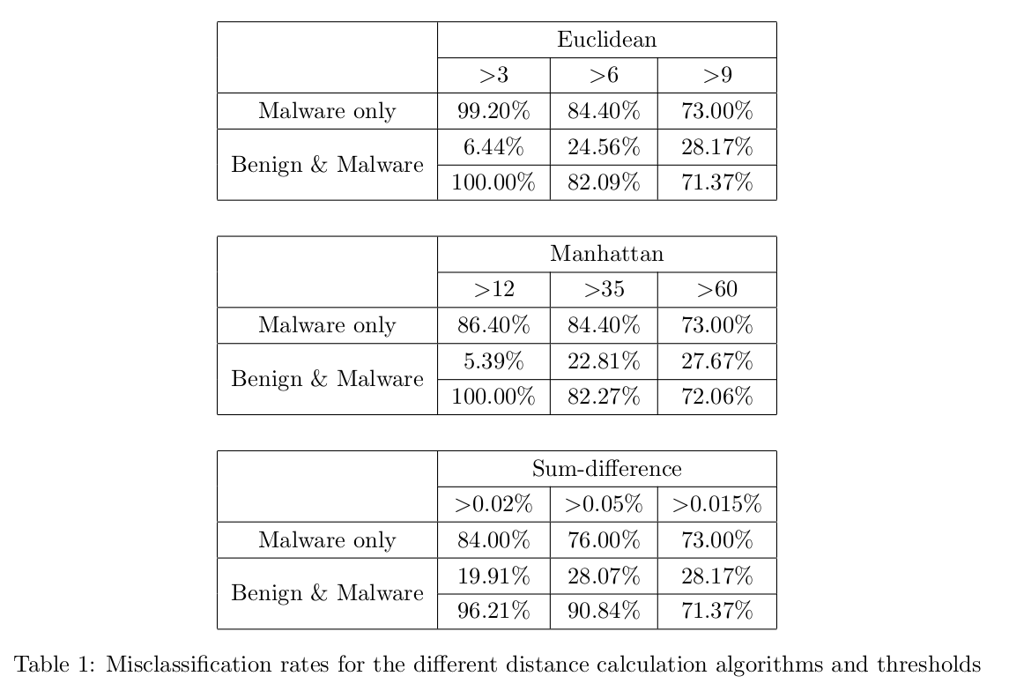
Evaluation

Slide 9
Evaluation
500 epochs and 1500 epochs
4000 IoT binaries – 2000 benign and 2000 malware, all of ARM architecture
Average accuracy 98.7% on the original test data
The lower the threshold, the higher malware misclassification rate. (more erroneous model states, and the model state exploration is done quicker)
An opposite trend for benign
Numbers highly sensitive to threshold values => hard to choose the best algorithm
Lower threshold => the model is retrained more times, but the misclassification still increases

Slide 10
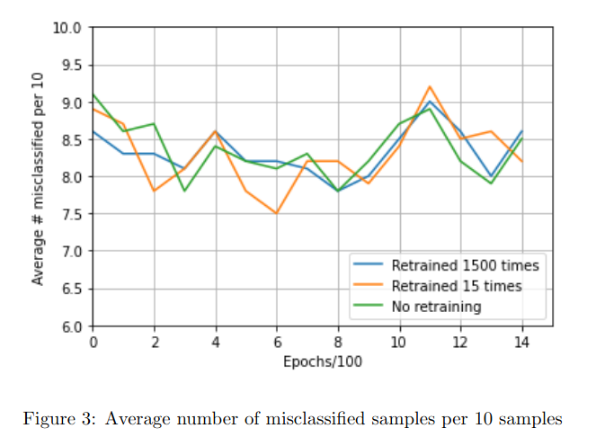
Evaluation
With more iterations the model did not improve the performance => the AE generator is indeed good at fooling the detector.
The most stable strategy is to retrain the model every time after a new coverage is discovered.
In the region where every curve peaks, probably an overfitting happens.

Slide 11
Evaluation
Decreasing the size of the appended byte sequence from 0.1% of the file length to 0.02% did not deteriorate the performance
However, after removing the MIPS byte sequences from the available mutation pool, the misclassification rate significantly dropped (from 83.3% to 60.2%)
The model hardly learns on significantly different byte sequences unless they were initially present in the dataset.
Running time
MalFuzz - generates avg. 34.7 samples/min
Our approach - generates avg. 78.125 samples/min.

Slide 12
Related work
MalFuzz: Coverage-guided fuzzing on deep learning-based malware classification model
Coverage-guided fuzzing to test deep learning-based malware detection models.
Model state representation: first and last layer neuron values as an approximation.
New coverage: fast approximate nearest neighbor algorithm.
Retained the original functionality of malware with probability of 92.9%.

Slide 13
Related work
MalFuzz: Coverage-guided fuzzing on deep learning-based malware classification model
Did not elaborate on how the threshold to consider a coverage new was chosen => here I had a big focus on studying the threshold effects on the performance
The model was considered static
No attempt to generalize => motivation for the present study

Slide 14
Conclusion and future work
The misclassification rate can reach 95% regardless of the distance calculation algorithm
The executability of the samples is preserved
Possibly there is no detector perfectly safe from the adversarial attacks. The best thing that can be done is using an extensive training dataset
Contribution to exploring the issues of AEs generation
Future work:
Other mutation operations to be added to the framework
Distance calculation algorithms with better semantics and a threshold estimation methodology
Other detection models based on this feature set would be constructed => comparative analysis

