Slide 1
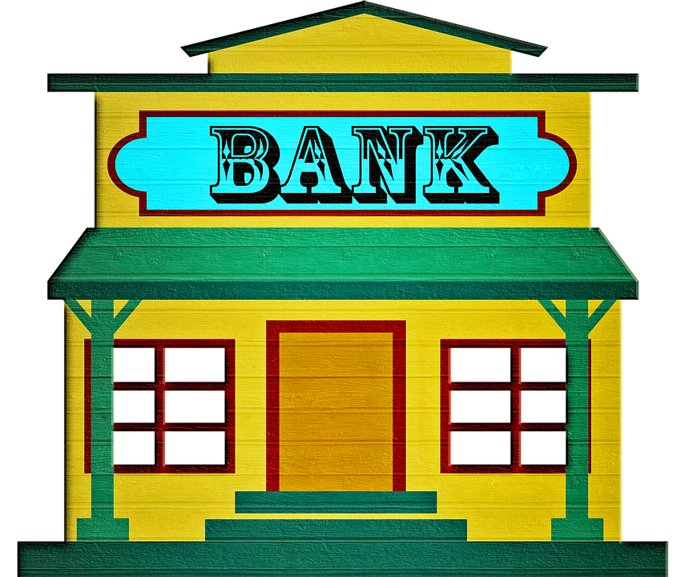


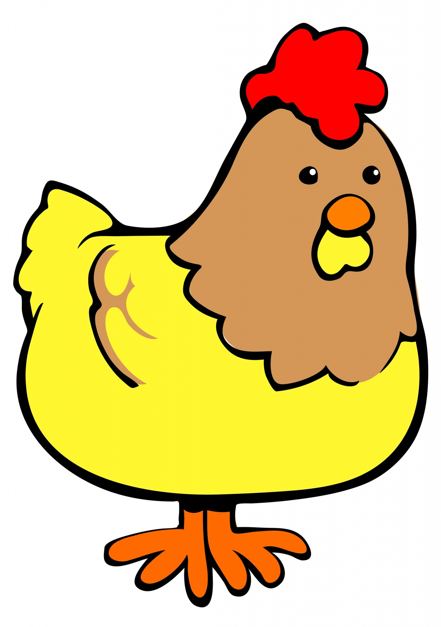

Start
El pollo loco
Share

Slide 10




Boost
13 m

Slide 11
13 m

Slide 12
13 m

Slide 13
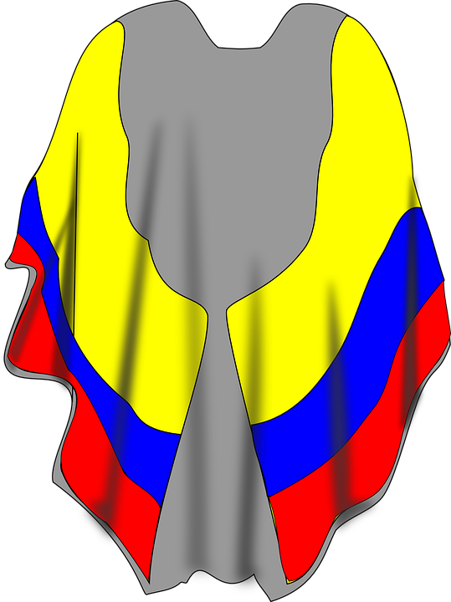
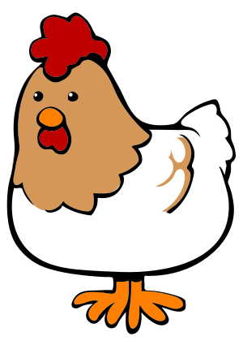

Boost
123 m

Slide 14

Energy
411 m

Slide 15
Energy
411 m

