Slide 1



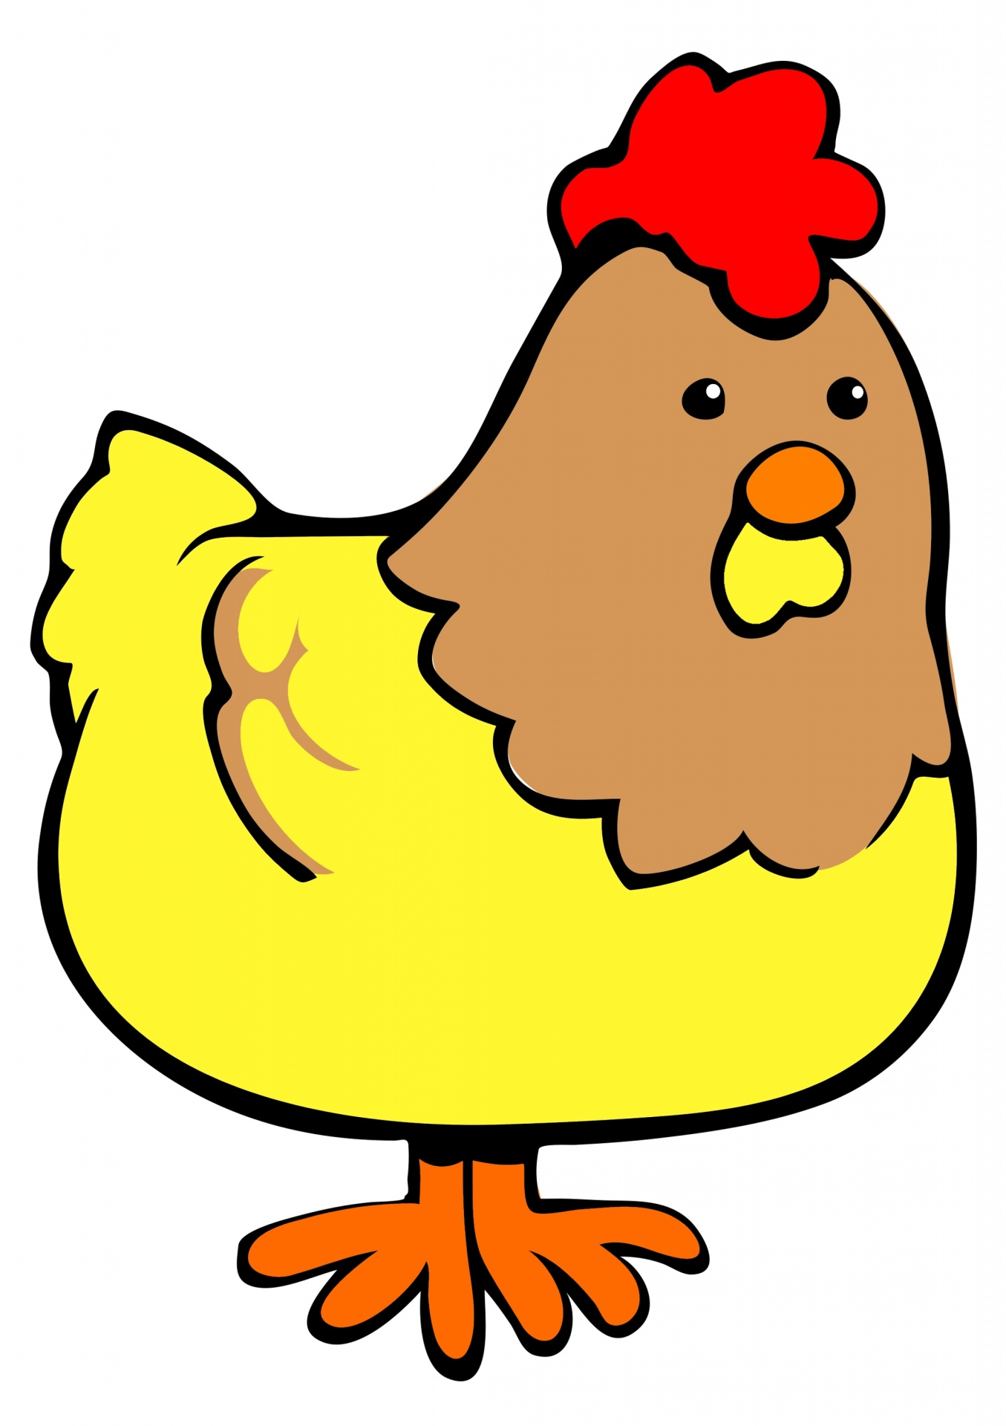

Start
El pollo loco
Share

Slide 2




Boost
13 m

Slide 3
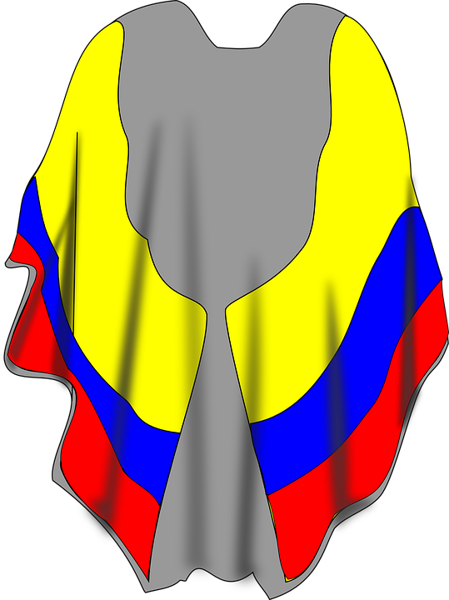
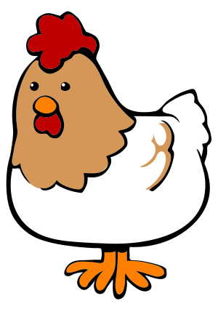

Boost
123 m

Slide 4

Energy
411 m

