Slide 1
Income and crime
Ruben | Jenwei | Harrison | Danica
26/10/2021
Data 201

Slide 2

INTRODUCTION

Slide 3
Our target
1
investigate how levels of income may impact crime rates, and whether particular types of crime are more impacted than others.

Slide 4
Hypothesis
Area’s with less income would see more crime.

Slide 5
Analysis considerations
Poverty or inequality could be the cause of crime not income.
This explores the correlation not a causal link.
Not economists.

Slide 6
Ethics issues
Wanted to explore how drop out rate affects crime but didn’t consider implications.
Ethnicity and area data being misused / interpreted.
Risk painting drop outs as criminals.

Slide 7
Data Wrangling
2

Slide 8
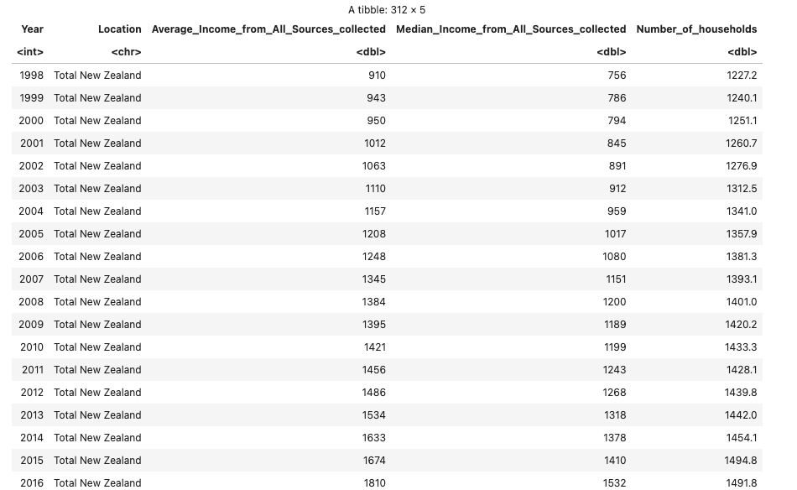
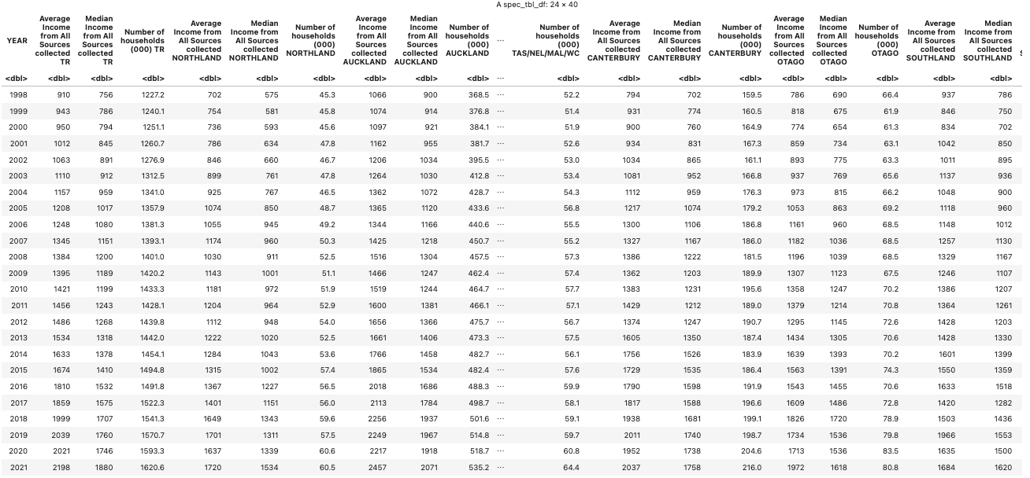
Initially, the income dataset was in wide format, which needed to be converted to long format and the regions renamed for use in matching policing districts.

Slide 9
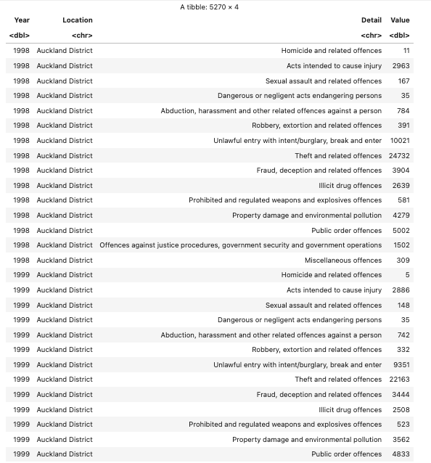
Once the income data frame was converted, the crime data frame was joined by matching year and region together. This allowed for a final data frame to be constructed that mapped average and median household income to numbers of offenses for each region by year.

Slide 10
Data Analysis
3

Slide 11
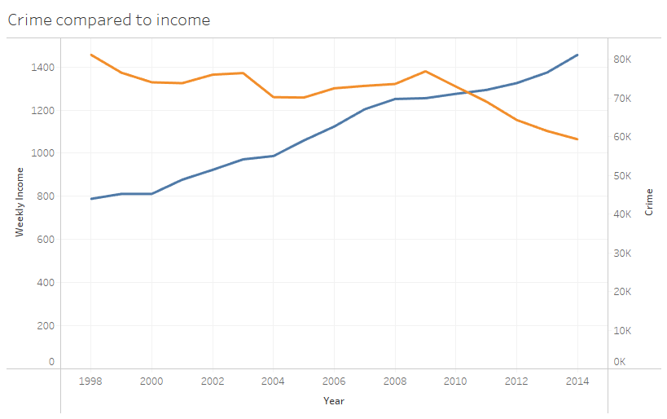

Income is related to crime.

Slide 12
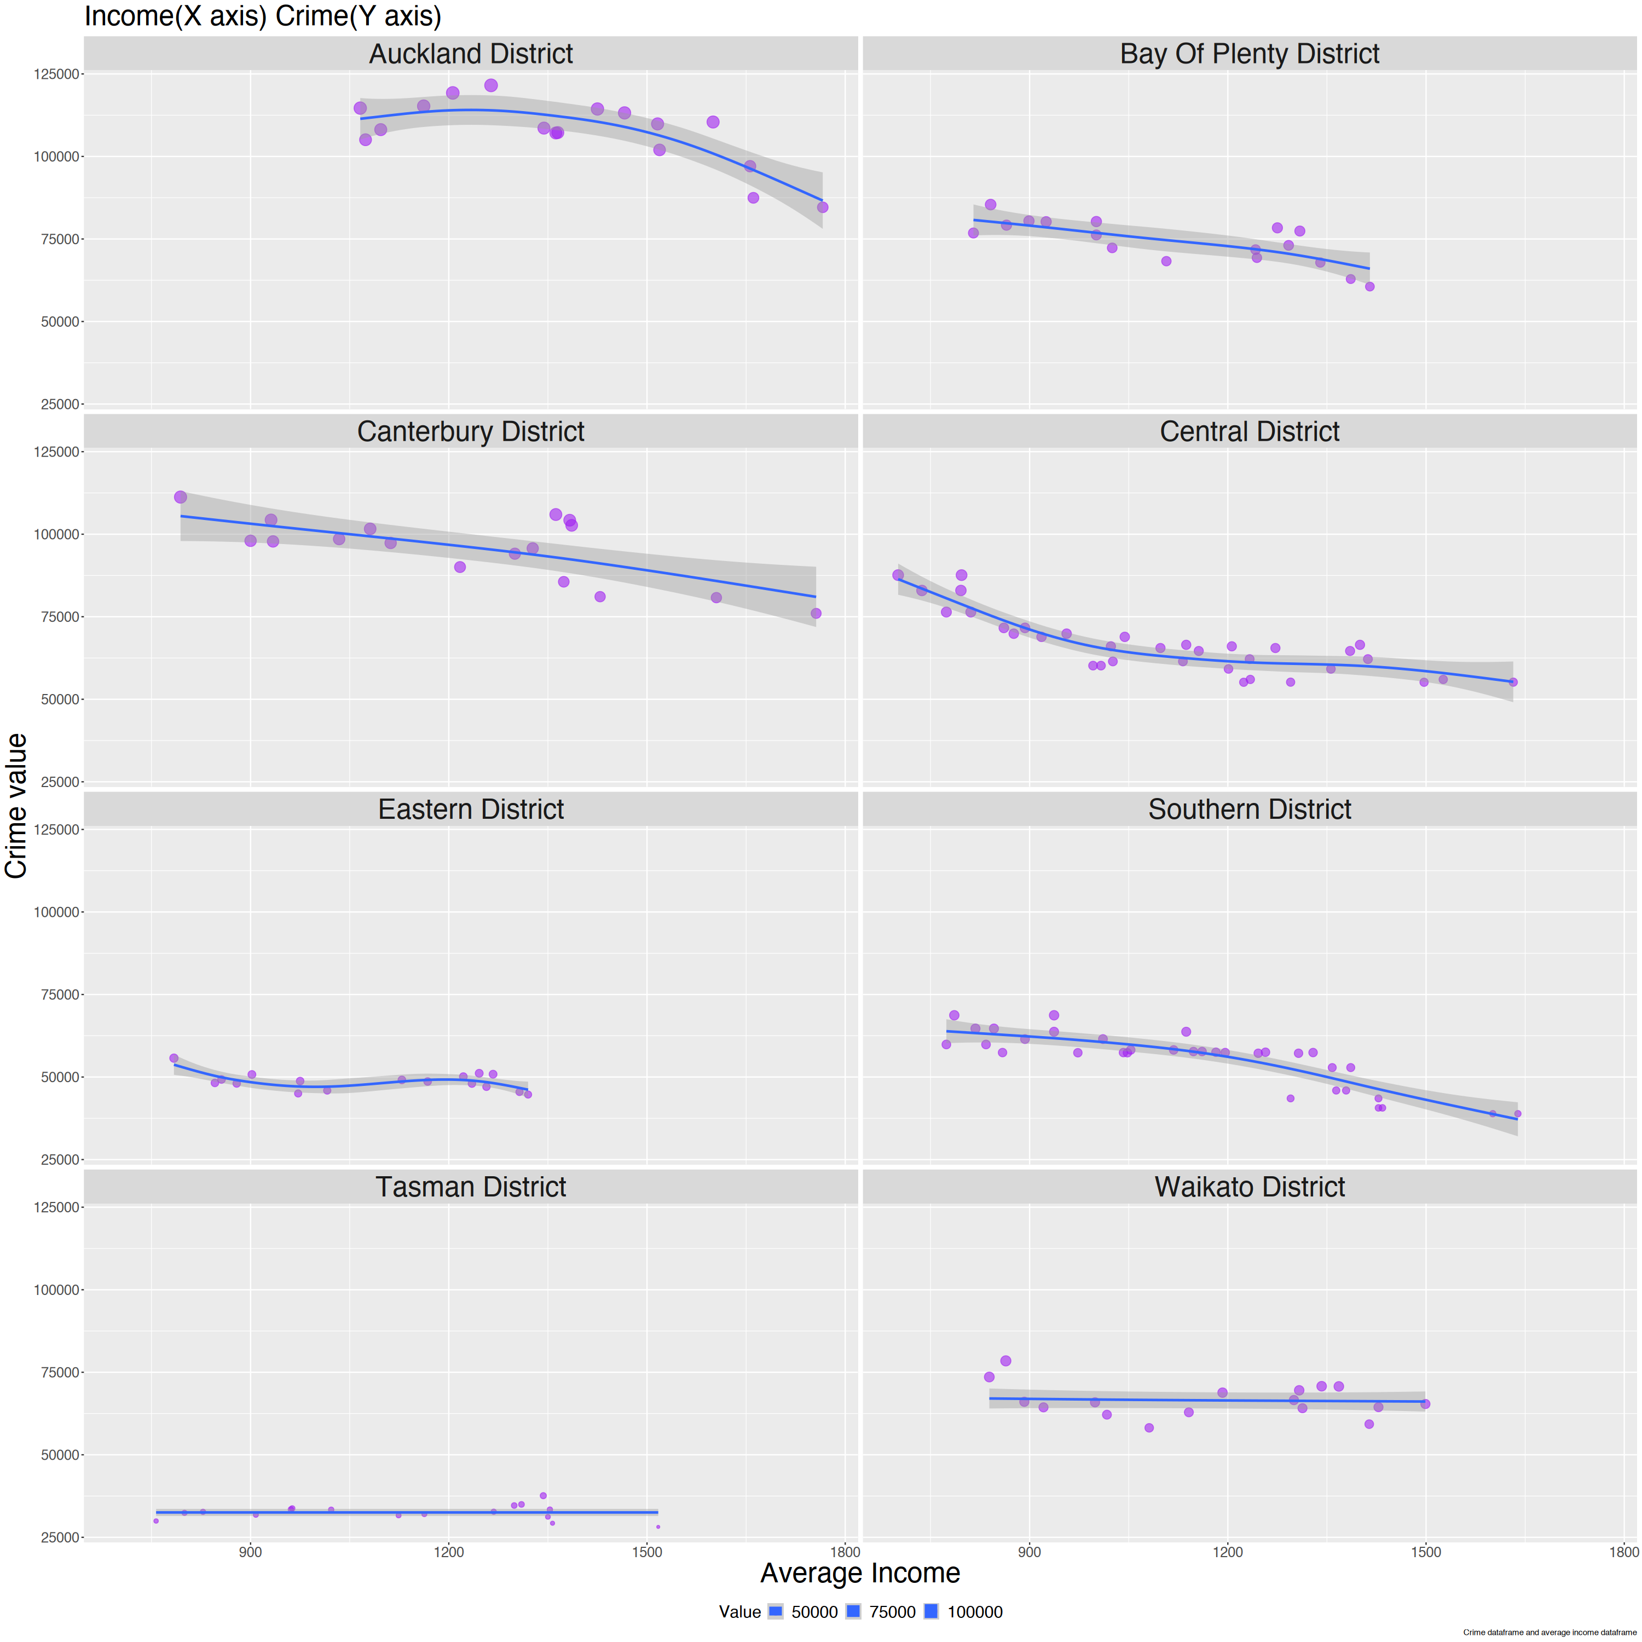
Relationship is true for regions

Slide 13
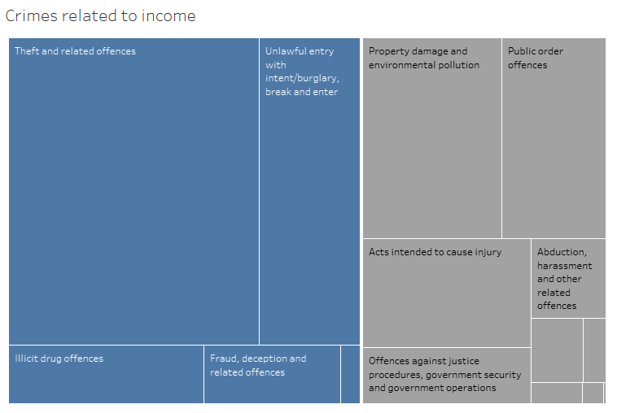

Slide 14
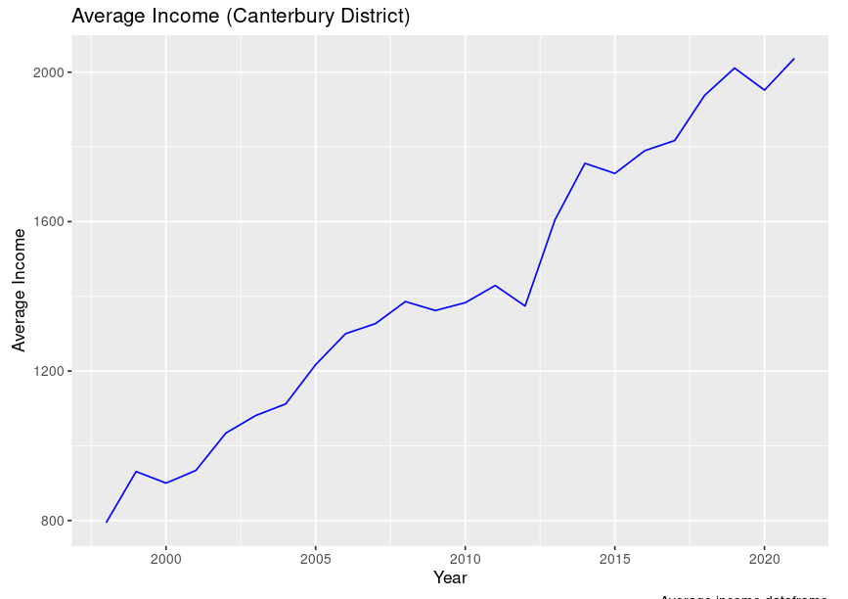

Slide 15
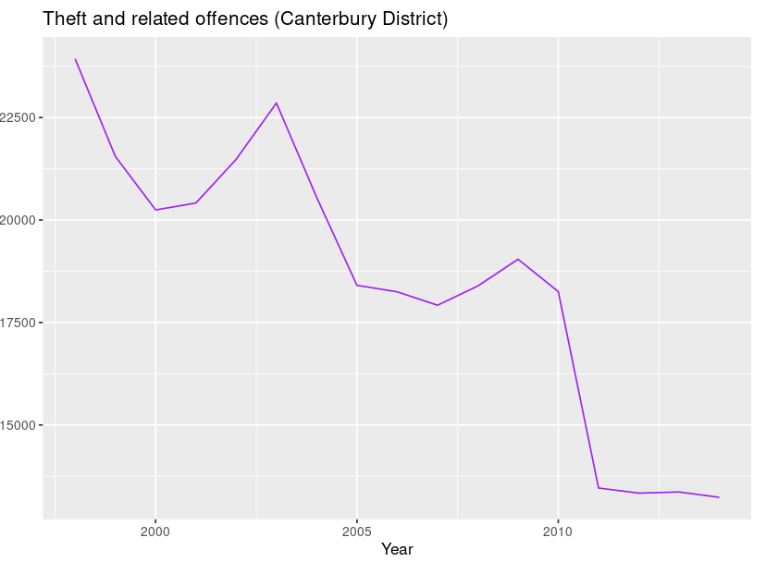

Slide 16
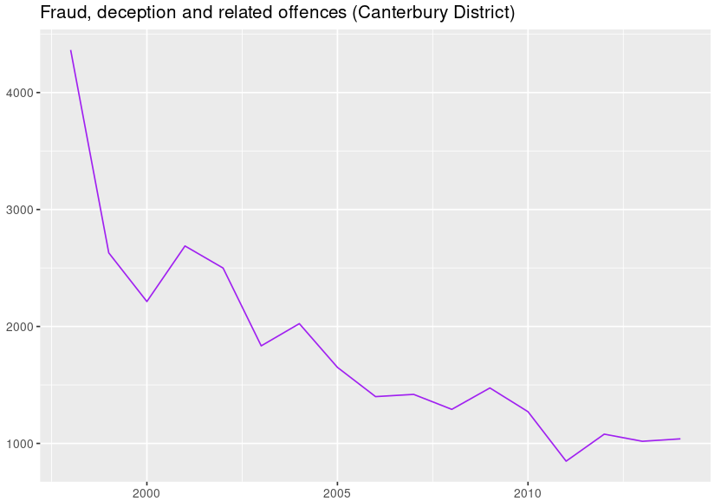

Slide 17
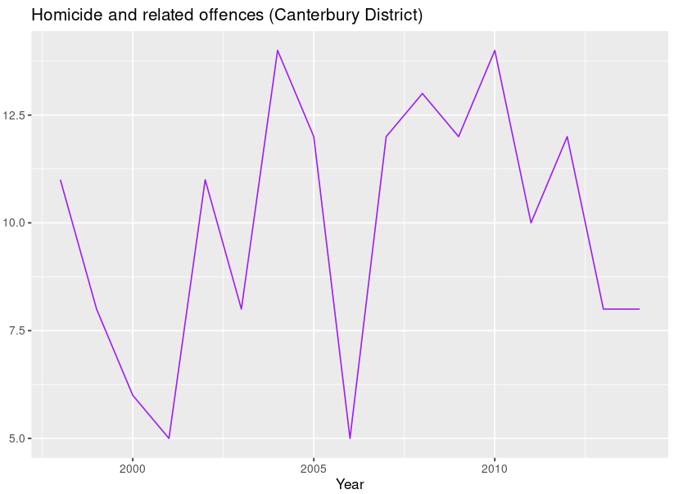

Slide 18

A Link to see more
https://data201dhrl.shinyapps.io/data201dhrldeployedshinyapp/

Slide 19
Conclusion
Income is correlated with crime
The difficulties we have encountered so far
Achievements
Worked on GitLab
Developed a shiny app
Developed an R package

Slide 20
Thanks!
ANY QUESTIONS?

