Slide 1
Income and crime
Ruben | Jenwei | Harrison | Danica
26/10/2021
Data 201

Slide 2

INTRODUCTION

Slide 3
Our target
1
Investigate how incomes may impact crime rates, and whether types of crime are more impacted than others.

Slide 4
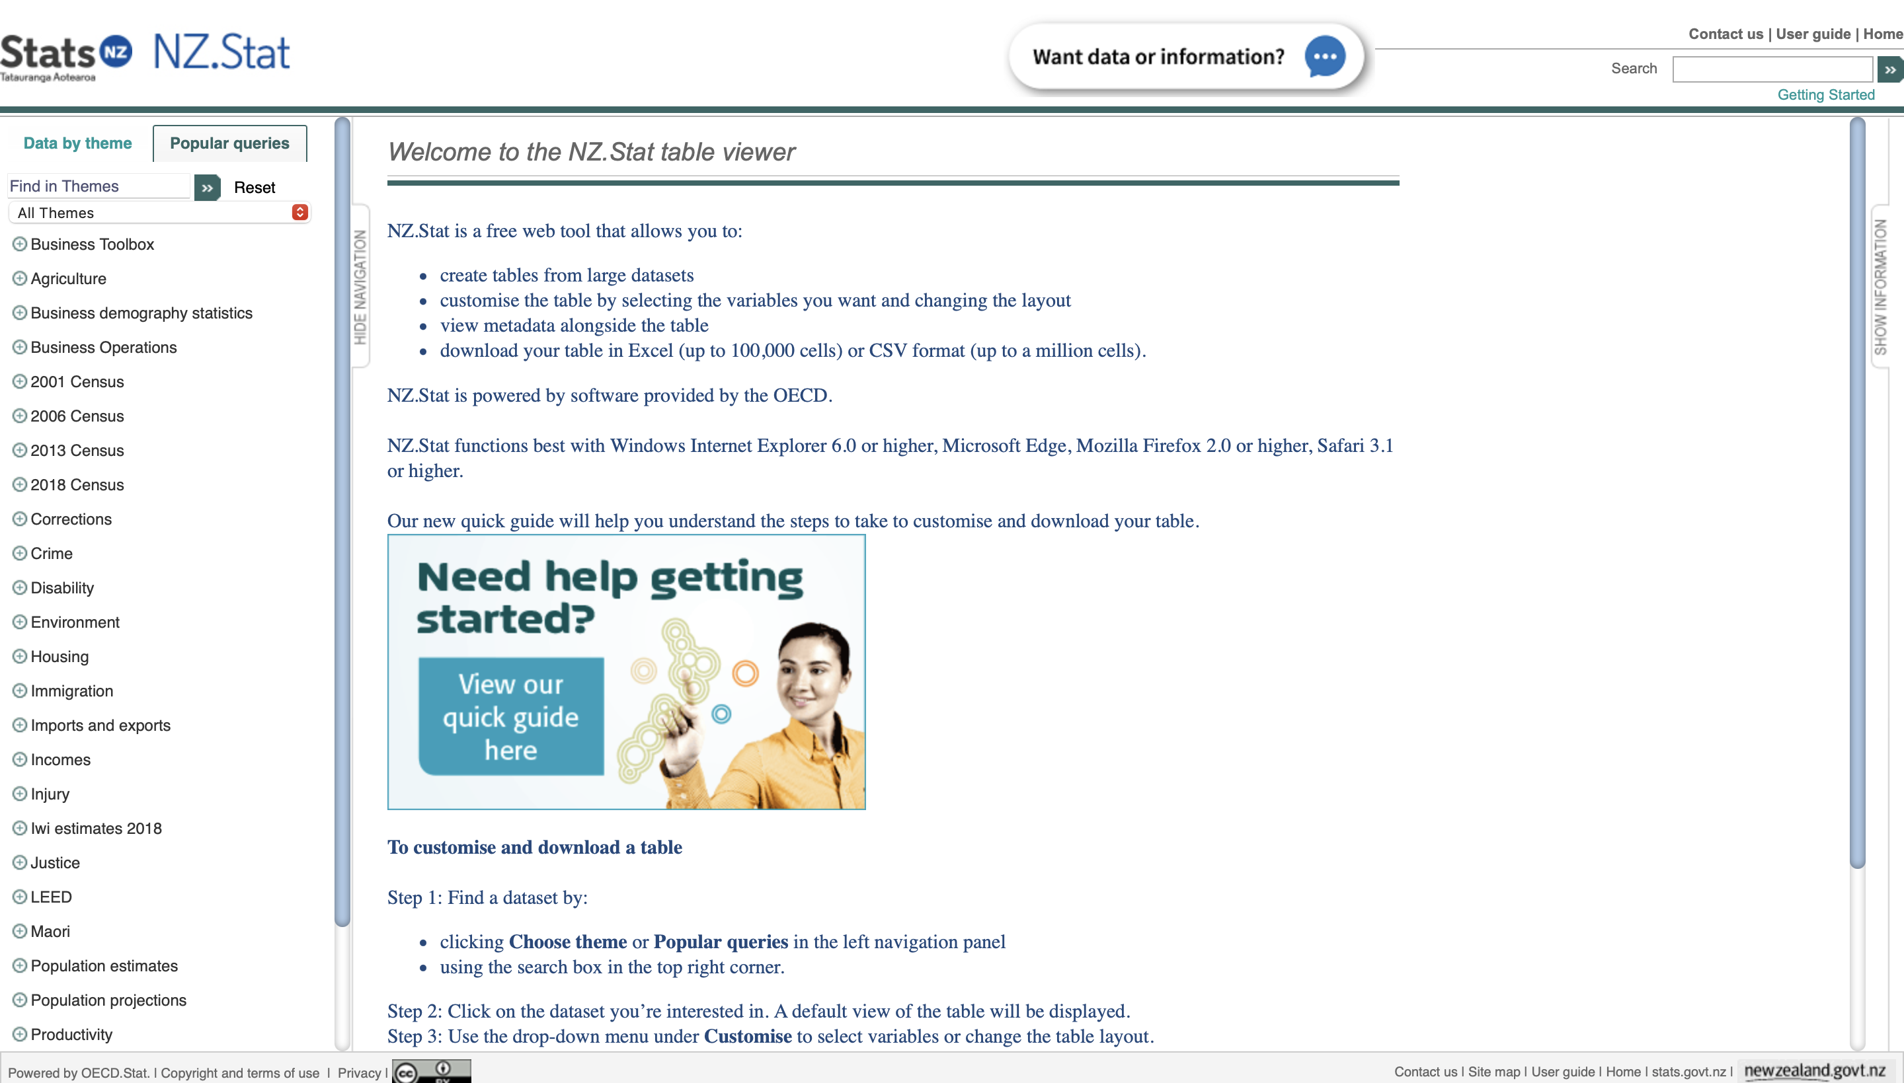
Data Sets
Notes:
The datasets were obtained from Statistics New Zealand’s NZ.Stat table viewer. This allows for datasets to be created in a table view, with different variable selection options. These can then be exported as a CSV file, with Creative Commons licensing

Slide 5
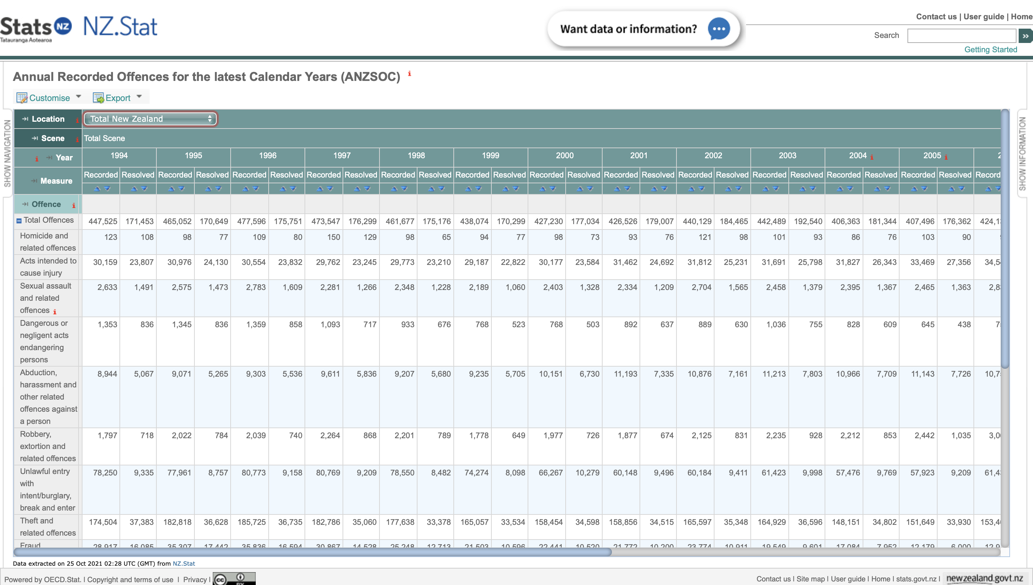
Crime dataset
Notes:
The first dataset generated was Annual Recorded Offences for the latest Calendar Years (ANZSOC).
This dataset contains a breakdown of recorded and resolved offences across New Zealand by both type of offence (for example Homicide) and by policing district (for example Canterbury District). The dataset spans from 1994 to 2014.
A recorded offense is an offence that is reported to police, and a resolved offence is the classification of a recorded offence when an offender is identified and dealt with. (E.g. prosecuted, warned, cautioned, diverted, etc.)
Data in this dataset is derived from the New Zealand Police National Intelligence Application (NIA).
This data set was selected as it gives a large and accurate nominal record of crime reported to police across New Zealand, and has a large enough time span to develop trends.
The data collected for the crime rate in New Zealand is based on crimes being reported to the police. As a result, the true crime rate may be different, as crimes may be committed that are not reported. A variety of factors are known to affect whether a crime is reported to police. These include:
• the type of crime
• age, sex, race and ethnicity of the victim
• relationship between the victim and offender
• perceived seriousness of the crime,
•. A perception of how police would deal with the matter
As a result, income appears to have a relation on crime rates but there should be caution in making definitive comparisons.

Slide 6
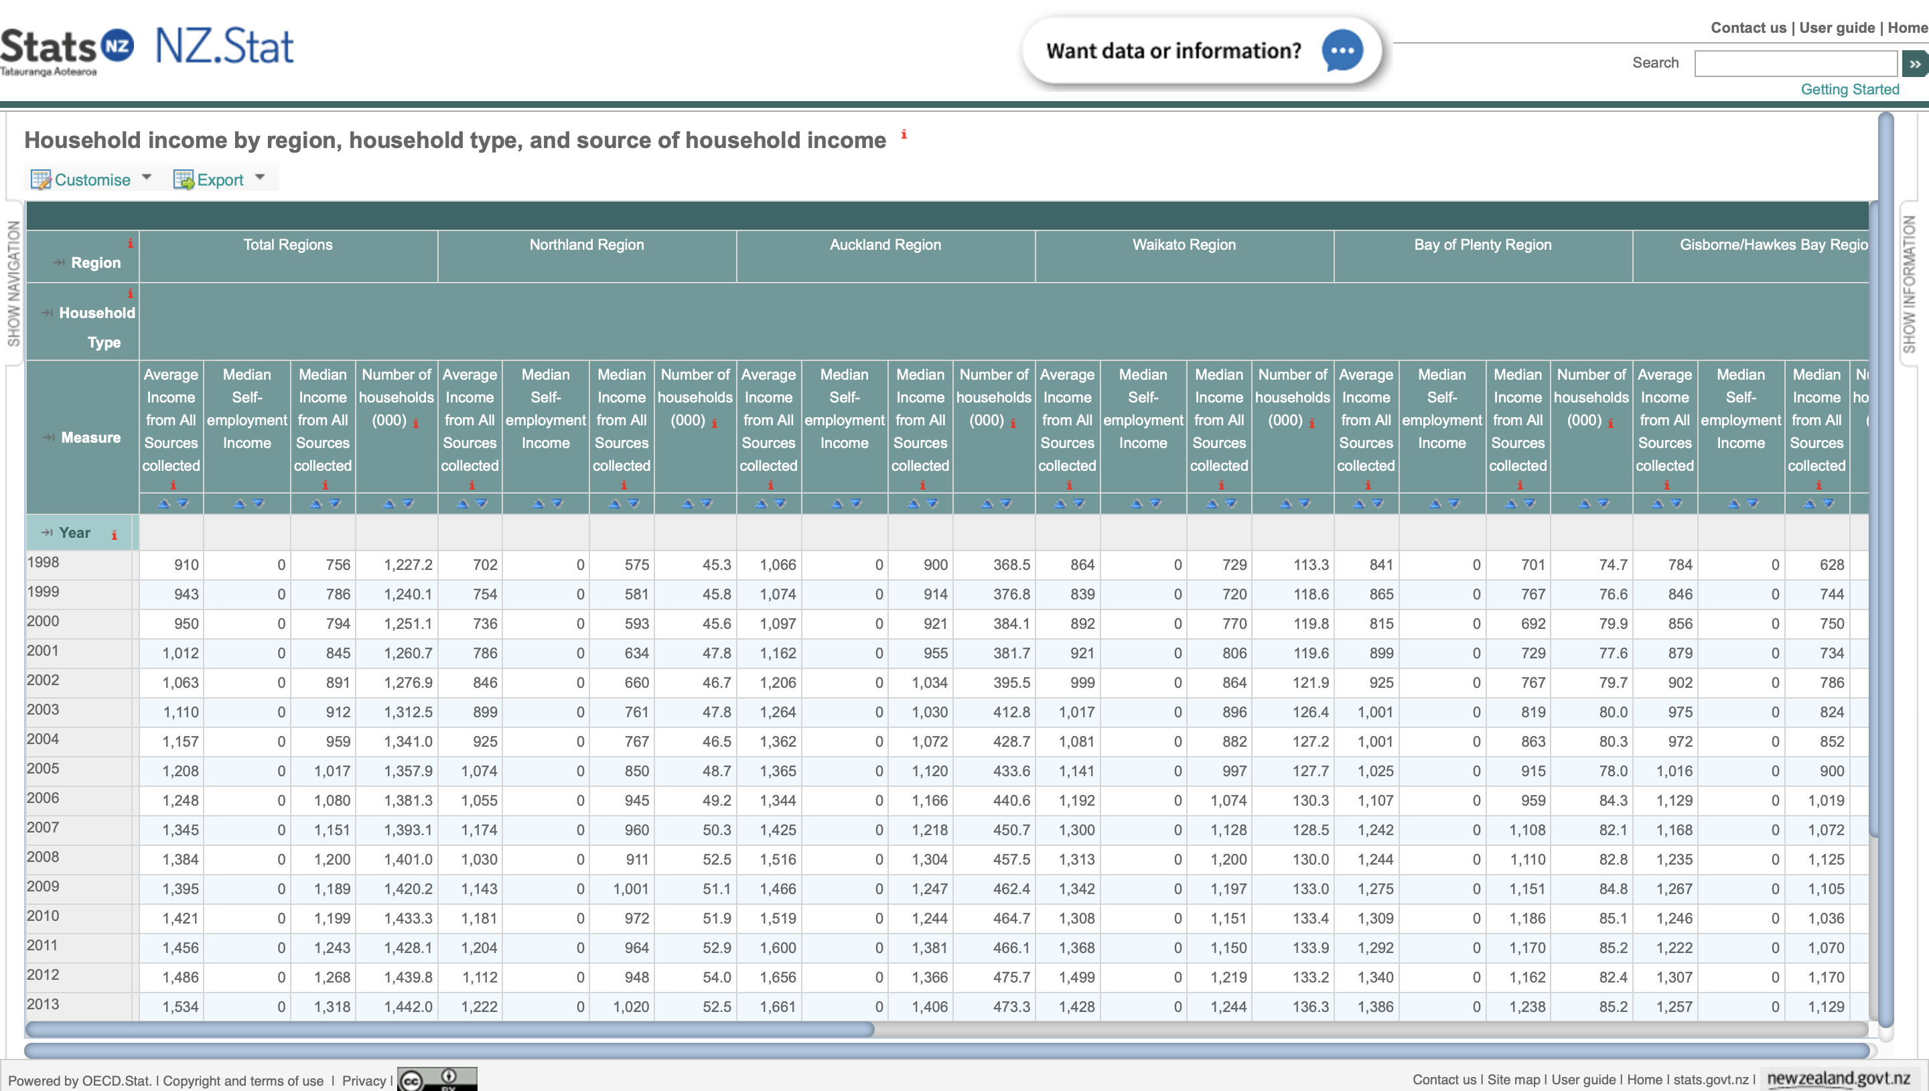
Income Dataset
Notes:
The second dataset second dataset is Household income by region, household type, and source of household income. This dataset contains both the average and median incomes for households across New Zealand, broken down by regional council areas. The dataset spans 1996 to 2021.
The income data in this dataset is derived from question in the household labour force survey conducted by Stats NZ. This dataset is restricted to households where at least one member is in within the 18 to 64 year age range. Weekly household income is defined as the sum of weekly income of all people in the household from wages, salaries, self-employment and government transfers. The average is the total weekly household income, divided by the number of households.
This data set was selected as it provided a measure of wealth at a more individual level than other measures, for example Gross Domestic Product (GDP) , but avoid focusing on one group.
When selecting these datasets, we were looking for data that would provide insights at a high level, and avoid narrowing in on a particular group.

Slide 7
Data Wrangling
2

Slide 8
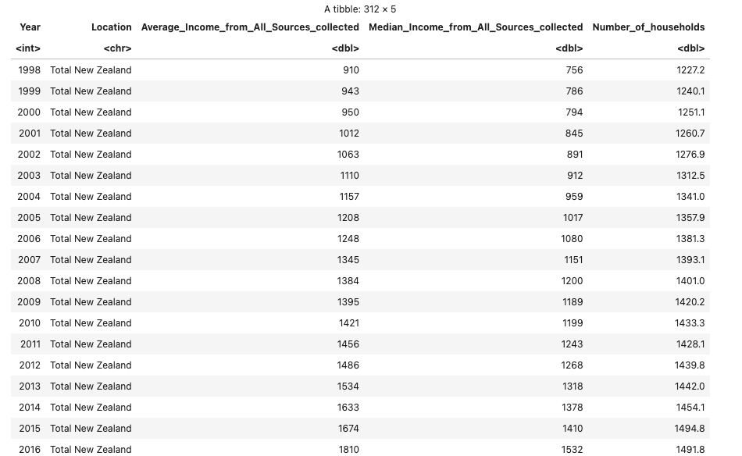
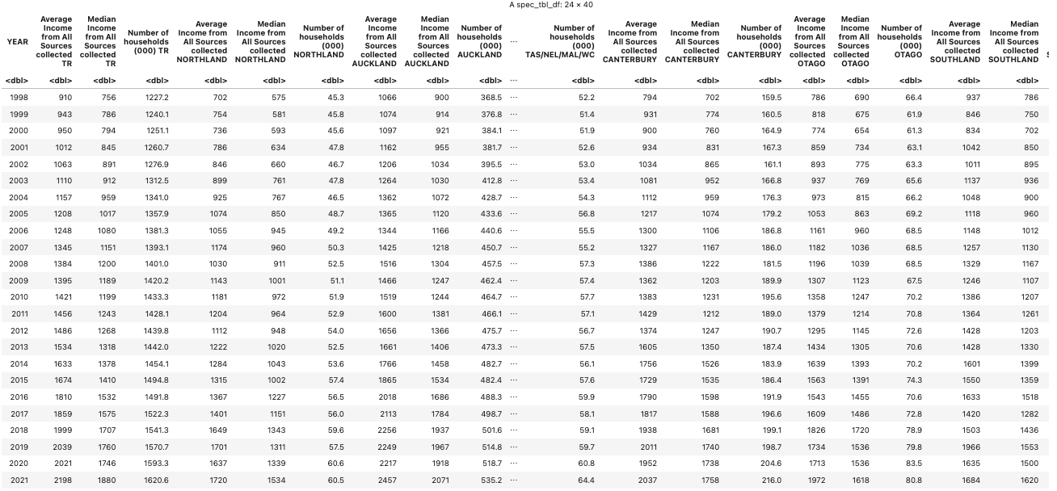
Initially, the income dataset was in wide format, which needed to be converted to long format and renamed the regions for use in matching policing districts.
Notes:
To begin, we'd like to load datasets of interest into R by using the read csv function to read files.
Then we discovered that while the crime dataset was fine, the income dataset was in wide format. We prefer that this dataset be in long form so that it could be easily matched with policing districts.
Following that, we defined a function to help us in converting a wide frame to a long frame, and then we had a bunch of individual dataframes that we joined vertically using rbind().
Next, we would like to collect data from all categories, such as Average, Median, and Number, so we select them first and then link them with Year and Region using the left join function.
We went through all rows and changed their names to better match the Crime dataframe because there is a small inconsistency between policing districts and income regions.
Finally, we were able to obtain this dataset.

Slide 9
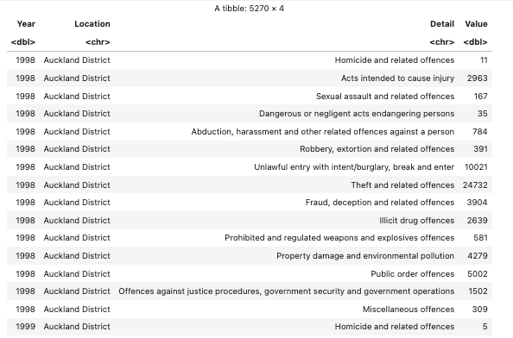

Once the income data frame was converted, the crime data frame was joined by matching year and region together. This allowed for a final data frame to be constructed that mapped average household income to numbers of offenses for each region by year.
From 1998 to 2014
Year
Region of NZ
Location
Offence types
Detail
average household income
Value
Notes:
Since the locations of the income dataframe are a subset of the locations of the crime dataframe, we considered modifying the income dataframe and vertically merging two dataframes.
Then we were using inner join function to join two tables, since we only want to match their values.
Following that, we'd like to modify some details, such as selecting specific columns and renaming and removing values.
This allowed for a final data frame to be constructed that mapped average household income to numbers of offenses types for each region by year.

Slide 10
Data Analysis
3

Slide 11
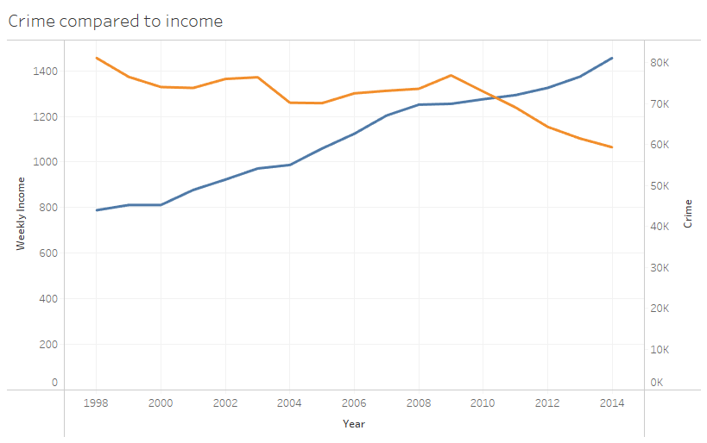

Slide 12
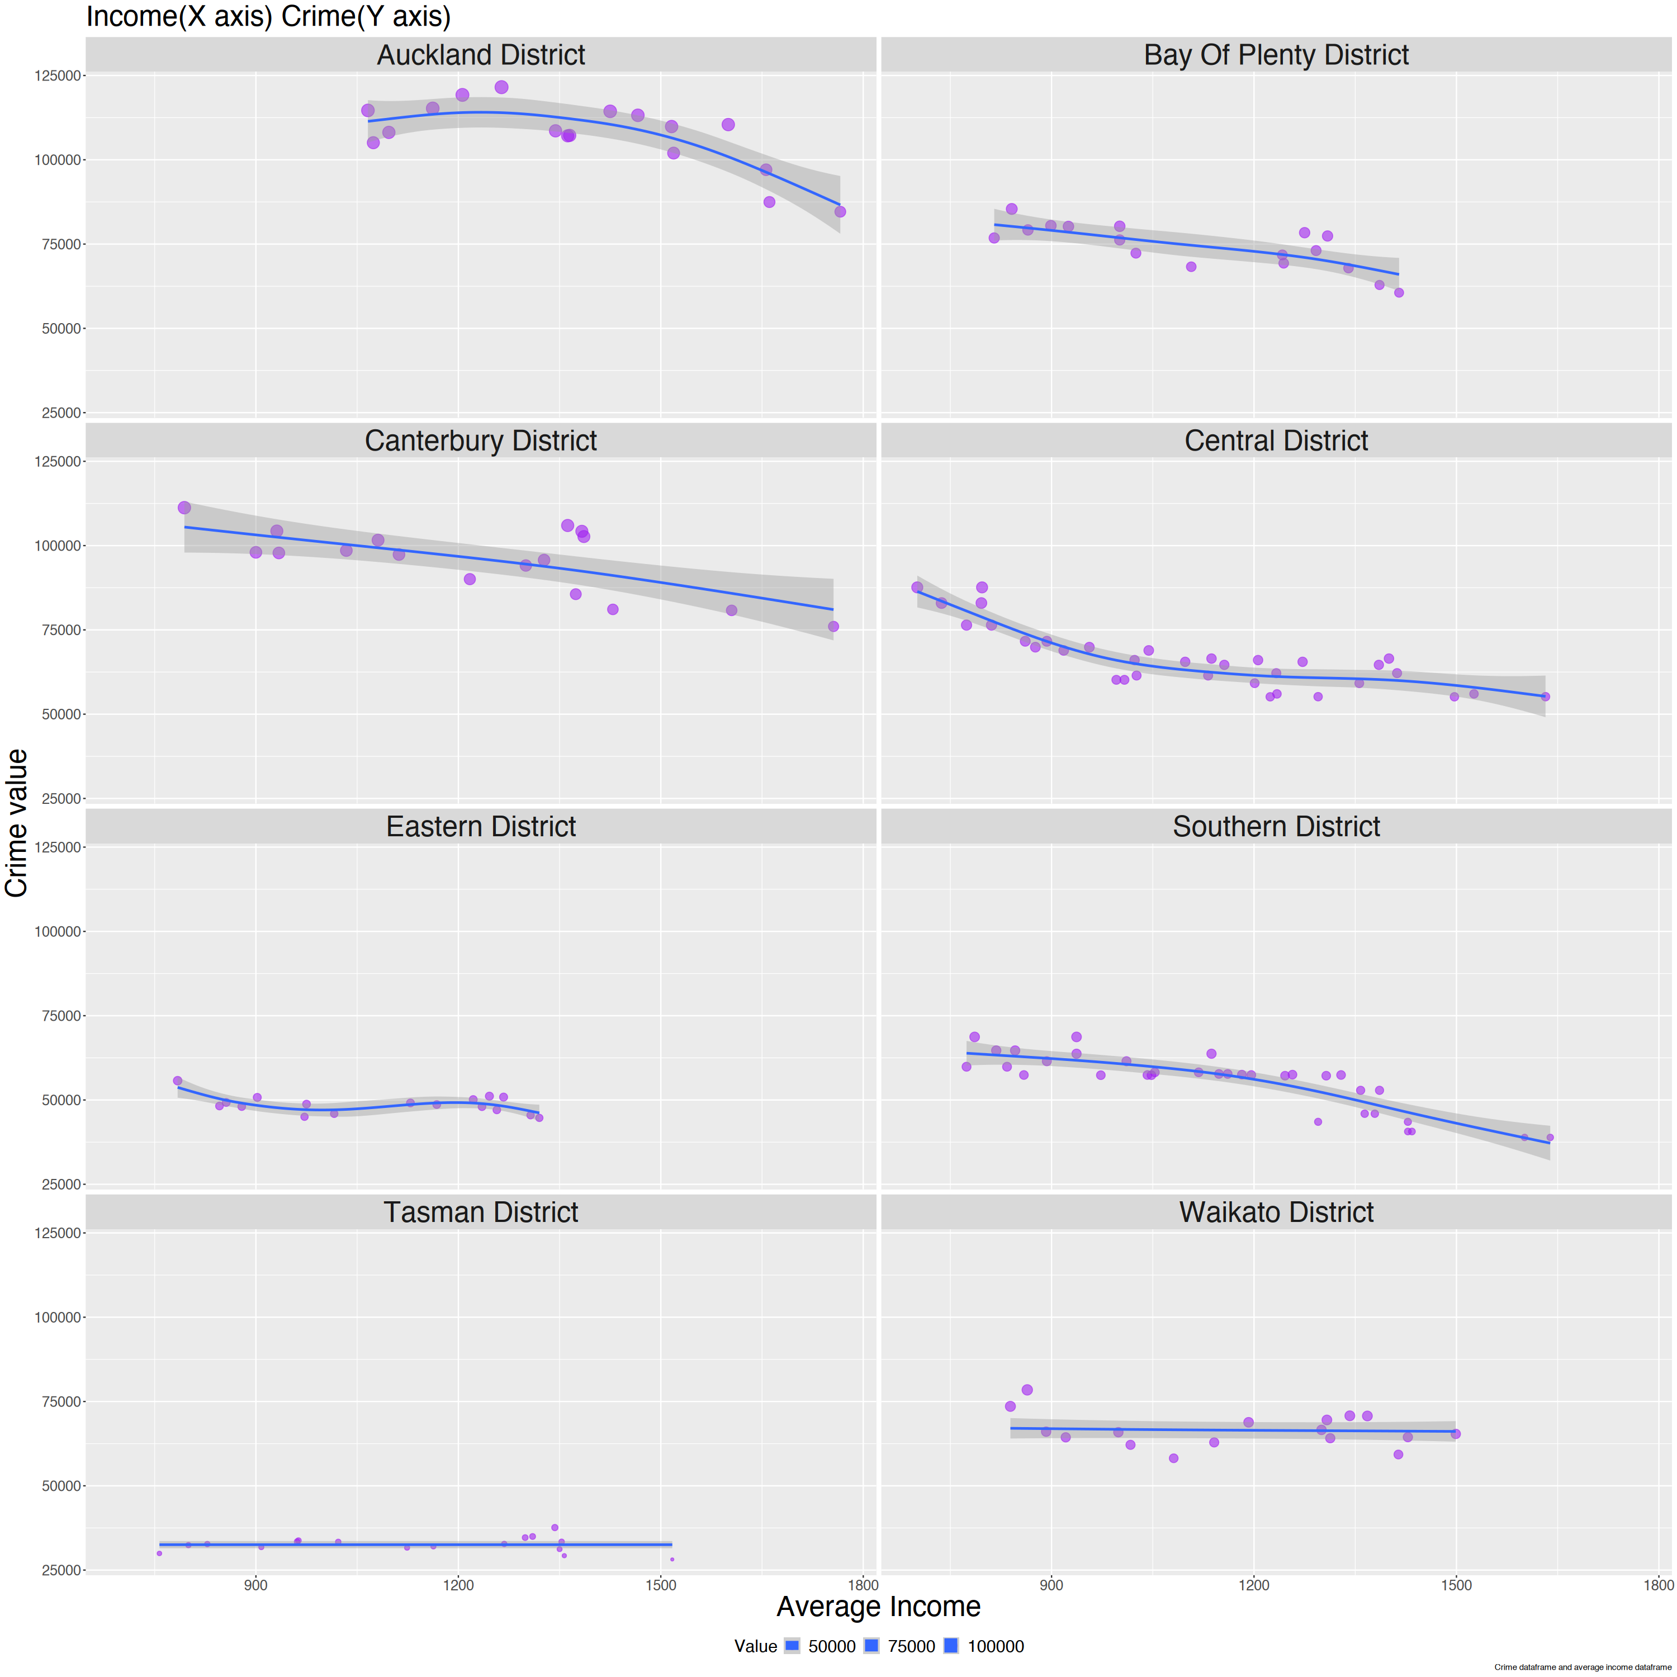
Relationship is true for regions

Slide 13
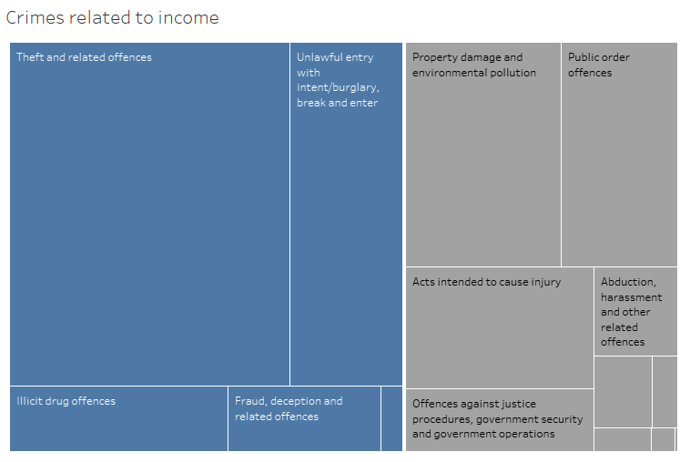

Slide 14
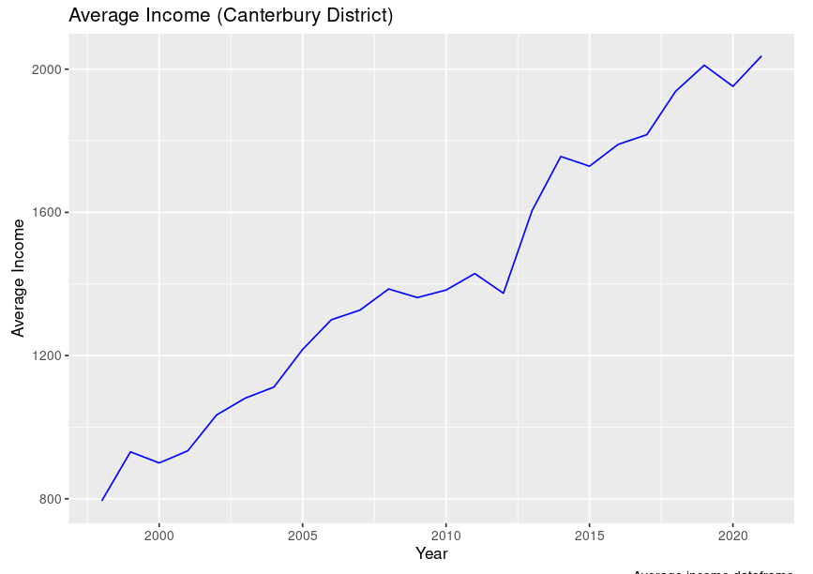

Slide 15
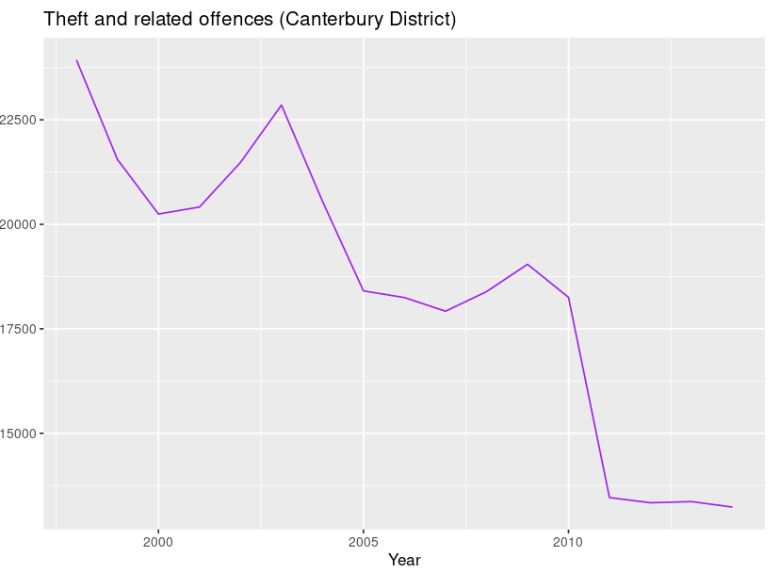

Slide 16
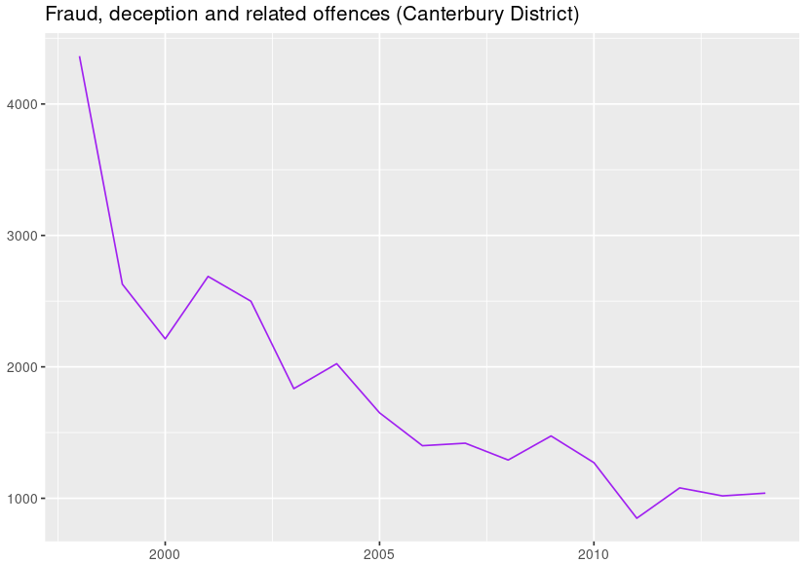

Slide 17
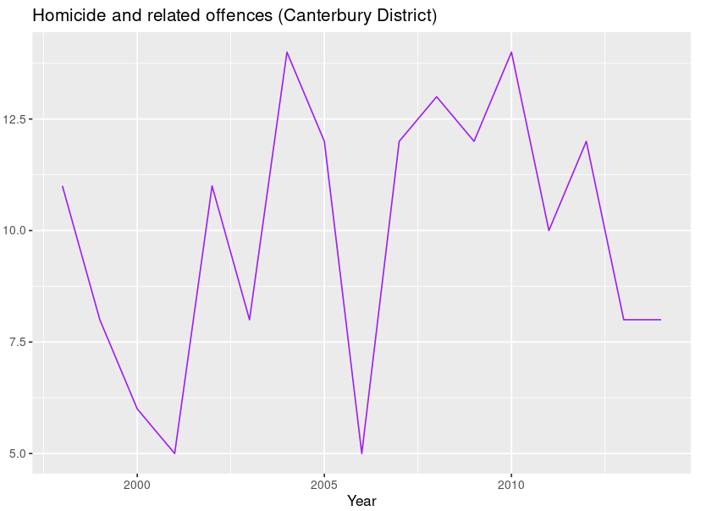

Slide 18
Achievements
4

Slide 19
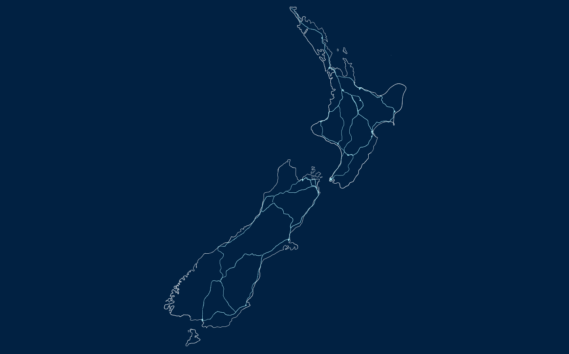
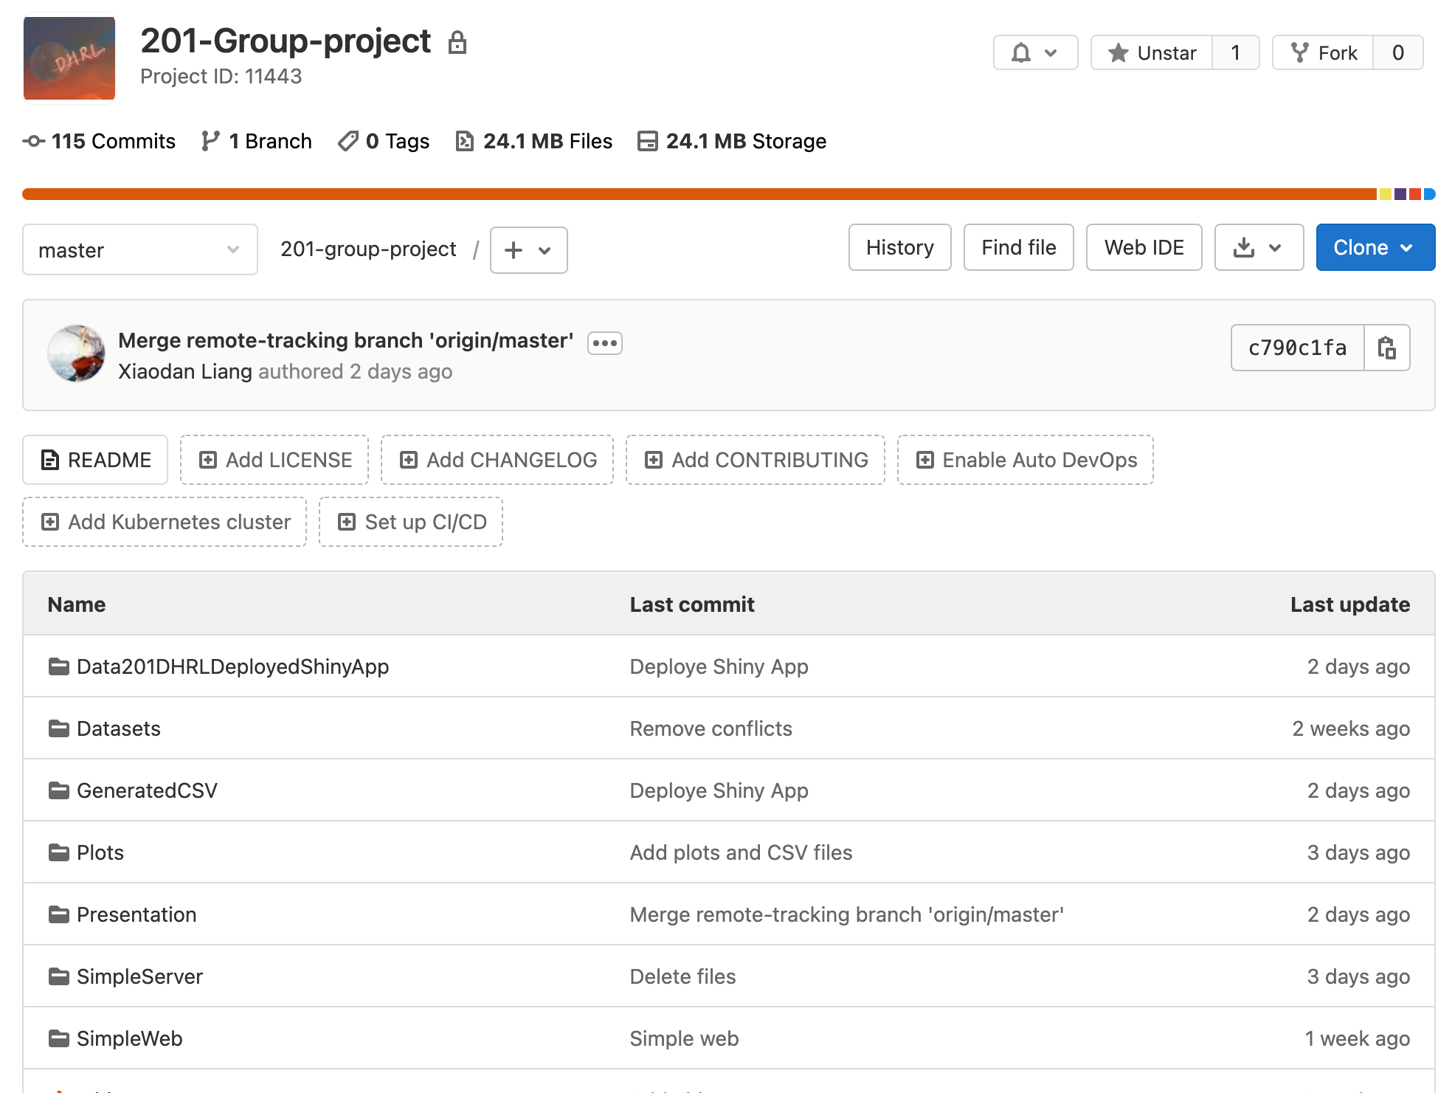
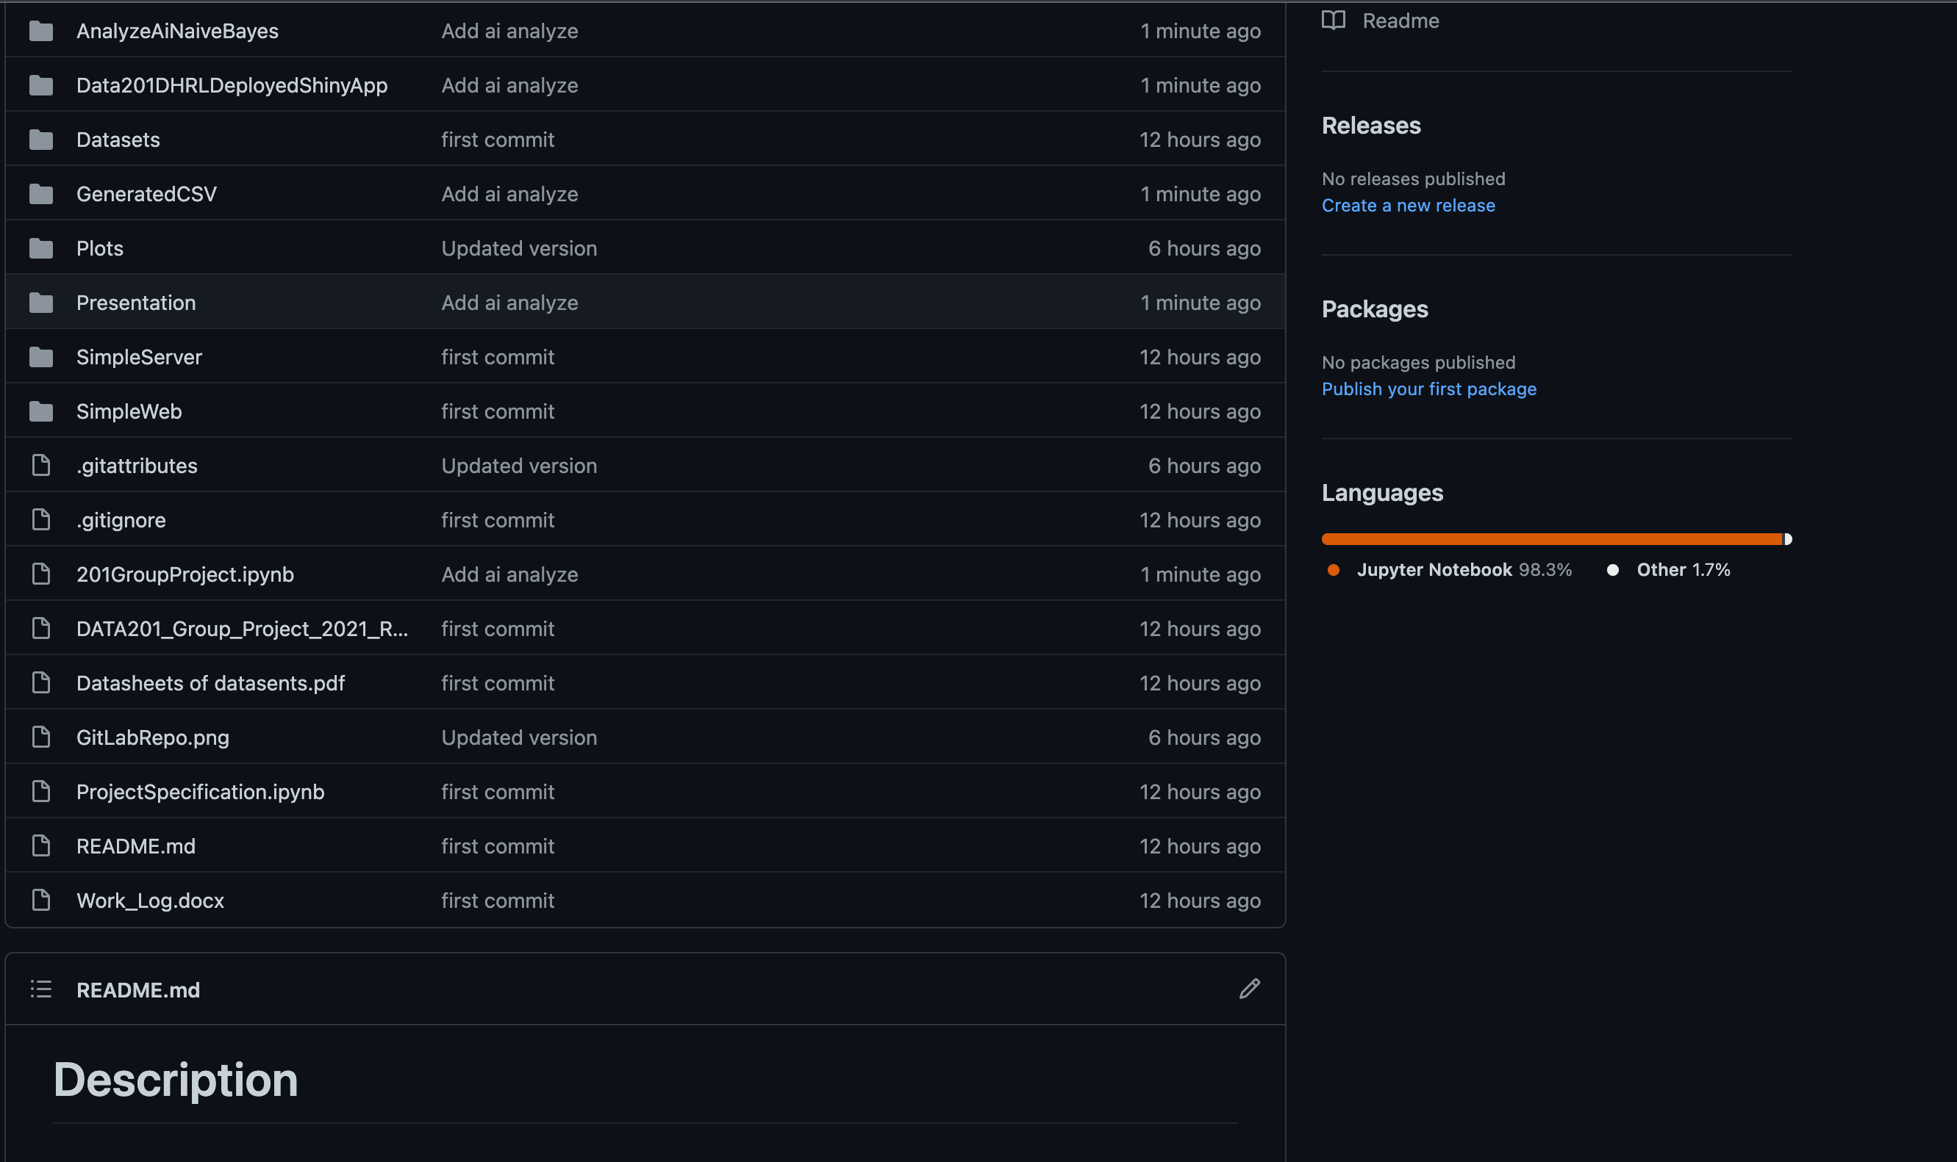
Developed a Shiny App
https://data201dhrl.shinyapps.io/data201dhrldeployedshinyapp/
Developed an R package
remotes::install_github(“JunweiL0-0/CrimeIncome”)
library(CrimeIncome)
Worked on GitHub/GitLab
Developed a RESTful API
https://eng-git.canterbury.ac.nz/jli328/201-group-project
https://github.com/JunweiL0-0/201-Group-project

Slide 20
Thanks!
ANY QUESTIONS?

