Slide 1
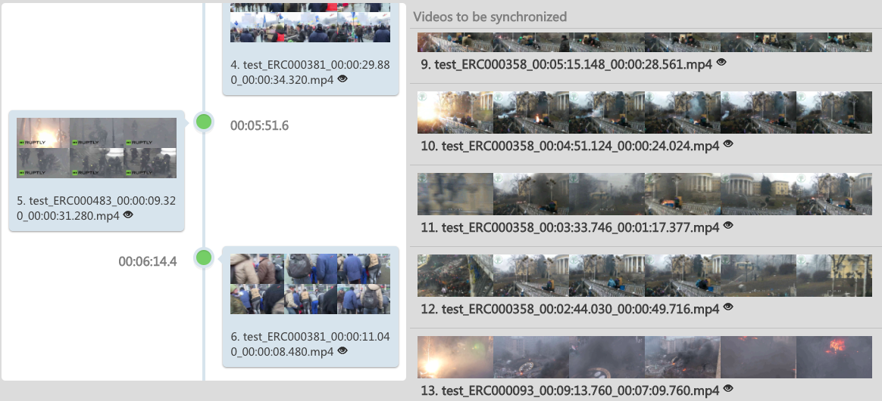
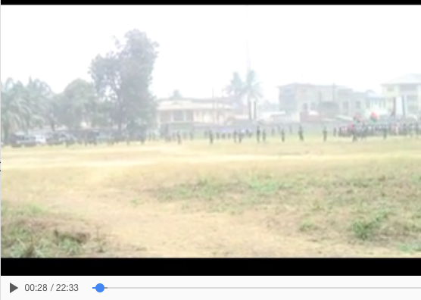
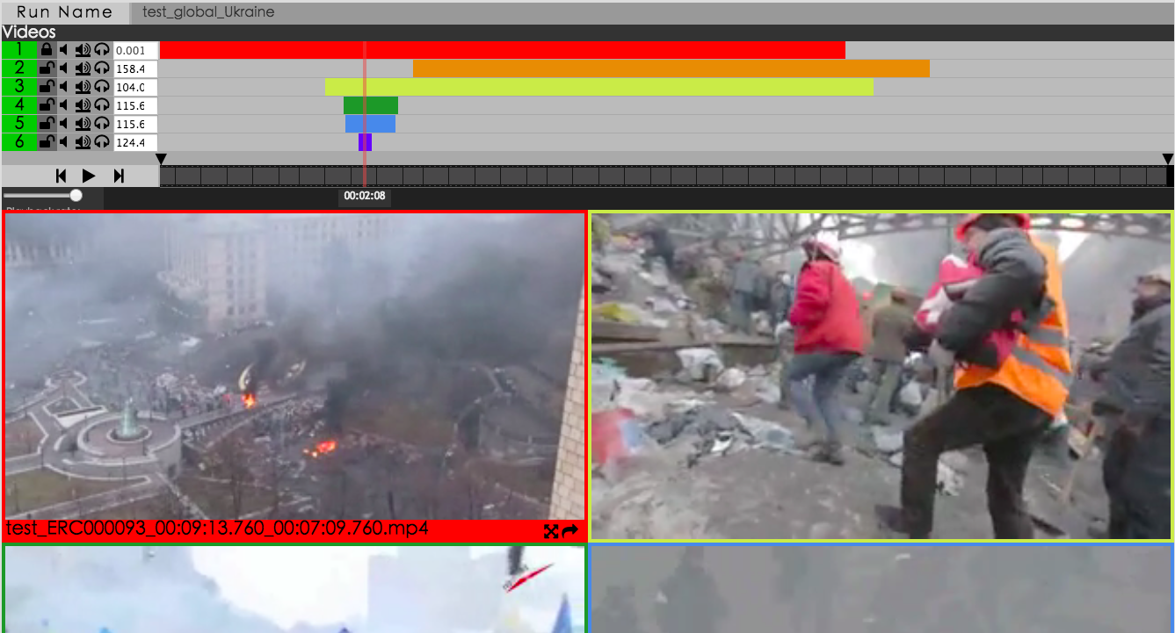
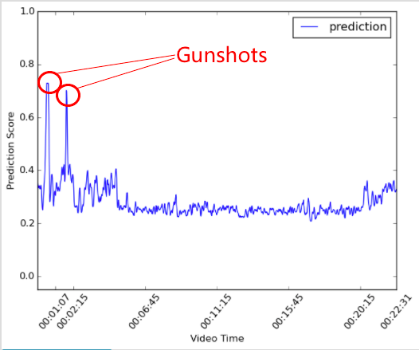
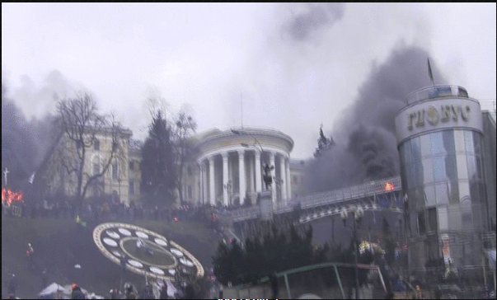
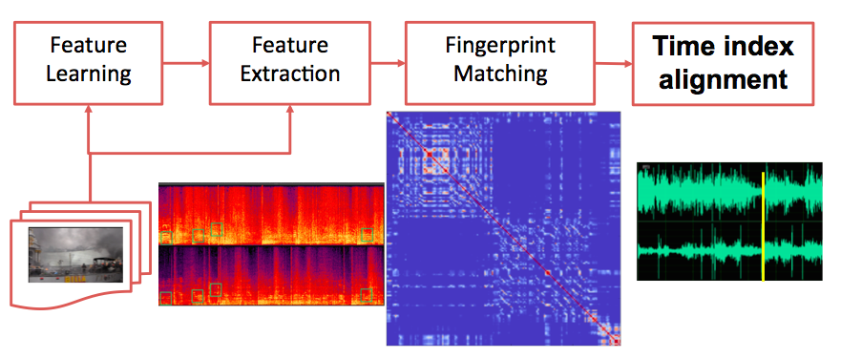
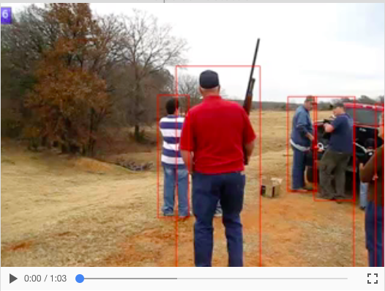
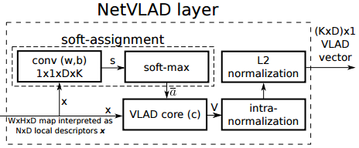
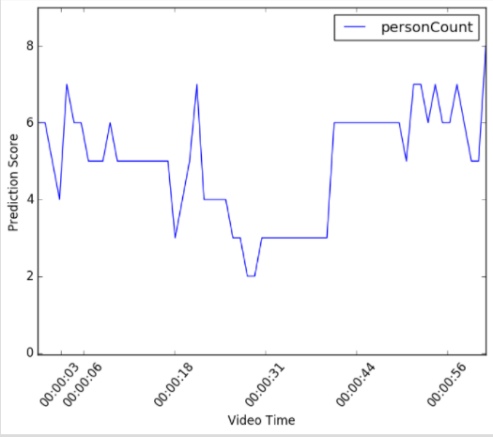
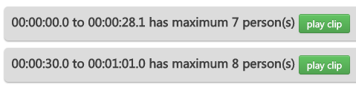
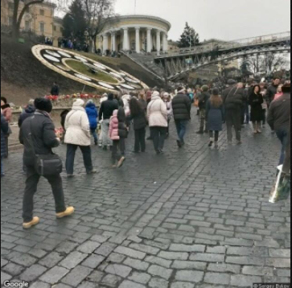
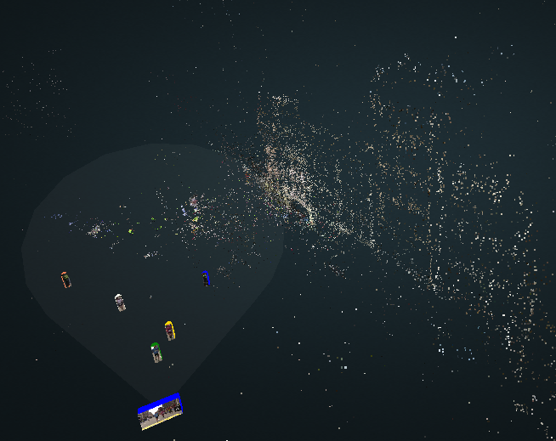
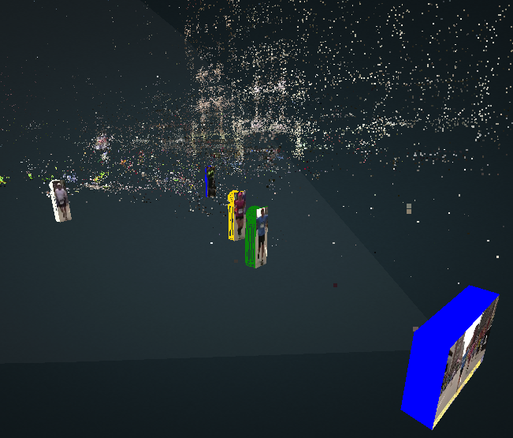
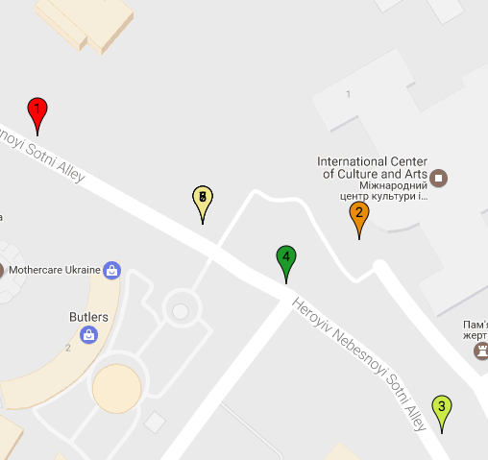
An Event Reconstruction Tool for Conflict Monitoring Using Social Media
Junwei Liang, Desai Fan, Han Lu, Poyao Huang, Jia Chen, Lu Jiang and Alexander Hauptmann
Carnegie Mellon University
{junweil, dfan, hlu2, poyaoh, jiac, lujiang, alex}@cs.cmu.edu
Abstract
Video Synchronization
Gunshot Detection and
Crow Size Estimation
What happened during the Boston Marathon in 2013? Nowadays, at any major event, lots of people take videos and share them on social media. To fully understand exactly what happened in these major events, researchers and analysts often have to examine thousands of these videos manually. To reduce this manual effort, we present an investigative system that automatically synchronizes these videos to a global timeline and localizes them on a map. In addition to alignment in time and space, our system combines various functions for analysis, including gunshot detection, crowd size estimation, 3D reconstruction and person tracking. To our best knowledge, this is the first time a unified framework has been built for comprehensive event reconstruction for social media videos.
Intuition. During a conflict or an terrorist attack on a public event, many user-generated videos would be taken to document the event. However, these videos are varied in qualities and may be taken in different point of the event timeline. To utilize these videos for further analysis, we will need to synchronize them and put them into the global timeline.
System Overview. After synchronization and localization of the video collection, users can then utilize the gunshot detection and crowd size estimation tool for further event information retrieval. The gunshot detection tool can show users which segments within the videos contain gunshots. A pre-trained bag-of-audio-words gunshot model is used to detect gunshot on segments of each video and positive segments above a certain threshold are combined.
Video Geo-Localization
Intuition. Given a video of interest, we aim to find out where this video takes place so that we can get the geo location of the video and do further analysis. The location information of a video is an essential part of its content.
Implementation. Our system takes a video as input and extract keyframes. Then the NetVLAD features are extracted from the video frames and matched to Google Street View images or Flickr images with geo-tag.
Implementation. Our system utilizes the audio of the videos for synchronization since many videos taken at the same time will face different directions and the audio will be the only cue to identify their global time. We match each video to the others based on the audio fingerprint.
To estimate the crowd size in a video, we fine-tuned the faster-RCNN model (Ren et al. 2015) and its region proposal network on MS COCO dataset to detect and localize persons with bounding boxes in each video frame. The video segments with a crowd size above a threshold are then presented to the users for further analysis.
Extract NetVLAD Features
Person Tracking and 3D Reconstruction
In order to fully reconstruct the trajectory of a person, it is important that our system can track a person or object in 3D space. To achieve that, we combine person tracking with 3D reconstruction to allow users to search for a person of interest. In detail, we first reconstruct the whole 3D point cloud model by merging two or more models that were reconstructed from Google Street View images and frames from relavent videos via VisualSFM (Wu 2013), and then use the result of the detection of the person as well as the camera location, which is obtained while we reconstruct the point cloud, to infer where the person locates in 3D space. Finally, the tracking result of a person of interest is transformed into a trajectory in 3D space.
Video frame matched to Google Street View
Acknowledgement
This project was conducted in partnership with Carnegie Mellon’s Center for Human Rights Science (http://www.cmu.edu/chrs). The authors would like to thank the MacArthur Foundation, Oak Foundation, and Humanity United for their generous support of this collaboration.
3D Reconstruction of the Boston Marathon finish line. A video is put in the 3D space
Person Tracking in 3D space. Blue box marks the location of the video

