Slide 1


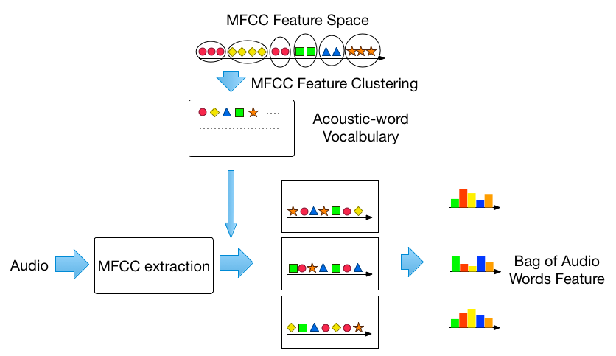
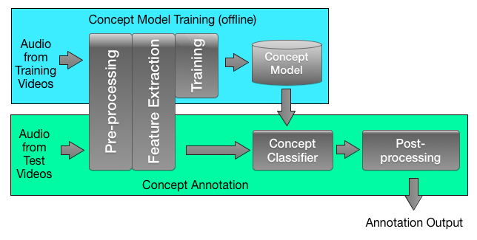


Detecting Semantic Concepts In Consumer Videos Using Audio Junwei Liang, Qin Jin, Xixi He, Gang Yang, Jieping Xu, Xirong Li Multimedia Computing Lab, School of Information, Renmin University of China, Beijing, China {leongchunwai, qjin, xxlanmi, yanggang, xjieping，xirong}@ruc.edu.cn
Abstract
Audio Feature Representations
Additional Experiments and Analysis
With the increasing use of audio sensors in user generated content collection, how to detect semantic concepts using audio streams has become an important research problem. In this paper, we present a semantic concept annotation system using sound-tracks/audio of the video.
Different acoustic feature representations:
Bag-of-audio-words representation
BoW+TF-IDF representation
Gaussian super vector representation
Fusion with visual system:
Performance boost
Interpreting a semantic concept both visually and acoustically, it is better to train concept models for the visual system and audio system using visual-driven and audio-driven ground truth separately.
Bag-of-Words (BoW) features: In our system, we use bag-of-audio-words model to represent each audio segment by assigning low-level acoustic features to a discrete set of codewords in the vocabulary (codebook) thus providing a histogram of codewords’ counts. These codewords are learnt via unsupervised clustering. In this paper we apply this model to the low level MFCC features.
BoW+TF-IDF features: We consider using the term frequency–inverse document frequency (tf-idf) method to eliminate the influence of noises. For each codeword, we calculate its inverse document frequency in the training set and then multiply it with the original term frequency in all the dataset and get the IDF-bag-of-audio-word features.
Gaussian Super Vector Features: A GSV is constructed by stacking the means, diagonal covariances, and/or component weights of the mixture model. We first trained a universal background model (UBM) by sampling audio from the training set. To generate the GSV feature representation for each audio segment, we first MAP adapt to the UBM based on the MFCC features extracted from this segment and then create a super vector by concatenating the means of each Gaussian component in the adapted GMM.
Audio-driven Concept Ground Truth: We choose 6 acoustically salient concepts (kids, football-game, dog, party, car, beach), and hand label the whole dataset by listening to the sound tracks without looking at the videos to generate the new audio-driven semantic concept ground truth.
Audio 1: the BoW audio baseline system trained using the visual-driven ground truth.
Audio 2: the BoW audio system trained using the audio-driven ground truth.
Visual 1: the visual system trained using the visual-driven ground truth.
We also train a new visual and a new audio system using the intersection ground truth. “Visual 2” and “Audio 3” refer to these two new systems respectively.
Concept | Audio 1 | Audio 2 | Audio 3 | Visual 1 | Visual 2
kids | 47.4% | 54.1% | 51.5% | 26.5% | 23.8%
party | 34.5% | 35.7% | 34.2% | 80.8% | 80.2%
car | 17.6% | 20.6% | 19.4% | 37.4% | 39.5%
fb-game | 77.4% | 80.2% | 80.4% | 94.5% | 94.5%
beach | 11.4% | 13.0% | 12.5% | 44.7% | 42.0%
dog | 40.9% | 49.9% | 50.4% | 13.3% | 12.8%
Average | 38.2% | 42.2% | 41.4% | 49.5% | 48.8%
Audio Annotation System
GMM Super Vector (GSV)
U₁
U₂
.
.
.
U_{M}
GMM UBM
MAP Adaptation
Performance scored against intersection ground truth.
Feature Extraction
Concept | Fusion I (A1+V1) | Fusion II (A2+V1) | Fusion III (A2+V2) | Fusion IV (A3+V2)
kids | 47.9% | 61.1% | 59.6% | 57.5%
party | 82.9% | 83.4% | 82.9% | 82.4%
car | 38.3% | 45.9% | 46.6% | 45.8%
fb-game | 95.7% | 97.0% | 96.4% | 96.3%
beach | 50.9% | 55.9% | 52.1% | 51.7%
dog | 42.7% | 55.3% | 51.6% | 51.8%
Average | 59.7% | 66.4% | 64.9% | 64.3%
Input Utterance
Baseline Experiments
Pre-processing. In order to detect concept on frame-level, we chunk the audio stream into small segments with overlap (exp. 3-sec window and 1-sec shift), extract audio features and apply concept detection on those segments.
Audio Feature Representations. We explore different audio feature representations for concept annotation in this paper.
Concept Annotation Models. After we extract the audio features, we train two-class SVM classifiers for each of the 10 concepts.
Post-processing. we conduct boundary padding and cross-segment smoothing over the raw annotation results.
Concept | BoW Audio Sys | Tf-idf Audio Sys | GSV Audio Sys | Audio Fusion | Visual Sys | Audio & Visual fusion | Audio fusion weight
beach | 12.2% | 11.8% | 14.8% | 15.2% | 60.3% | 61.9% | 0.2
car | 25.9% | 26.0% | 26.0% | 28.3% | 65.5% | 66.1% | 0.1
ch-bldg | 18.4% | 17.1% | 16.7% | 22.2% | 65.1% | 68.6% | 0.3
cityview | 21.5% | 20.2% | 18.8% | 23.2% | 57.2% | 60.5% | 0.3
dog | 46.0% | 44.5% | 46.4% | 47.8% | 49.7% | 66.3% | 0.5
flower | 27.8% | 27.2% | 26.2% | 31.8% | 74.6% | 76.9% | 0.2
food | 7.3% | 7.3% | 7.6% | 8.6% | 46.4% | 46.7% | 0.3
fb-game | 71.5% | 71.3% | 69.4% | 75.3% | 97.3% | 97.9% | 0.3
kids | 41.7% | 39.4% | 37.4% | 47.1% | 38.3% | 56.6% | 0.6
party | 25.2% | 23.2% | 33.5% | 36.9% | 77.5% | 80.9% | 0.6
Average | 29.8% | 28.8% | 29.7% | 33.6% | 63.2% | 68.2% | -
We use the average precision to evaluate the concept annotation performance for each concept class:
Top 20 ranked videos for “kids” ( Visual System )
Top 20 ranked videos for “kids” ( Fusion System )
where R is total number of relevant segments of that concept, n as the total amount of segments, I_{j}=1 when the j^{th} segment is relevant otherwise I_{j}=0. R_{j} is the number of relevant segments in the first j segments.
Conclusions
This work is supported by the Fundamental Research Funds for the Central Universities and the Research Funds of Renmin University of China (No. 14XNLQ01), the Beijing Natural Science Foundation (No. 4142029).

