Slide 1
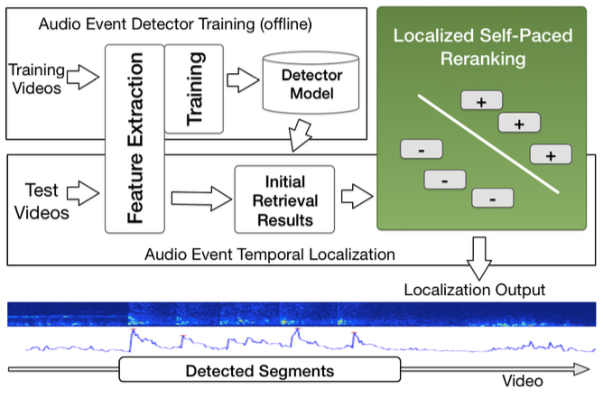
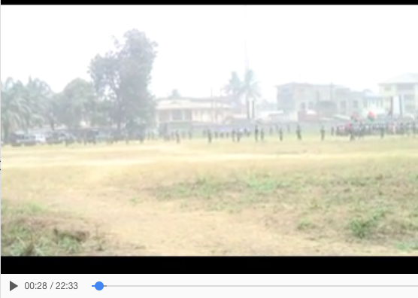
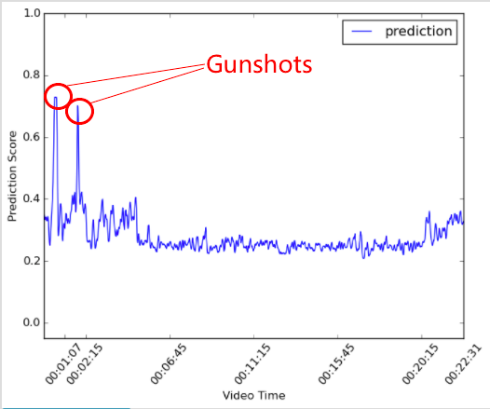
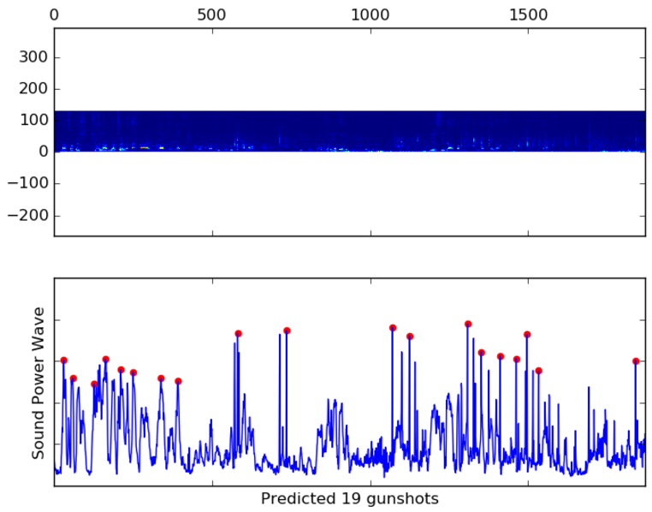
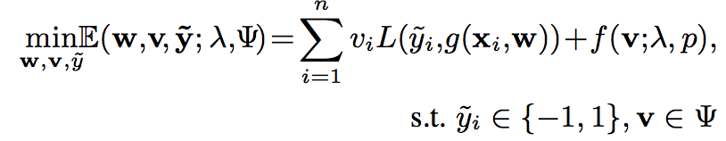
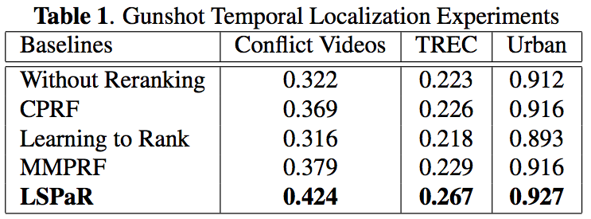
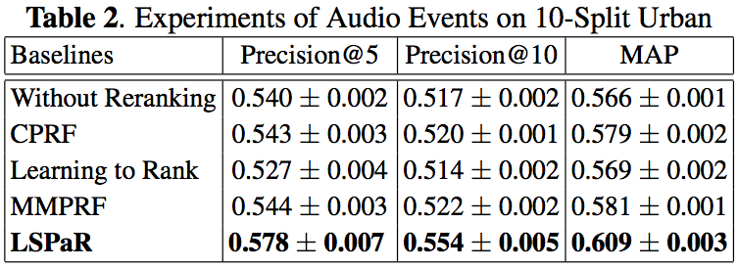
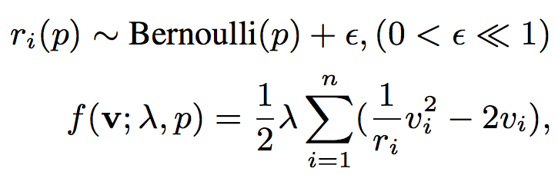
Temporal Localization of Audio Events for Conflict Monitoring in Social Media
Junwei Liang, Lu Jiang and Alexander Hauptmann
Carnegie Mellon University
{junweil, lujiang, alex}@cs.cmu.edu
Abstract
Temporal Localization of Audio Events
Demo System
With the explosion in the availability of user-generated videos documenting any conflicts and human rights abuses around the world, analysts and researchers increasingly find themselves overwhelmed with massive amounts of video data to acquire and analyze useful information. In this paper, we develop a temporal localization framework for intense audio events in videos which addresses the problem. The proposed method utilizes Localized Self-Paced Reranking (LSPaR) to refine the localization results. LSPaR utilizes samples from easy to noisier ones so that it can overcome the noisiness of the initial retrieval results from user-generated videos. We show our framework's efficacy on localizing intense audio event like gunshot, and further experiments also indicate that our methods can be generalized to localizing other audio events in noisy videos.
We use LSPaR to develop a tool for temporal localization of gunshots in videos. The gunshot detection tool can show users which segments within the videos contain gunshots. A pre-trained bag-of-audio-words gunshot model is used to detect gunshot on segments of each video and positive segments above a certain threshold are combined.
The proposed audio event temporal localization framework contains the following key components as shown in the figure above.
Audio Feature Representation. In order to temporally localize audio event within a video, we first extract soundtrack from the videos and chunk the audio stream into small segments with overlap (exp. 3-sec window and 1-sec shift). We incorporate the widely used Bag-of-Words (BoW) features in our system. In this paper we apply this model to the low level MFCC features.
Event Detector Model. After we extract audio features, we train two-class SVM classifiers for each audio events and then apply them to the video segments from test videos. However, because of the nature of the user-generated videos, the initial detection results have low accuracy due to noise.
Localized Self-Paced Reranking. For the test videos, after the detector model produces an initial ranked list of video segments, we utilize LSPaR to learn a reranking model iteratively from first using a few video segments with more confident scores at the top of the list, then incorporates more noisy segments. Detailed algorithm is described in the following section. Finally after smoothing we merge the segment results and output the final localization result.
Introduction
Intuition. Tremendous amount of videos is being uploaded to social network sites every minute, documenting every aspect of our lives and events all over the world. This boom of ever-increasing video data has resulted in an explosion in the availability of documentation and visual evidence for any unexpected conflicts events or wrong-doing, such as the Boston Marathon Bombing in 2013 and the Shooting of Dallas police in 2016. Such incidents usually happen during a major event where a large crowd of people are gathered and recording the surroundings with personal devices. As audio-visual surveillance data are often unavailable at the scene, such huge volume of user-generated videos are probably the only source for researchers and analysts to investigate the situation.
To address this challenge, this paper proposes a novel method called Localized Self-Paced Reranking (LSPaR). Reranking has been an important technique in retrieval to improve initial search results, and has proven to be effective in a variety of problems. The proposed LSPaR advances the state-of-the-art reranking method by allowing it to temporally localize audio events within a video clip.
Since the initial ranked list is noisy, LSPaR trains a reranking model starting from easy samples with more confidence score from the top of the list and then gradually incorporates noisier samples later. Such easy to noisy strategy has proven to be efficient in the learning of noisy data.
To verify its efficacy and robustness, we conduct experiments on three datasets for localizing the gunshot event, where LSPaR significantly outperforms existing baseline methods. We also experiment on other common audio events and demonstrate that LSPaR can generalize to discover general audio event in videos.
Localized Self-Paced Reranking
Objective Function. To overcome the noise of the initial detection result, we propose Localized Self-Paced Reraning (LSPaR). Formally, given a set of D of n video segments, Let L(y_i,g(x_i,w)), or l_i for short, denote the loss function which calculates the cost between the pseudo label y_i and the estimated label ,g(x_i,w). y_i in {-1,1} is the pseudo label for the i-th video segment whose value is assumed since the true labels are unknown. Here w represents the model parameter inside the decision function g. For example, in our paper, w represents the weight parameters in the Support Vector Machine (SVM). Our objective function is to jointly learn the model parameter w, the pseudo label y and the latent weight variable v= [v_1,..,v_n]^T for the video segments by:
Gunshot Counting for a predicted gunshot segment.
Experiments
where L is the standard hinge loss, calculated from:
v ∈ [0,1]_{n} denote the latent weight variables reflecting the pseudo labels’ confidence, which determine a learning sequence for the video segments. Video segments with greater weights tend to be learned earlier. Our goal is to assign greater weights to the segments with more confident labels whereas smaller or zero weights to the segments with noisy labels. To this end, we employ the self-paced regularizer f, which controls the learning process of the model.
air_conditioner, car_horn, children_playing, dog_bark, drilling, engine_idling, jackhammer, siren, street_music
Ψ is a curriculum region [20] that incorporates the localization knowledge extracted from the initial detection result as a convex feasible region for the weight variables. The shape of the region indicates a prior learning sequence for the segments, where favored segments have greater expected values. The region is derived based on initial detection results, i.e. video segments in videos that have greater initial detection scores have greater expected values. For simplicity, in this paper, Ψ is only used in the initialization of v.
Acknowledgement
This project was conducted in partnership with Carnegie Mellon’s Center for Human Rights Science (http://www.cmu.edu/chrs). The authors would like to thank the MacArthur Foundation, Oak Foundation, and Humanity United for their generous support of this collaboration.

