Slide 1
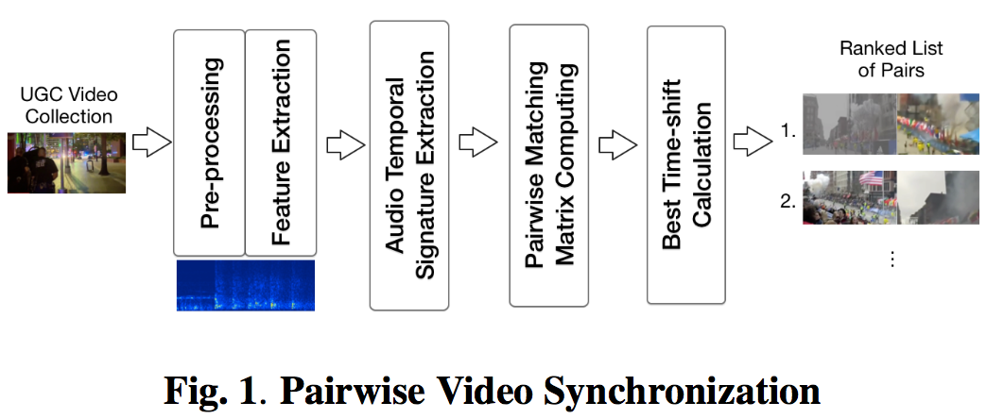

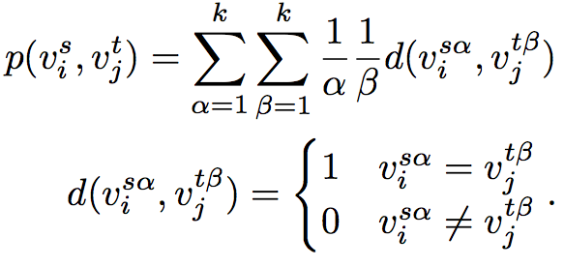
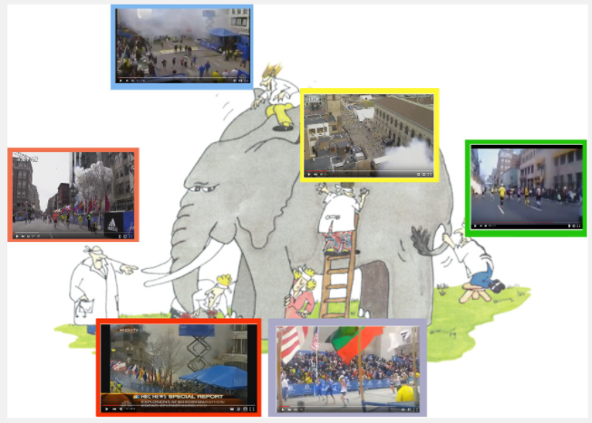
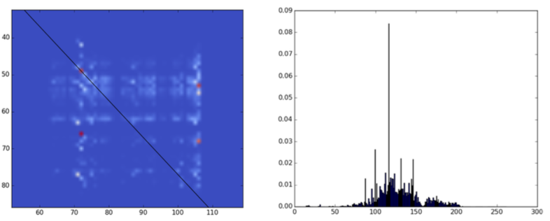
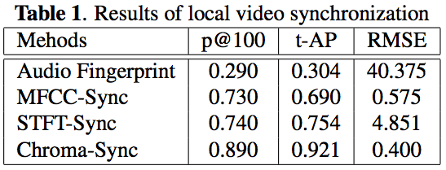
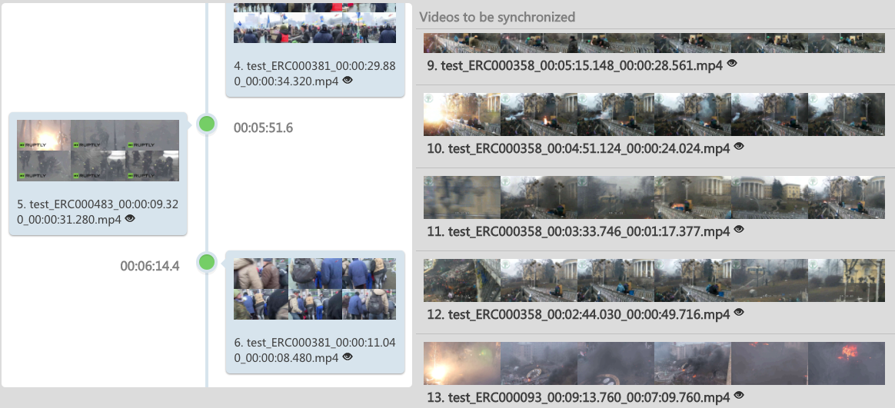
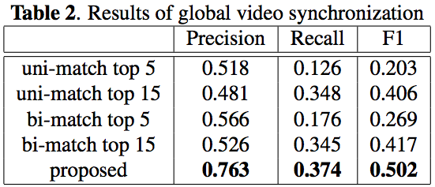
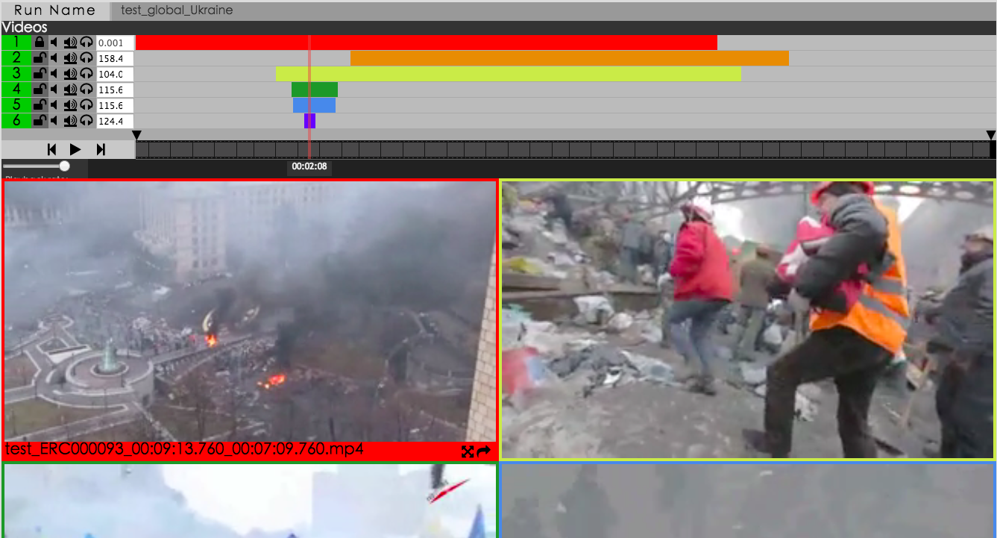
Synchronization for Multi-Perspective Videos in the Wild
Junwei Liang, Poyao Huang, Jia Chen and Alexander Hauptmann
Carnegie Mellon University
{junweil, poyaoh, jiac, alex}@cs.cmu.edu
Abstract
Video Synchronization
The Boston Dataset
In the era of social media, a large number of user-generated videos are uploaded to the Internet every day, capturing events all over the world. Reconstructing the event truth based on information mined from these videos has been an emerging challenging task. Temporal alignment of videos ``in the wild" which capture different moments at different positions with different perspectives is the critical step. In this paper, we propose a hierarchical approach to synchronize videos.Our system utilizes clustered audio-signatures to align video pairs. Global alignment for all videos is then achieved via forming alignable video groups with self-paced learning. Experiments on the Boston Marathon dataset show that the proposed method achieves excellent precision and robustness.
We collect a real-world event synchronization dataset “Boston Marathon 2013”, in which two consecutive explosions happened on the sidewalk near the finish line of a traditional city marathon in Boston in 2013. This event received widespread international media attention and synchronizing videos of such event is very useful to event reconstruction and analysis. We constructed the queries “Boston marathon 2013 explosion”, “Boston marathon 2013 bomb”, “Boston marathon 2013 after explosion”, “Boston marathon 2013 after bomb” to crawl videos from Youtube and Dailymotion, two of the most popular video sharing websites. We crawled the top 500 search results from each query on Youtube, and all the search results from Dailymotion. We manually refined the relevance of all the crawled search results by removing irrelevant videos, resulting in 347 relevant videos. The relevant video is defined as on-site videos of the “Boston Marathon 2013” event.
Pre-processing and Feature Extraction. Since many user-generated videos are edited before uploading to social media, our system first chunk videos into time-continuous segments based on the shot boundary detection. In an unexpected violent event, people are scared and the video quality may be low and too blurry to see any useful visual evidence. Therefore in this system we focus on the audio modality for synchronization. We extract low-level audio features from the audios, leaving out the videos with no sound.
Audio Temporal Signature Extraction. Most user-generate videos are very noisy. In order to extract useful audio signature at each given time frame, our system first conducts an unsupervised clustering to get an audio signature dictionary, and then assigns each time frame of the video segments to the closest k centers.
Pariwise Matching Matrix Computing. After assigning each time frame, our system computes the matching matrix $m_{ij}$ for each video segment pairs $v_i$ and $v_j$. Each element of the matching matrix for each pair of video segments is calculated by a function:
Introduction
With the growing world-wide connectivity and popularity of camera-embedded smart devices, events around the world can now be captured and rapidly shared via social media. When an event happens, especially those with a large crowd of people, different videos would record different moments of the same event at different positions from different perspectives. For example, New Year's Eve at NYC, Carnival in Brazil, and Boston Marathon bombing all have hundreds or even thousands of attendees upload videos of the event. The collection of these user-generated recordings not only enable new applications such as free-view video and 3D-reconstruction, but it may also help our society achieve a more unbiased understanding of the event truth. Such information would particularly important for conflict or violence events, in which the truth of what happened is critical to the general public and for law enforcement to take action.
Video In the Wild. Unlike videos captured by fixed, calibrated surveillance cameras, consumer videos are captured ``in the wild" (i.e., at varying time, location, perspectives, with different devices such as smart phones, watches or camcorders.) These videos are noisy and sometimes with low quality. In an unexpected violent event, people are often scared and the videos may be too blurry or shaky to see.
Useful information about the event may spread across different time segments of different videos. Therefore, To properly process and analyze a video collection, one main problem that must be solved is to synchronize these video and put them into a global timeline.
where s in [1,c_i] and t in [1,c_j] give the time frame number of video segment v_i and v_j. v^s_i is a vector of center numbers for the s-th frame of v_i. For each time frame in the video segment pair, our system checks through the center number vectors and adds a matching score p to m^{st}_{ij} if the center numbers are the same.
The Boston Dataset link:
http://aladdin1.inf.cs.cmu.edu:8081/boston/
Technical Report:
http://www.cmu.edu/chrs/documents/Videos-Boston-Marathon.pdf
Experiments
Video Synchronization Demo System
Acknowledgement
This project was conducted in partnership with Carnegie Mellon’s Center for Human Rights Science (http://www.cmu.edu/chrs). The authors would like to thank the MacArthur Foundation, Oak Foundation, and Humanity United for their generous support of this collaboration.

