Slide 1
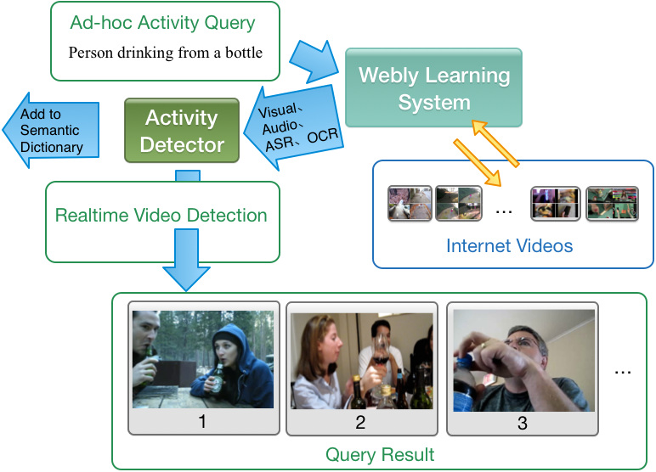
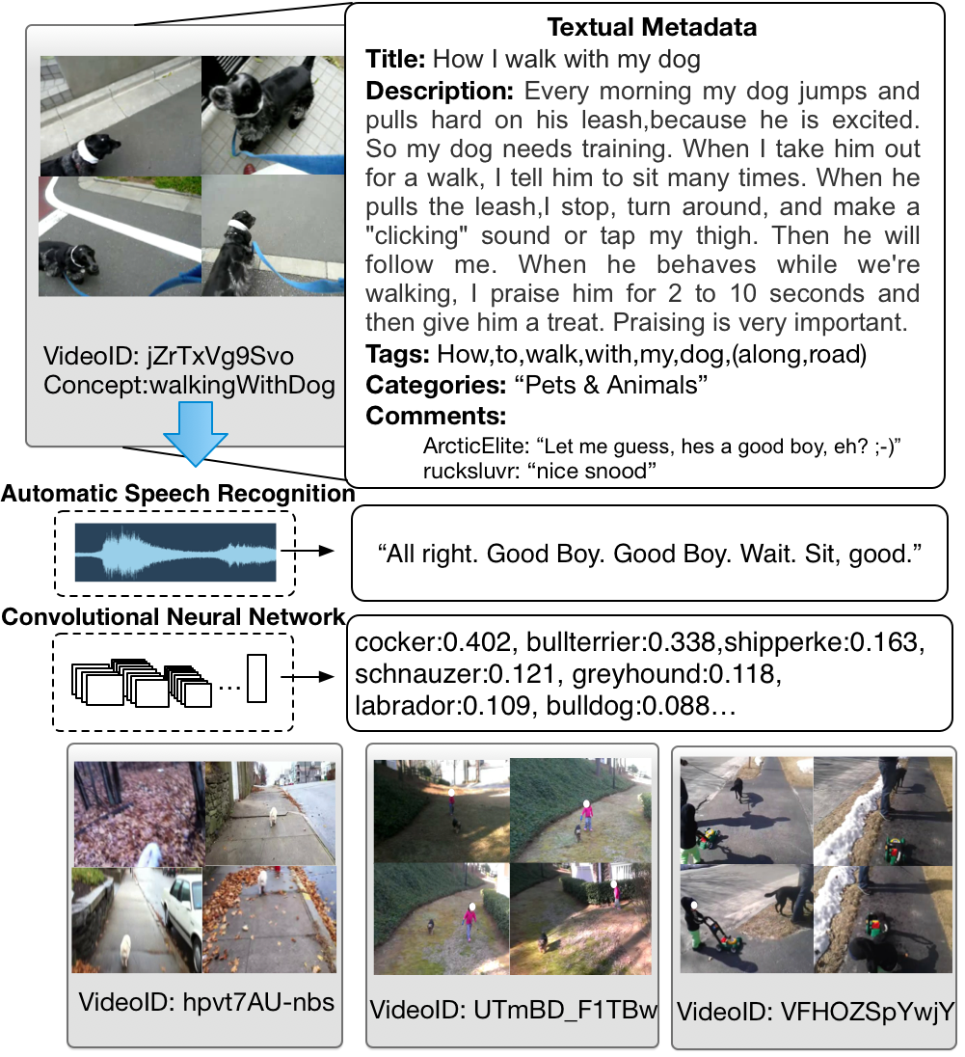
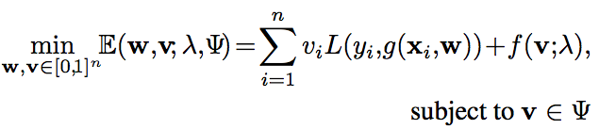
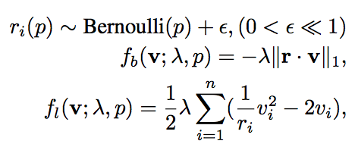
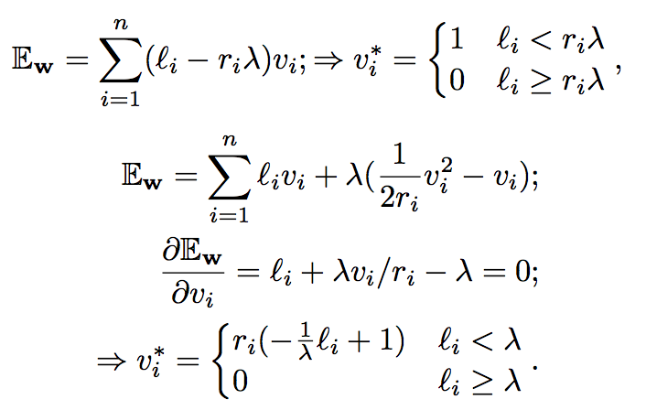
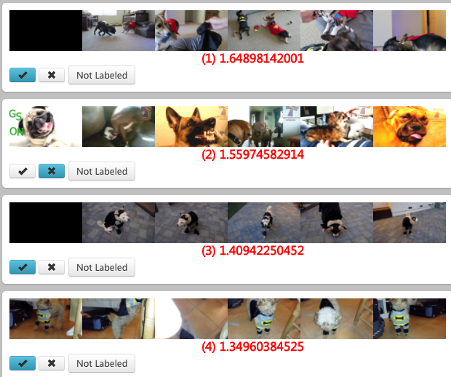
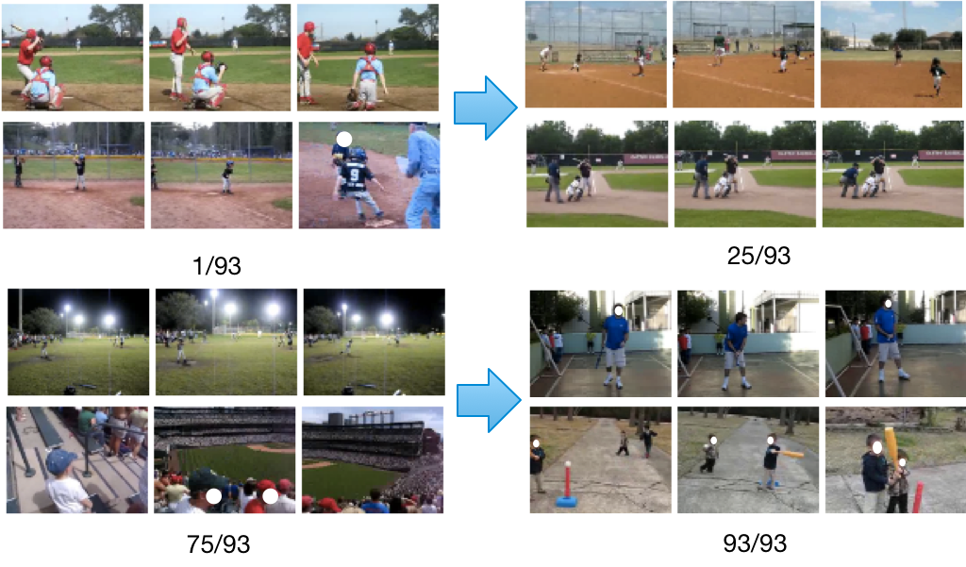
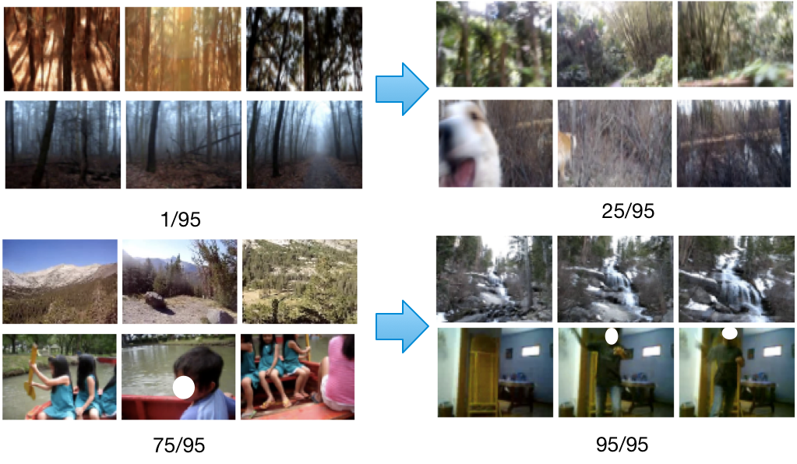
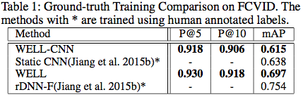
Webly-Supervised Learning of Multimodal Video Detectors Junwei Liang, Lu Jiang and Alexander Hauptmann Carnegie Mellon University {junweil, lujiang, alex}@cs.cmu.edu
Abstract
System Overview
Curriculum Region Design
Given any complicated or specialized video content search query, e.g. ”Batkid (a kid in batman costume)” or ”destroyed buildings”, existing methods require manually labeled data to build detectors for searching. We present a demonstration of an artificial intelligence application, Webly-labeled Learn- ing (WELL) that enables learning of ad-hoc concept detectors over unlimited Internet videos without any manual an- notations. A considerable number of videos on the web are associated with rich but noisy contextual information, such as the title, which provides a type of weak annotations or labels of the video content. To leverage this information, our system employs state-of-the-art webly-supervised learning (WELL) (Liang et al. ). WELL considers multi-modal information including deep learning visual, audio and speech features, to automatically learn accurate video detectors based on the user query. The learned detectors from a large number of web videos allow users to search relevant videos over their personal video archives, not requiring any textual metadata, but as convenient as searching on Youtube.
In our demo system, users can provide arbitrary text to query for videos in a target video collection. Figure above shows the workflow of our system. Our system will first collect related videos from popular video hosting sites like Youtube by using their text search engine and combine these videos to our own video dataset. Then it mainly involves two procedures, curriculum design and model training, to learn multimodal video detectors.
Curriculum Design. In curriculum design, our system extract the multi-modal prior knowledge from the videos to decide which videos are more confident to be positive examples in model training. Figure above shows an example of a high-confidence webly-labeled video for the query ”walking with a dog”. As we see, the textual metadata we get from the web videos contain useful but very noisy information. The multi-modal prior information we get is correlated across modalities. Our system first extract bag-of-words features from different modalities and then match them to the query words. Each video will then come with a matching score to the query.
Introduction
Webly-Labeled Learning (WELL)
Nowadays, millions of videos are being uploaded to the Internet every day. These explosively growing user generated content videos online are becoming an crucial source of video data to learn detectors and apply to personal video collections. Unlike web videos that are usually accompanied with textual labels like titles and descriptions, personal videos or surveillance videos are often stored with no label at all. Therefore traditional text-based indexing methods would not work in such video collections. The need for manual labels by human annotators has become one of the major important limitations for large-scale concept learning. In addition, it is difficult for common datasets to include concepts like ”Batkid” (a kid in batman costume), which makes it even harder to search these concepts in person collections.
Let L(y_{i}, g(x_{i}, w)) denote the loss function which calculates the cost between the noisy label y_{i} and the estimated label g(x_{i},w). Here w represents the model parameter inside the decision function g. Our goal is to jointly learn the model parameter w and the latent weight variable v = [v1, · · · , vn]^{T}, reflecting the labels’ confidence. Samples with greater weights tend to be learned earlier. The self-paced regularizer f controls the learning scheme. We extract the partial-order curriculum that only distinguish the training order for groups of samples. We have also applied dropout in the self-paced function.
Model Training. After curriculum is extracted, we train detectors using multi- modal webly-labeled learning. Specifically, we train models based on Convolutional Neural Network (CNN) features, Motion features and MFCC features with late (average) fusion. We use a pre-trained convolutional neural network as the low-level features (VGG network (Simonyan and Zisserman 2014)). We extract the key-frame level features and create a video feature by the average pooling. We automatically generate curriculum labels based on the video metadata, ASR, OCR and VGG net 1,000 classification results using latent topic modeling with word embedding matching. During each iteration of the training, the system combines the multi-modal curriculum with the dynamic information learned from the statistical model (SVM model) to determine which video samples to learn in the next iteration.
Qualitative Analysis – What does WELL pick?
Search result of
“dog in batman costume”
Easy to complex (Baseball)
Easy to wrong (Forest)
Conclusions
Data Description
Webly Learning Experiments on FCVID
In this demo, we demonstrate a novel method called WELL for webly labeled video data learning. WELL extracts informative knowledge from noisy weakly labeled video data from the web through a general framework with solid theoretical justifications. WELL is able to train accurate detectors automatically from Internet video data.
FCVID. Fudan-columbia Video Dataset (FCVID) contains 91,223 YouTube videos (4,232 hours) from 239 categories. It covers a wide range of concepts like activities, objects, scenes, sports, etc. [Jiang et al., 2015d]. Each video is manually labeled to one or more categories. In our experiments, we do not use the manual labels in training, but instead we automatically generate the web labels according to the concept name appearance in the video metadata. The manual labels are used only in testing to evaluate our and baseline methods.
We compare our method with the state-of-the-art method trained using ground truth labels on FCVID.
We compare WELL trained using a single the static CNN features (WELL-CNN), the standard features provided by the authors (Jiang et al. 2015b), and we also compare WELL to the method that achieves the best re- sult on FCVID trained using the same multi-modal features, rDNN-F (Jiang et al. 2015b). Noted that the state-of-the-art method uses the ground truth labels to train models, which includes 42,223 videos with manual labels, while WELL uses none of the human annotation into training but still be able to outperform one of the state-of-the-art results.
Acknowledgement
This paper was partially supported by the National Science Foundation under Grant No. IIS-1251187. Any opinions, findings, and conclusions or recommendations expressed in this material are those of the author(s) and do not necessarily reflect the views of the National Science Foundation.

