Slide 1
Final Project
Blood Supply
Members:
Jiamin Shang
Junxi Fan
Zhixin Wang

Slide 2
1. Design Statement
2. Model Introduction
3. Flow Demonstration
4. Primary Features
Content

Slide 3
1 Design Statement
Ideas about blood supply
Blood supply serves as an essential part of curing people. Thus our teammates come up with an idea about combining the blood donation with the blood distribution to construct a relatively complete blood supply system. Our design can meet some requirements which probably occur in real life.

Slide 4
1. Design Statement
Design Goals
Donation
Processing
Distribution
People who want to donate their blood for individual or organization can easily register here.
Once the system receives the request from donators, their requests would be processed from the reception to blood test.
Only qualified blood would be accepted.
Blood manager center would distribute blood to individual or organization in need.
Notes:
本项目以手机客户端形式展现，以鲜明的简单的界面想用户展示APP功能。能让用户在手机上以地图的视角随时随地的了解正在以及将要进行的科普活动，可为用户制定行进路线（公交、出租、步行等）。与此同时，活动组办方以可通过登录方式随时更新发布公告。

Slide 5
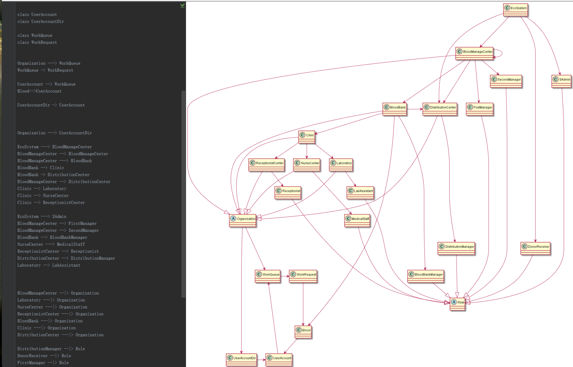
2.Model Introduction

Slide 6
2. Model Introduction
Scope of Function
For Donator or Receiver
Register an account for their request. By logining the system ,they send their requests to clinic staff.
For Clinic Staff
Receptionist would assign these requests to specific nurses, after that ,nurse will draw blood from donators and pass them to labassistants for further analysis, labassistant can test these samples to see if the blood is qualified for donation, verified blood would be sent to blood bank.
For Blood Manage Center
Blood Manage Center would collect blood donation from the blood bank. Guided by the receivers’requests ,it will address the blood allocation.

Slide 7
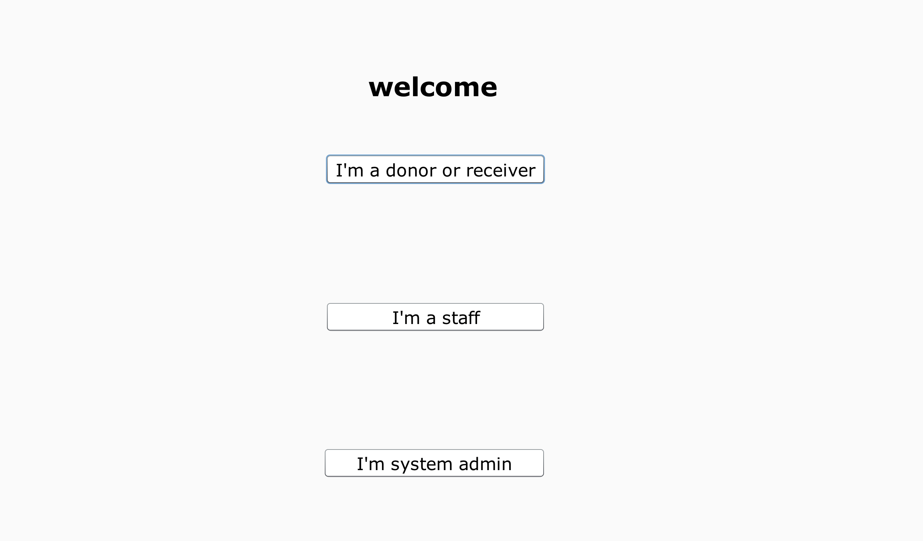
3. Flow Demonstration

Slide 8
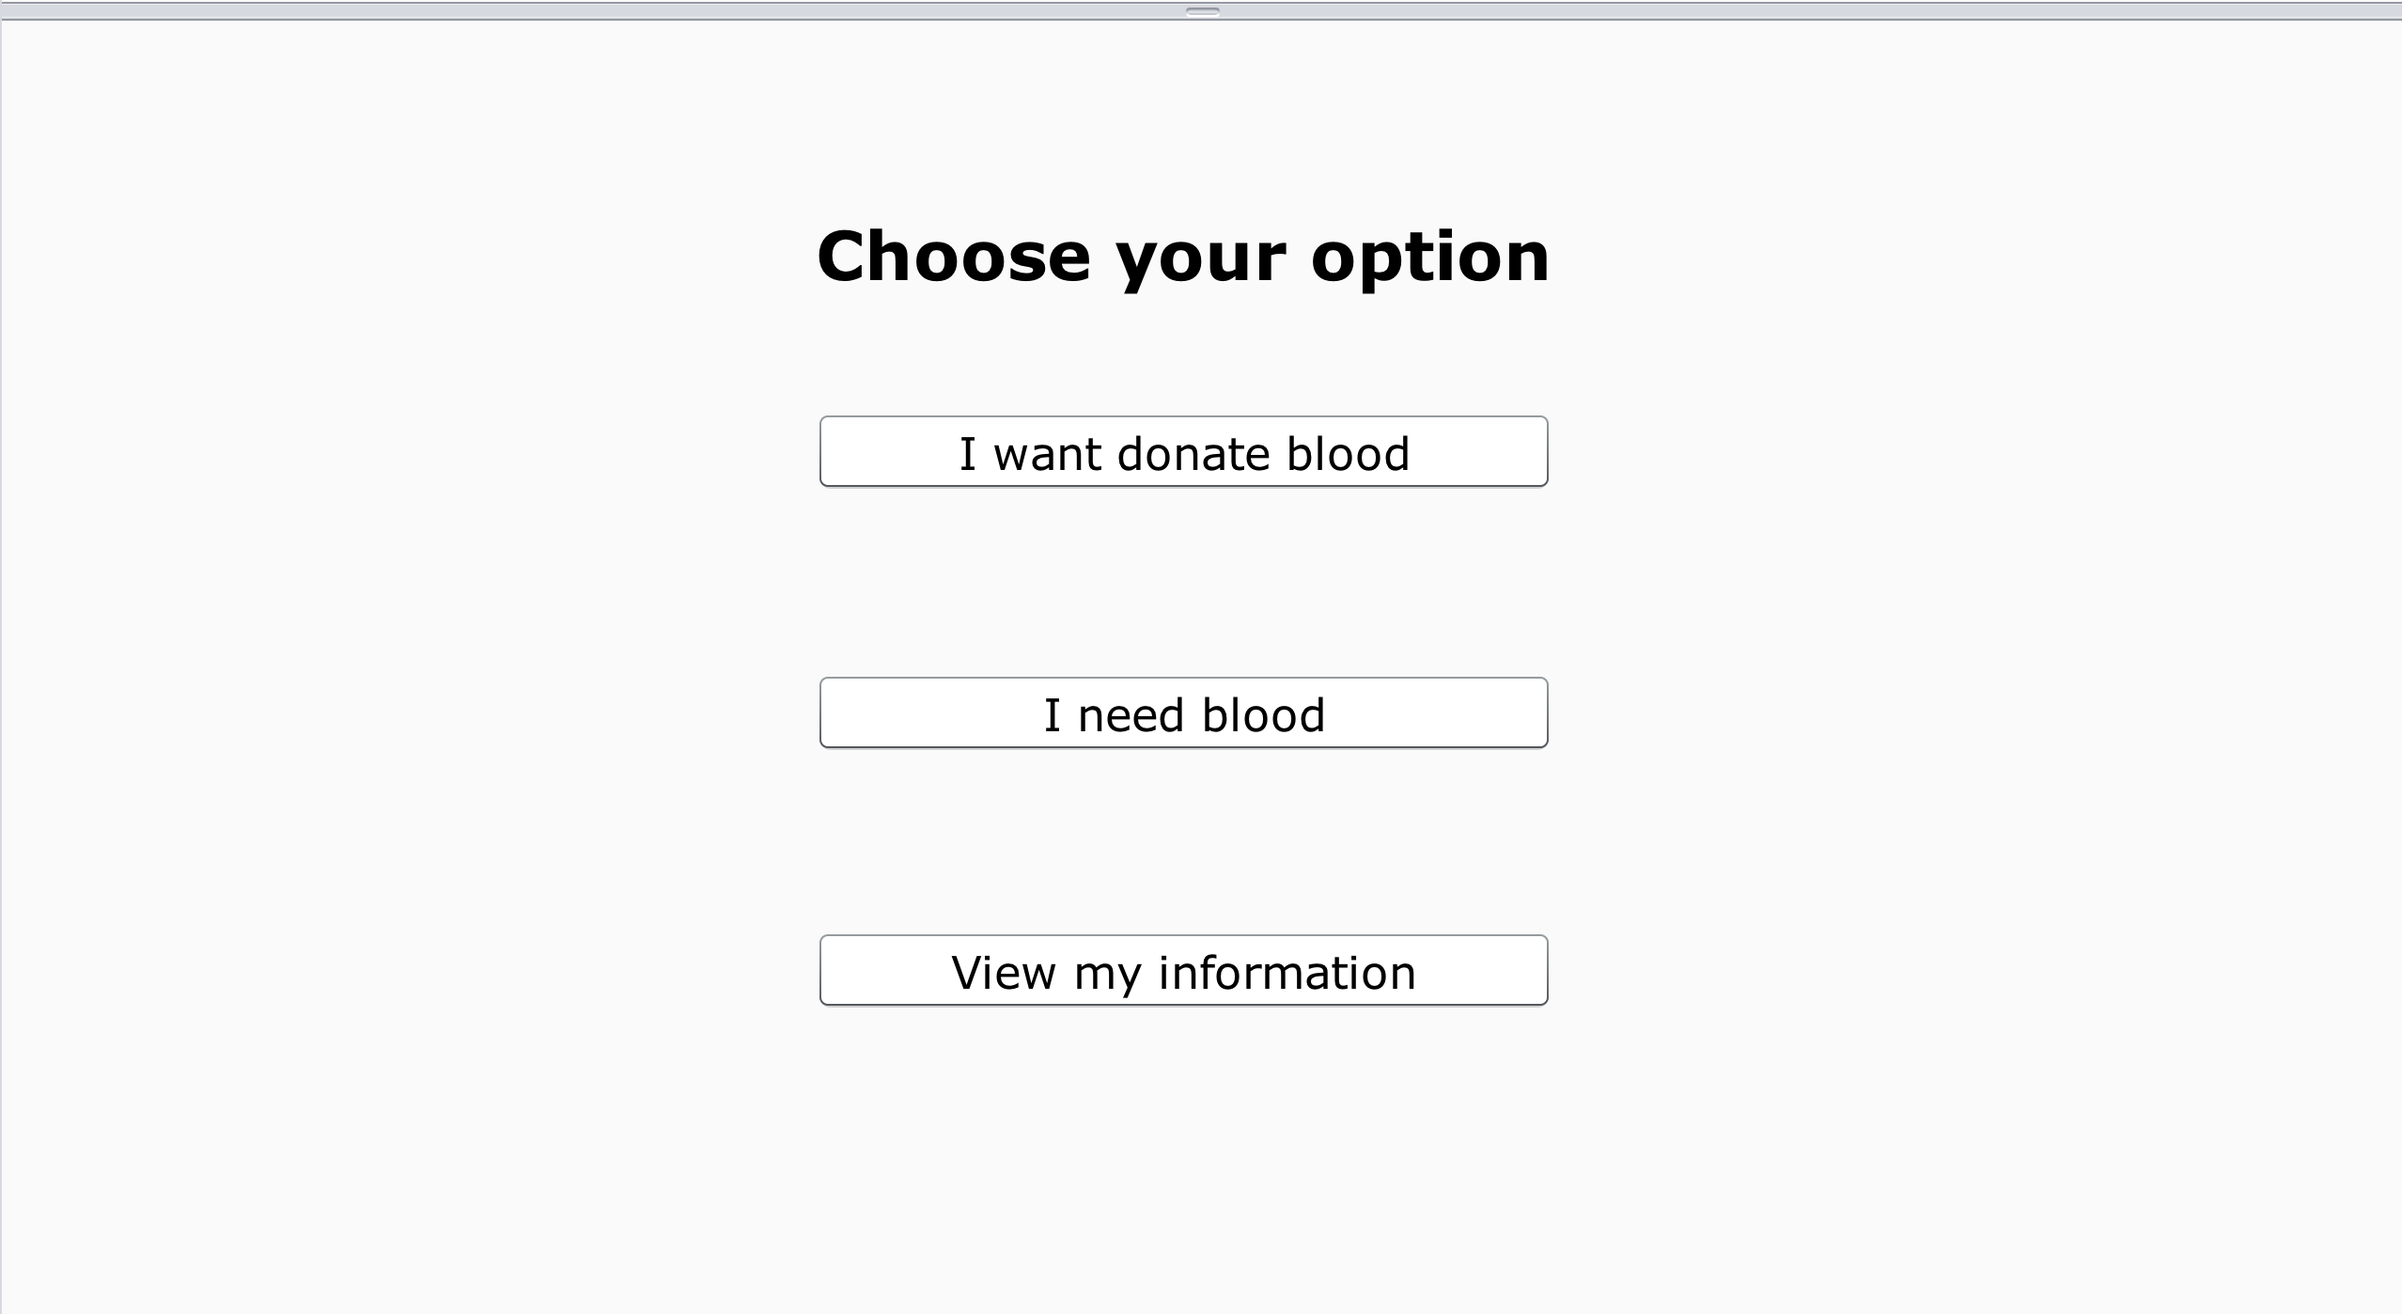
3. Flow Demonstration

Slide 9
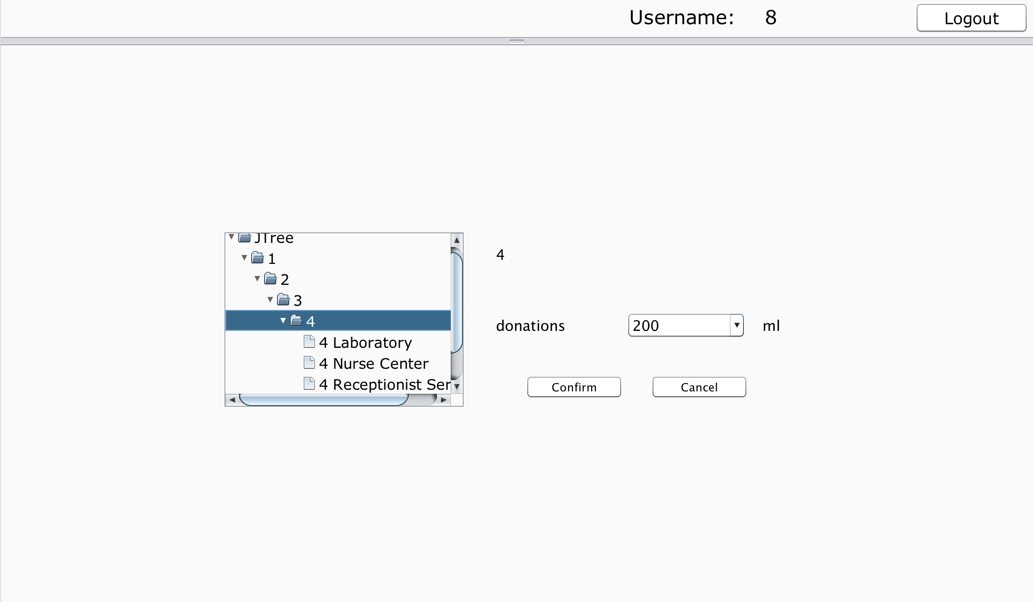
3. Flow Demonstration

Slide 10
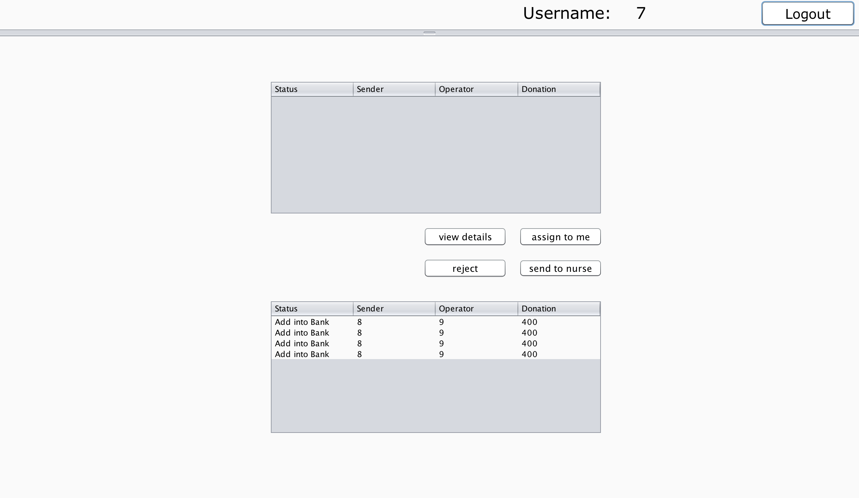
3. Flow Demonstration

Slide 11
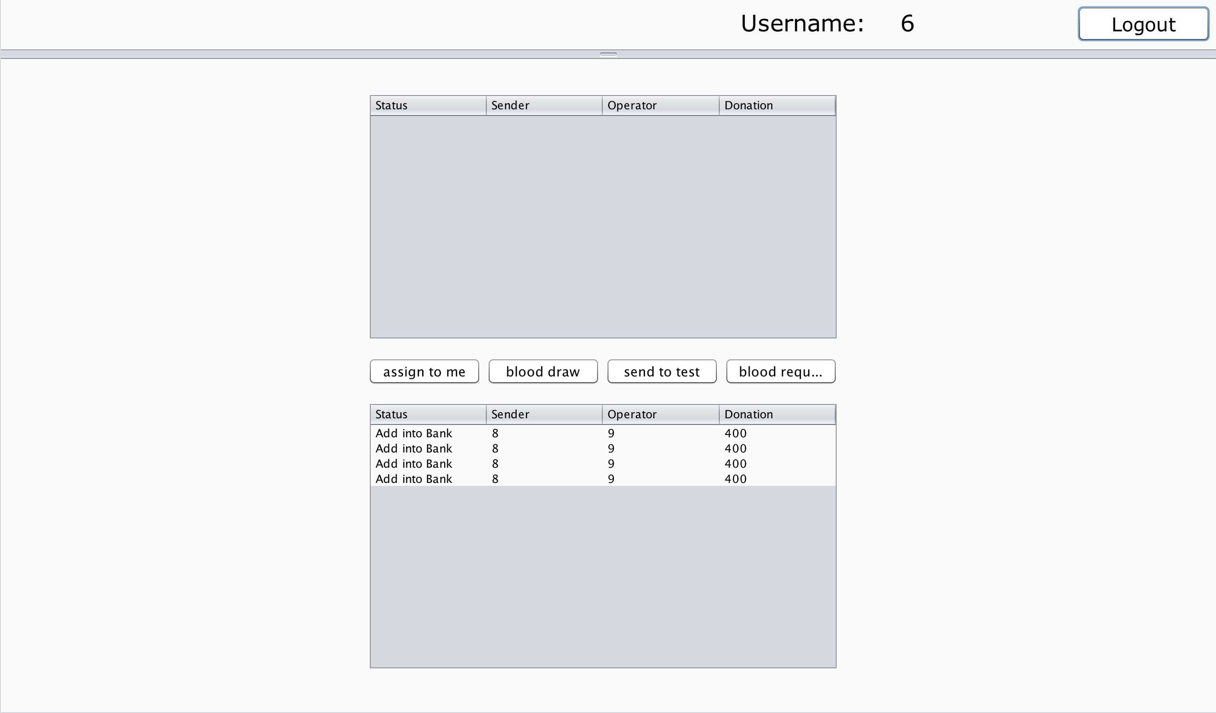
3. Flow Demonstration

Slide 12
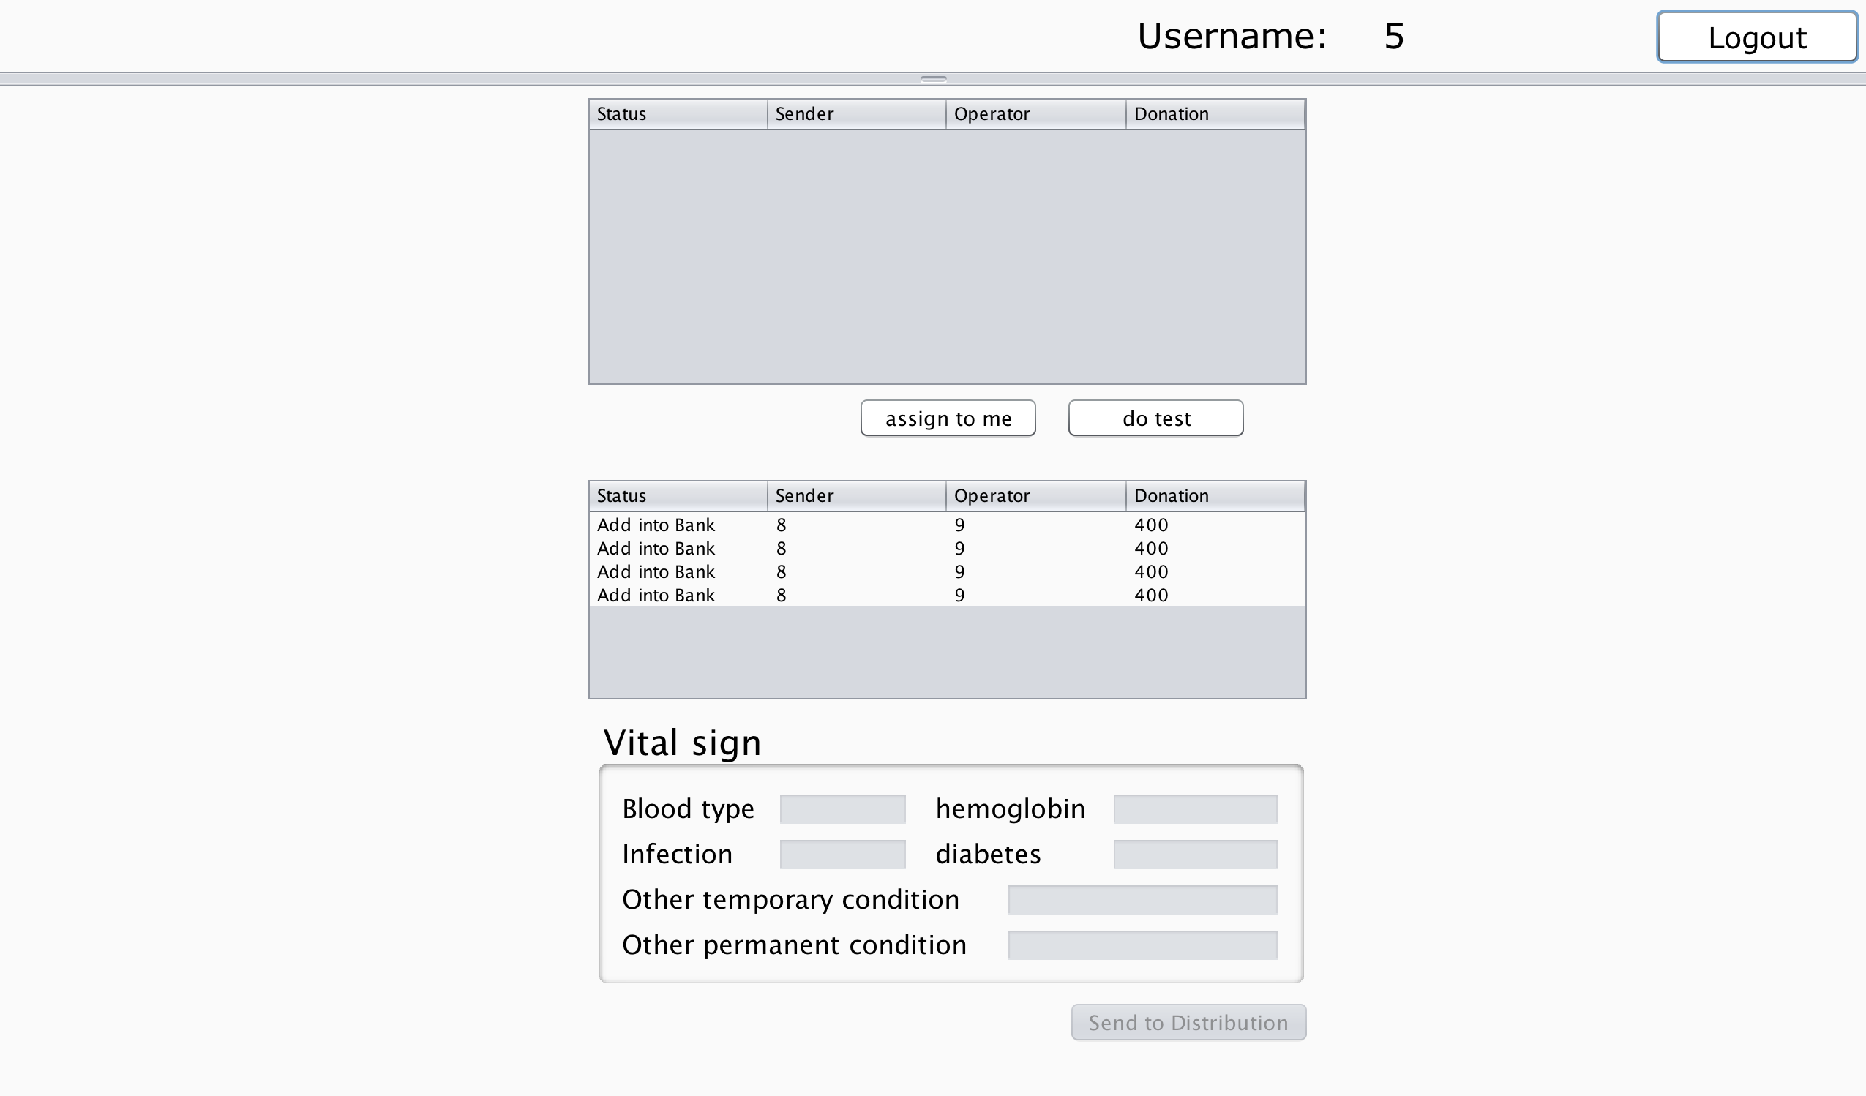
3. Flow Demonstration

Slide 13
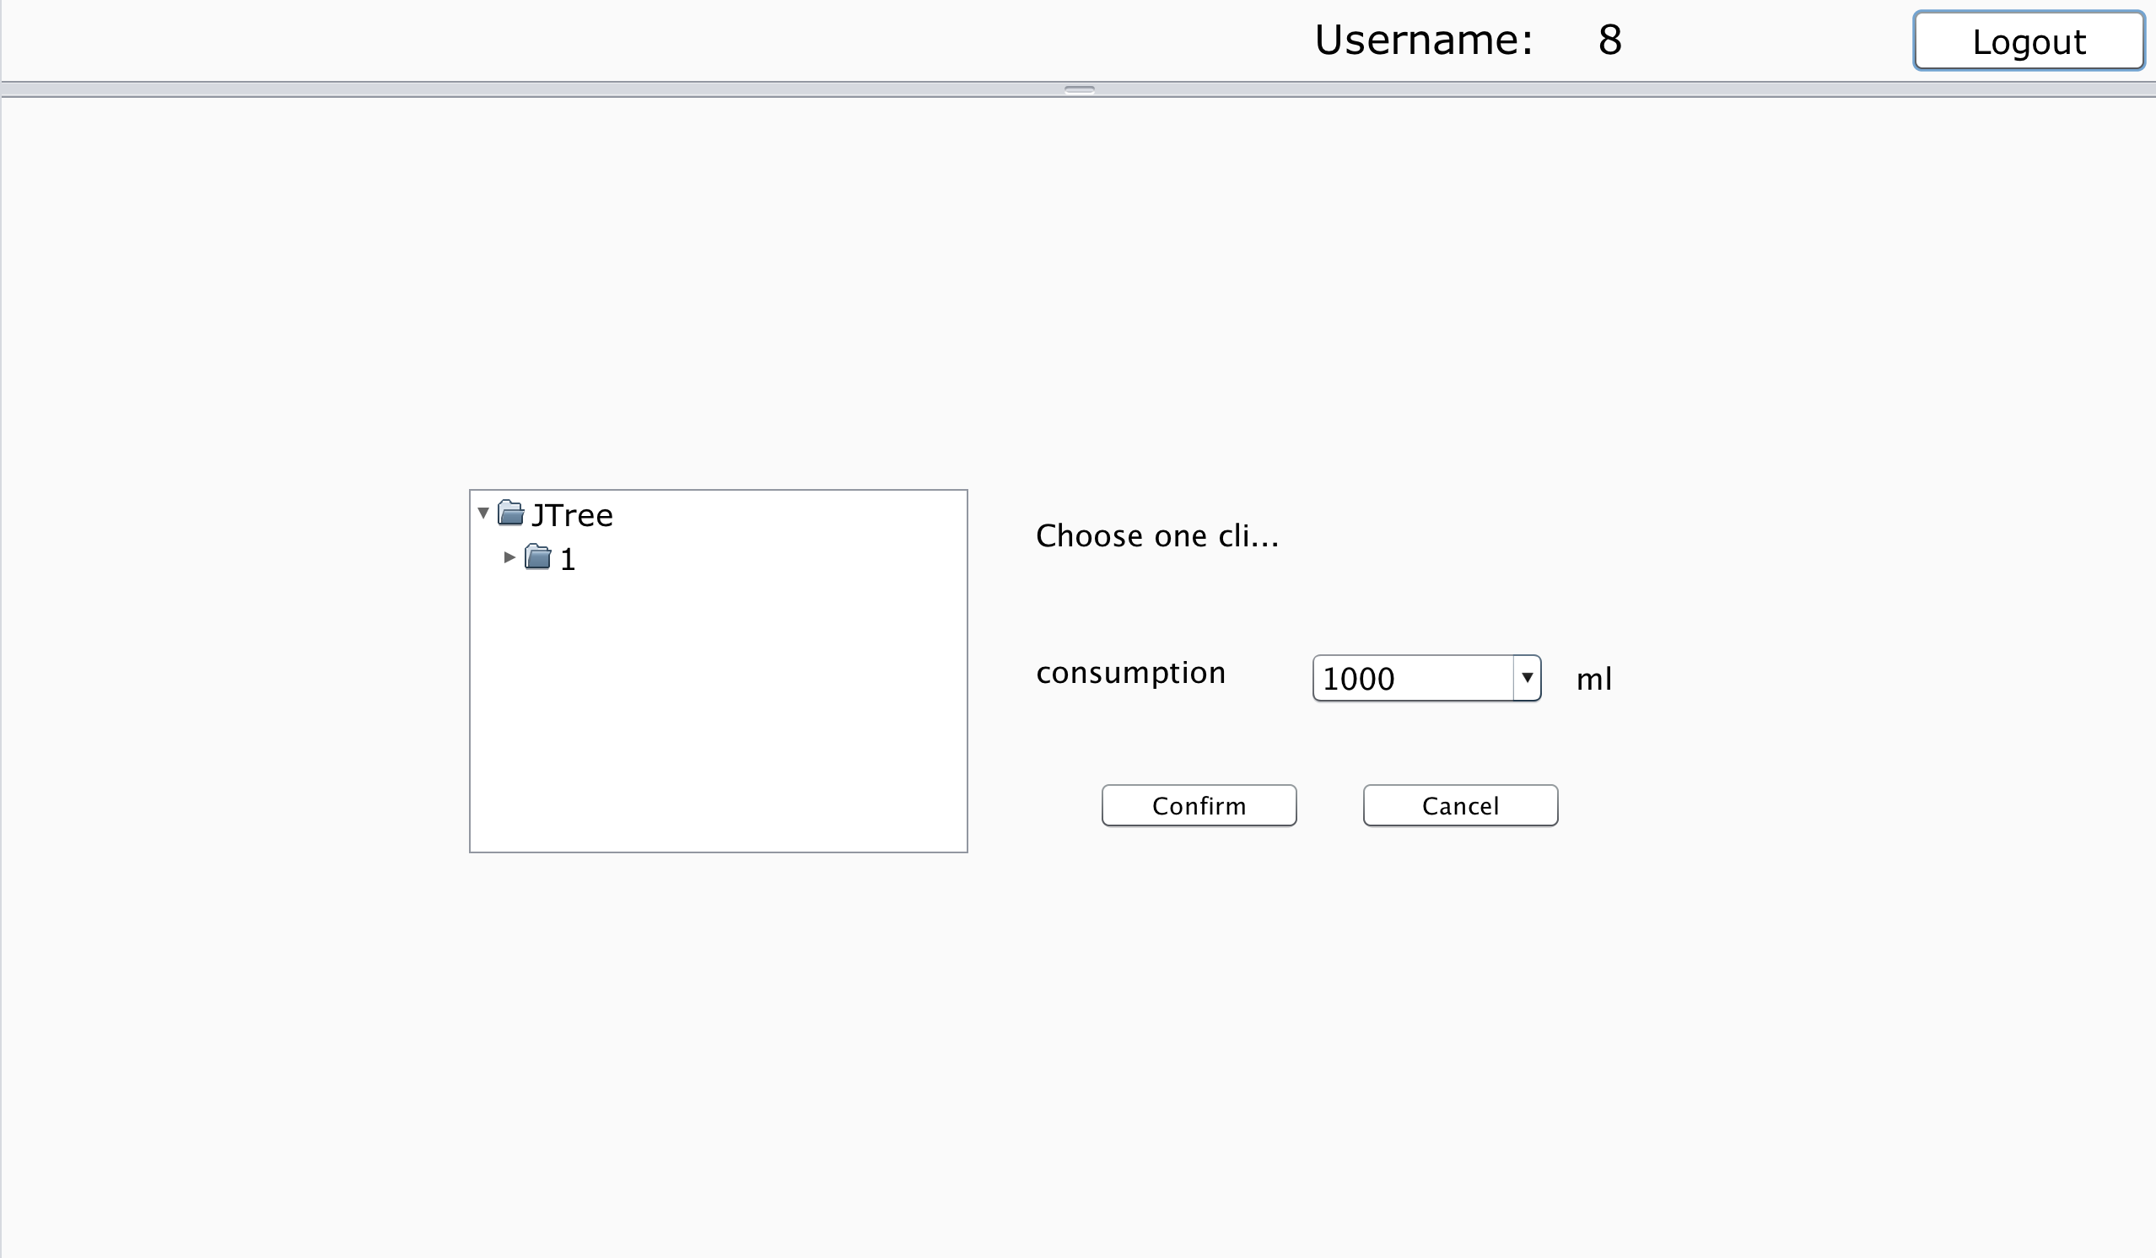
4. Primary Features

Slide 14
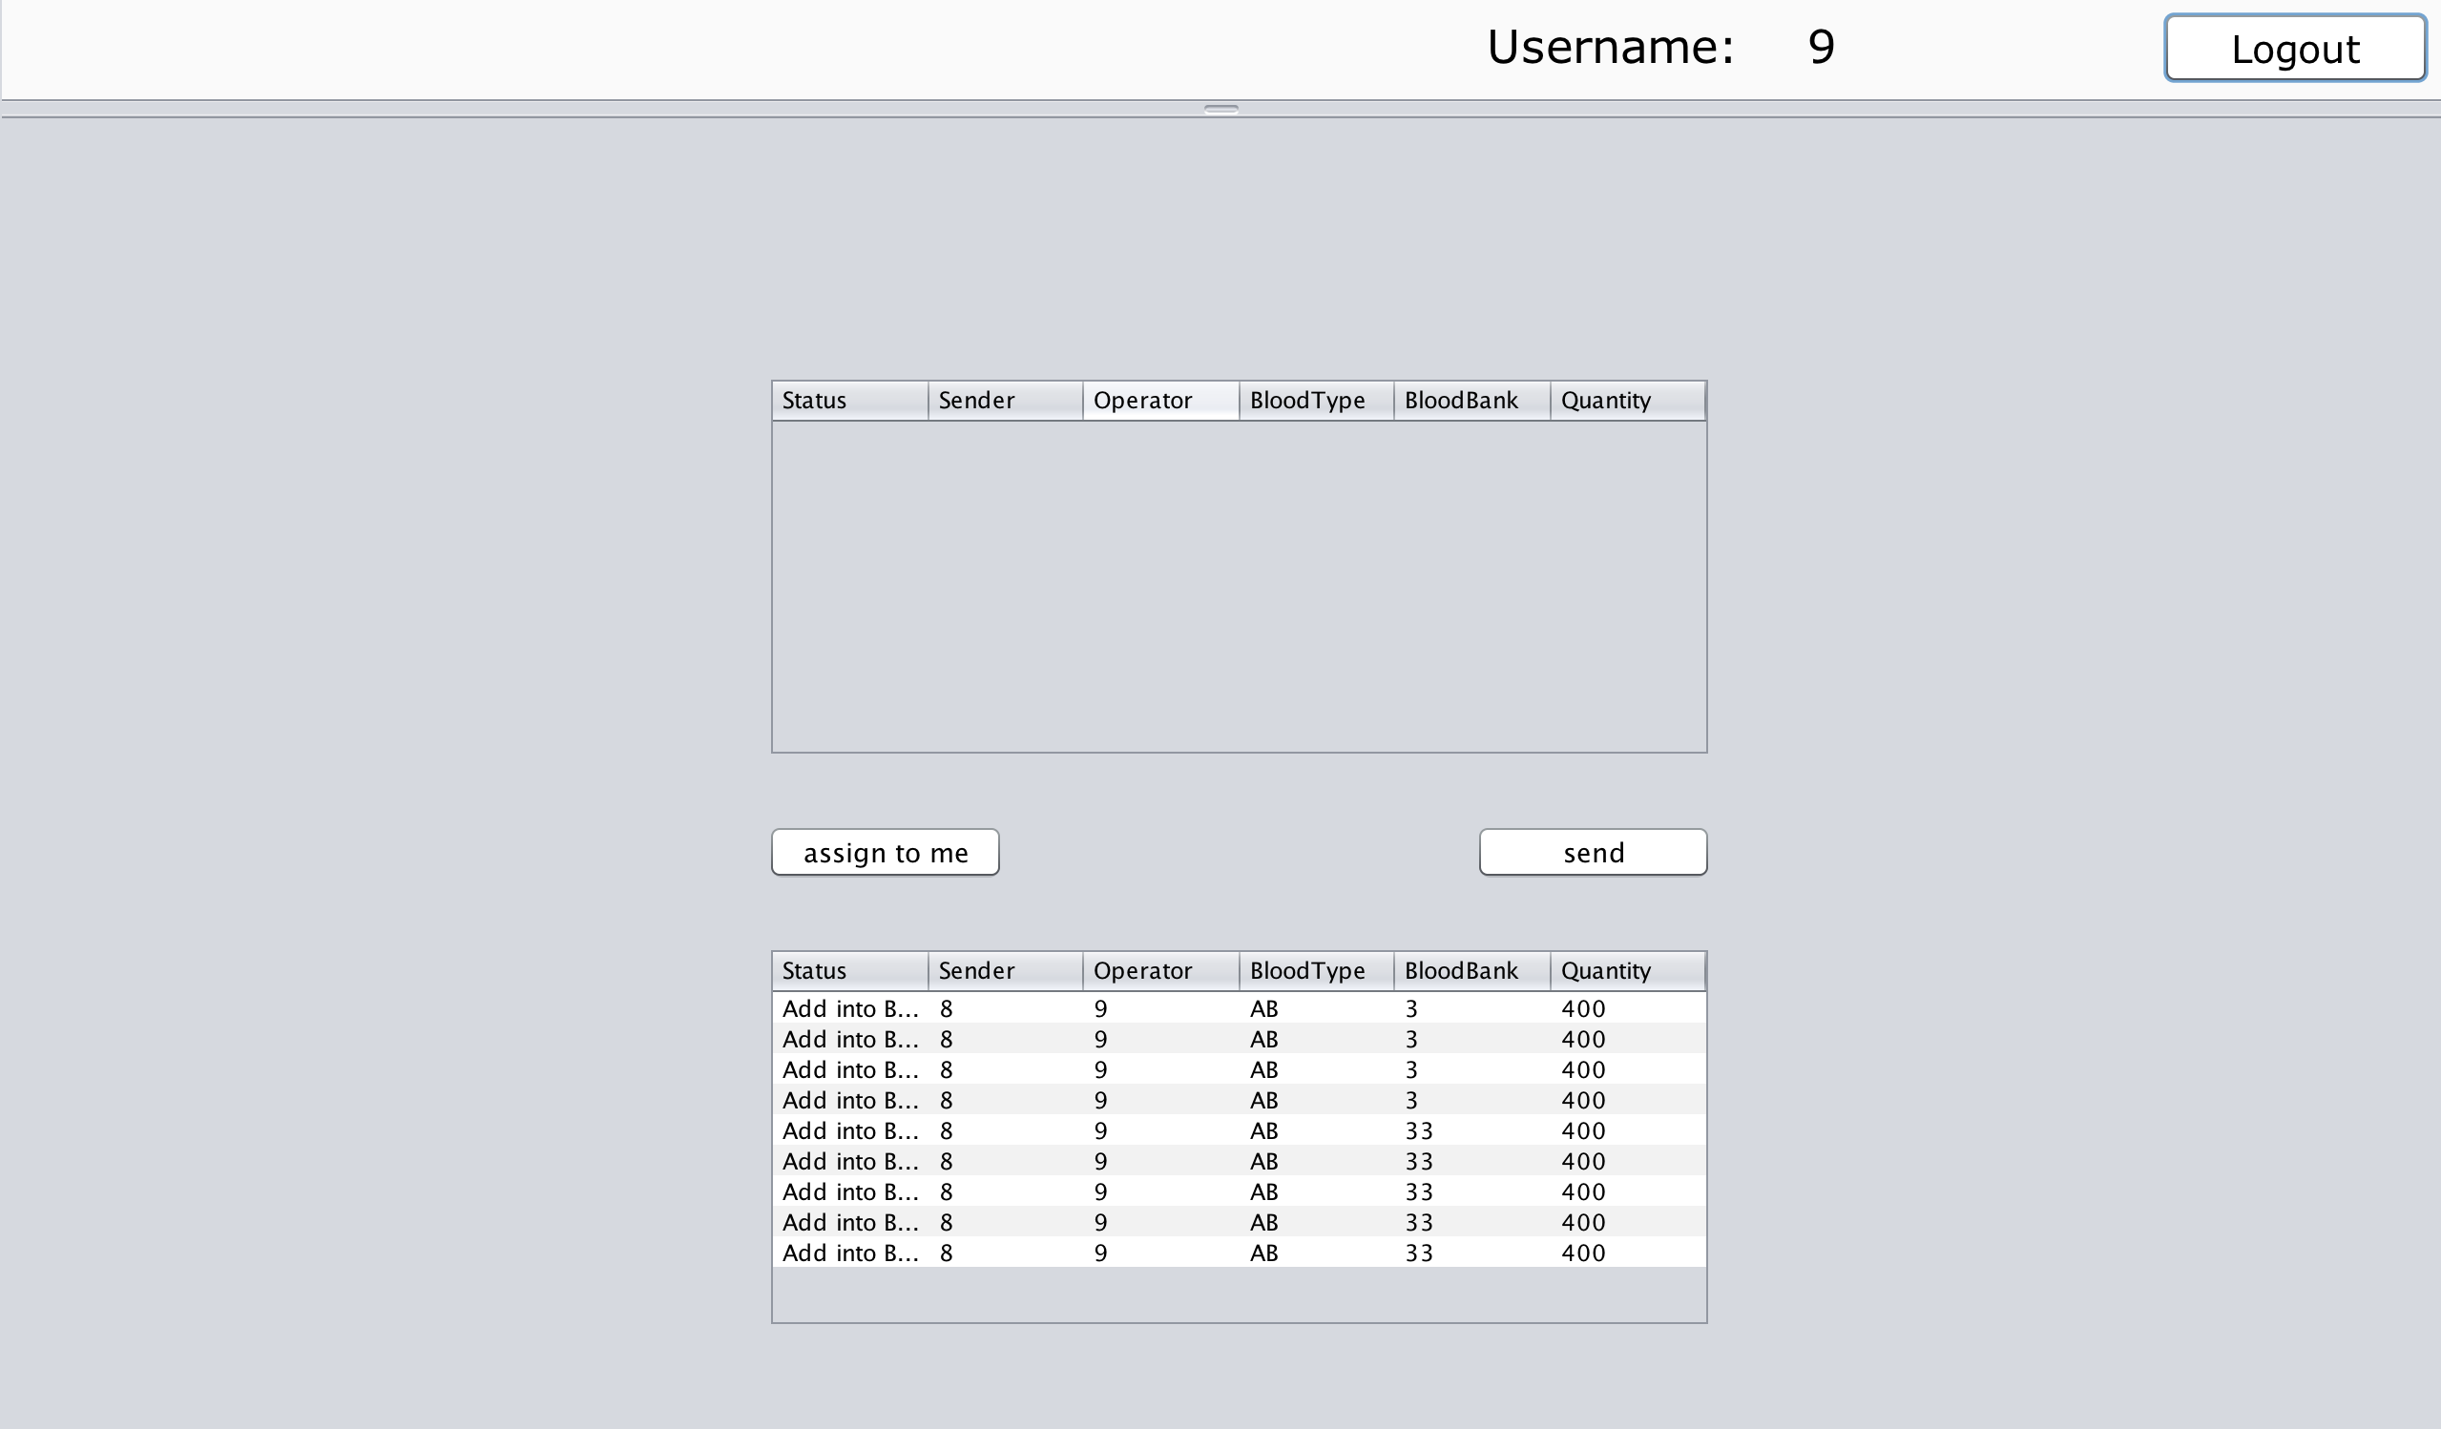
4. Primary Features

Slide 15
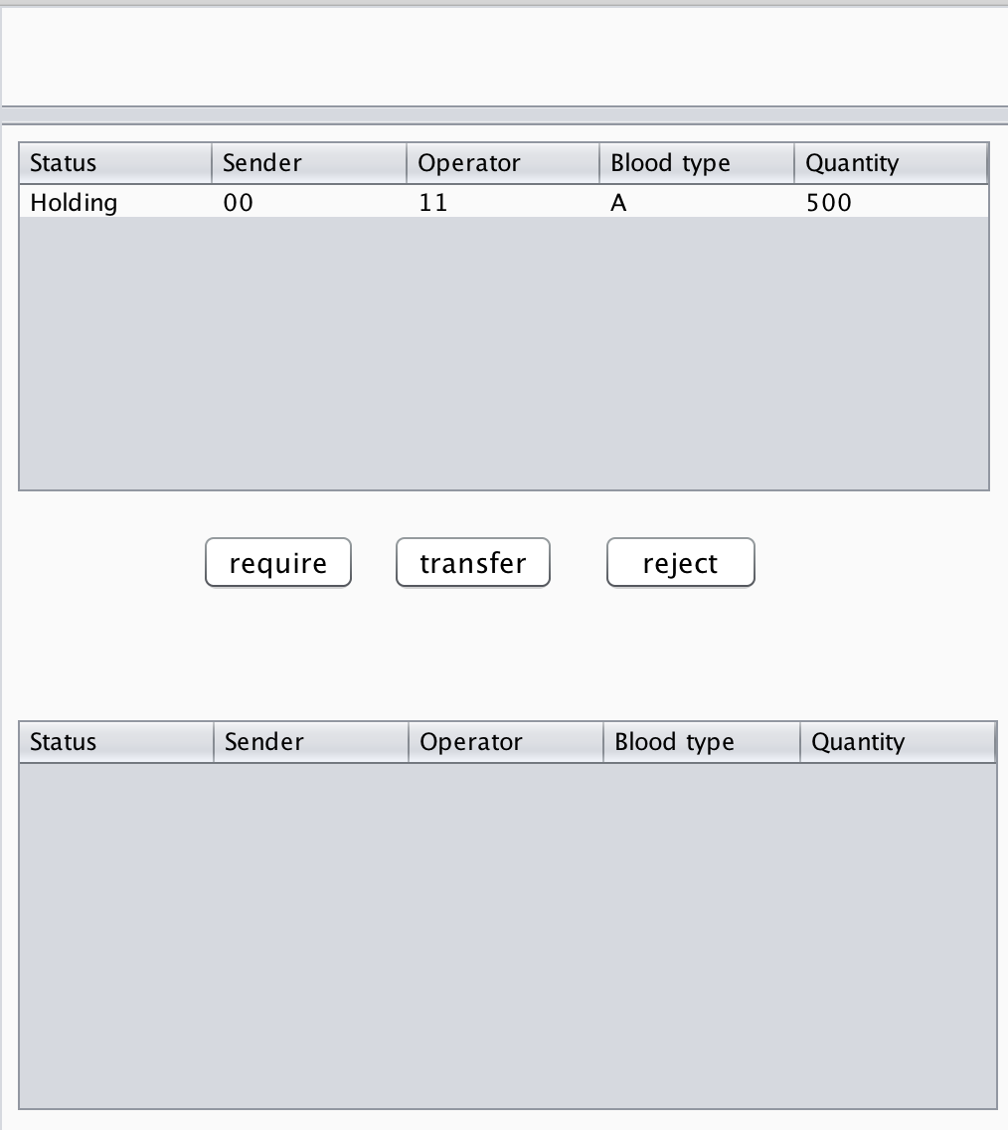
4. Primary Features

Slide 16
Thank you
for any advice and suggestion.

