Slide 1


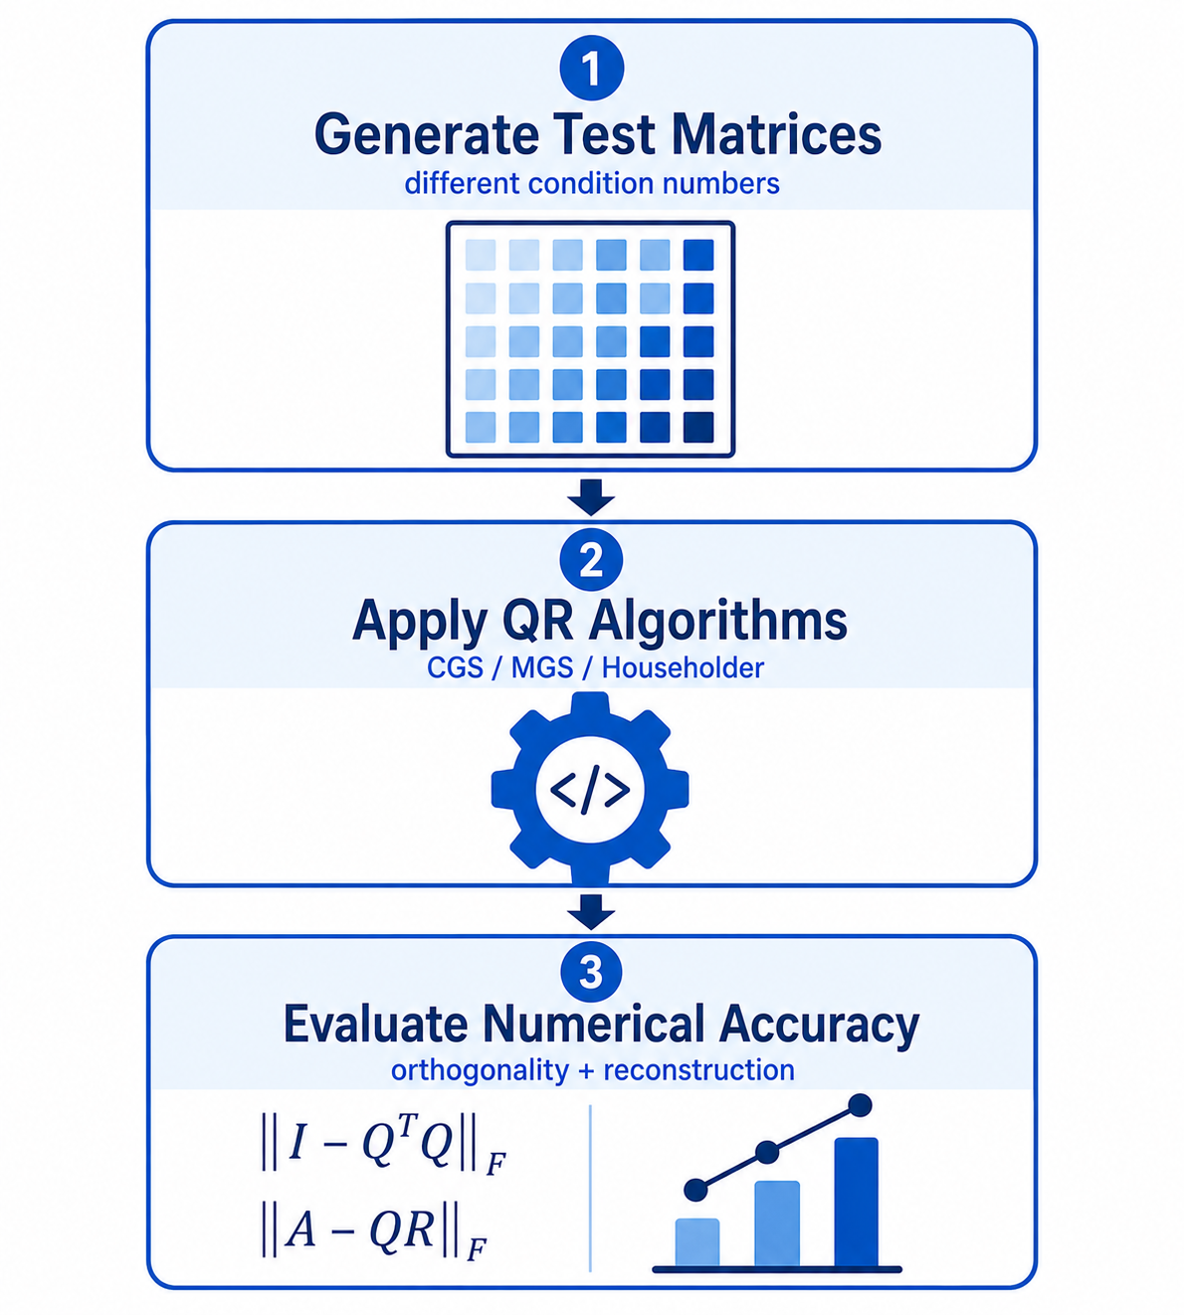
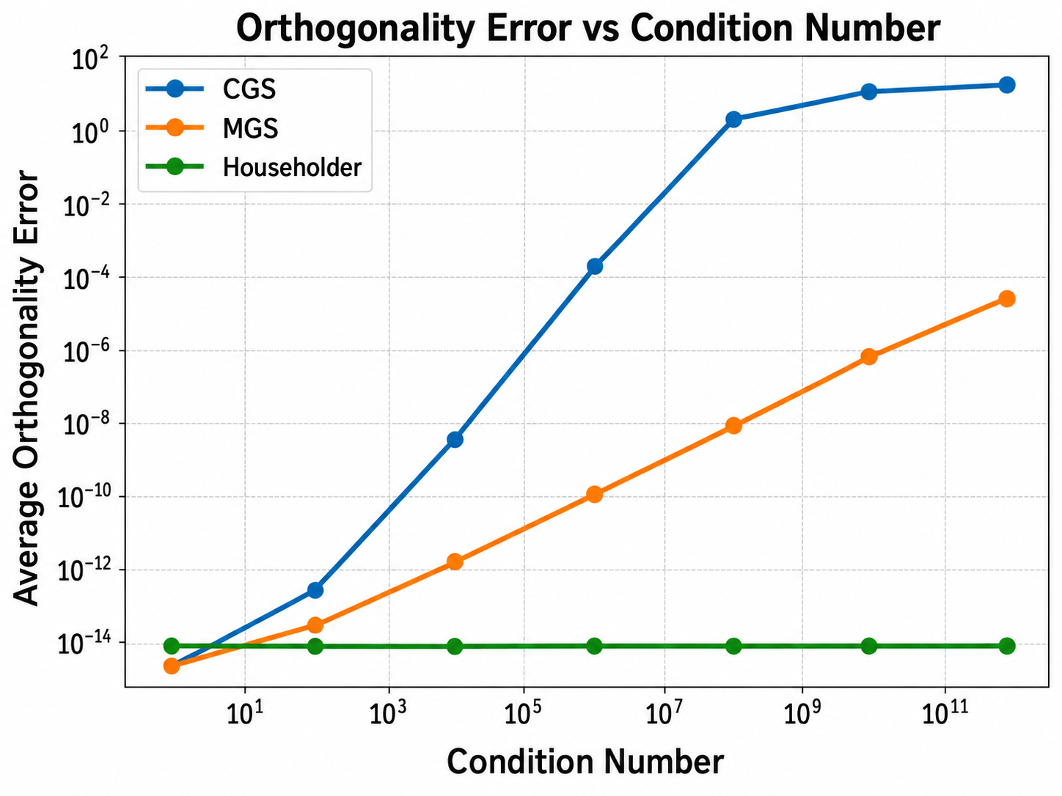
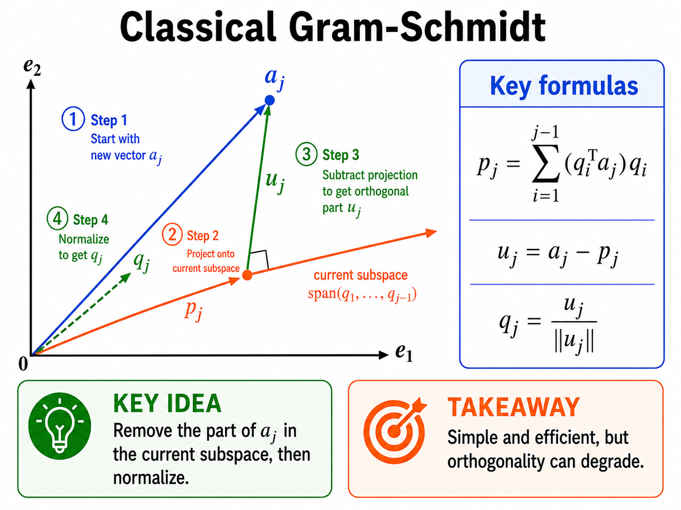
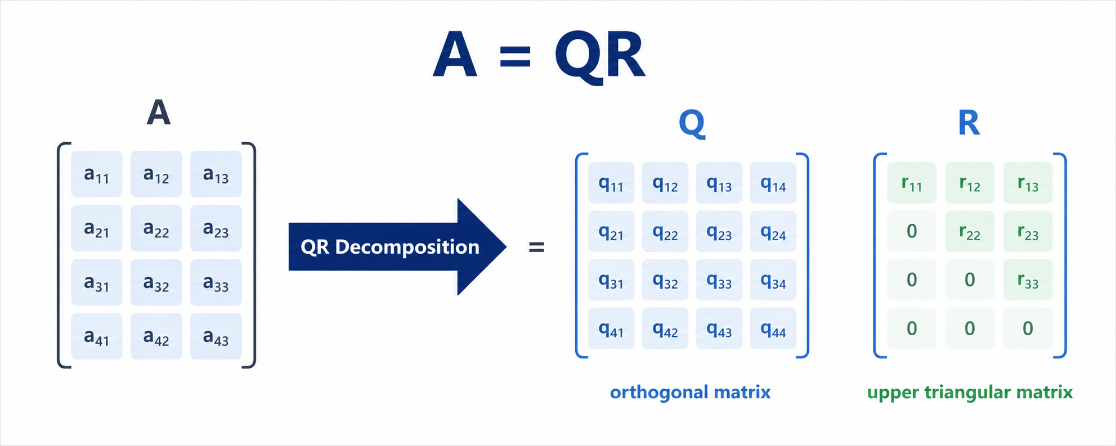
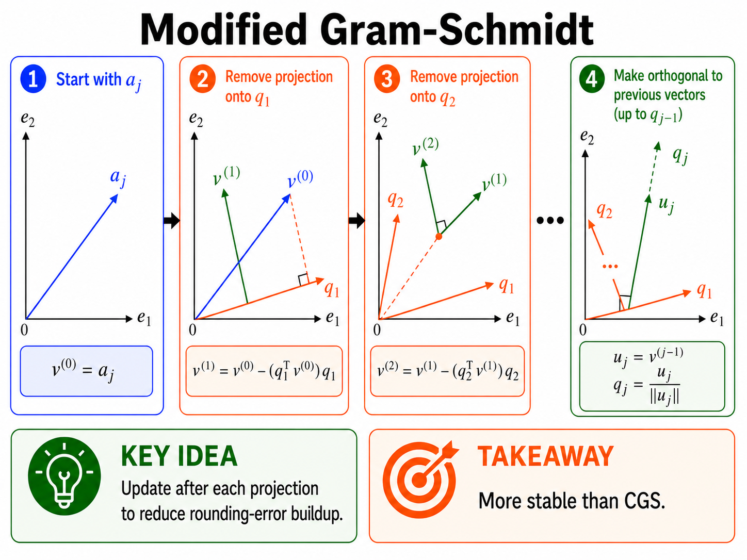
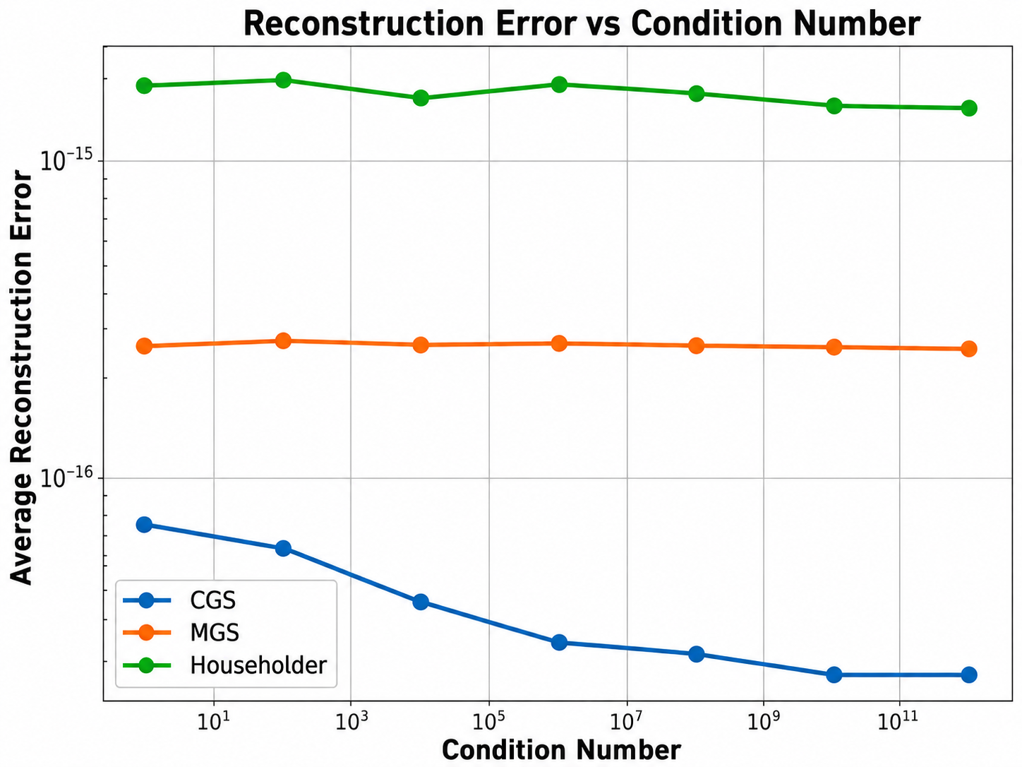
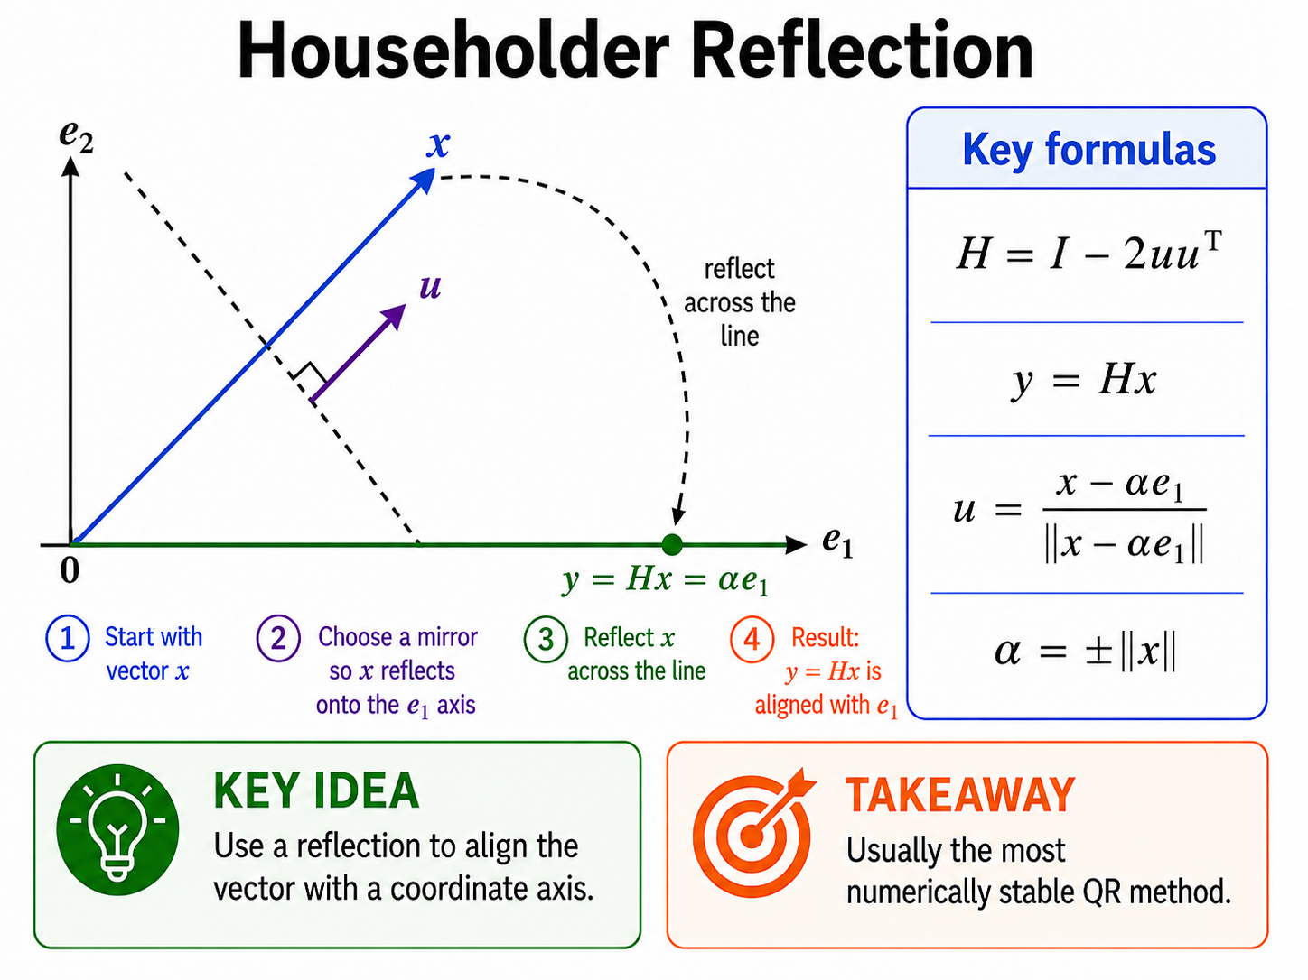
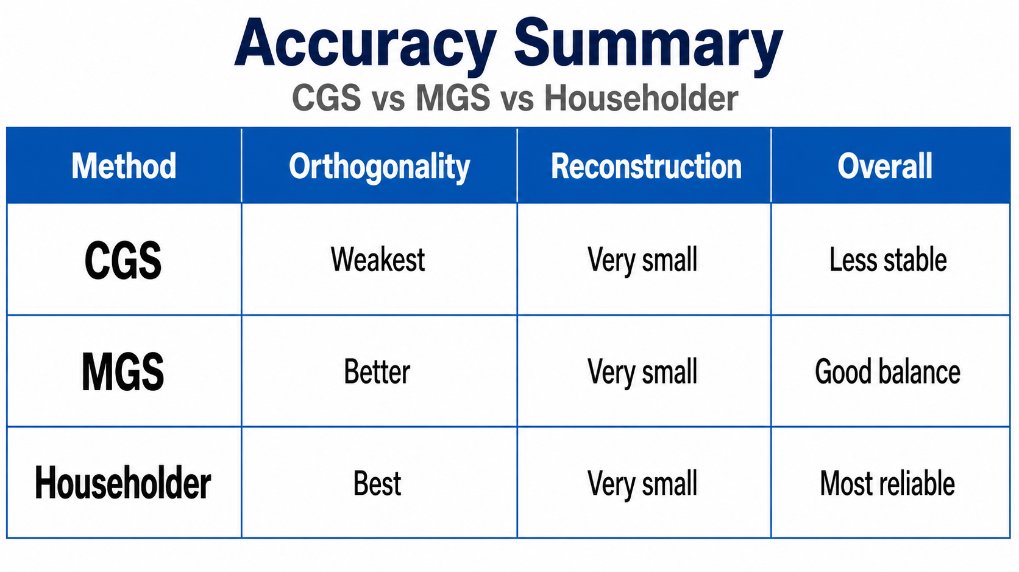
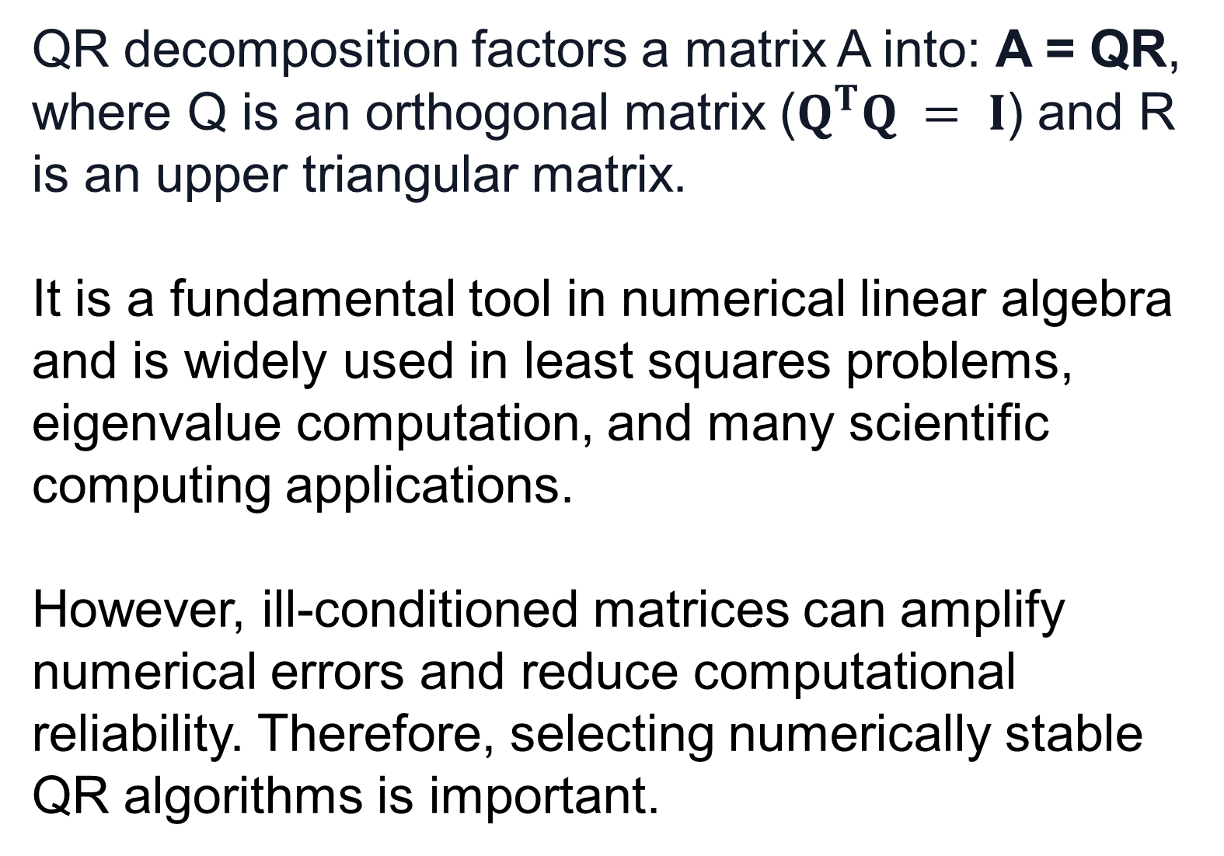
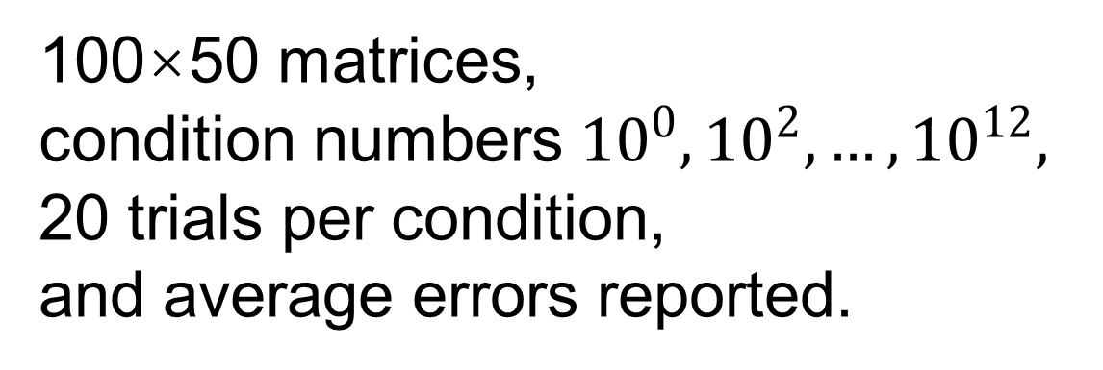
A Numerical Accuracy Comparison of Three QR Decomposition Algorithms
Junxiang Huang, School of Data Science, The Chinese University of Hong Kong, Shenzhen, Shenzhen, Guangdong, China, huangjohnson1020@outlook.com
Chao Chen, Department of Mathematics, North Carolina State University, Raleigh, NC, USA, cchen49@ncsu.edu
Logo
1. Background & Objective
2. Methods
3. Results
QR decomposition factors a matrix A into: A = QR,
where Q is an orthogonal matrix ($Q^{T}Q = I$) and R is an upper triangular matrix.
It is a fundamental tool in numerical linear algebra and is widely used in least squares problems, eigenvalue computation, and many scientific computing applications.
However, ill-conditioned matrices can amplify numerical errors and reduce computational reliability. Therefore, selecting numerically stable QR algorithms is important.
Algorithms Compared
Experimental Workflow
Orthogonality error increases as matrices
become more ill-conditioned.
MGS and Householder maintain better
orthogonality than CGS.
*Condition number measures how sensitive a matrix is to numerical errors. A larger condition number indicates a more ill-conditioned matrix and greater numerical instability.
Experimental Setup
100×50 matrices,
condition numbers ${10}^{0},{10}^{2},…,{10}^{12},$
20 trials per condition,
and average errors reported.
Research Question & Expected Outcome
All three algorithms achieve very small reconstruction errors, indicating accurate factorization.
Evaluation Metrics
How do different QR decomposition algorithms influence the numerical stability of QR factorization for ill-conditioned matrices?
We compare CGS, MGS, and Householder QR based on orthogonality preservation and reconstruction accuracy under different matrix conditions. We expect MGS and Householder QR to preserve orthogonality better than CGS for ill-conditioned matrices. Reconstruction error is expected to remain small for all three algorithms.
• Orthogonality Error: ||QᵀQ − I||
Measures how close Q is to an orthogonal matrix.
Smaller values indicate better numerical stability.
• Reconstruction Error: ||A − QR||
Measures how accurately QR reconstructs the original matrix A.
Smaller values indicate better accuracy.
• Focus: accuracy and numerical stability
4. Conclusion
Main Takeaway
• Orthogonality error increases as matrices become more ill-conditioned, especially for CGS.
• MGS maintains better orthogonality than CGS by reducing numerical errors.
• Householder QR shows the most consistent stability across different condition numbers.
• Reconstruction errors remain very small for all three methods, indicating accurate QR factorization.
Reliable QR factorization is important because loss of numerical stability can affect the accuracy of downstream scientific computations. Householder QR provides the strongest numerical stability among the tested methods (with higher computational cost). MGS offers a balance between stability and efficiency, while CGS remains less stable for ill-conditioned matrices.
Acknowledgements
References
I would like to thank Prof. Chao Chen for his guidance and the GEARS Summer Research Program for supporting this project.
1. Golub, G. H., & Van Loan, C. F. Matrix Computations (4th ed.). Johns Hopkins University Press, 2013.
2. Trefethen, L. N., & Bau, D. Numerical Linear Algebra. SIAM, 1997.

