Slide 1
MedEx: a medication information extraction system for clinical narratives
Xu, H (Xu, Hua); Stenner, SP (Stenner, Shane P); Doan, S (Doan, Son); Johnson, KB (Johnson, Kevin B.) ; Waitman, LR (Waitman, Lemuel R.); Denny, JC (Denny, Joshua C.)
JOURNAL OF THE AMERICAN MEDICAL INFORMATICS ASSOCIATION JAN 2010

Slide 2
BACKGROUND
Narrative clinical notes: Even in electronic prescribing tools, free text inputs such as medication signatures are often allowed
Medication reconciliation：Create a most complete and accurate list of a patient’s medications
Current medication extraction systems extract drug names with high accuracy, but they perform less well on identifying drug signature information.
Furthermore little has been done on extracting contextual level information such as status about medications.
Precision and recall of drug names, dose and frequence……

Slide 3
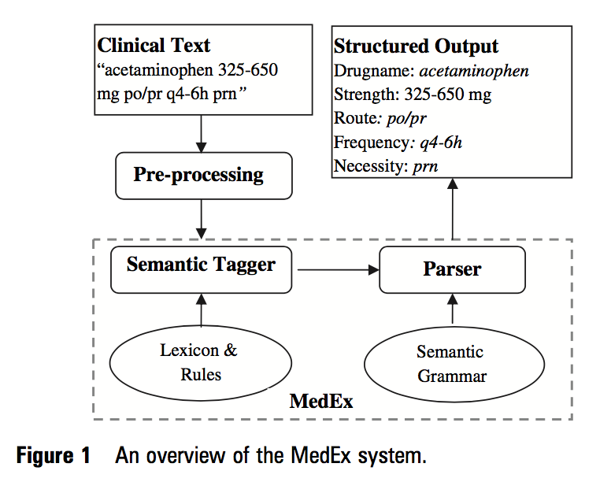

Slide 4
Evaluation
Database：Synthetic Derivative (SD) database, de-identified copy of the EMR at Vanderbilt University Medical Center
one month (January 2004) of notes titled as ‘Discharge Summary’ from the SD
3510 notes
50：test set for evaluation
Outpatient notes：25 notes ‘Clinic visit notes ’from the SD January 2004 and manually reviewed in a similar way

Slide 5
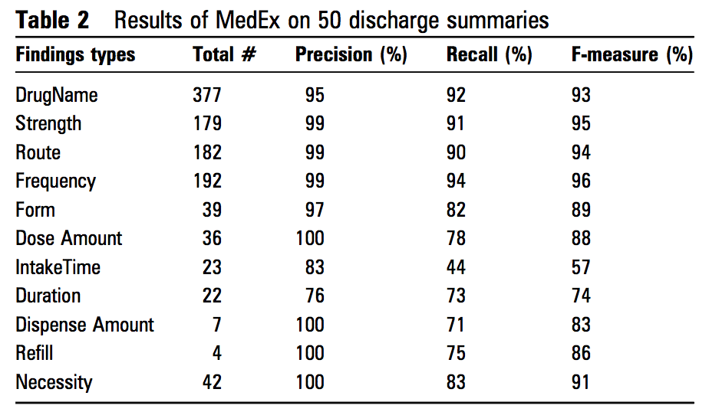
Evaluation：discharge summaries

Slide 6
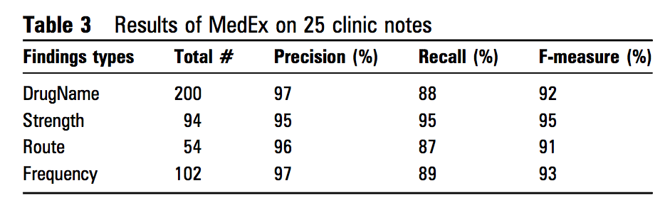
Evaluation：clinic notes

Slide 7
DISCUSSION
MedEx can accurately extract not only drug names, but also medication associated signature information, such as strength, route, and frequency, with high F-measures (93.2%-96.0%). For the task of medication signature information extraction, the performance of MedEx is superior to systems reported in previous studies (F-measures of 85.3%, 80.3%, and 48.3% on strength, route, and frequency, respectively).
Manually reviewed errors：
Terms that were not in lexicon files or not recognized by regular expressions. Ex:06→6am
Ambiguous drug names. Ex: potassium in‘potassium is normal’

Slide 8
DISCUSSION
drug names from databases could be English words (eg. First Data Bank's NDDF)
sentence detection program sometimes breaks one medication finding into two sentences

Slide 9
DISCUSSION：门诊记录性能更低
clinic visit notes are often typed
‘Medication’ section in discharge summaries often contains semi-structured medication text, which is easier to parse
not use a training set of outpatient clinic notes to expand lexicon and tweak the algorithm

Slide 10
DISCUSSION：
In the future, we plan to integrate an existing section tagger (SecTag) to the pre-processing step of MedEx, to reduce this type of false positives.
develop a disambiguation method that can determine the meaning of an ambiguous drug term (eg, ‘Vital’ can be a drug name or an adjective in English)
use a set of manually defined rules for disambiguation in the sequential tagger→further improve the semantic tagging step by implementing a transformation-based tagger (Brill Tagger), which automatically learns rules from an annotated training set.
We will also extend the MedEx by: (1) encoding the extracted medication names using RxNorm; (2) capturing contextual level information

Slide 12
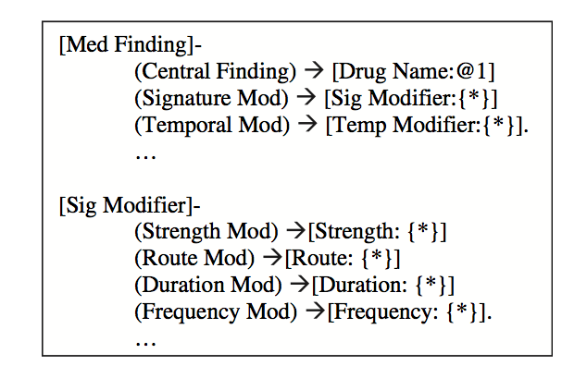
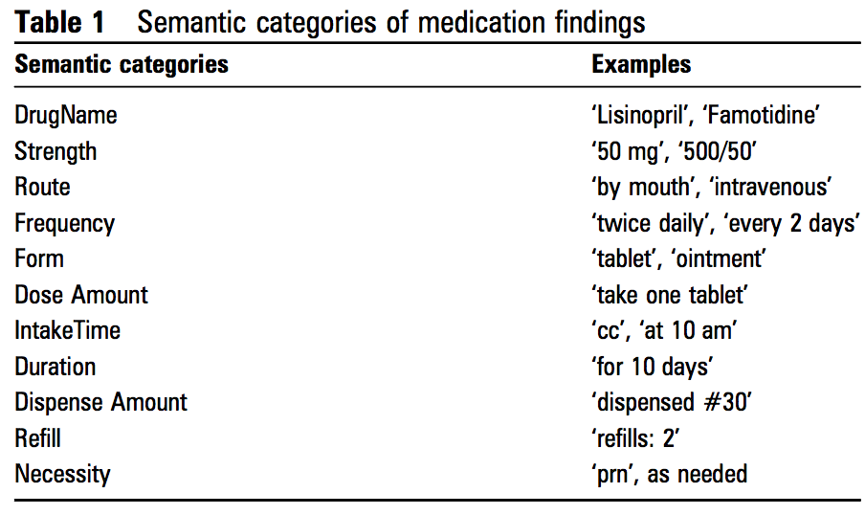
A medication representation model
All relevant medication information provided in the text
-including the central finding of a medication name, and its modifiers such as signature information and contextual information such as status and temporal information.
identified 11 semantic categories

Slide 13
Pre-processing
Goal：determine the sentence boundaries in a clinical note
Used an existing rule-based sentence boundary detection program
Denny JC, Miller RA, Johnson KB, et al. Development and evaluation of a clinical note section header terminology. AMIA Annu Symp Proc 2008:156e60.
Denny J, Spickard IA, Johnson K, et al. Evaluation of a method to identify and categorize section headers in clinical documents. J Am Med Inform Assoc. In press.

Slide 14
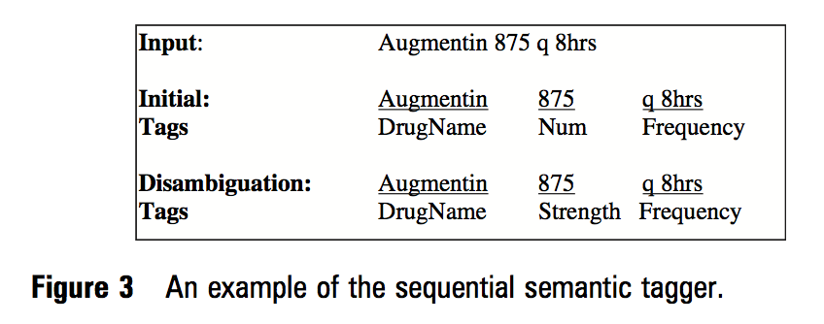
Semantic tagging
Goal: break an input sentence into tokens and label proper words or phrases with a semantic category as described above.
The sequential tagger in this paper consists of:
(1) an initial tagging step that combines lookup and regular expression tagging methods, (2) a disambiguation step that transforms the initial ambiguous tags into the final tags based on a set of pre-defined context-based rules.

Slide 15
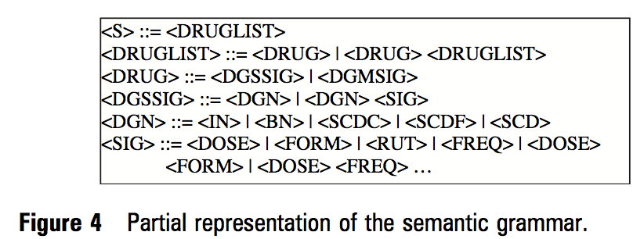
Parsing
Goal：uses a context-free grammar to parse textual sentences into structured forms, via a Chart Parser, a dynamic programming parsing method.
existing implementation of a Top-down Chart Parser in the Natural Language Tool Kit in Python
If the Chart parser fails, a regular expression based Chunker in Natural Language Tool Kit is used

Slide 16
Thanks

