Slide 1
CSC 735 – Data Analytics
Introduction to Scala

Slide 2
Goal
Our goal here is to learn enough Scala to write Spark code

Slide 3
What is Scala?
Scala is a general-purpose programming language
Concise – like Python
Scala source code compiles to Java bytecode that runs on a Java virtual machine
Language interoperability with Java

Slide 4
Brief History
Scala invented by Martin Odersky at the École Polytechnique Fédérale de Lausanne (EPFL) (in Lausanne, Switzerland)
Scala was released publicly in early 2004
A second version (v2.0) was released in March 2006

Slide 5
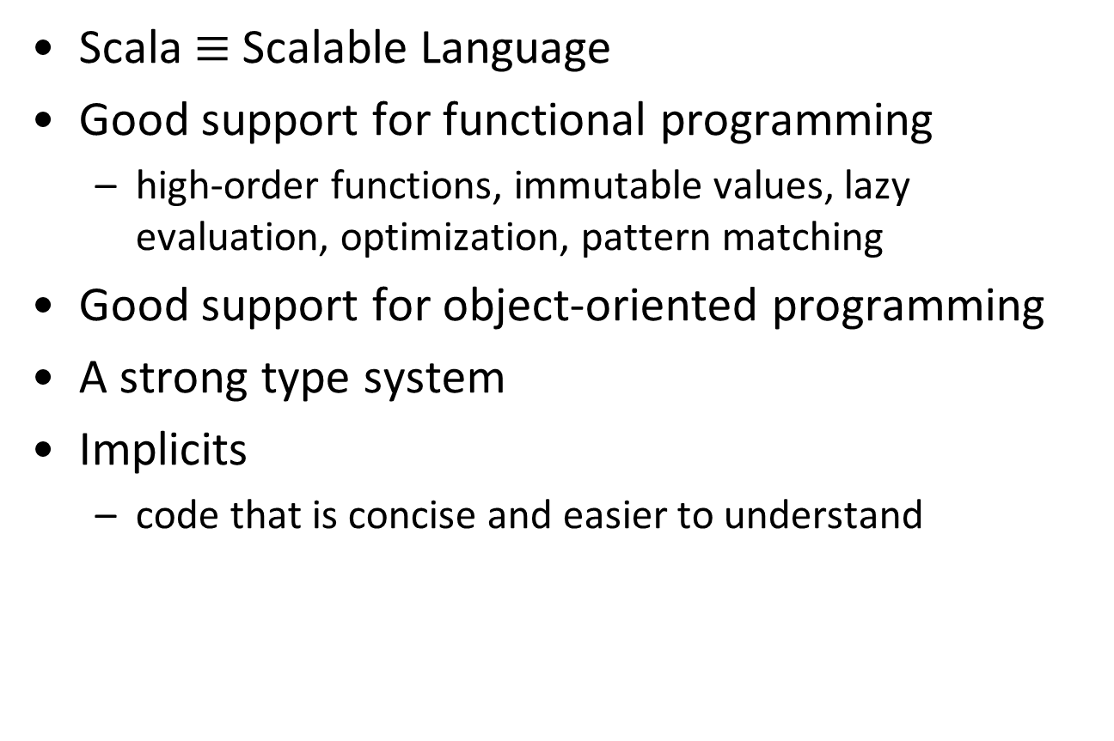
Features of Scala
Scala $≡$Scalable Language
Good support for functional programming
high-order functions, immutable values, lazy evaluation, optimization, pattern matching
Good support for object-oriented programming
A strong type system
Implicits
code that is concise and easier to understand

Slide 6
Why Learn Scala for Big Data
Scala is the Cadillac of programming languages
beautiful language
provides a boost to your professional career
write robust code with few bugs
Spark is written in Scala
best support for Spark
faster Spark code

Slide 7
Installing Scala
Make sure you have Java 1.8
Download the Scala Binaries from https://www.scala-lang.org/download/
Uncompress it
Place the scala\bin subdirectory to system path

Slide 8
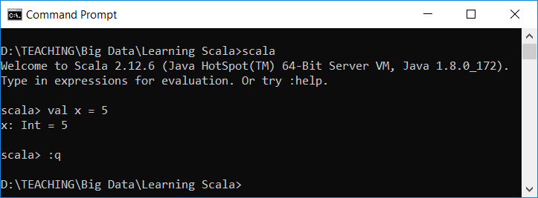

Using Scala
To start Scala REPL, type scala at the command prompt
To quit, type :quit, or :q
REPL $≡$ Read, Evaluate, Print, Loop

Slide 9
Alternative Way of Using Scala
Use a text editor to type your code as a singleton object
Assume we saved the following program as HelloWorld.scala
Then, use the command prompt and the following command to compile c:\>scalac HelloWorld.scala
Scala creates an executable file with the same name as the object name. Use the following command to run it c:\> scala HelloWorld
object HelloWorld {
def main(args: Array[String]){
println("Hello World")
}
}

Slide 10
Alternative Way of Using Scala (cont.)
Assume file saved as HelloWorld2.scala
Use this command to compile scalac HelloWorld2.scala
What is the name of the executable?
What is the command to run?
scala MyFirstScalaProgram
object MyFirstScalaProgram extends App {
println("Hello World")
}

Slide 11
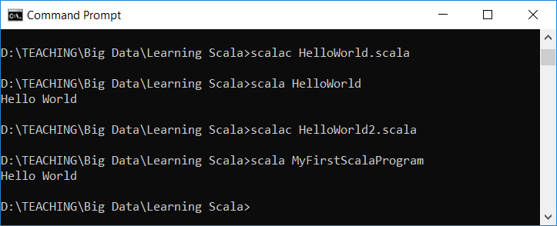
Compiling and Running A Scala Program

Slide 12
Using an IDE with Scala
You could use Eclipse or IntelliJ
Instructions for IntelliJ at https://docs.scala-lang.org/getting-started-intellij-track/getting-started-with-scala-in-intellij.html
For Eclipse
Download from scala-ide.org
Instructions at http://scala-ide.org/docs/current-user-doc/gettingstarted/index.html

Slide 13
Basic Types
Variable Type | Description
Byte | 8-bit signed integer
Short | 16-bit signed integer
Int | 32-bit signed integer
Long | 64-bit signed integer
Float | 32-bit single precision float
Double | 64-bit double precision float
Char | 16-bit unsigned Unicode character
String | A sequence of Chars
Boolean | true or false

Slide 14
Basic Types (cont.)
Scala has 7 numeric types and a Boolean type
Each type in Scala is implemented as a class
We can invoke methods on numbers
1.toString() //yields the string "1"
99.44.toInt //yields 99
1.to(10) // yields the Range(1, 2, 3, …, 10)
2.3.getClass.getSimpleName //res26: String = double

Slide 15
Variables
mutable vs. immutable
Use var to declared a mutable variable
var x = 10
x = 20
Use val to declare an immutable variable
val x = 10
x = 20 //error

Slide 16
Remarks
semicolon at the end of a statement is optional
val y = 10; val y = 10 // Equivalent
the compiler infers type wherever possible
val y = 10
val y: Int = 10
Scala is a statically typed language, so everything has a type

Slide 17
Lazy Values
When a val is declared as lazy, its initialization is deferred until it is needed
Syntax: lazy val x = 10
Initialization will take place when x is used print( x + 5) val y = x + 2
Notice: only vals can be lazy

Slide 18
Arithmetic and Operator Overloading
Scala has the same arithmetic operators as other languages: + - * / %
In Scala, operators are actually methods
a + b is a shorthand for a.+(b)
In general, these are equivalent: a method b a.method(b)
So, 1.to(10) can be written as 1 to 10
There is no ++ or – – in Scala

Slide 19
More about Calling Methods
When calling a method that has no parameters, don’t use parentheses after method’s name
Ex: the method sorted, yields a new string with the letters in sorted order
"Bonjour".sorted // Yields the string "Bjnooru“
The rule of thumb is that a parameter-less method that doesn’t modify the object has no parentheses

Slide 20
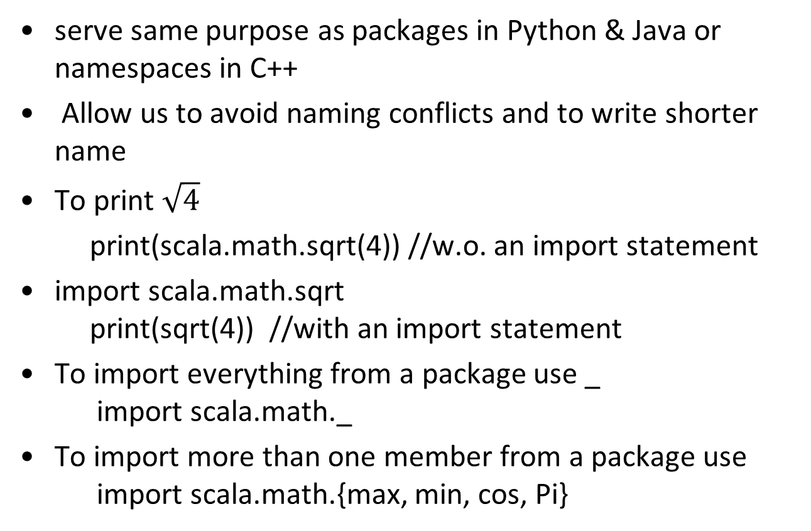
Importing Packages
serve same purpose as packages in Python & Java or namespaces in C++
Allow us to avoid naming conflicts and to write shorter name
To print $\sqrt{4}$
print(scala.math.sqrt(4)) //w.o. an import statement
import scala.math.sqrt print(sqrt(4)) //with an import statement
To import everything from a package use _ import scala.math._
To import more than one member from a package use import scala.math.{max, min, cos, Pi}

Slide 21
Importing Packages (cont.)
We can rename members: import scala.math.{max => maximum} print(maximum(2, 3))
Every Scala program implicitly starts with
import java.lang._
import scala._
import Predef._
if a package starts with scala., you can omit the scala prefix
math.sqrt is as good as scala.math.sqrt

Slide 22
The apply Method
In Scala, overloading the method apply lets us use () with many types/classes
Ex: val s = "Hello"; s(4) //yields 'o'
s(4) is a shortcut for s.apply(4)
In the class StringOps, you find a method def apply(n: Int): Char

Slide 23
The apply Method
Likewise, BigInt("1234567890") is a shortcut for BigInt.apply("1234567890")
It yields a new BigInt object BigInt("1234567890") * BigInt("112358111321")
Using the apply method of a class is a common Scala idiom for constructing objects
For example, Array(1, 4, 9, 16) returns an array

Slide 24
Expressions vs. Statements
An expressions has a value
2 + 3
A statement carries an action
if statement, assignment statement
In Scala, almost all constructs have values
an if expression has a value
a block has a value—the value of its last expression
Benefit: concise and more readable code

Slide 25
Conditional Statements
If/else statements have same syntax as in Java/C++
In Scala, an if/else has a value, namely the value of the expression that follows the if or else
if (x > 0) 1 else -1
This allows us to assign that value to a variable val weather = if (temperature > 85) "hot" else "not hot"

Slide 26
Type/Class Any
In Scala, every expression has a type
if (x > 0) 1 else -1 has type Int
What is the type of if (x > 0) "positive" else -1
The type of a mixed-type expression is the common supertype of both branches
The common supertype of String and Int is called Any

Slide 27
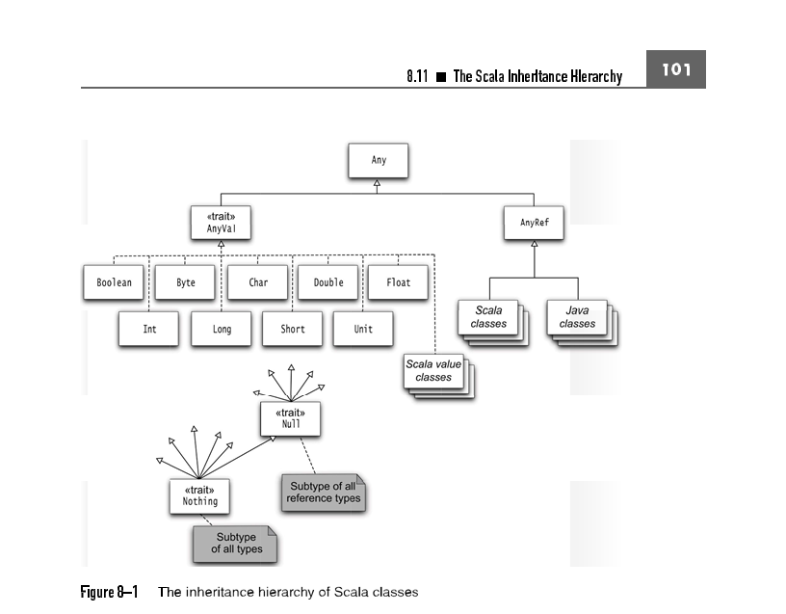
The Inheritance Hierarchy of Scala Classes

Slide 28
Type/Class Unit
What is the type of if (x > 0) 1
This if statement could yield no value
Since every expression should have a value, Scala introduces a class Unit that has one value, “no value”, written as ()
The above if statement is equivalent to
if (x > 0) 1 else ()
Think of () as a placeholder for “no useful value,” and of Unit as an analog of void in Java/C++
The supertype of Int and Unit is AnyVal

Slide 29
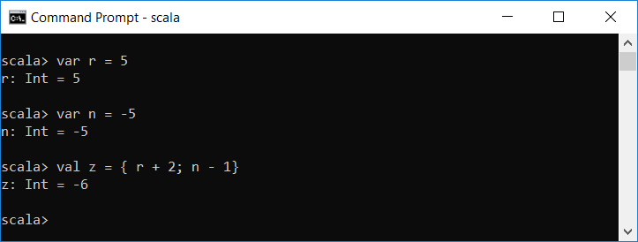
Block Expressions and Assignments
{} makes a block of code
The value of a block is that of the last expression inside it

Slide 30
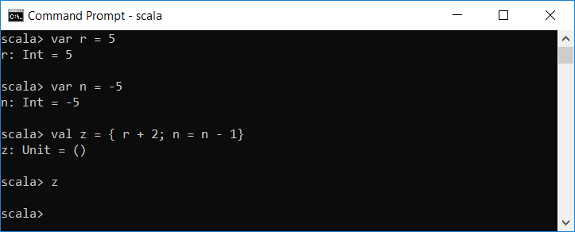
Block Expressions and Assignments
In Scala, assignments have no value (i.e., Unit value)
So, if we have a block that ends with an assignment statement, that block has a Unit value

Slide 31
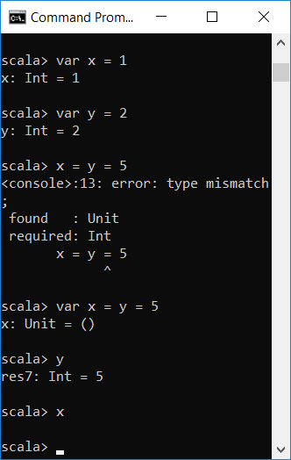
Remark on Chained Assignments
Do not use chain assignments in Scala
x = y = 1 // No
The value of y is 1
The expression y = 1 has Unit value
If syntax allows it, x would have a Unit value

Slide 32
Input and Output
print() and println()
Scala has printf() with a C-style syntax
val x = 3; val y = 5
println(x + y) //outputs: 8
val name = "Mark"; val age = 5
printf("Hello %4s! Your are %5d years old.\n", name, age);
//Hello Mark! Your are 5 years old.

Slide 33
Input and Output - String Interpolations
We can also use string interpolation
A formatted string can contain expressions and format directives
val name = "Mark"; val age = 5
print(f"Hello, $name! In six months, you'll be ${age + 0.5}%7.2f years old.%n")
//Hello, Mark! In six months, you'll be 5.50 years old.

Slide 34
String Interpolations (cont.)
With prefix s, a string can contain expressions but not format directives. Escape sequences are evaluated.
val name = "Mark"; val age = 5
print(f"Hello, $name! In six months, you'll be ${age + 0.5}%7.2f years old.%n")
//Hello, Mark! In six months, you'll be 5.50 years old.
print(s"Hello, $name! In six months, you'll be ${age + 0.5}%7.2f years old.%n")
//Hello, Mark! In six months, you'll be 5.5%7.2f years old.%n
print(s"Hello, $name! In six months, you'll be ${age + 0.5}%7.2f years old.\n")
Hello, Mark! In six months, you'll be 5.5%7.2f years old.
scala>

Slide 35
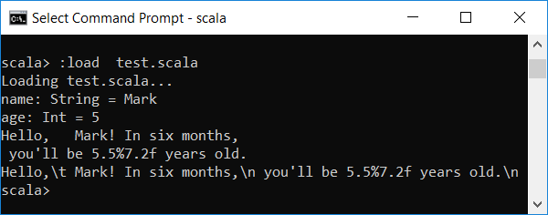
String Interpolations (cont.)
With a prefix of raw, neither escape sequences nor format directive are evaluated
val name = "Mark"; val age = 5
print(s"Hello,\t $name! In six months,\n you'll be ${age + 0.5}%7.2f years old.\n")
print(raw"Hello,\t $name! In six months,\n you'll be ${age + 0.5}%7.2f years old.\n")

Slide 36
Reading Input
import scala.io.StdIn
ReadLine
To read a numeric, Boolean, or character value, use readInt, readDouble, readByte, readShort, readLong, readFloat, readBoolean, or readChar
The readLine method, but not the other ones, takes a prompt string:
import scala.io.StdIn
val name = StdIn.readLine("Enter your name: ")
print("Enter your age: ")
val age = StdIn.readInt()
println(s"Hello, ${name}! Next year, you will be ${age + 1}.")

Slide 37
Loops
Scala has the same while and do while loops as in Java/C++
var i = 5; var summation = 0
while (i > 0){
summation += i
i -=1
}
print(summation) //15
// 5 + 4 + 3 + 2 + 1
var i = 0; var summation = 0
do {
i += 1
summation += i
} while ( i <= 5)
print(summation) //21
// 1 + 2 + 3 + 4 + 5 + 6

Slide 38
Loops - for
Scala does not have C++/Java for loop
Instead, one can use this kind of loop
no val or var before the variable in the for loop
type of the variable is the type of the elements of the collection
scope of loop variable is until the end of the loop
for (i <- 1 to n) do something
for (i <- expr) do something

Slide 39
Loops – for (Examples)
for (i <- 1 to 5)
print(i + " ")
// 1 2 3 4 5
val s = "ABC"
for (ch <- s)
print(ch + " ")
//A B C
val s = "ABC"
var result = 0
for (i <- 0 to s.length - 1)
result += s(i)
print("result is " + result)
//result is 198 "65 + 66 + 67"
val s = "ABC"
var result = ""
for (i <- 0 to s.length - 1)
result += s(i)
print("result is " + result)
//result is ABC

Slide 40
For Comprehension
if the body of the for loop starts with yield, the loop constructs a collection of values, one for each iteration:
This type of loop is called a for comprehension
for (i <- 1 to 10) yield i % 3
// Yields Vector(1, 2, 0, 1, 2, 0, 1, 2, 0, 1) ////res104:scala.collection.immutable.IndexedSeq[Int] = Vector(1, 2, 0, 1, 2, 0, 1, 2, 0, 1)

Slide 41
Functions
To define a function, specify its name, parameters, and body like this
If the function is not recursive, it is optional to specify its return type
def maximum(x: Double, y: Double) = if (x > y) x else y
def maximum(x: Double, y: Double): Double = if (x > y) x else y

Slide 42
Functions (cont.)
If body is more then one expression, enclose in { }
Recursive version of above function
/*A function to raise a number m to the power n.
Assume that n is a nonnegative integer*/
def power(m:Int, n:Int) = {
var result = 1
for ( i <- 1 to n)
result *= m
result
}
Calling the function: power(5, 4)
def raise(m: Int, n: Int): Int = if ( n <= 0) 1 else m * raise(m, n -1)

Slide 43
Procedures
A procedure is a function that does not return a value
Usually used for its side effect such as printing
You can define such function/procedure by
either specifying Unit as the return type
def sayHello(name: String): Unit = {
println("Hello " + name)
}
sayHello("David") // Hello David

Slide 44
Procedures (cont.)
or, omitting the return type and not using = symbol before the function body
def sayGoodBye(name: String) {
println("Good Bye " + name)
}
sayGoodBye("David") // Good Bye David

Slide 45
Functions as First class Citizens
Functions in Scala, are first class citizens
can be assigned to a variable, stored in a data structure, passed as a parameter to another function, or be the returned value of another function

Slide 46
Functions as First class Citizens - Examples
//file name: firstClassCitizens.scala
import math._
val num = 3.14
val f = ceil _
//_ is needed to let Scala know that you intended to assign ceil as a ref to f
f(num) // 4
//A function that takes another function as a parameter
def f2(functionArgument: (Double) => Double, dataArgument: Double) = functionArgument(dataArgument)
f2(math.sqrt, 2) //res156: Double = 1.4142135623730951
//A function that returns a function as its result
def f3() = math.sqrt _
f3()(4) //res165: Double = 2.0

Slide 47
Anonymous Functions
A function without a name is called an anonymous function (aka function literal)
An anonymous function is defined with input parameters in parenthesis, followed by a right arrow and the body of the function
The body of a functional literal is enclosed in "optional" curly braces.

Slide 48
Anonymous Functions - Examples
We can store an anonymous function in a variable val add100 = (x: Int) => x + 100
(x: Int) => {
x + 100
}
//res174: Int => Int
(x: Int) => x + 100
//res175: Int => Int

Slide 49
Anonymous Functions
Anonymous functions are useful when a function is passed as an argument to another function
def doSomething(func: (Double) => Double, x: Double): Double = {
func(x)
}
doSomething(math.sqrt, 2)
//1.4142135623730951
doSomething( (x: Double) => 0.25 * x, 12)
//3.0

Slide 50
Higher Order Methods
A function that takes a function as a parameter is called a higher order function
def doSomething(func: (Double) => Double, x: Double): Double = {
func(x)
}
doSomething( (x: Double) => 0.25 * x, 12)

Slide 51
Parameter Inference
Scala can deduce types whenever possible
How can we call the following function?
doSomething( (x: Double) => 0.25 * x, 12)
Scala can deduce the type of x from the function header
doSomething( (x) => 0.25 * x, 12)
If an anonymous function takes only one parameter, we can omit the () around the parameter
doSomething( x => 0.25 * x, 12)
If the parameter occurs only once on the right-hand side of the =>, we can replace it with an underscore
doSomething( 0.25 * _, 12)
def doSomething(func: (Double) => Double, x: Double): Double = { func(x) }

Slide 52
Closures
A function whose return value depends on one or more variables declared outside it is called a closure
var c = 10
def add(a: Int, b: Int) = a + b + c
add(3, 4) //17
c = 50
add(3, 4) //57

Slide 53
Closures (cont)
The function can be called when a non-local variable is no longer in scope
The function is aware of any changes to such variable and will use the new values

Slide 54
Closures – Example (closures.scala)
class MyClass {
def exec(f:(String) => Unit, name: String) {
f(name)
}
}
var greetings = "Hello"
def sayHello(name: String) { println(s"$greetings, $name") }
val object1 = new MyClass()
object1.exec(sayHello, "Mark") // Hello, Mark
greetings = "Howdy"
object1.exec(sayHello, "Martin") //Howdy, Martin

Slide 55
Arrays
similar to Arrays in Java and C++
homogeneous
has a fixed length
You can efficiently access any element in an array in constant time
It is a mutable data structure
you can update an element in an array
arrays are zero indexed

Slide 56
Declaring an Array
val names: Array[String] = new Array[String](3) //names: Array[String] = Array(null, null, null)
or val names = new Array[String](3) //names: Array[String] = Array(null, null, null)
val nums = new Array[Int](10)
val s = Array("Hello", "World") // Note: no new when you supply initial values

Slide 57
ArrayBuffer
ArrayBuffer is similar to ArrayList in Java or vector in C++
import scala.collection.mutable.ArrayBuffer
val b = ArrayBuffer[Int]()
// Or, b = new ArrayBuffer[Int]
b += 1
// ArrayBuffer(1)
b += (1, 2, 3, 5)
// ArrayBuffer(1, 1, 2, 3, 5)
b ++= Array(8, 13, 21)
// ArrayBuffer(1, 1, 2, 3, 5, 8, 13, 21)
// You can append any collection with the ++= operator
val a = b.toArray
//a: Array[Int] = Array(1, 1, 2, 3, 5, 8, 13, 21)
val c = a.toBuffer
//c: scala.collection.mutable.Buffer[Int] = ArrayBuffer(1, 1, 2, 3, 5, 8, 13, 21)

Slide 58
Built—in Functions
Array(1, 7, 2, 9).sum // 19
Works for ArrayBuffer too
ArrayBuffer("Mary", "had", "a", "little", "lamb").max // "little"
val b = ArrayBuffer(1, 7, 2, 9)
val bSorted = b.sorted
// bSorted is ArrayBuffer(1, 2, 7, 9)
// b is unchanged

Slide 59
Built-in Functions (cont.)
val bDescending = b.sortWith(_ > _)
// ArrayBuffer(9, 7, 2, 1)
You can sort an array, but not an array buffer, in place:
val a = Array(1, 7, 2, 9)
scala.util.Sorting.quickSort(a)
// a is now Array(1, 2, 7, 9)

Slide 60
Built-in Functions - mkString
The mkString method lets us specify the separator between elements val a = Array(1, 7, 2, 9) a.mkString(" and ")
// "1 and 7 and 2 and 9"
A second variant has parameters for the prefix and suffix a.mkString("<", ",", ">")
// "<1,7,2,9>"

Slide 61
Maps
A Map is a collection of key-value pairs
In other languages, it known as a dictionary, associative array, or hash map
Allows us to index a value by a specific key for fast access

Slide 62
Creating a Map
val capitals = Map("USA" -> "Washington D.C.", "UK" -> "London", "India" -> "New Delhi") This creates an immutable map whose contents cannot be changed
If you want a mutable map, use var scores = scala.collection.mutable.Map("Alice" -> 10, "Bob" -> 3, "Cindy" -> 8)
scores("George") = 9
scala> capitals("France") = "Paris"
error: value update is not a member of scala.collection.immutable.Map[String,String]
capitals("France") = "Paris"

Slide 63
Accessing Map Values
scala> scores
res342: scala.collection.mutable.Map[String,Int] = Map(George -> 9, Bob -> 3, Alice -> 10, Cindy -> 8)
scala> scores("Cindy")
res343: Int = 8
scala> scores("Mark")
java.util.NoSuchElementException: key not found: Mark
scala> scores.getOrElse("Mark", 0)
res345: Int = 0

Slide 64
Iterating over Maps
Syntax: for ((k, v) <- map) process k and v
scala> for ((k, v) <- scores) print(s"$k: $v\t")
George: 9 Bob: 3 Alice: 10 Cindy: 8
scala> scores.keySet
res347: scala.collection.Set[String] = Set(George, Bob, Alice, Cindy)
scala> scores.values
res348: Iterable[Int] = HashMap(9, 3, 10, 8)
scala> for (v <- scores.values) print(s"$v\t")
9 3 10 8

Slide 65
Tuples
A tuple is a Scala collection which can hold multiple values together
Unlike an array or list, a tuple can hold objects with different types
Tuples are immutable
Tuples are always used when you see parentheses wrapping around data without a specific type
In Scala, a tuple can have up to 22 elements

Slide 66
Creating Tuples
scala> val t = new Tuple3(1, "hello", 20.3)
t: (Int, String, Double) = (1,hello,20.3)
scala> val t = (1, "hello", 20.3)
t: (Int, String, Double) = (1,hello,20.3)
scala> val t = new Tuple4(1, "hello", 20.3, true)
t: (Int, String, Double, Boolean) = (1,hello,20.3,true)
scala> val t = (1, "hello", 20.3, true)
t: (Int, String, Double, Boolean) = (1,hello,20.3,true)
scala> name -> "Mark"
res350: (String, String) = (Mark,Mark)

Slide 67
Accessing Tuple Values
Use the methods _1, _2, _3 val t = (1, "hello", 20.3)
val first = t._1 // Sets first to 1
Notice: index of the first element is 1, not 0
We can also do this:
val (first, second, third) = t // Sets first to 1, second to hello, third to 20.3
You can use a _ if you don’t need all components:
val (first, second, _) = t

Slide 68
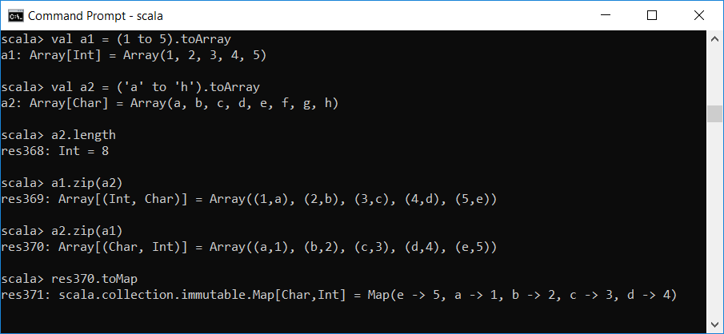
Zipping
Zipping allows us to combine the corresponding elements in two collections

Slide 69
Collections Overview
A collection is a container data structure
Scala has a rich collections library that includes collections of many different types
Collections provide an easy-to-use interface that reduces the need to manually loop through all the elements
They enable functional programming
Collections provide a similar interface

Slide 70
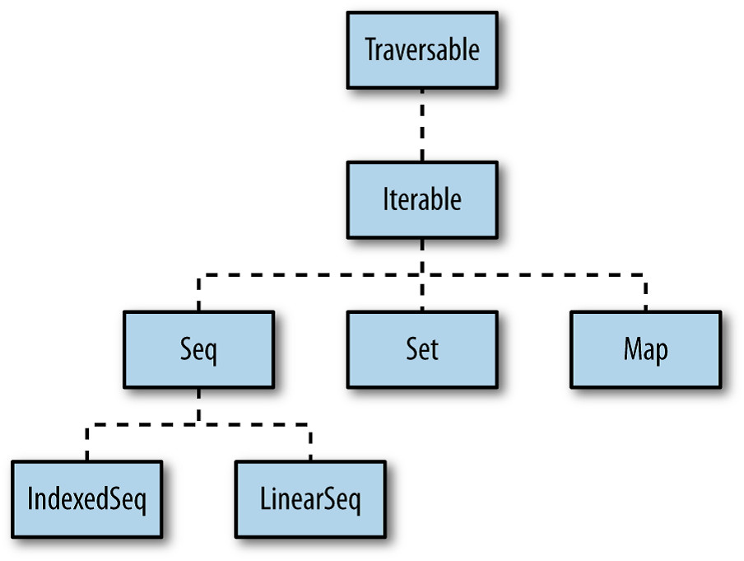
Collections Overview (cont.)
Scala collections are grouped into three main categories: sequences, sets, and maps

Slide 71
Mutable and Immutable Collections
Scala supports mutable and immutable collections
Scala prefers working with immutable collections
When you do not specify a package for a collection, you are using an immutable version
Mutable objects are in scala.collection.mutable scala.collection.mutable.Map scala.collection.immutable.Map
Figures 13-2 & 13-3 show some immutable and mutable sequences

Slide 72
Fig 13-2 Immutable Sequences

Slide 73
Figure 13-3 Mutable Sequences

Slide 74
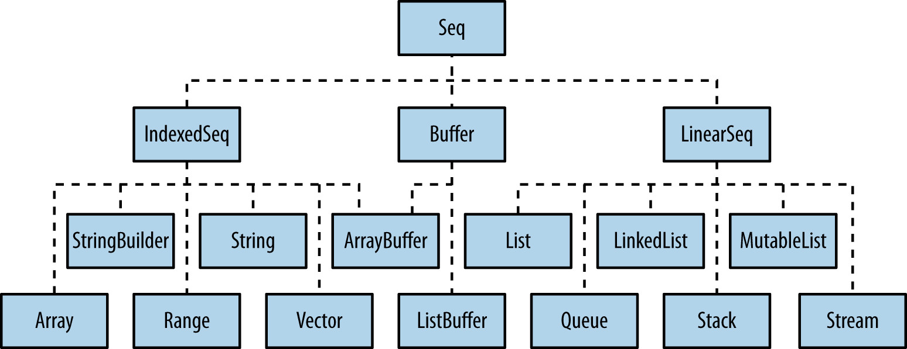
Sequences
The Seq trait represents sequences
Sequences branch into two main categories
Indexed Sequences
Linear Sequences

Slide 75
Indexed Sequences
In an indexed sequence, any element can be accessed by an index which makes random element access efficient
Examples: Array, Vector, Range
By default, specifying that you want an IndexedSeq, Scala creates a Vector:
scala> val x = IndexedSeq(1,2,3)
x: IndexedSeq[Int] = Vector(1, 2, 3)

Slide 76
Linear Sequences
A LinearSeq is a collection that can be efficiently split into head and tail components
Examples: List, Stack, Queue
Accessing a LinearSeq through an index is inefficient
We work with them using the head, tail, and isEmpty methods
By default specifying that you want a LinearSeq, Scala creates a List:
scala> val seq = scala.collection.immutable.LinearSeq(1,2,3)
seq: scala.collection.immutable.LinearSeq[Int] = List(1, 2, 3)

Slide 77
Arrays & Ranges
Arrays were discussed earlier
A Range is a range of values, such as 1,2,3,4,5 or 10,20,30
A Range stores only the start, end, and increment
You construct Range objects with the to and until methods
scala> val a1 = 0 to 10 by 2
a1: scala.collection.immutable.Range = inexact Range 0 to 10 by 2
scala> val iter = a1.iterator
iter: Iterator[Int] = non-empty iterator
scala> while (iter.hasNext) print (iter.next() + " ")
0 2 4 6 8 10
scala> val a2 = 0 until 10 by 2
a2: scala.collection.immutable.Range = Range 0 until 10 by 2
scala> val iter = a2.iterator
iter: Iterator[Int] = non-empty iterator
scala> while (iter.hasNext) print (iter.next() + " ")
0 2 4 6 8

Slide 78
Lists
A List is a linear sequence of elements of the same type
linked list implementation
It is an immutable data structure
It is a recursive data structure
It is not an efficient data structure for accessing elements by their indices
access time is proportional to the position of an element in a list

Slide 79
Creating A List
A few ways to create a list:
val xs = List(10,20,30,40)
val ys = (1 to 100).toList
val zs = someArray.toList

Slide 80
Basic List Operations
The method head returns the first element
The method tail returns a list with all the elements except the first
The method isEmpty returns true if a list is empty
The :: operator makes a new list from a given head and tail
scala> 5 :: List(2, 7, 10)
res19: List[Int] = List(5, 2, 7, 10)
scala> res19.head
res20: Int = 5
scala> res19.tail
res21: List[Int] = List(2, 7, 10)

Slide 81
Example
//file name: list_sum.scala
val lst = (1 to 10).toList
def sumList(lst: List[Int]):Int = {
if (lst == Nil) //lst.isEmpty
0
else
lst.head + sumList(lst.tail)
}
print(sumList(lst)) //55

Slide 82
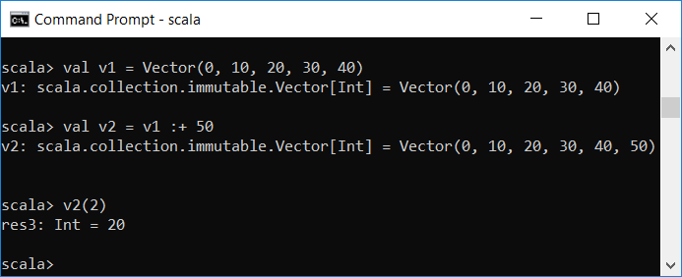
Vectors
Vector is a new immutable collection type in Scala 2.8 that addresses the inefficiency for random access on lists
Vectors allow accessing any element in the list in "effectively" constant time
You can think of it as a hybrid of a list and an array

Slide 83
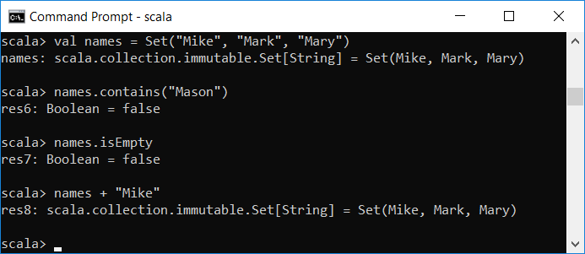
Sets
Set is an unordered collection of distinct elements
You cannot access an element by an index

Slide 84
Table 13—1 Operators on Collections
The operators to use depend on the collection type
Operator | Description | Collection Type
col += elem col += (e1, e2, …) col ++= col2 col -= elem col -= (e1, e2, …) col --= col2 | Modifies col by adding or removing the given elements | Mutable collections
col ++ col2 | A collection of the same type as col, containing the elements of both collections | Iterable
col :+ elem elem +: col | A collection of the same type as col to which elem has been appended or prepended. | Seq
col + elem col + (e1, e2, …) | A collection of the same type as col to which the given elements have been added | Set, Map

Slide 85
Higher Order Functions on Collections
Scala collections support many built-in HOFs
A HOF does not mutate a collection
We mention some of the most commonly used HOFs
All Scala collections support these HOFs

Slide 86
Map
A map applies a function to all the elements in a collection and returns another collection
The input function describes what should be done to elements in the calling collection
The returned collection has the exact same number of elements as the collection on which map was called.
Type of returned collection can be different

Slide 87
Map – Examples
val xs = List(1, 2, 3, 4, 5)
//xs: List[Int] = List(1, 2, 3, 4, 5)
val ys = xs.map( (x: Int) => x / 2.0)
//ys: List[Double] = List(0.5, 1.0, 1.5, 2.0, 2.5)
val ys = xs.map(x => x / 2.0)
//ys: List[Double] = List(0.5, 1.0, 1.5, 2.0, 2.5)
val ys = xs map ( _ / 2.0)
//ys: List[Double] = List(0.5, 1.0, 1.5, 2.0, 2.5)
val ys = xs map { _ / 2.0}
//ys: List[Double] = List(0.5, 1.0, 1.5, 2.0, 2.5)

Slide 88
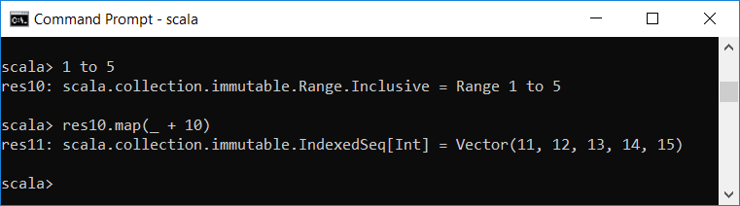
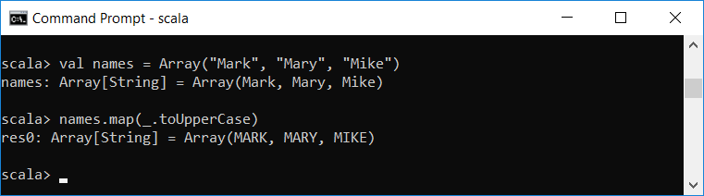
Map – Examples

Slide 89
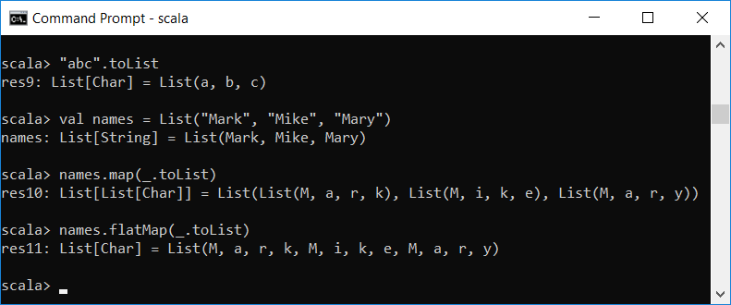
flatMap
When the function applied to map returns a collection on each element (instead of a single value), and you want to concatenate the results together, then use flatMap to do that for you

Slide 90
filter
Takes a function that operates on an element and return a Boolean
Returns a new collection that contains only the elements for which the function evaluates to true
(1 to 10).filter( _%2 == 0)
// Vector(2, 4, 6, 8, 10)

Slide 91
Reduce
Similar to reduces in Python
It reduces a collection to a single value
The input function to reduce takes two inputs at a time and returns one value
scala> val nums = 1 to 10
nums: scala.collection.immutable.Range.Inclusive = Range 1 to 10
scala> nums.reduce{(x,y) => x + y}
res23: Int = 55
scala> nums.reduce{(x,y) => if (x > y) x else y}
res24: Int = 10

Slide 92
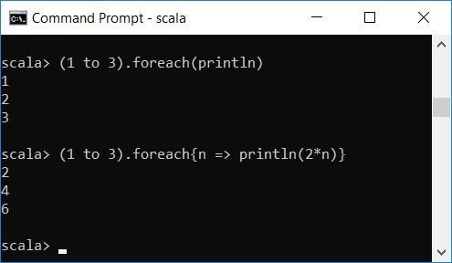
foreach
Takes a procedure as a parameter
The parameter procedure is used only for its side effect
The parameter procedure is applied to each element in the collection

Slide 93
Reading from a Text File
To read from KB, we used import scala.io.StdIn
To read from other sources, use import scala.io.Source
To read from a file, use val objectName = Source.fromFile(filename)
scala> val fileSource = Source.fromFile("file1.txt")
fileSource: scala.io.BufferedSource = non-empty iterator

Slide 94
Reading from a Text File
The method mkString returns the whole content of the file as a string
scala> fileSource.mkString
res0: String =
Line 1
Line 2
Line 3
//content of file1.txt
Line 1
Line 2
Line 3
scala> fileSource
res45: scala.io.BufferedSource = empty iterator
scala> fileSource.mkString
res2: String = ""

Slide 95
Reading from a Text File
fileSource is Iterator[Char]
It is difficult to process file one char at a time
The method getLines returns an Iterator of type Iterator[String]
Each element is a line in the file without the EOL
val fileSource = Source.fromFile("file1.txt")
for (value <- fileSource) print(value + " ")
i n e 1
L i n e 2
L i n e 3

Slide 96
Reading from a Text File
Remember to close file when done
import scala.io.Source
val fileSource = Source.fromFile("file1.txt")
val lineIterator = fileSource.getLines
//lineIterator: Iterator[String] = non-empty iterator
for (line <- lineIterator) println(line)
Line 1
Line 2
Line 3
fileSource.close

Slide 97
Classes
A simple class
class Counter {
private var value = 0 // You must initialize the field
def increment() { value += 1 }
def current() = value
}
val myCounter = new Counter
myCounter.increment()
println(myCounter.current)
You can run code from command line as follows: C:\>scala Counter.scala

Slide 98
Getters and Setters
Scala provides getter and setter methods for every field
In Scala, the getter and setter methods for age are called age and age_=
class Person { var age = 0 }
val fred = new Person println(fred.age) // Calls fred.age
fred.age = 21 // Calls fred.age_=(21)

Slide 99
Getters and Setters
If the field is val, then only a getter will be created
If the field is private then the automatically generated getter and setter methods will be private
You can always override the provided getters and setters
The practice in Scala is to use a different name for a private field and to use the normal names for the methods

Slide 100
Getters and Setters
class Person {
private var privateAge = 0 // Make private and rename
def age = privateAge
def age_= (newAge: Int) {
if (newValue > privateAge) privateAge = newValue; }
}
val fred = new Person
fred.age = 30
fred.age = 21
println(fred.age)

Slide 101
Auxiliary Constructors
A Scala class can have any number of auxiliary constructors
They are similar to constructors in Java and C++ but have the name this
Each auxiliary constructor must start with a call to a previously defined auxiliary constructor or the primary constructor

Slide 102
Example - Auxiliary Constructors
class Person {
private var name = ""
private var age = 0
// An auxiliary constructor
def this(name: String) {
this() // Calls primary constructor
this.name = name
}
// Another auxiliary constructor
def this(name: String, age: Int) {
this(name) // Calls previous auxiliary constructor
this.age = age
}
}
val p1 = new Person
val p2 = new Person("Fred")
val p3 = new Person("Mark", 42)

Slide 103
The Primary Constructor
Every class has a primary constructor
It is intertwined with the class definition
The parameters of the primary constructor are placed immediately after the class name
Parameters of the primary constructor turn into fields
class Person(val name: String = "", val age: Int = 0) {
// Parameters of primary constructor in (...)
...
}

Slide 104
The Primary Constructor
name and age become fields of the class
constructing an object, sets values for the fields
class Person(val name: String = "", val age: Int = 0) {
// Parameters of primary constructor in (...)
...
}
val p1 = new Person("Fred", 42)

Slide 105
The Primary Constructor
The primary constructor executes all statements in the class definition
Using default arguments in the primary constructor can eliminate auxiliary constructors class Person(val name: String = "", val age: Int = 0)
class Person(val name: String = "", val age: Int = 0) {
println("Just constructed another person")
def description = name + " is " + age + " years old"
}

Slide 106
Singleton
When all you need is a single instance of a class, then you can create a singleton object
Singleton objects are defined using the keyword object
A singleton object is instantiated automatically
singleton objects cannot take constructor parameters
Members will be called through the object name
Since Scala does not support static members, we can place utility functions and constants in singletons

Slide 107
Singleton - Example
//file name: singleton.scala
object Accounts {
private var lastNumber = 0
def newUniqueNumber() = { lastNumber += 1; lastNumber }
}
println(Accounts.newUniqueNumber()) //1
println(Accounts.newUniqueNumber()) //2

Slide 108
Companion Objects
A companion object is an object that has the same name as a class and is placed in the same file as the class
Since Scala does not have the static keyword, companion objects are used to place members that look like “static” members
The class and its companion object have access to each other’s private members

Slide 109
Companion Objects - Example
//file name: companionObject.scala
class Account {
val id = Account.newUniqueNumber()
private var balance = 0.0
def deposit(amount: Double) { balance += amount }
def description = "Account " + id + " with balance " + balance
}
object Account {// The companion object
private var lastNumber = 0
def newUniqueNumber() = { lastNumber += 1; lastNumber }
}

Slide 110
Example
//file name: companionObjectWithApply.scala
class Account private (val id: Int, initialBalance: Double) {
private var balance = initialBalance
def deposit(amount: Double) { balance += amount }
def description = "Account " + id + " with balance " + balance
}
object Account { // The companion object
def apply(initialBalance: Double) =
new Account(newUniqueNumber(), initialBalance)
private var lastNumber = 0
private def newUniqueNumber() = { lastNumber += 1; lastNumber }
}
val acct = Account(1000.0)
println(acct.description) //Account 1 with balance 1000.0

Slide 111
Application Objects
An object declaration defines an entry point to an application if it contains a method called main that takes an argument of type Array[String] and returns Unit
object FirstApp {
def main(args:Array[String]) {
println("My first application.")
}
}

Slide 112
Application Objects
If the object extends the App train, then you do not need to write a main method;
just write the code inside the constructor body
object FirstApp extends App{
println("My first application.")
}

Slide 113
Case Classes
A case class is a class with a case modifier
Example:
Scala automatically does the following:
An apply method for creating objects is added to the companion object
All input parameters specified in the definition of a case class implicitly get a val prefix
case class Message(from: String, to: String, content: String)
val request = Message("harry", "sam", "fight")
case class Message(val from: String, val to: String, val content: String)

Slide 114
Case Classes (cont.)
Scala adds these four methods to a case class: toString, hashCode, equals, and copy
Case classes are useful for creating immutable objects
Case classes support pattern matching

Slide 115
Pattern Matching
Pattern matching is a Scala concept that looks similar to a switch statement
Syntax: expr match {
case pattern1 => expr1
case pattern2 => expr2
case pattern3 => expr3
...
}

Slide 116
Pattern Matching
If no pattern matches, the exception MatchError is thrown
Use the case _ pattern to avoid that
expr match {
case pattern1 => expr1
case pattern2 => expr2
case pattern3 => expr3
...
case _ => exprn
}

Slide 117
Example
This example shows how to use match as a switch statement
//file name: match_as_switch.scala
val color = "Blue"
var num = 0
color match {
case "Red" => num = 1
case "Blue" => num = 2
case "Green" => num = 3
case "Yellow" => num = 4
case _ => 0
}
println(num)

Slide 118
Value of match Expression
Like other constructs, match is an expression
//file name: colorToNumber.scala
def colorToNumber(color: String): Int = {
val num = color match {
case "Red" => 1
case "Blue" => 2
case "Green" => 3
case "Yellow" => 4
case _ => 0
}
num
}
println(colorToNumber("Yellow"))

Slide 119
Value of match Expression (cont)
We did not need the variable num in the previous slide
def colorToNumber(color: String): Int = {
color match {
case "Red" => 1
case "Blue" => 2
case "Green" => 3
case "Yellow" => 4
case _ => 0
}
}
println(colorToNumber("Yellow"))

Slide 120
The Option Type
Option is a data type that indicates the presence or absence of some data
It represents optional values
Example: GA – some courses have a GA, while some do not
GA for CSC 450 is Jared
GA for CSC 735 is None

Slide 121
The Option Type
An option object can be an instance of either
a case class called Some, which can store a value
a singleton object called None that indicates there is no value
Option
Some
None

Slide 122
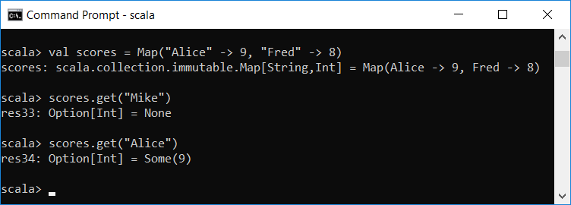
The Option Type - Example
Example: the get method of the Map collection returns an Option
If there is no value for a given key, get returns None. Otherwise, it wraps the value inside Some

Slide 123
The Option Type - Example
Option can be the return type of a function that optionally returns a value
The optional value returned by a function can be read using pattern matching
Example: colorCode.scala

Slide 124
Subclasses
Use the keyword extends to create a subclass
class Person {
var name = ""
}
class Employee extends Person {
var salary = 0.0
def description = "An employee with name " + name + " and salary " + salary
}
object Main extends App {
val mike = new Employee
mike.name = "Mike"
mike.salary = 65000
println(mike.description)
}
An employee with name Mike and salary 65000.0

Slide 125
Overriding Methods
class Person {
var name = ""
override def toString = getClass.getName + " name = " + name
}
class Employee extends Person {
var salary = 0.0
override def toString = super.toString + " salary = " + salary
}
object Main extends App {
val mike = new Employee
mike.name = "Mike"
mike.salary = 65000
println(mike)
}
Employee name = Mike salary = 65000.0

Slide 126
Superclass Construction
Only the primary constructor of a subclass can call a superclass constructor
class Person(val name: String, val age: Int) {
override def toString = "name = " + name + ", age = " + age
}
class Employee(name: String, age: Int, val salary : Double) extends
Person(name, age) {
override def toString = super.toString + " salary = " + salary
}
val mike = new Employee("Mike", 21, 65000)
println(mike)
//name = Mike, age = 21 salary = 65000.0

Slide 127
Traits
Scala has traits instead of interfaces
A trait can have abstract and concrete methods and fields
A class can inherit from only one class but it can inherit from any number of traits
Syntax to inherit from multiple traits: class C extends T1 with T2 with T3

Slide 128
Traits - Example
trait Shape {
def area(): Int
}
class Square(length: Int) extends Shape {
def area = length * length
}
class Rectangle(length: Int, width: Int) extends Shape {
def area = length * width
}
val square = new Square(10)
println(square.area) //100

