Slide 1
network verification
Junyao cai
Tsinghua Univ.

Slide 2
网络验证概述
将网络数据/网络配置抽象出网络模型，利用模型验证方法验证需要检验的网络属性，并发现其中的网络错误。
 | 输入 | 具体数据 | 公式 | 验证任务(输出) | 基本工作流程
数据面验证 | 转发数据表 转发逻辑 | 传统IP网络: 转发表 SDN网络：流表 | 转发表 × 转发逻辑 = 转发结果 | 给出转发结果是否满足需要验证的网络属性，若不满足给出错误问题
控制面验证 | 利用拓扑信息建立转发表的控制信息 | 传统IP网络：RIP, OSPF, BGP SDN网络：SDN控制器 | 网络配置 × 网络环境 = 转发表 | 给出网络配置是否满足需要验证的网络属性，若不满足给出错误问题
具体的网络属性
抽象成网络约束
转发表转发逻辑
抽象成数据面模型
验证网络约束
网络属性是否成立
具体的网络属性
抽象成网络约束
网络配置环境信息
抽象成控制面模型
验证网络约束
发现网络配置问题

Slide 3
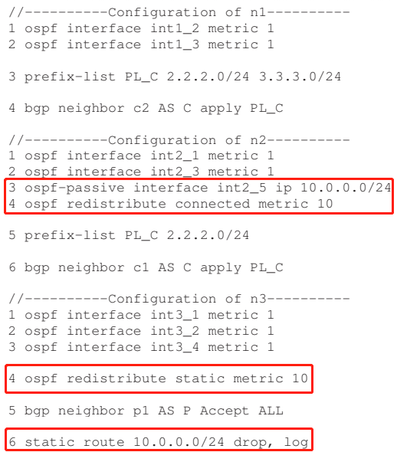
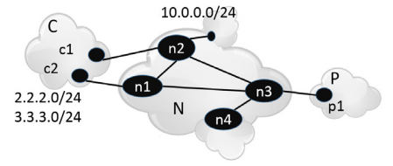
Batfish (NSDI’15 UCLA Microsoft) A General Approach to Network Configuration Analysis
network properties
reachability
multipath/failure consistency
* OSPF selects the smallest metric in valid next hop routes
Notes:
根据路由器学习路由信息、生成并维护路由表的方法包括直连路由(Direct)、静态路由(Static)和动态路由(Dynamic)。直连路由：路由器接口所连接的子网的路由方式称为直连路由；非直连路由：通过路由协议从别的路由器学到的路由称为非直连路由.
静态路由是由网络规划者根据网络拓扑，使用命令在路由器上配置的路由信息，这些静态路由信息指导报文发送，静态路由方式也不需要路由器进行计算，但是它完全依赖于网络规划者，当网络规模较大或网络拓扑经常发生改变时，网络管理员需要做的工作将会非常复杂并且容易产生错误。
而动态路由的方式使路由器能够按照特定的算法自动计算新的路由信息，适应网络拓扑结构的变化。如我们经常用于自治系统（AS:Autonomous System）内部网关协议有开放式最短路径优先（OSPF:Open Shortest Path First）协议和寻路信息协议(RIP:Routing Information Protocol)。

Slide 4
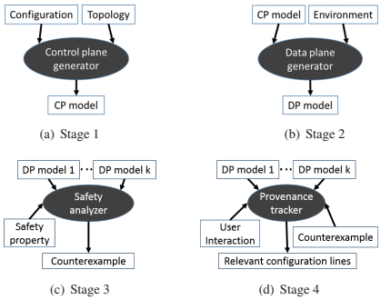
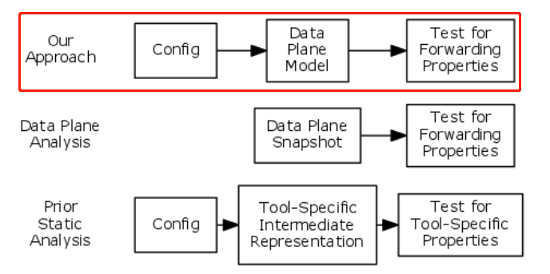
Batfish (NSDI’15 UCLA Microsoft) A General Approach to Network Configuration Analysis
network properties
access control list(ACL)
multipath/failure consistency
insight faithfully derives and then analyzes the actual data plane that would emerge given a configuration
workflow
strength
precise forwarding impact
proactive, ‘what-if’ analysis
weakness
router software or hardware bugs
infeasible environment
Notes:
Stage 1 generates a logical model of the control plane. This model compactly represents the network configuration and topology and the computation that the network routers carry out collectively to produce the data plane.
(A key challenge addressed in our work is faithfully encoding the semantics of a range of low-level configuration directives in a high-level, declarative language.)
The second stage of Batfish takes an environment as an additional input, which facilitates performing “what if” analysis.
The environment consists of the up/down status of each link in the network as well as a set of route announcements from each of the network’s neighboring ASes. It is represented as a set of logical facts.
前两个阶段不考虑感兴趣的网络属性，忠实翻译配置+拓扑+环境
The last two stages of Batfish identify and localize configuration errors. In the third stage, we analyze one or more data planes to check desired correctness properties.
The final stage helps operators understand property violations, in order to properly repair the network configuration. It works by logically simulating the behavior of counterexample packets through the network on top of our logical data plane model.

Slide 5


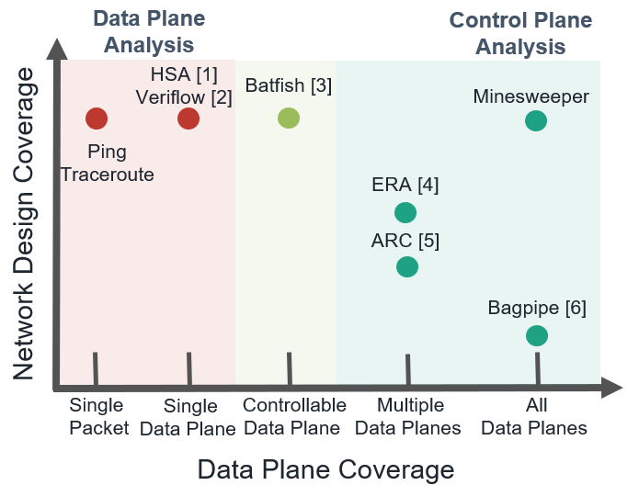
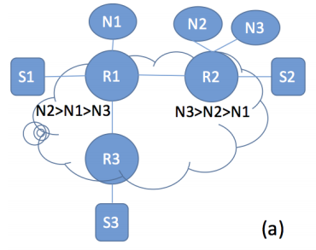

Minesweeper (sigcomm’17 Princeton University) A General Approach to Network Configuration Verification
insight1: paths-based(ERA) vs. graphs-based
S3 uses N1 to reach any external destination ?
Notes:
It has three internal routers, R1 to R3, that run OSPF. It connects to three external neighbors, N1 to N3, via BGP. The internal routers are connected to subnets, S1 to S3, whose address prefixes they redistribute into OSPF and BGP. R1 and R2 connect via iBGP, to share the BGP routes they hear from N[1..3]. They also redistribute BGP destinations into OSPF, so that R3 can reach those destinations, and OSPF into BGP so that internal subnets are announced externally. The BGP preferences of R1 and R2 are as shown: R1 (R2) prefers routes through N2, N1, and N3 (N3, N2, N1) in that order. Recall that in BGP, when multiple routes are available to the same destination, a router will select and share the most preferred one according to the local configuration
In the general case, all possible paths can interfere with one another, and for correct analysis, all mutual interactions should be considered.
Route redistribution acts as a glue logic that lets various protocols with different formats interoperate and exchange information in a highly flexible, user-defined way.

Slide 6
Minesweeper (sigcomm’17 Princeton University) A General Approach to Network Configuration Verification
insight2: Message sets(Batfish) vs. combinational search
simulate all possible outcomes of the distributed control plane computation by computing (symbolic) sets of messages for all destinations. leads to a lot of unnecessary work
SMT solver search only use required aspects of control plane
Approach
Relates the network inputs and outputs of devices with SMT constraints
Use static analysis to optimize the circuit encoding, remove protocol details when possible
Notes:
返回上页的图
if router R3 had an ACL that drops traffic sent to R1, then the solver might quickly learn that S3 will not be able to reach N1 without reasoning about the full control plane behavior.

Slide 7
Encoding Overview
‘‘
’’
Does P hold in the network?
N1
N2
N3
Network Encoding: N
S1
R1
R2
S2
⋀
Network Property: ¬ P
R3
Satisfiable: Property Violation
S3
Unsatisfiable: Holds for all data planes

Slide 8
Running Example
‘‘
Data plane packet
1
How does each router
forward a packet?
’’
N1
N2
N3
Symbolic Packet
{
}
0 ≤
dstIp
≤ 2³²
S1
R1
R2
S2
0 ≤
srcIp
≤ 2³²
0 ≤
dstPort
≤ 2¹⁶
???
???
0 ≤
srcPort
≤ 2¹⁶
R3
0 ≤
protocol
≤ 2⁸
S3
Notes:
At the end of the day, we care about how a packet is forwarded through the network.

Slide 9
Running Example
Protocol Interactions
2
N1
N2
N3
N1
N2
N3
Protocol
View
R1
R2
R1
R2
BGP
BGP
S1
S2
S1
CON
OSPF
OSPF
CON
S2
R3
R3
OSPF
CON
S3
S3

Slide 10
Running Example
Protocol Interactions
2
N1BGP
N1
N2
N3
Redistribution
From CON to BGP
BGP peering
Between R1 and R2
Circuit
View for R1
R1
R2
BGP
BGP
S1
CON
OSPF
OSPF
CON
S2
R1CON
R1BGP
R2BGP
R3
in4
e4
OSPF
CON
After R2
export filter
S3
R1OSPF
After R1
import filter
Notes:
Can a “routing record“ reach this point in a stable solution Define term. Black dots are routing records.

Slide 11
Running Example
Control Plane Info
3
N1BGP
Routing Record
valid:
1 bit
{
}
prefix:
[0,2³²)
prefixLen:
[0,2⁵)
R1CON
R1BGP
adminDist:
[0,2⁸)
localPref:
[0,2³²)
metric:
[0,2³²)
med:
[0,2³²)
ospfType
[0,2²)
R1OSPF

Slide 12
Running Example
R1 BGP import filter from R2
Import FIlters
4
ip prefix_list L deny 192.168.0.0/16 le 32
ip prefix_list L allow
route-map R1_Import_From_R2 10
match ip address prefix-list L
set local-preference 120
N1BGP
SMT constraint
If R2 exports a route
if e4.valid ∧ failedR1,R2 = 0 then if ¬ (FBM(e4.prefix, 192.168.0.0, 16) ∧
16 ≤ e4.prefixLen ≤ 32) then
in4.valid = true in4.lp = 120 in4.prefix = e4 .prefix
in4.metric = e4.metric
in4.prefixLen = e4 .prefixLen
…
else in4.valid = false
else in4 .valid = false
R1CON
If it passes the import filter
R1BGP
R2BGP
in4
e4
Then R1 has the same
route with local-pref 120
R1OSPF
Otherwise, R1 does not
have a route from R2
Notes:
The function FBM (first bits match) tests for equality of the first e.length bits of the prefix (e.prefix) and destination IP, thus capturing the semantics of prefix-based forwarding

Slide 13
Running Example
Decision Process
5
N1BGP
What is the best BGP route?
R1-BGP-BEST = Min(in1, in4, in5, in7)
in1
in7
What is the best overall route?
R1CON
R1BGP
R2BGP
R1-BEST = Min(R1-BGP-BEST
in4
R1-OSPF-BEST
in5
R1-CON-BEST)
R1OSPF

Slide 14
Running Example
Decision Process
5
N1BGP
Does R1 have a RIB entry for R2?
RIB_{R1,R2} = (in4 = R1-Best)
R1CON
R1BGP
R2BGP
Does R1 have a FIB entry for R2?
e4
FIB_{R1,R2} = RIB_{R1,R2} ⋀ ¬ ACL(R1,R2)
in4
R1OSPF

Slide 15
Property: Reachability / Isolation
‘‘
’’
Can router R3 (not) reach subnet S2?
N1
N2
N3
canReach_{R2} ⇔ FIB_{R2,S2}
canReach_{R1} ⇔
(FIB_{R1,R2} ⋀ canReach_{R2}) ⋁
(FIB_{R1,R3} ⋀ canReach_{R3})
S1
R1
R2
S2
canReach_{R3} ⇔
(FIB_{R3,R1} ⋀ canReach_{R1})
R3
Property: canReach_{R3}
S3
Notes:
Emphasize, reachability here is for all possible data planes

Slide 16
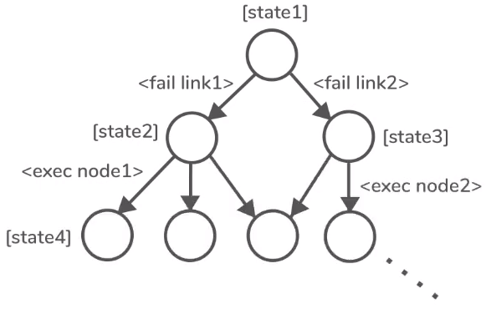
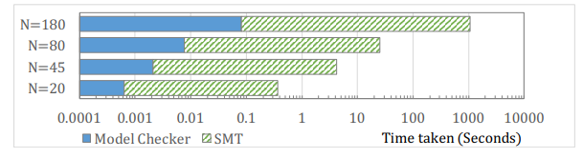
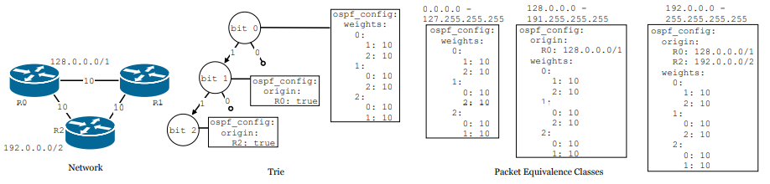
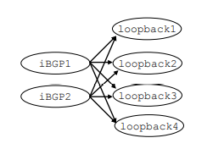
Plankton (NSDI’20 University of Illinois at Urbana-Champaign) Scalable network configuration verification through model checking
motivation
SMT(Minesweeper) scales poorly
focus on relevant non-determinism
BGP non-determinism route selection
Non-deterministic link failures
insight uses equivalence partitioning to manage the large header space, and explicit-state model checking to explore protocol execution
Notes:
non-determinism:比如这是某个状态1，链路1和2都有可能出现故障，他们导向两个不同的状态；如果是状态2，接着节点1执行动作，他会导向状态4，and so on…
BGP路由选择不确定，链路故障不确定（对收敛状态没有影响的不确定性是无关紧要的）
每个分支是网络不确定性的一个选择
Plankton goes for a more surgical approach. Once the PECs are calculated, Plankton identifies dependencies between the Packet Equivalence Classes, based on recursive routing entries, BGP sessions, etc.
Figure 5 illustrates the dependency graph for a typical case where two PECs are being handled in iBGP on a network with 4 different routers. The only constraint in this case is that the loopback PECs should be analyzed before the iBGP PECs can start. In such cases, Plankton’s keeps the problem size significantly smaller, and maximizes the degree of parallelism that can be achieved.

Slide 17
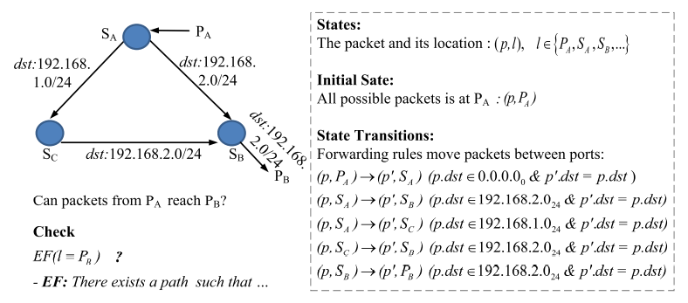
Plankton (NSDI’20 University of Illinois at Urbana-Champaign) Scalable network configuration verification through model checking

Slide 18
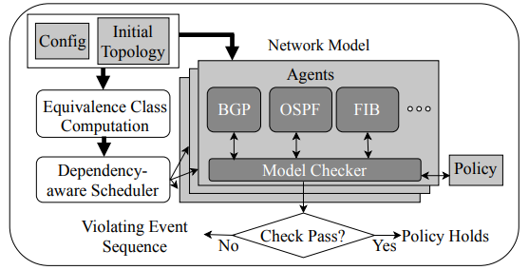
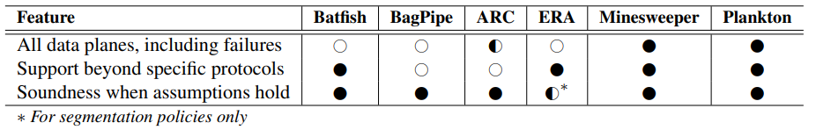
Plankton (NSDI’20 University of Illinois at Urbana-Champaign) Scalable network configuration verification through model checking
workflow
a suite of optimizations
state hash, partial order reduction, policy-based pruning…
stay close to the actual protocol execution
scalable, expressiveness
Notes:
feature1:multiple possible converged data plane states of the network (e.g., due to topology changes or control plane non-determinism)
ARC [7], for example, uses graph algorithms to compute the multiple converged states enabled by failures, but only for shortest-path routing.
As a result it cannot handle common network configurations such as BGP configurations that use LocalPref, any form of recursive routing, etc.

Slide 19
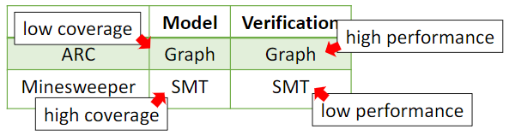
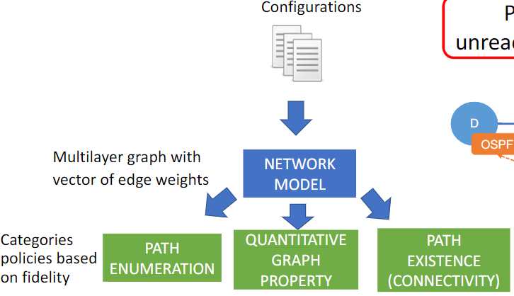
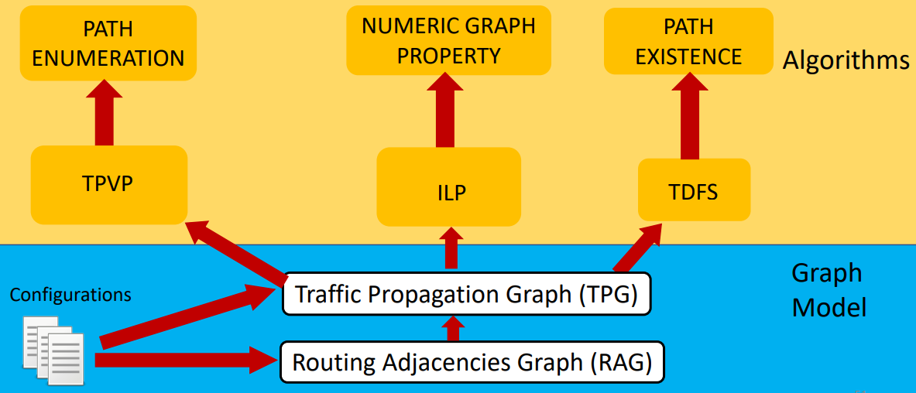


Tiramisu (NSDI’20 University of Wisconsin-Madison) Fast Multilayer Network Verification
insight1 decouple network encoding from verification algorithm
insight2 different properties require different levels of fidelity modeling of the control plane. Use property-specific algorithm for performance benefits
Notes:
ARC, Minesweeper, Plankton网络模型和验证算法高度耦合，在coverage和performance间不够灵活
用不同建模程度的算法对不同的网络属性进行验证
1.枚举路径（选路）; 2.对图的属性量化（路由器A能够到达B当其中某一条链路故障时）；3.路径存在性（路由器A能够到达B）
TPVP - Tiramisu Path Vector Protocol（路径矢量选路协议）
ILPs - Integer Linear Programs （整数线性规划，Reachability < K failures = Minimize link failures ）
Tiramisu Depth First Search

Slide 20
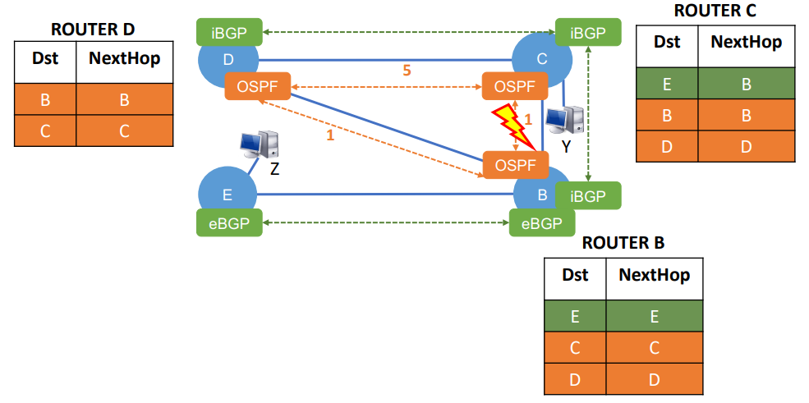
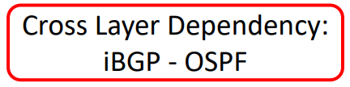
Tiramisu (NSDI’20 University of Wisconsin-Madison) Fast Multilayer Network Verification
key idea: use graph algorithms specific to each type of policy
Notes:
ARC: low coverage(如缺少对iBGP-OSPF依赖建模), high performance
Plankton(如iBGP-OSPF的依赖被建模为PEC之间的依赖，导致SPIN的并行度低)

Slide 21
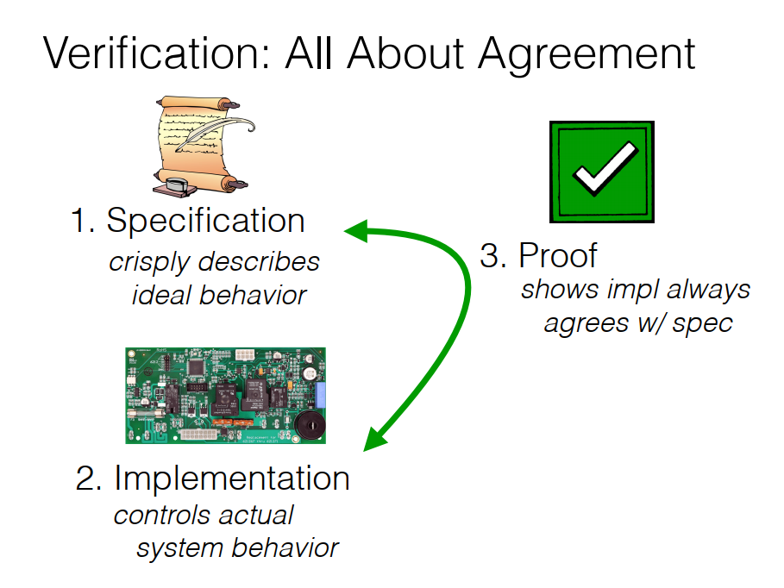
sigcomm’16
Notes:
主要关注路由，就介绍这几篇
其他还有别的验证
这里给出sigcomm16 verification的一种理解

Slide 22
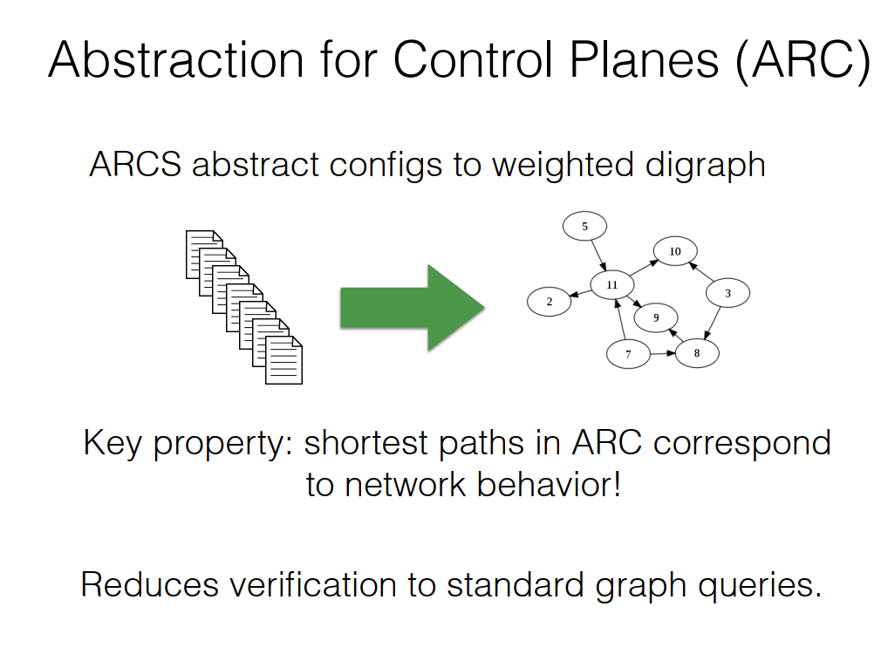

Slide 23
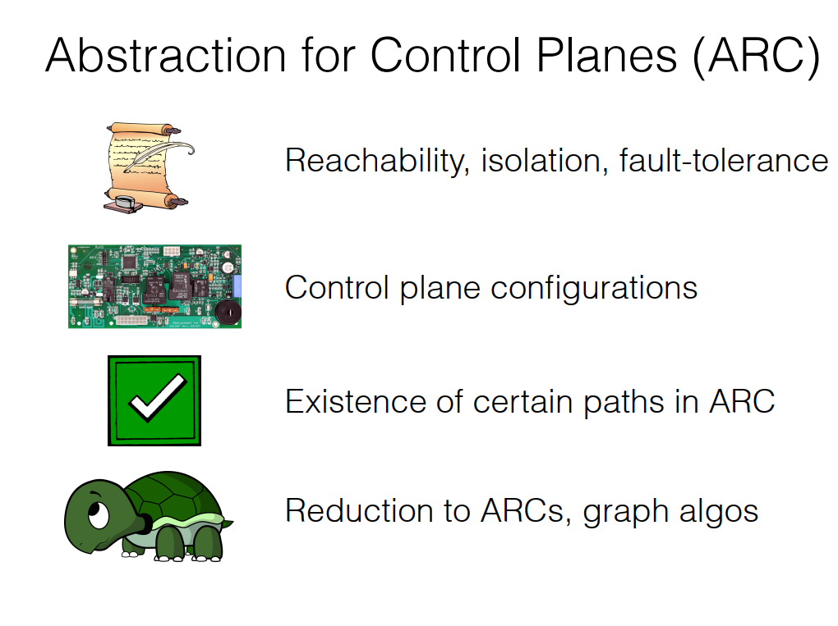
Notes:
Abstraction for Control Planes(ARC)
用最短路来表达网络属性

Slide 24
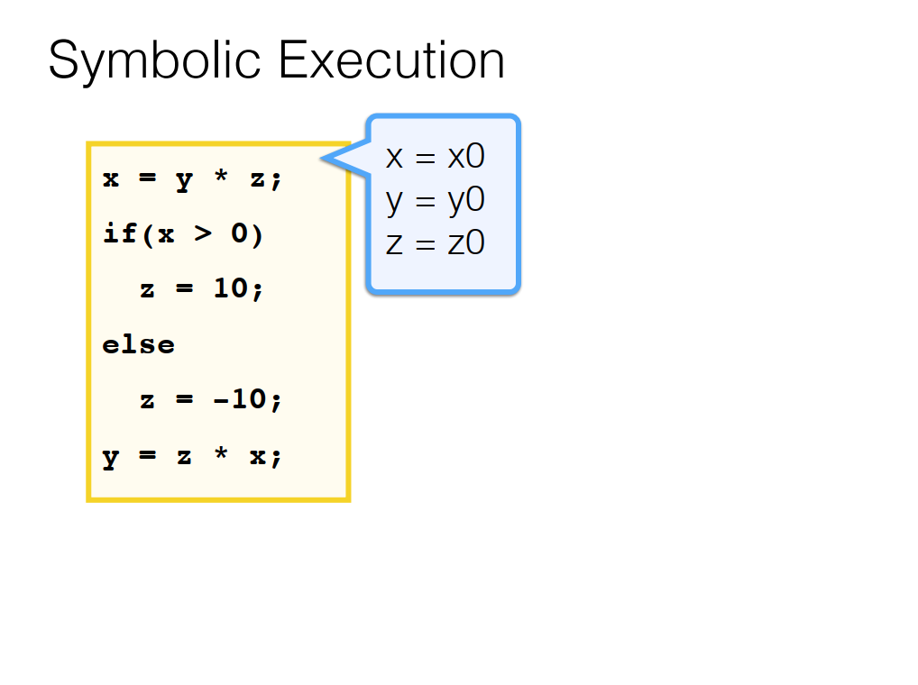

Slide 25
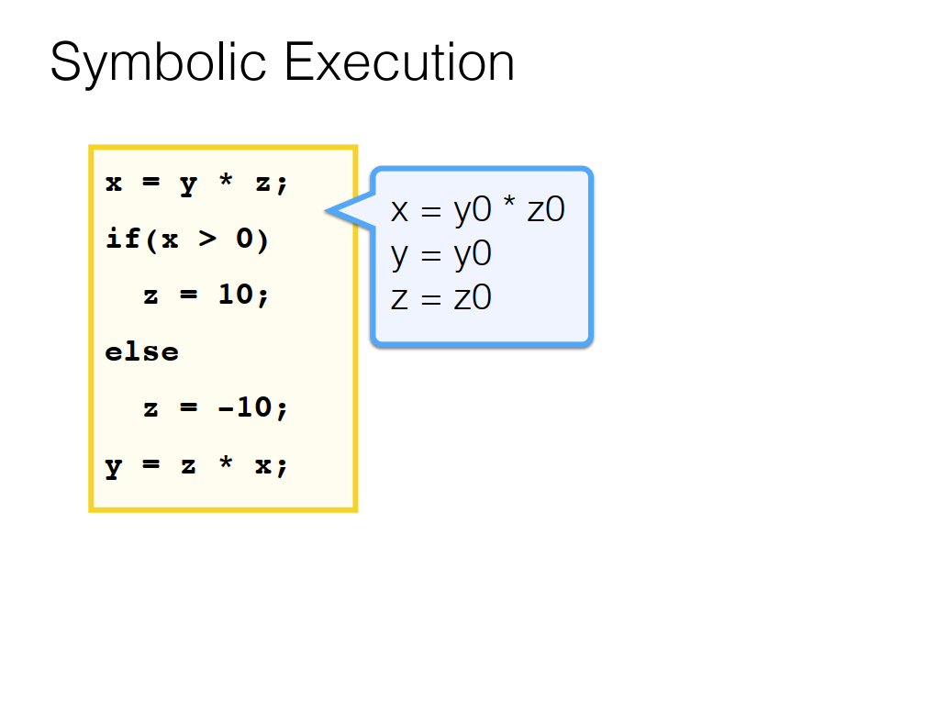

Slide 26
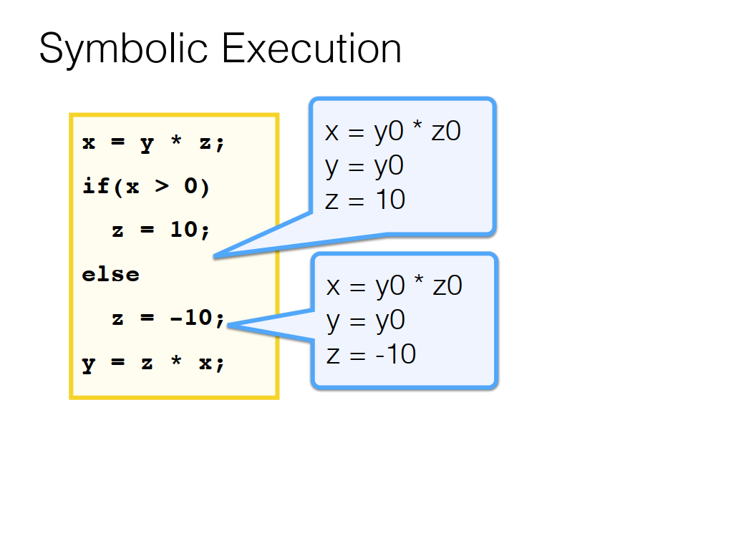

Slide 27
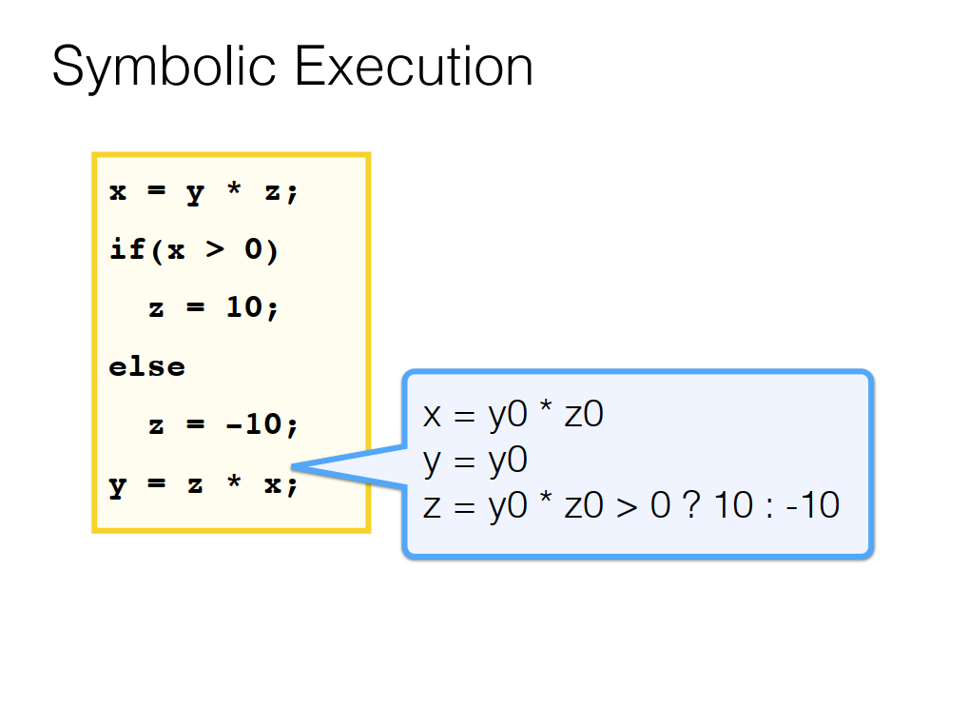

Slide 28
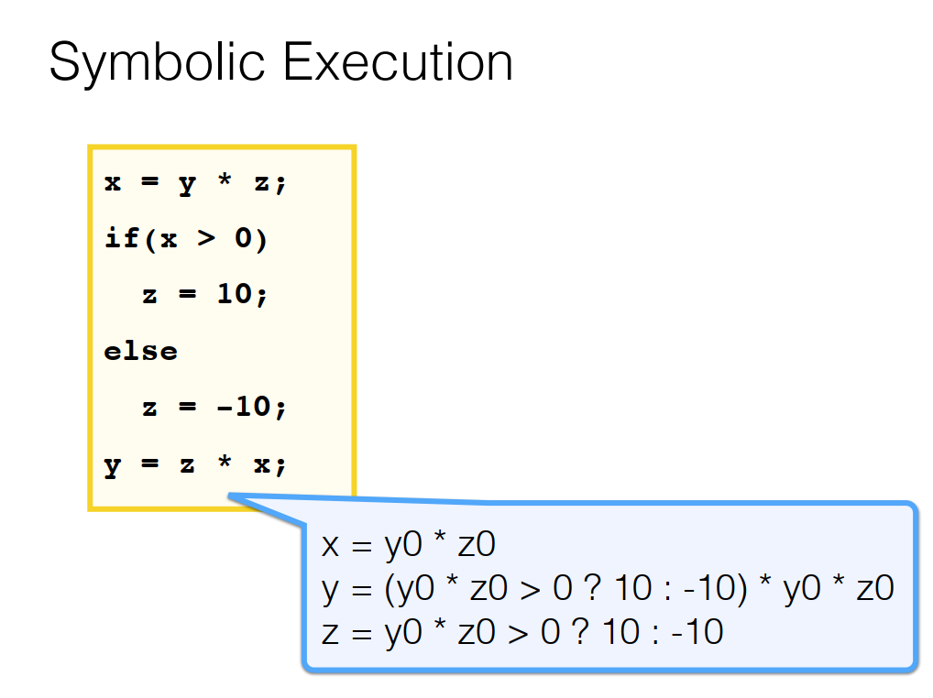
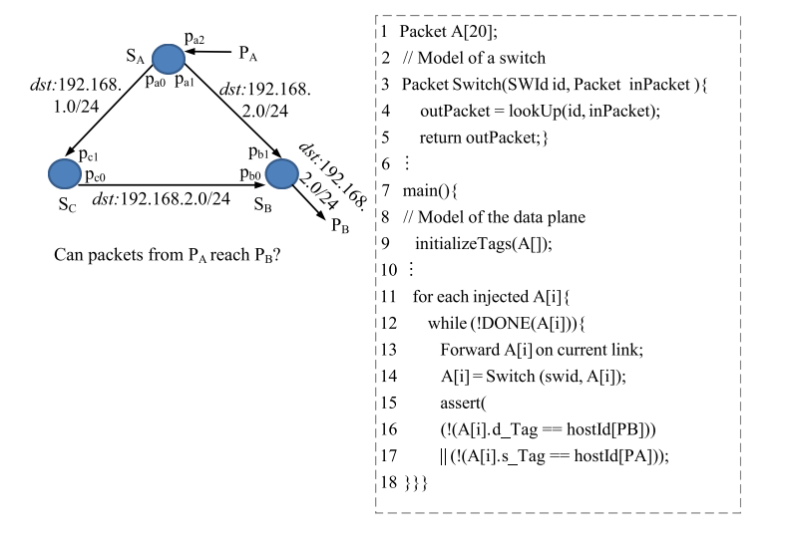

Slide 29
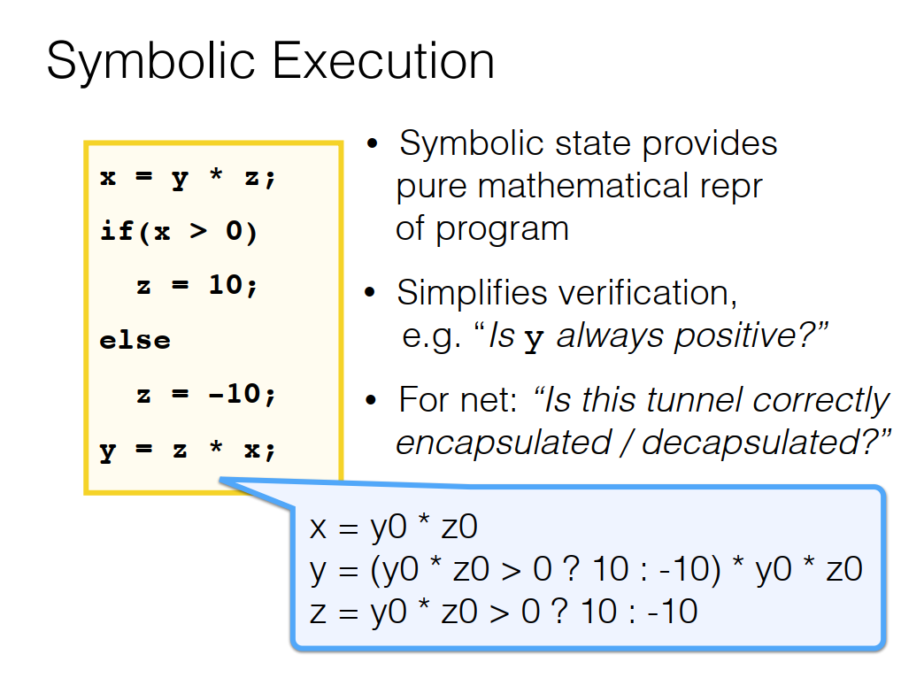


Slide 30
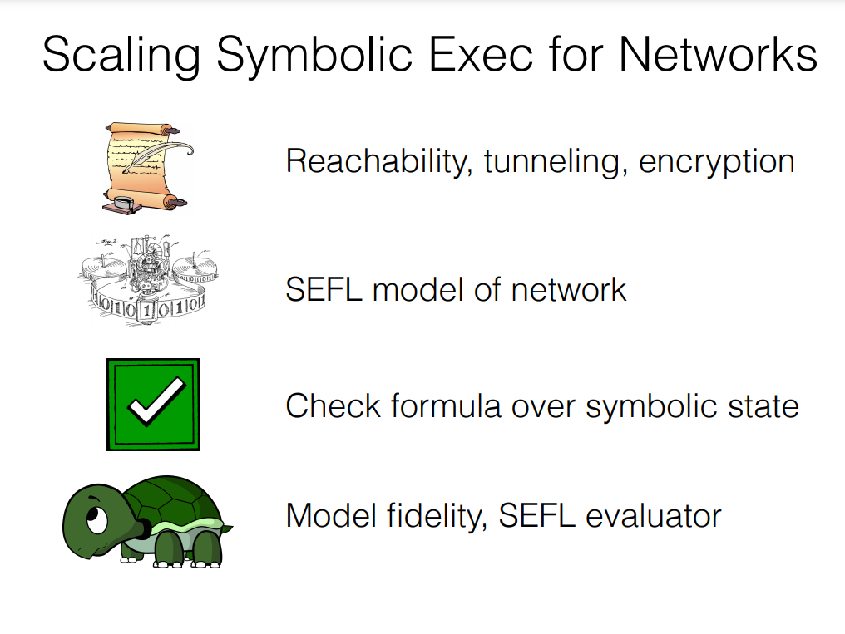
Notes:
Scaling Symb. Exec.

Slide 31
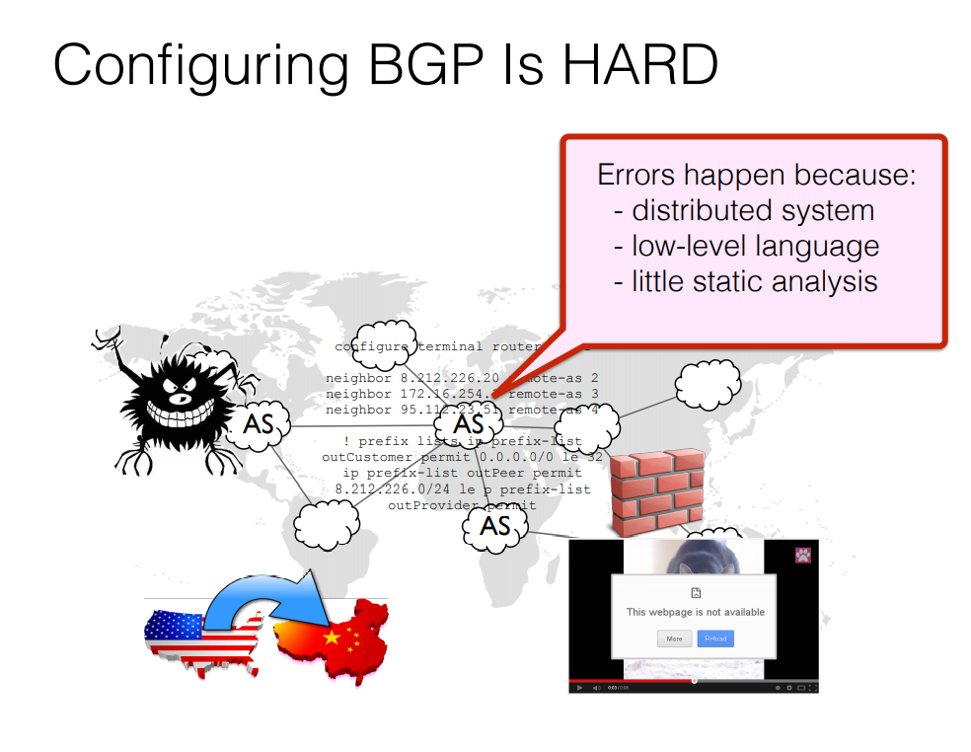
Don't Mind the Gap: Bridging Network-wide Objectives and Device-level Configurations
Synthesis
Compiling net Policies to BGP
Generate Impl from Spec!
Notes:
Compiling net Policies to BGP
Generate Impl from Spec!

Slide 32
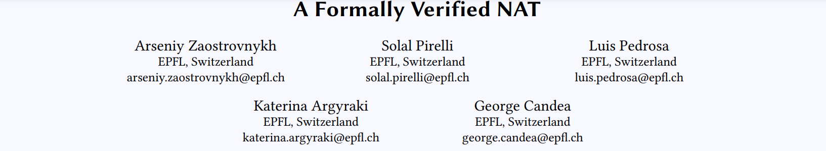
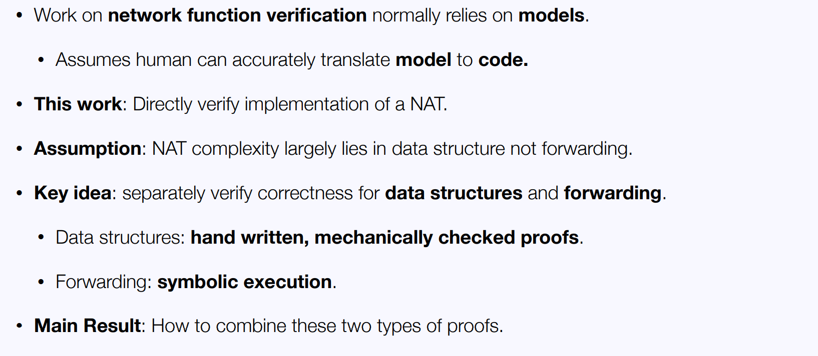
Notes:
NAT的复杂性很大程度上取决于数据结构的不转发

Slide 33

Our Contributions
GRoot – First verification tool for DNS to verify if a property of interest holds for all possible DNS queries
Symbolic execution of equivalence classes with the help of formal model for property checking
Correctness Theorems
Soundness – All queries in an EC have the same DNS resolution
Completeness – Each query belongs to at least one EC
Algorithm to generate equivalence classes of DNS queries to cover all possible queries for scalable analysis
Key Results
Campus – 109 bugs
Large Infrastructure service provider – 160k blackholing cases
First formal model of DNS resolution (RFC 6672) for automating zone file review

