Slide 1

ROTTEN ORANGE
Junyi Pan, Cam Lahey,
Badri Manishankar, Tierra Smith

Slide 2
PROJECT SUMMARY
The database is designed for Rotten Orange Inc., which is an online movie catalog to keep track movies and user reviews. Users can view movie ratings, post reviews, and view other reviews. Admins can add new movies to the catalog.

Slide 3
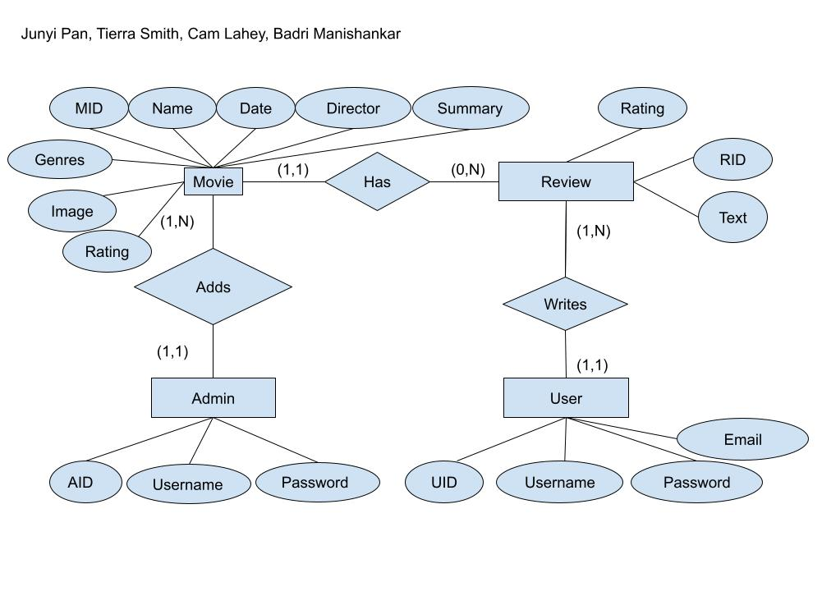
E-R DIAGRAM

Slide 4
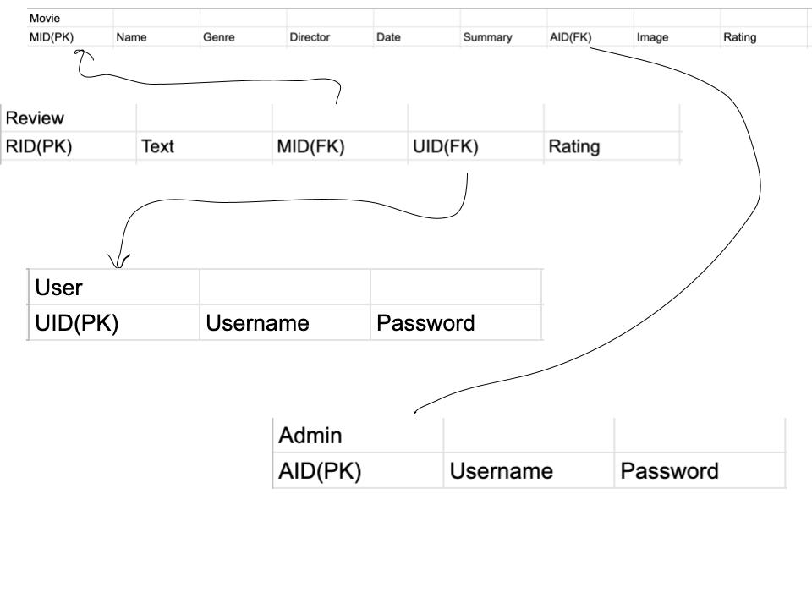
RELATIONAL SCHEMA

Slide 5
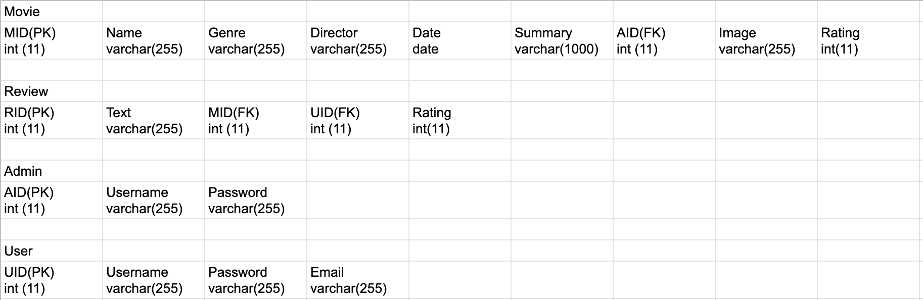
Data Types

Slide 6
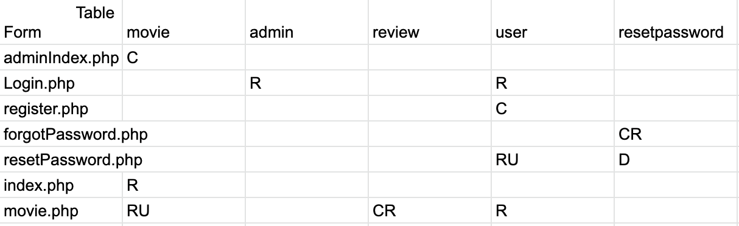
CRUD MATRIX

Slide 7
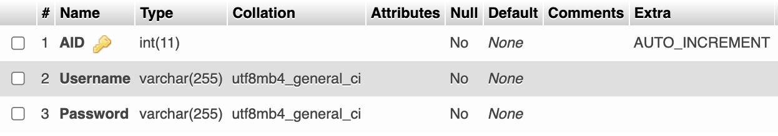
admin

Slide 8
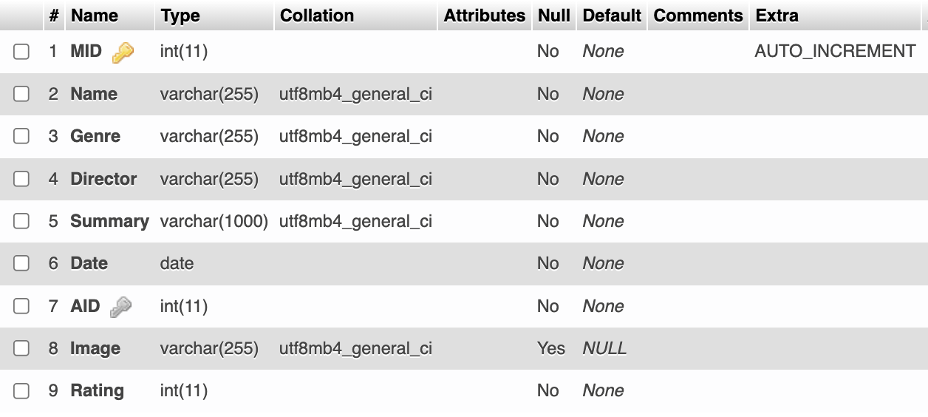
movie

Slide 9
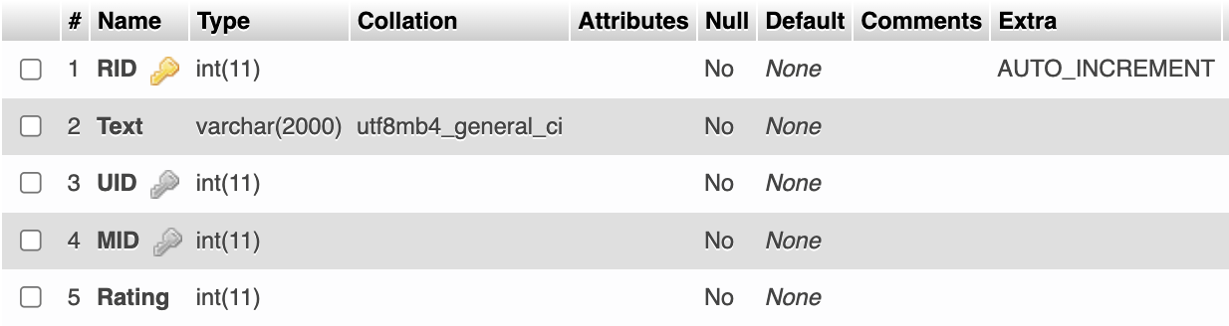
review

Slide 10
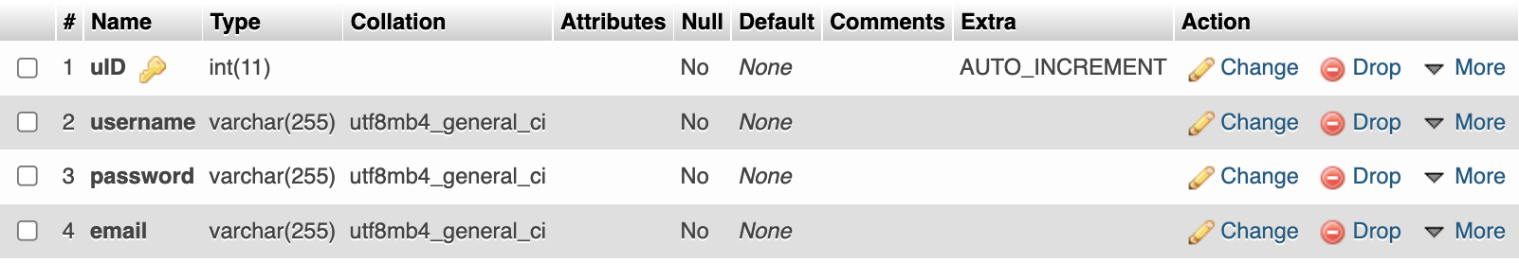
user

Slide 11
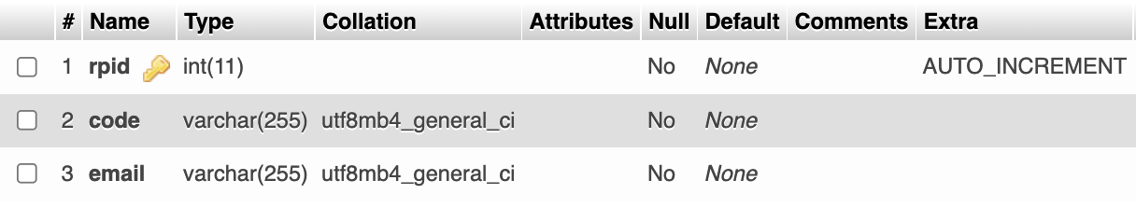
resetpassword

Slide 12
Trigger
Create Trigger addReview
After Insert
on review
FOR EACH ROW
UPDATE movie
SET movie.rating = (SELECT AVG(rating) FROM review WHERE movie.mid = review.mid)

Slide 13
View
CREATE VIEW MovieView AS SELECT * FROM movie;

