Slide 1
Rethinking LLM Internal-State Probing
From Fragmented Signals to Extensible Fusion
Junyi Chen
University of Auckland · NeurIPS 2026
Notes:
Thank the chair, introduce self and paper title. Keep brief.

Slide 2
Why Probe LLMs?
• Many deployment-critical properties are latent: hallucination, factuality, calibration, tool invocation
• Probing reads an internal signal from a frozen LLM and fits a lightweight classifier
• No finetuning, cheap to scale: a default tool in modern LLM analysis
2 / 15
Notes:
Frame probing as the go-to technique. The properties we care about are inside the model.

Slide 3
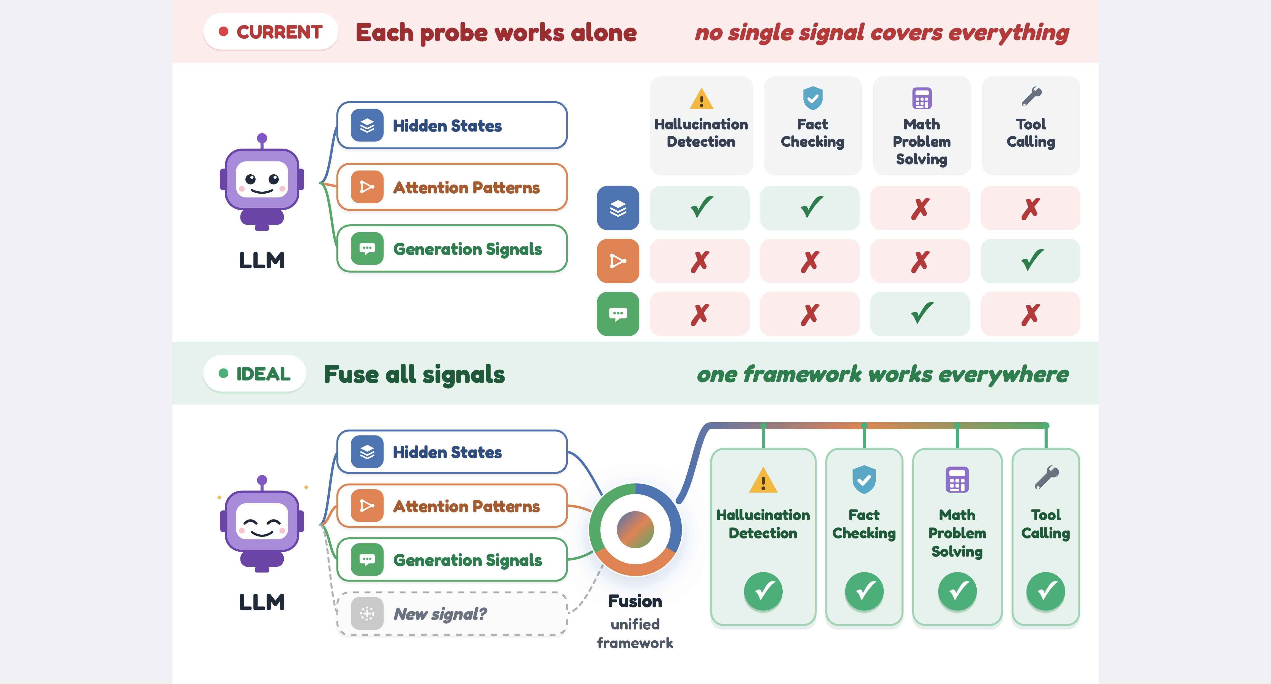
From Fragmented Probes to an Extensible Scaffold
Top: current paradigm, probes read in isolation. Bottom: ideal paradigm, probes plug into a shared scaffold.
3 / 15
Notes:
Thesis slide. Walk top (fragmentation) then bottom (plug-in scaffold). The single visual the talk hinges on.

Slide 4
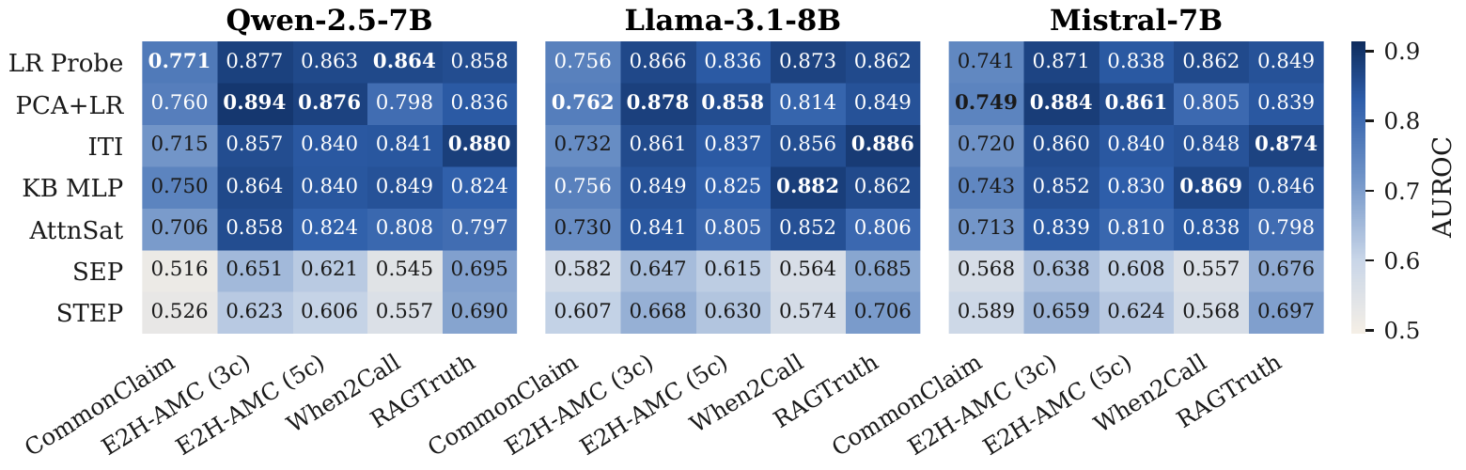
RQ1: Does Any Probe Generalize?
• Benchmark: 7 representative probes × 5 classification datasets × 3 open LLMs
• Tasks span hallucination, factuality, math, tool routing
• Each probe uses its original pipeline and hyperparameters
4 / 15
Notes:
Empirical setup. Hold on the heatmap briefly; punchline is on slide 5.

Slide 5
No Single Probe Dominates
• Column-winning probe shifts across tasks and models
• The ranking of probes changes in almost every cell
5 / 15
Notes:
Deliver the punchline: fragmentation is real. Point to cells where the winner flips.

Slide 6
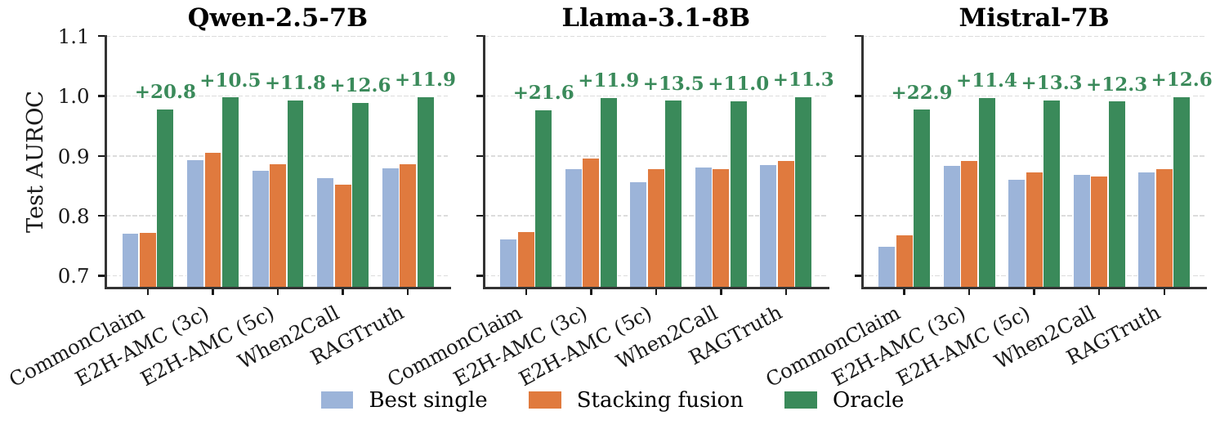
RQ2: Is Probe Disagreement Exploitable?
• Per-example oracle: for each test example, pick the probe that gets it right
• Headroom = oracle AUROC − best-single-probe AUROC
• Small headroom: probes agree. Large headroom: probes make genuinely different errors.
6 / 15
Notes:
Define the oracle. It measures whether fusion even has a ceiling worth chasing.

Slide 7
Probes Make Genuinely Different Errors
• Oracle headroom exceeds 10 pp on every dataset
• Simple stacking already captures part of it: the complementarity is exploitable in practice
7 / 15
Notes:
Green-vs-blue gap is the ceiling. Orange bar shows simple stacking already benefits.

Slide 8
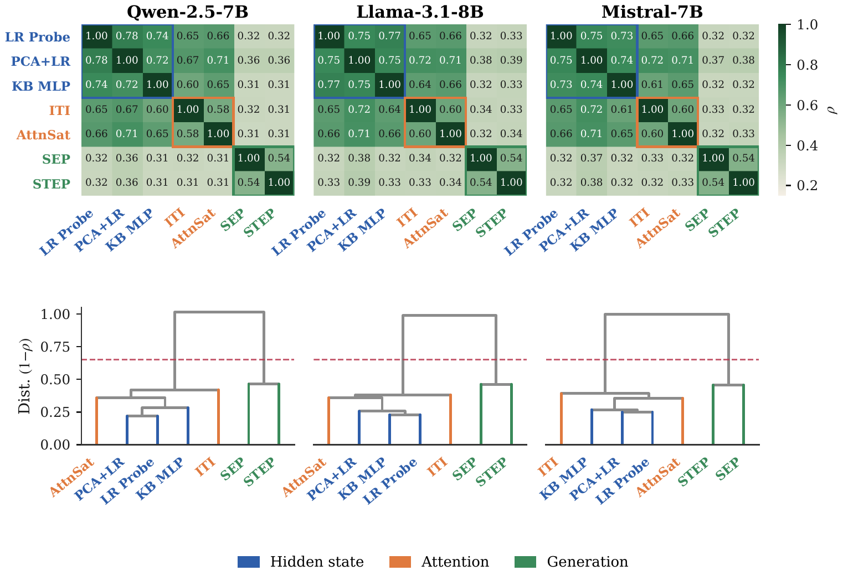
RQ3: Where Does the Diversity Come From?
• Probes cluster by signal family: hidden-state, attention, generation-side
• Cross-family correlation is low: diversity is structural, not random noise
8 / 15
Notes:
Spearman between probes. Clusters are clean and consistent across models.

Slide 9
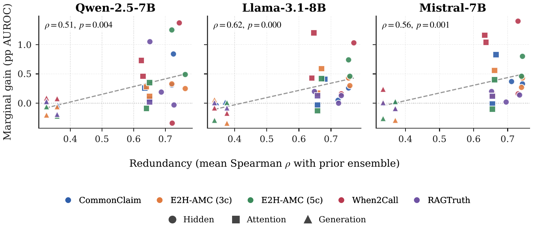
But Orthogonality Is Not Enough
• Most-orthogonal probes (generation-side) contribute the least because they are weakest in isolation
• Effective fusion needs diversity AND individual probe competence
9 / 15
Notes:
Counterintuitive: more orthogonal is not more useful. Competence is the missing variable.

Slide 10
Design Targets for the Scaffold
• (i) Decision-level fusion → keep each probe's prediction separate, preserve cross-family orthogonality
• (ii) Learned meta-combiner → per-task weighting, no manual probe selection
• (iii) Plug-in extensibility → adding a new probe requires retraining only the combiner
10 / 15
Notes:
The three design targets fall out of the three findings.

Slide 11
The Scaffold: Two Stages
Stage 1 — Per-expert prediction
Each probe wrapped in an identical predictor: • StandardScaler + PCA • Logistic regression (linear) • Gradient-boosted trees (nonlinear) → 5-fold out-of-fold probabilities per probe
Stage 2 — Meta-classification
Concatenate all per-expert probabilities into a meta-feature vector Fit L2-regularized logistic regression with cross-validated strength → Final class prediction
Adding a new probe: train its expert, refit the combiner. Existing experts are untouched.
11 / 15
Notes:
Walk through Stage 1 then Stage 2. Emphasize decision-level fusion and plug-in property.

Slide 12
Main Results
Ranks first on all 15 dataset-model pairs
+1.7%
+5.6%
15 / 15
Median gain over best single probe
Largest single gain (Qwen / When2Call)
Dataset-model pairs improved
No task-specific tuning. Same pipeline, same hyperparameters across datasets and models.
12 / 15
Notes:
Headline result. 15/15 is every dataset-model combination tested.

Slide 13
Both Design Choices Are Load-Bearing
• Meta-combiner: replacing the learned combiner with Prediction Averaging loses up to 6.1 pp
• Simple LR Stacking recovers most of it but still fails on When2Call (heterogeneous probe behavior)
• Expert library: LR-only or GBT-only loses several pp on heterogeneous tasks; LR + GBT covers both
• Neural meta-learners (≈ 500K params) degrade by 2–9 pp: standard overfitting at these training sizes
13 / 15
Notes:
Naive fusion hurts. Library diversity is the lift on heterogeneous tasks.

Slide 14
Takeaway
Stop searching for a universal probe.
Maintain a scaffold that absorbs each new signal as a plug-in expert.
Diagnostic
Structural
Constructive
No single probe generalizes; oracle headroom is large
Disagreement clusters by signal family
Two-stage scaffold wins on all 15 pairs
14 / 15
Notes:
End with the one-liner. Recap three contributions in one line each.

Slide 15
Thank You
Questions?
Paper + code available
(QR code placeholder — replace with real URL)
Notes:
Pause and invite questions. Swap placeholder for the real QR before presenting.

