Slide 1
maia
USER ACCEPTANCE TESTING · GO-LIVE READINESS
Macro Frozen × MAIA
THE ONLY OUTPUT THAT MATTERS
A go-live decision
by 3:15 p.m.
Core Order Workflow UAT
GREEN
AMBER
RED
Session run by AutorunBiz PLT × MAIA · Facilitator: Ivan · Walkthrough: Gareth
Evidence-based, not opinion-based.
28 July 2026
1:00 – 3:15 p.m.
Macro Frozen office
Hard stop 3:15 p.m.
Notes:
Open by naming the purpose: this is hands-on UAT, not a demo. The session succeeds only if we can make a defensible Green/Amber/Red call by 3:15.

Slide 2
PURPOSE
What today decides
This is a hands-on User Acceptance Test, not a product demonstration. We are checking whether your team can run the core order workflow themselves.
1
2
3
4
The workflow works end to end
Each user can do their own job
Controls block what they should
The workflow is safe to go live
Customer order → Sales Order → Pick List → Delivery Note → Invoice → SQL.
Not Gareth driving. Your people, your accounts, your roles.
Permissions, price approval tiers and credit checks are tested by trying to break them.
After the final production-data synchronisation.
Success = the evidence supports a clear Green, Amber or Red decision before 3:15 p.m.
Anything we cannot prove today becomes a logged defect with an owner and a date — not an assumption.
Notes:
Emphasise: we test prohibited actions as well as permitted ones. A control that has never been tried is not a control.

Slide 3
RUNNING ORDER
Agenda — 1:00 to 3:15 p.m.
1:00 – 1:15
Introduction, changes since last UAT, data notice
Ivan
85
1:15 – 1:30
One-order guided walkthrough
Gareth
minutes hands-on
with your team
1:30 – 1:40
Confirm operating model and roles
Ivan + David
1:40 – 2:05
Scenario 1 — Lead → Customer → non-PO kg order
Queenie + team
Parking lot
2:05 – 2:30
Scenario 2 — formal PO and carton order
Grace, Ben, CJ
Anything off today's scope gets written down and owned — not debated in the room.
2:30 – 3:05
Scenario 3 — live order and Pick List PDF
Whole Macro Frozen team
Hard stop 3:15 p.m.
3:05 – 3:15
Results and go-live decision
Ivan + David
The decision is made inside the session.
Notes:
Highlighted rows are hands-on. Keep the walkthrough to one order and 15 minutes — no feature tour.

Slide 4
GROUND RULES
How we will run the session
1
Your hands on the keyboard
Gareth demonstrates once, then observes. If we have to take over, that is a finding and we log it.
2
We test what must be blocked
Ben will try to open Queenie's Lead. Lai will try to submit a Delivery Note. Both must fail.
3
Known data issue ≠ product defect
Before logging a missing record: is it after 3 July, or on the known exception list?
4
Everything unresolved gets an owner
Blocker, impact, workaround, owner, date. No open items leave this room unassigned.
If something is genuinely broken, we want to find it here — not on Monday with a real customer waiting.
Notes:
Set the tone: finding defects today is a good outcome, not an embarrassment.

Slide 5
CHANGES SINCE THE LAST UAT · 1 OF 2
What is different this time
1
Leads only — Prospect hidden
2
Box orders on kilogram items
3
Improved Pick List PDF
One place for new opportunities. Leads carry notes and details, then convert into a Customer with the information intact.
An agreed method for customers who order in cartons when the item is priced by weight.
Clearer customer details, better layout, practical space for handwriting, and re-upload back into MAIA.
No more deciding between Lead and Prospect.
See the next slide for the exact rule.
Must be judged in the warehouse, not on screen.
4
Shipping address on Customer Listing
5
Near-expiry and low-stock alerts
6
Excel-like bulk price setting
Delivery locations are now visible in the listing to help group orders by route or area.
Version 1 has shipped — notifications plus a report, with PDF output for users. Still being improved.
An Excel-style editing experience with pivot table views by item or by customer.
Lai will use this in Scenario 2.
Refinements land in the first week of August.
For awareness — not an acceptance target today.
Everything on these two slides is presented so nobody mistakes a deliberate change for a defect.

Slide 6
CHANGES SINCE THE LAST UAT · 2 OF 2
What is different this time
7
SQL data synchronised to 3 July 2026
8
SCN / CCN adapter hardening
A full synchronisation is loaded, with a short list of known source-data exceptions.
Both document flows work today, but the adapter is still being hardened.
Covered in detail in two slides.
Target: first week of August.
9
Purchasing page hidden
10
Goods Receive Note stays in SQL
MAIA does not support a Purchasing Module for Macro Frozen. Hiding the page also keeps costing information out of view for current users.
GRN creation, stock receiving and purchasing-related stock entry continue in SQL, unchanged.
Nobody builds a habit on a workflow we do not run.
By design — not a gap in today's test.
Everything on these two slides is presented so nobody mistakes a deliberate change for a defect.

Slide 7
THE RULE THAT MATTERS MOST
Kilograms, cartons, and what actually gets billed
The billed quantity is always the actual picked weight. Never a guess made at order entry.
CUSTOMER ORDERS IN KG
CUSTOMER ORDERS IN CARTONS
Customer order
20.00 kg
Additional Notes
“2 cartons”
Sales Order quantity
20.00 kg
Sales Order quantity
1 kg placeholder
Actual picked
19.71 kg
Carton 1 picked
10.44 kg
Carton 2 picked
11.82 kg
Billed on the Delivery Note and Invoice
19.71 kg
Billed on the Delivery Note and Invoice
22.26 kg
A short pick is normal. The customer is billed for what actually left the warehouse, not what was ordered.
Carton count goes in Additional Notes. The 1 kg placeholder holds the line. Real weight is confirmed at picking.
Automatic splitting of document lines is not built yet, so Lai breaks the picked total into individual weight lines by hand, and Grace checks it before submitting.
Notes:
This is the single most misunderstood rule. Make Queenie and Ben repeat it back before moving on.

Slide 8
HONEST STATUS
What is not ready — and not part of today's acceptance
Sales Dashboard by salesperson
Estimated first week of September
Also out of scope today
Purchasing module workflows
Delivery-route management
Driver application
Barcode / QR scanning
AP and supplier payments
Cosmetic-only improvements
Product Catalogue Generator
Estimated mid-September
AR bank-statement reconciliation and OR creation in SQL
Estimated mid-September
Packing List Excel extraction
Not completed — not part of the adopted workflow
RESOLVED SINCE LAST REVIEW
Proof of Delivery is now confirmed in scope — capture and storage are part of today's acceptance.
Automatic line splitting across SO, DO and Pick List
Not completed — manual breakdown continues
Goods Receive Note creation for stock entry
Outside current MAIA scope — continue in SQL
None of the above blocks go-live for the core order workflow. They are tracked with their own dates.
Notes:
Say this early and plainly. If the client discovers a gap themselves later in the session, trust drops.

Slide 9
BEFORE WE START TESTING
What is in the UAT data
Records that could not be synchronised
3 JULY 2026
Exception | Count | Amount | Current understanding
Payment Entries with missing Invoice references | 8 | RM593,457 | Linked Invoices are suspected deleted
Zero-amount Payment Entries | 6 | RM0 | No accounting-ledger impact
Delivery Note with zero quantity | 1 | — | Invalid or incomplete DN record
SQL synchronisation cut-off
for this environment
Before logging a missing record
1
Is it dated after 3 July?
These are existing source-data issues, not new MAIA defects.
2
Is it on the known exception list?
They are tracked separately for data remediation. Today we are validating workflow, permissions, controls, documents and the valid synchronised records. If a newer customer, item, price or document is missing, we check the cut-off and the exception list before treating it as a defect.
3
Does it exist in SQL at all?
4
Only then classify it as a defect.
Notes:
Read the client-facing wording almost verbatim. This slide protects the defect log from noise.

Slide 10
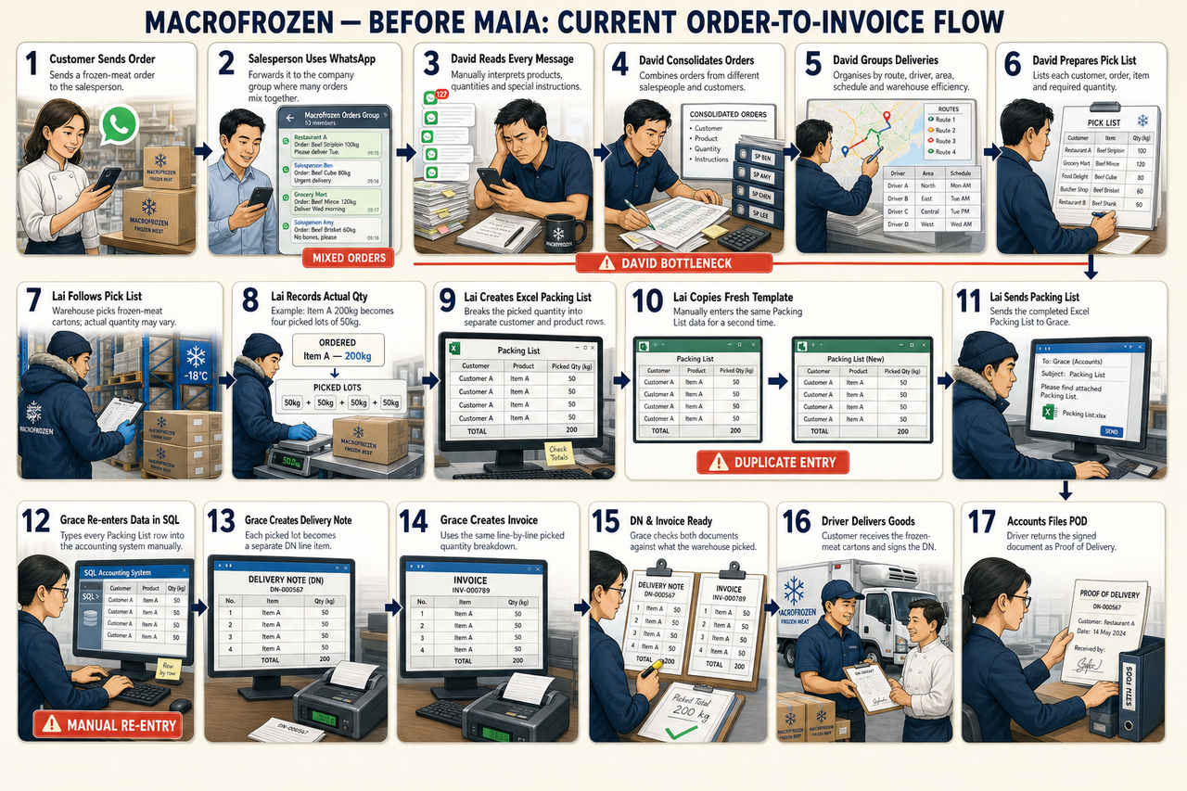
WHERE WE STARTED
Before MAIA — today's order-to-invoice flow
17 steps
from customer order to filed proof of delivery
One bottleneck
David reads, interprets and consolidates every message
Three re-entries
Excel packing list, fresh template, then SQL by hand
Every re-entry is a chance to bill the wrong weight.
Notes:
Do not dwell. This slide exists to make the after-state feel earned.

Slide 11
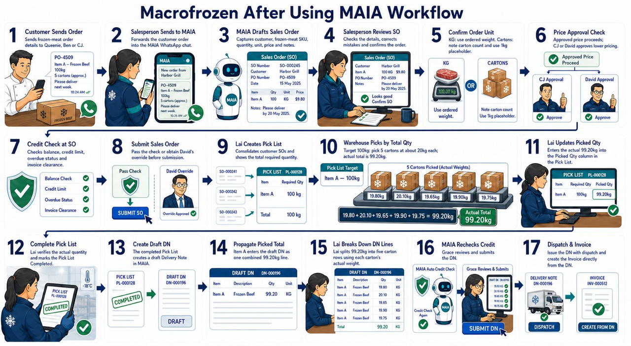
THE ADOPTED TARGET — APPROACH 1
After MAIA — the workflow we are testing today
No separate Excel Packing List
The Pick List becomes the Draft Delivery Note directly.
One source of quantity
Actual picked weight flows through DN and Invoice.
Controls built into the flow
Price approval and two credit checks, before anything ships.
Worked example — picked total 99.20 kg becomes DN lines of 19.80 + 20.10 + 19.65 + 19.90 + 19.75 kg
Notes:
Confirm out loud with David that Approach 1 is still the adopted model before starting the scenarios.

Slide 12
CONFIRM THE OPERATING MODEL
Who does what today
D
David
C
CJ
Q
Queenie
Owner · Credit & Price Controller
Sales Manager & Sales User
Sales User
Approves below-minimum prices. Shares credit overrides with Finance. Final go-live call.
Sees the whole sales team. Approves mid-tier price exceptions. Runs own orders too.
Own Leads and customers. Forwards orders to MAIA, reviews the draft, submits the SO.
B
Ben
L
Lai
G
Grace
Sales User
Warehouse Manager
Finance · Credit Controller
Own Leads and customers. Forwards orders to MAIA, reviews the draft, submits the SO.
Pick List, actual picked quantity, box weights, Draft Delivery Note. Cannot submit a DN.
Formal PO intake, reviews every DN line, submits the DN, then creates the Invoice.
Every named user logs in with their own account. No shared credentials during UAT or after go-live.

Slide 13
ACCESS CONTROL
Who can see what — and what nobody can see
Sales Users
Sales Manager
Owner
Finance
Queenie · Ben
CJ
David
Grace · Apple
Own Leads & customers only
Own Sales Orders only
Can't see each other's records
Sees whole sales team
Approves mid-tier prices
No credit-override rights
Sees everything
Sets any price tier
Approves credit overrides
Only one who sees cost price
Credit controllers
View prices, can't set them
No cost-price visibility
“See all” never means see everything — the negative tests we will run
Queenie cannot see Ben's Leads or customers
Ben cannot see Queenie's Leads or customers
Sales users cannot approve their own price exception
CJ cannot approve below the minimum price
Grace and Apple cannot set or approve any price
Lai cannot submit a Delivery Note
Sales users cannot edit credit limits
Only David, Grace or Apple can approve a credit override
Only David can see product buying cost
Notes:
These are not theoretical. QA has attempted each one; we will re-attempt live in the scenarios. Credit-override authority sits with the credit controllers — David, Grace and Apple — not with CJ or sales. Price authority stays with David and CJ only; Grace and Apple can view any price but never set one.

Slide 14
CONTROLS
Price approval and credit checks
Three-tier price approval
Credit checks run twice
At or above the approved customer price
Auto-proceed
No approver
At Sales Order submission
1
Before the order enters the warehouse queue.
Below customer price, above the minimum
Approval required
CJ
Again at Delivery Note stage
2
Before goods leave and before invoicing.
Below the minimum price
Approval required
David
Each check tests
Outstanding balance
Credit limit
Overdue position
Previous invoice clearance, where required
Hard rules
Sales users can never approve their own price · CJ can never approve below the minimum · Grace and Apple can view any price but never set one
Today, approving means CJ or David open the order themselves, set the price, and submit it — the requester tags them with a comment to notify.
David, Grace or Apple — the credit controllers — approve an override.

Slide 15
SCOPE
What we are accepting today
Included in today's acceptance
Not acceptance-gated today
Access
Logins, roles, permissions, sales ownership limits, manager oversight
Sales Dashboard by salesperson
Product Catalogue Generator
AR bank-statement reconciliation
Official Receipt creation from AR
Packing List Excel extraction
Automatic document-line splitting
Goods Receive Note creation
Purchasing module workflows
Full product catalogue workflow
Delivery-route management
Driver application
Barcode / QR scanning
AP and supplier reconciliation
Near-expiry / low-stock refinements
Cosmetic-only improvements
Leads
Creation, notes, conversion to Customer, information carry-over
Order intake
WhatsApp forwarding, Draft SO, customer and SKU matching, user corrections
Units, price, credit
Kilogram orders, carton requests, approval routing, credit check at SO and re-check at DN
Warehouse
Pick List creation and grouping, shipping-address columns, MAIA's own PDF layout, re-upload, actual quantities and box weights
Documents
Draft DN from Pick List, review, submission, Invoice creation, POD capture. SO, Invoice and DN keep the SQL PDF layout.
Data
SQL synchronisation, record integrity, duplicate-document controls
Anything outside the left column goes to the parking lot with an owner — it does not change today's decision.

Slide 16
SCENARIO 1 · 1:40 – 2:05 · PRIMARY USER: QUEENIE
Lead → Customer → non-PO kilogram order
Validate the simplified Lead model, notes carry-over, sales ownership restrictions, and a standard kilogram order end to end.
Steps
Pass criteria
1
Queenie creates a Lead and adds customer notes
Prospect is not visible anywhere
2
Ben attempts to open Queenie's Lead — access must be denied
Ben is blocked from Queenie's Lead
3
Queenie converts the Lead to a Customer; notes and ownership carry over
4
Queenie forwards a 20 kg order; MAIA drafts the SO; she reviews and submits
Notes and ownership survive conversion
5
Approved price auto-proceeds; credit check passes
Billing uses the actual 19.71 kg
6
Lai creates the Pick List; actual picked quantity is 19.71 kg
Every permission holds
7
Lai completes the Pick List, creates the Draft DN, splits the box weights
8
Lai attempts to submit the DN — must be denied
SQL records are correct
9
Grace reviews and submits the DN, then creates the Invoice; verify SQL
Red-numbered steps are actions that MUST fail. If they succeed, that is a blocker.
Notes:
Scenario 1. Keep to the window. If the scenario stalls, log the blocker and move on — the decision at 3:15 matters more than a completed run.

Slide 17
SCENARIO 2 · 2:05 – 2:30 · PRIMARY USERS: GRACE, BEN, CJ
Formal PO and carton order
Validate formal PO intake, the carton rule on a kilogram-based item, and middle-tier price approval routing.
Steps
Pass criteria
1
Grace uploads the customer PO; MAIA extracts customer, item and PO reference
PO mapping works
2
Ben verifies customer & SKU; notes “2 cartons” with the 1 kg placeholder
The carton rule is followed exactly
3
Ben attempts to set the price himself — must be denied
4
Ben tags CJ in a comment to request approval
Self-approval is blocked
5
CJ opens the SO, sets the price, and submits; SO credit check passes
CJ can set and submit an eligible price
6
Lai groups the order using the shipping address and prints the Pick List PDF
Shipping address supports grouping
7
Warehouse records carton weights of 10.44 kg and 11.82 kg
8
Pick List uploaded and completed; Draft DN total confirms at 22.26 kg
The printed PDF is usable for handwriting
9
Grace reviews, submits the DN and creates the Invoice; verify SQL
Final quantity is 22.26 kg
Red-numbered steps are actions that MUST fail. If they succeed, that is a blocker.
Notes:
Scenario 2. Keep to the window. If the scenario stalls, log the blocker and move on — the decision at 3:15 matters more than a completed run.

Slide 18
SCENARIO 3 · 2:30 – 3:05 · USERS: THE ENTIRE MACRO FROZEN TEAM
Live operational order
Prove the real team can run a real order without Gareth taking over. Real order, real accounts, real roles. Gareth and Ivan observe; every assist is logged.
Steps
Pass criteria
1
Salesperson receives the order and forwards it to MAIA
Users operate independently
2
Salesperson reviews the Draft SO and submits it
Visibility rules hold under real use
3
Price and credit controls run
4
Lai groups the order using shipping information and produces the Pick List
Handoffs are clear to the team itself
5
Warehouse records the actual picked quantity and box weights
The PDF is practical in the warehouse
6
Lai completes the Pick List and creates the Draft DN
Quantities and SQL records are correct
7
Lai splits the actual line weights; DN credit check runs
8
Grace reviews, submits the DN and creates the Invoice; verify SQL
Nobody falls back to the old Excel process
9
The team explains each handoff in their own words
No scripted denials here — this run is judged on whether the team gets through it unaided.
Notes:
Scenario 3. Keep to the window. If the scenario stalls, log the blocker and move on — the decision at 3:15 matters more than a completed run.

Slide 19
DISCIPLINE
How we classify what we find
Core workflow is unsafe or impossible
Red unless fixed and re-tested
BLOCKER
Core works with a controlled workaround
Amber is possible
MAJOR WITH WORKAROUND
No material effect on correctness
Does not block go-live
MINOR
A future improvement
Parking lot
ENHANCEMENT
An existing SQL source-data issue
Tracked separately from defects
KNOWN DATA EXCEPTION
Classification happens in the room, by agreement — not afterwards by email.

Slide 20
3:05 – 3:15 P.M.
The go-live decision
GREEN
AMBER
RED
Proceed to go-live
Proceed with conditions
Do not go live
Critical scenarios pass
Accounts and permissions correct
Sales ownership restrictions hold
Manager visibility is in place
Pick List PDF is usable
Price and credit controls work
Actual quantity drives DN and Invoice
SQL records are correct
No blocker remains
No data-integrity risk remains
No permission risk remains
The workaround is documented
An owner is assigned
An expiry date is set
Macro Frozen accepts the constraint
Sales users can see each other's records
Manager visibility is missing
Account setup is incomplete
Unauthorised approval or submission is possible
Wrong customer, item, quantity, price or weight
Duplicate documents are created
SQL write failure
Pick List PDF is unusable
Users cannot complete the flow alone
Live two-way synchronisation is never enabled after a Red decision.

Slide 21
AFTER A GREEN OR APPROVED AMBER
The go-live transition and what follows
1
Catch-up sync
2
Reconcile
3
Confirm exclusions
Run the final SQL synchronisation up to the current date and time.
Check key record counts and control totals against SQL.
Verify the known excluded records remain documented.
4
Enable live sync
5
Smoke test
6
Official go-live
Turn on ongoing two-way synchronisation between MAIA and SQL.
Run a controlled post-sync test on a real order before opening it up.
The MAIA workflow becomes Macro Frozen's live operating process.
7
Hypercare group
8
Subscription starts
9
Virtual UAT per release
MAIA sets up a WhatsApp group for live support, issue resolution, bug reports and improvement feedback.
The balance of the set-up fee falls due only on delivery of all customisations.
We run a virtual UAT session for each customisation feature as it ships.
Items still in build — dashboard, catalogue generator, AR reconciliation, near-expiry refinements — continue on their own dates and do not gate this transition.
Notes:
Steps 1-5 are technical. Step 6 is the commercial moment. Steps 7-9 are the support model: hypercare WhatsApp group, subscription start with the set-up fee balance held against delivery of all customisations, and a virtual UAT for each customisation as it ships.

Slide 22
CLOSING THE SESSION
Today's result
GREEN
AMBER
RED
We tested the revised workflow, the simplified Lead model, sales ownership restrictions, manager visibility, carton handling on kilogram items, the improved Pick List PDF, shipping-address grouping, actual-weight processing, approvals, documents and SQL synchronisation.
Next step
On approval we run the catch-up synchronisation, reconcile the records, enable live two-way sync, then go live. A hypercare WhatsApp group opens the same day.
Still outside today's acceptance
Sales Dashboard · Product Catalogue Generator · AR reconciliation · Packing List Excel extraction · Automatic document-line splitting · Goods Receive Note creation
Every open item leaves here with an owner and a date.
maia
Macro Frozen × MAIA · Core Order Workflow UAT · 28 July 2026
Notes:
Read the result out loud, confirm it with David, and confirm the owner and date of every open item before anyone leaves.

