Slide 1
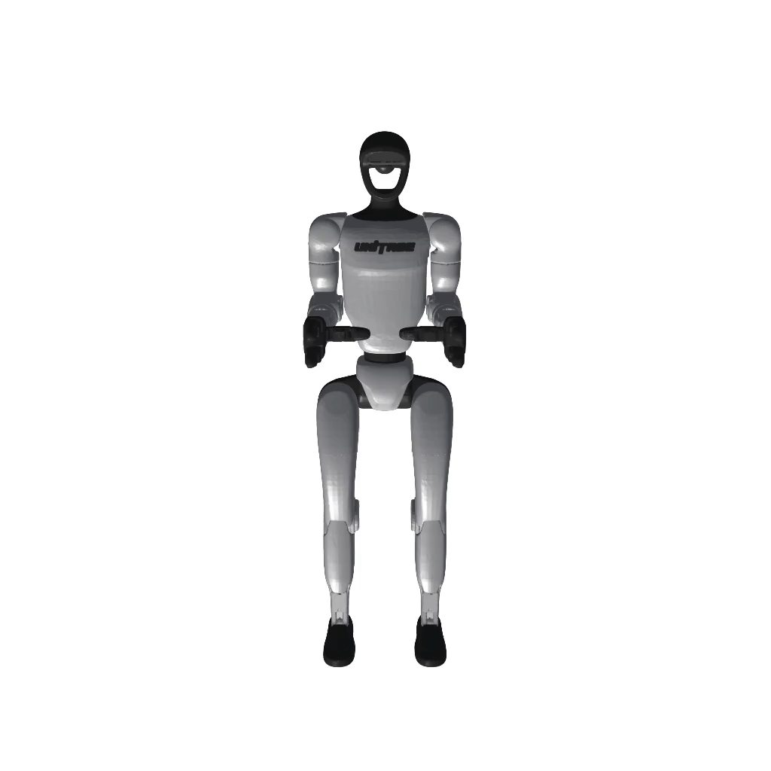
Independent Gaussian Sets
Gaussian Composition Engine
Real Scene Scan
(mesh and 3DGS)
🏠 Background
Rigid Transform
Object Scans
(mesh and 3DGS)
📦 Objects (×N)
Training Dataset
&
Photorealistic
Per Gaussian Relighting
Policy Training
🪑 Tables
Robot URDF
(mesh and 3DGS)
re-render
🤖 Robot Links
Cast shadow mapping
Zero-Cost
Augmentation
MuJoCo Physics
Contact dynamics
3DGS Rasterization
Grasp simulation
Collision (CoACD meshes)
→ Pose log (SE3 per frame)
Physics (MuJoCo) and Rendering (3DGS) are fully decoupled
Text is not SVG - cannot display
G1 3DGS
SE(3) per body per frame

