Slide 2
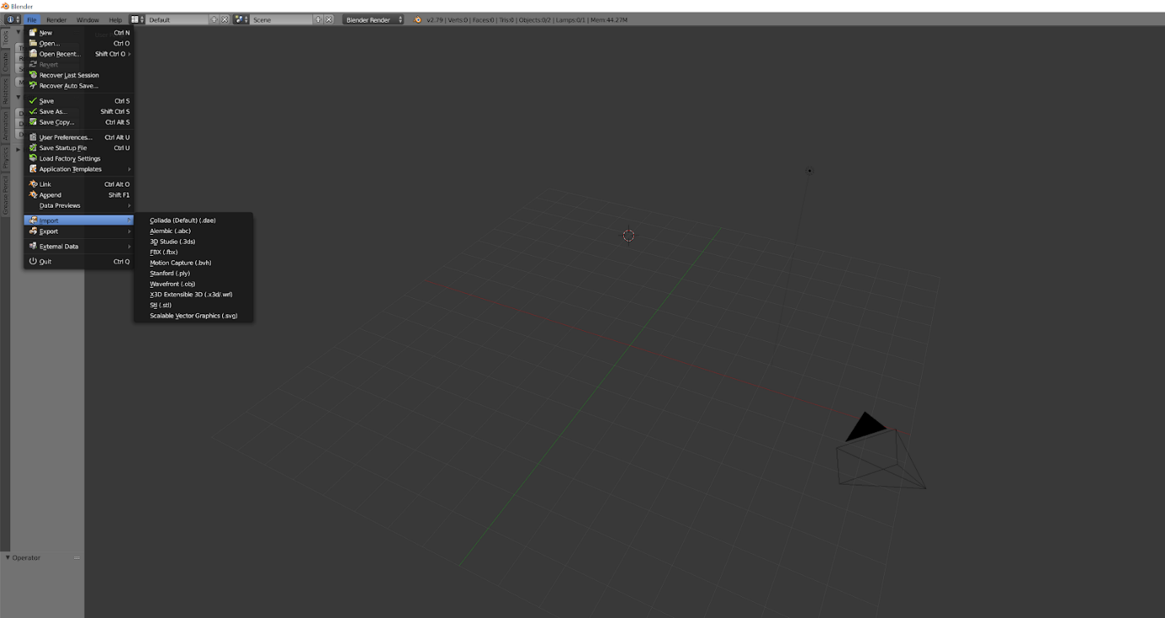
1
Import the obj file

Slide 3
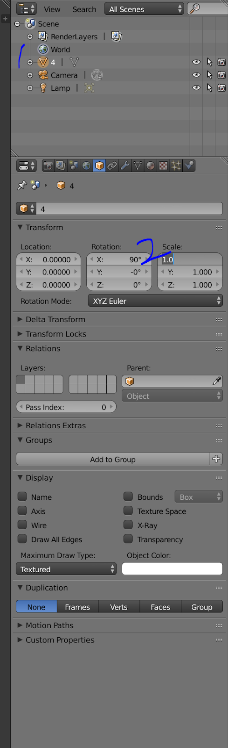
2
Select the obj and set scale
I’m using 0.007

Slide 4
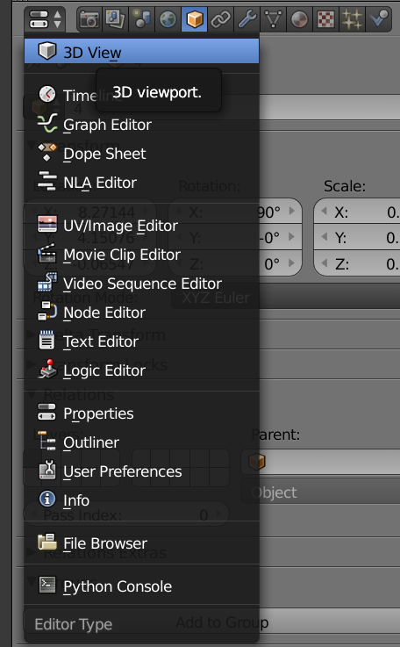
3
Set the window as 3D View

Slide 5
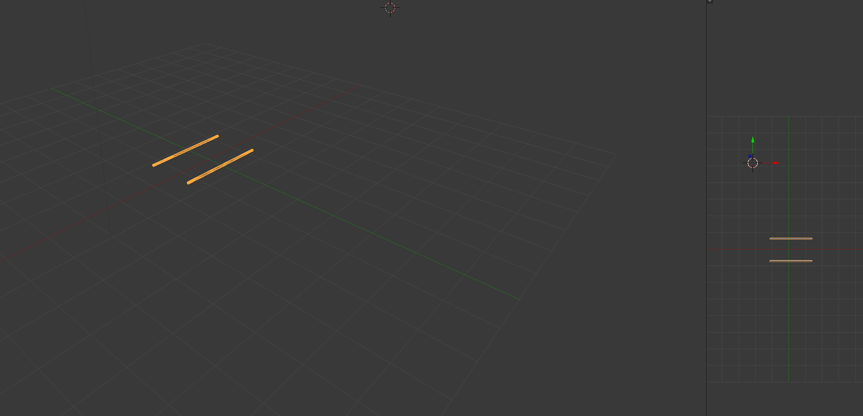
4
Set the window as 3D View
Translate the obj into origin

Slide 6
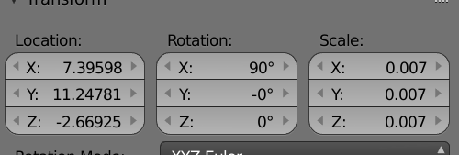
4
Translate other objs using same transform settings

Slide 7
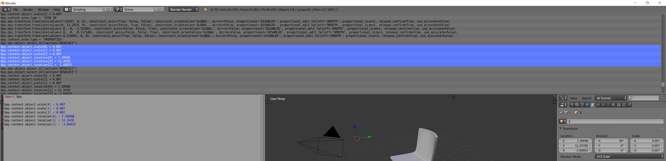
4
Or run the scale and location script after import and select the obj

Slide 8
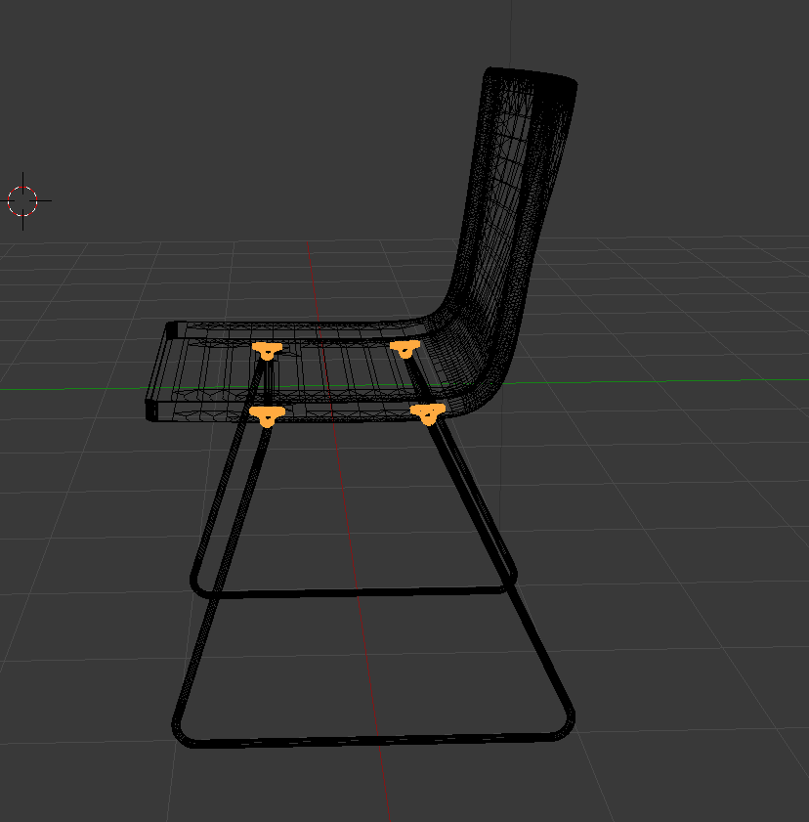
4
Result

Slide 9
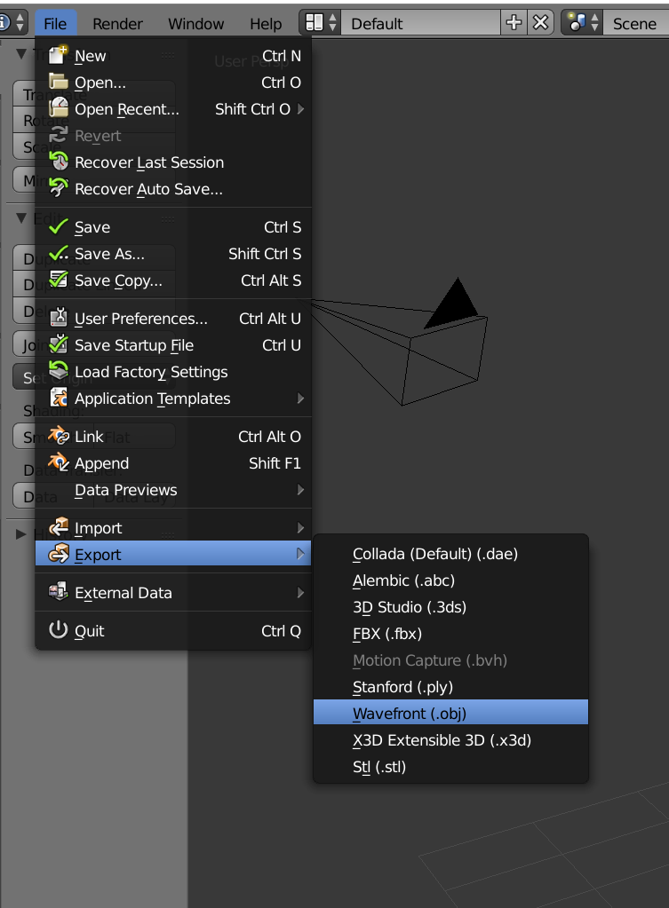
5
Then export the obj

Slide 10
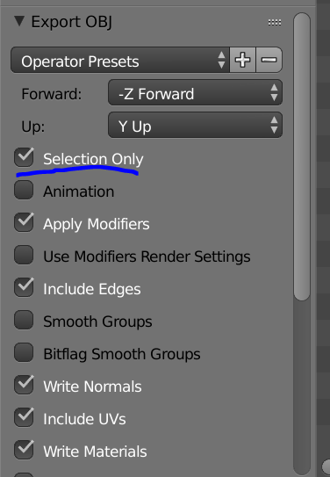
5
You can export single obj if you check this option in export window

Slide 11
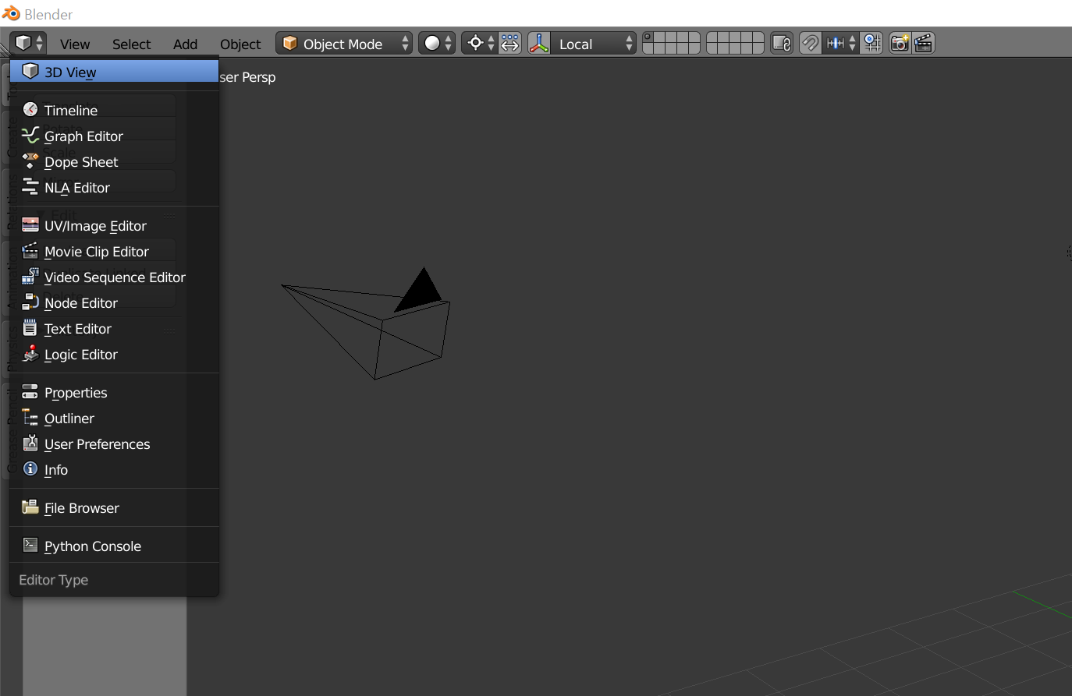
1
Set main window as 3D View mode

Slide 12
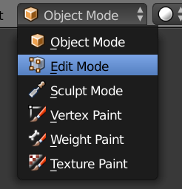
1
Use Edit Mode

Slide 13
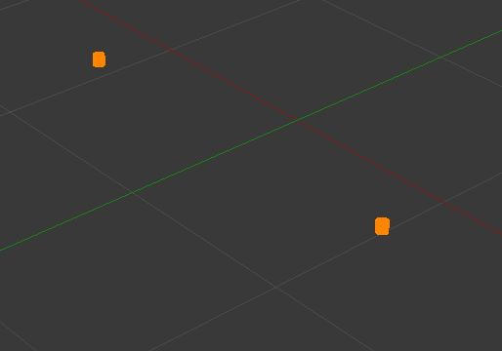
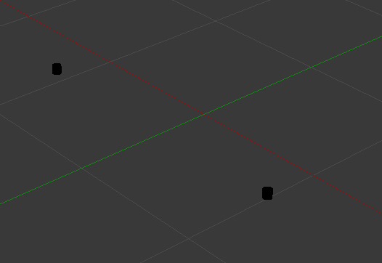
2
Press D A to Deselect All

Slide 14
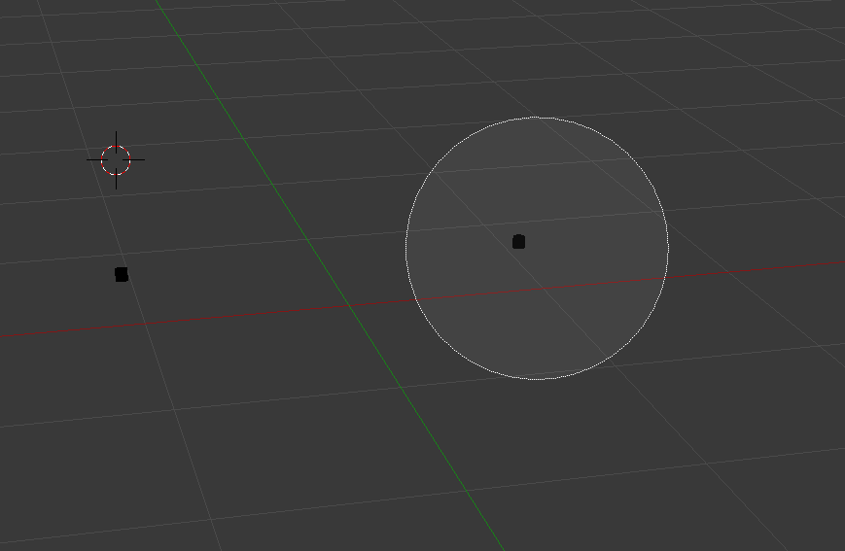
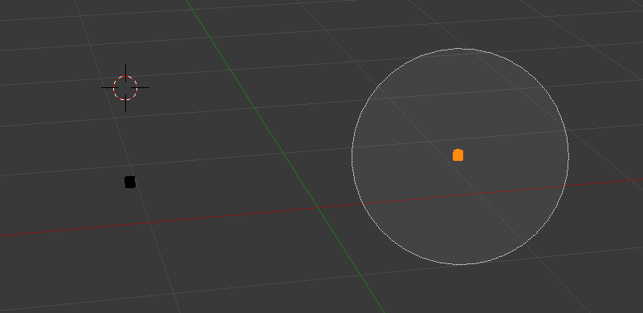
2
Press C to select then select one part

Slide 15
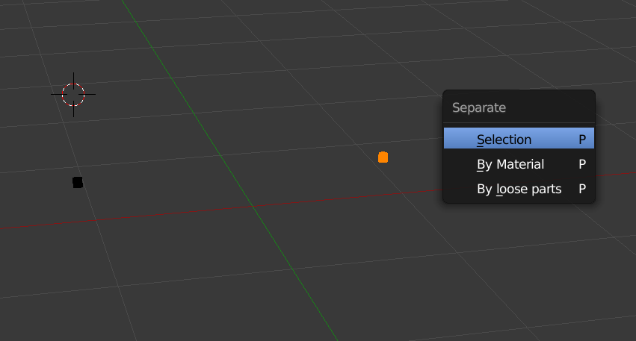
3
Right click to stop select and press P and choose separate by Selection

Slide 16

4
Now we have two separated objs

Slide 17
5
export single obj

