Slide 1
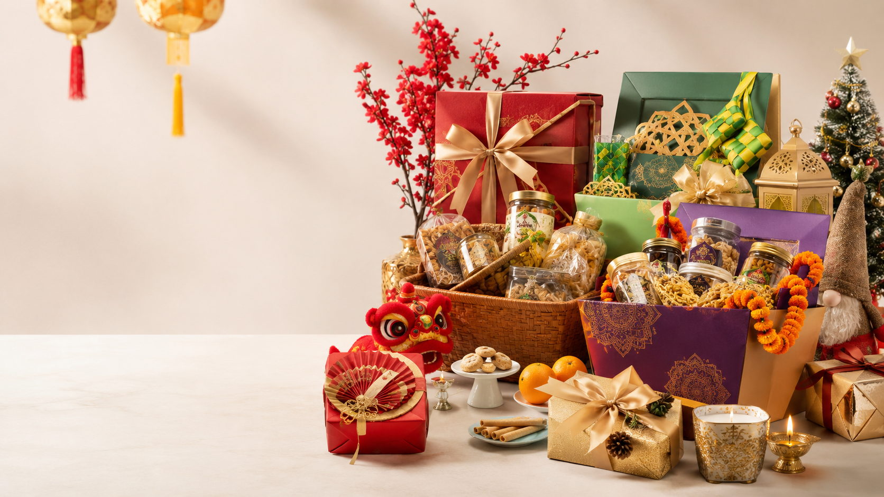
BUSINESS DECK
Malaysia Festive Gift Sales Pipeline
2026 campaign calendar, product structures, order pipeline, delivery windows and selling recommendations for festival gift boxes and hampers.
Comprehensive selling plan for seasonal hampers, gift boxes and corporate orders.

Slide 2
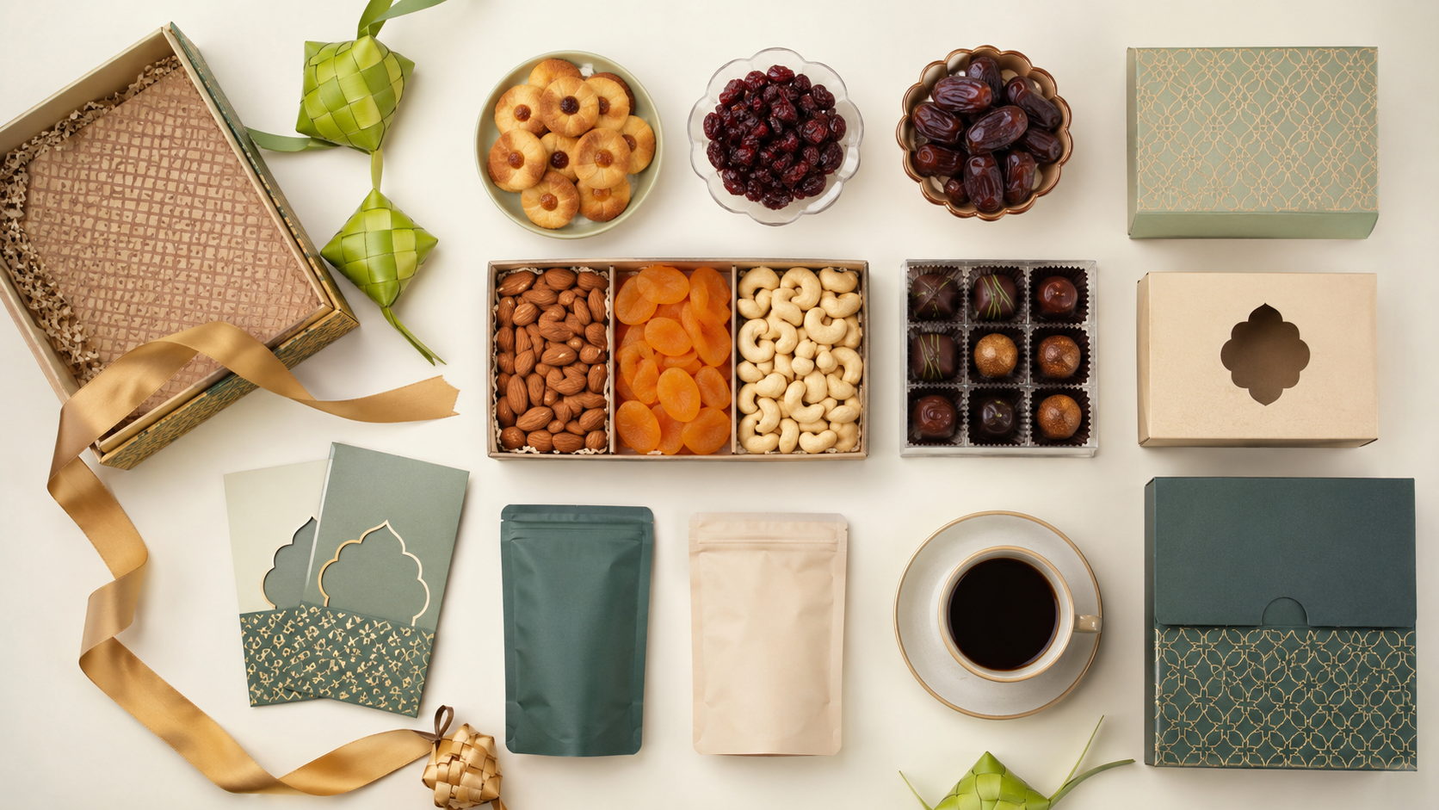
Executive Summary
A simple seasonal gift business can be run using repeatable campaigns and modular inventory.
1
Focus on 5 core seasons
2
Use 3-tier pricing
Chinese New Year, Hari Raya Aidilfitri, Christmas / Year-End, Deepavali and Mid-Autumn provide the strongest recurring gift demand.
Basic, Standard and Premium collections make ordering easy for personal and corporate buyers.
3
Open pre-orders early
4
Standardise operations
Launch 4–6 weeks before each major festival; close custom orders 7–10 days before delivery peak.
Keep reusable base items such as cookies, tea, coffee, nuts, chocolates, boxes, ribbons and greeting cards.
Business principle
One base hamper structure. Change the packaging colour, festive card and 1–2 seasonal hero items for each campaign.
Malaysia Festive Gift Sales Pipeline 2026
02

Slide 3
2026 Malaysia Festival Gift Demand Calendar
Campaign dates shown as practical selling windows; some Islamic dates may move by one day.
Very High
High
Medium
Low–Med
Festival / Season
Key date
Demand
Open orders
Delivery peak
Chinese New Year
17–18 Feb
Very High
5 Jan
1–16 Feb
Valentine’s Day
14 Feb
High
20 Jan
12–14 Feb
Hari Raya Aidilfitri
21–22 Mar
Very High
9 Feb
10–20 Mar
Mother’s Day
10 May
High
13 Apr
7–10 May
Hari Raya Haji
27 May
Medium
27 Apr
22–27 May
Wesak Day
31 May
Low–Med
4 May
27–31 May
Father’s Day
21 Jun
Medium
25 May
18–21 Jun
Merdeka Day
31 Aug
Medium
3 Aug
24–31 Aug
Malaysia Day
16 Sep
Medium
17 Aug
9–16 Sep
Mid-Autumn
25 Sep
High
24 Aug
18–25 Sep
Deepavali
8 Nov
High
5 Oct
1–8 Nov
Christmas / Year-end
25–31 Dec
Very High
16 Nov
10–24 Dec
Malaysia Festive Gift Sales Pipeline 2026
03

Slide 4

Master Campaign Pipeline
Run every festival with the same sequence; only change lead time based on demand and shelf life.
10–8 weeks
7–6 weeks
Plan products, suppliers, cost and packaging
Prepare samples, photos and product catalogue
5–4 weeks
3–2 weeks
Launch marketing and open pre-orders
Push main orders, corporate quotes and deposits
10–7 days
14–1 days
Close custom orders; keep ready-stock only
Pack, label, route and deliver orders
Malaysia Festive Gift Sales Pipeline 2026
04

Slide 5
Recommended Product Structure
Offer three clear buying levels and an add-on layer for margin.
Basic Gift Set
Standard Gift Box
Premium Hamper
RM39–RM79
RM88–RM168
RM188–RM388+
Friends, teachers, neighbours
Family, colleagues, regular customers
Companies, bosses, clients, VIPs
2–4 items; paper box or gift bag
4–7 items; premium box + card
7–12 items; ribbon, card, logo sticker, delivery
High-margin add-ons: customised greeting card, logo sticker, delivery surcharge, premium gift box, express packing, multiple-address delivery.
Malaysia Festive Gift Sales Pipeline 2026
05

Slide 6
Modular Hamper Architecture
Build one repeatable base, then swap seasonal hero items and packaging.
1
Base box
2
Core foods
Reusable boxes, ribbons, cards, stickers
Cookies, nuts, dried fruits, chocolates
3
Premium item
4
Festival hero
Tea, coffee, honey, bird’s nest, mooncakes
Mandarin oranges, dates, murukku, candy cane
5
Personalisation
6
Delivery layer
Name card, message, corporate logo
Carton, bubble wrap, route label, proof of delivery
Malaysia Festive Gift Sales Pipeline 2026
06

Slide 7
Core Campaigns I: CNY & Hari Raya Aidilfitri
The two biggest early-year campaigns need the longest preparation and strongest pre-order system.
Chinese New Year
Hari Raya Aidilfitri
Best items
Best items
Pineapple tarts, love letters, peanut cookies, premium tea, nuts, dried fruit, chocolates, mandarin oranges, red packets, abalone / bird’s nest for premium sets.
Kuih raya, premium dates, nuts, honey, tea / coffee, cordial, halal-friendly cookies, duit raya packets, fragrance or prayer item for premium sets.
Selling angle
Selling angle
Prosperity, reunion, wealth, family visit, corporate appreciation.
Berkat, balik kampung, open house, sharing, halal-friendly gifting.
Prepare 10 weeks before; open orders 5–6 weeks before.
Prepare 10 weeks before; close custom orders 7–10 days before.
Malaysia Festive Gift Sales Pipeline 2026
07

Slide 8
Core Campaigns II: Deepavali & Mid-Autumn
Strong cultural gifting seasons with attractive premium-box potential.
Campaign
Key date
Recommended items
Selling angle
Deepavali
8 Nov
Murukku, Indian sweets, cookies, candles, flowers, decorative items
Light, celebration, sweets, family sharing
Mid-Autumn
25 Sep
Mooncakes, tea sets, lanterns, premium gift boxes, bird’s nest
Reunion, appreciation, premium corporate gifting
Operations note
For Mid-Autumn, avoid holding too much finished stock because mooncakes are seasonal and shelf-life sensitive. For Deepavali, sweets and snacks can be pre-packed earlier but require careful freshness control.
Malaysia Festive Gift Sales Pipeline 2026
08

Slide 9
Mini Campaigns & Event-Based Sales
Use small collections and faster delivery for emotional gifting and national events.
Campaign
Recommended items
Commercial angle
Valentine’s Day
Flowers, chocolate, cake, teddy bear, perfume mini bottle
Same-day delivery surcharge
Mother’s Day
Bouquet, cake, wellness tea, skincare, bird’s nest
Personal message card
Father’s Day
Coffee, mug, wallet, belt, grooming set
Practical gift bundle
Merdeka / Malaysia Day
Local snacks, flags, batik-style packaging, tumbler, notebook
Corporate event pack
Recommendation: keep mini campaigns inventory-light. Offer limited ready-made sets, delivery add-ons and personalised cards rather than large custom hampers.
Malaysia Festive Gift Sales Pipeline 2026
09

Slide 10

Christmas & Year-End Corporate Gifting
The strongest year-end opportunity combines festive hampers and corporate appreciation gifts.
A
Christmas collection
Cookies, chocolates, coffee, tea, nuts, cake, festive card, alcohol-free hamper options for wider company acceptance.
B
Corporate appreciation
Notebook, pen, tumbler, organiser, premium coffee, cookies, branded card and logo sticker.
C
Bulk order mechanics
Set minimum order quantities at 10, 20, 50 or 100 sets. Offer bulk discount tiers and one-location or multiple-address delivery.
Malaysia Festive Gift Sales Pipeline 2026
10

Slide 11
Recommended Website / Catalogue Structure
Make browsing simple: festival, customer type, budget, delivery option.
Festival Gift Boxes
Corporate Gifts
Personal Gifts
CNY, Raya, Deepavali, Christmas, Mid-Autumn
Bulk hampers, branded gift boxes, staff appreciation
Valentine’s, Mother’s Day, Father’s Day, birthdays
Food Hampers
Custom Gift Sets
Ready Stock
Cookies, snacks, tea, coffee, chocolate, nuts
Choose box, items, message card, ribbon colour
Last-minute gifts with fast delivery only
Malaysia Festive Gift Sales Pipeline 2026
11

Slide 12
Order & Delivery Workflow
This workflow reduces mistakes and helps scale from personal orders to corporate batches.
1
2
3
4
5
6
Customer selects set
Collect details & message
Confirm payment / deposit
Pack & label by route
Deliver & send proof
Feedback / review
Recommended payment terms: 50% deposit for custom / corporate orders and full payment before delivery. Keep order cut-off at 7–10 days before major festivals.
Malaysia Festive Gift Sales Pipeline 2026
12

Slide 13
Inventory & Operations Recommendations
Control stock by shelf life, demand and packaging flexibility.
Category
Examples
Recommendation
Long shelf-life
Tea, coffee, nuts, dried fruits, boxes, ribbons, cards
Buy earlier and reuse across festivals
Medium shelf-life
Cookies, chocolates, murukku, snacks
Confirm freshness and pack close to delivery
Short shelf-life
Cakes, flowers, mooncakes, some sweets
Pre-order only or limited ready stock
Packaging
Plain premium boxes + seasonal sleeves / stickers
Lower cost and faster campaign turnaround
Operational KPI to track: order quantity, gross margin, fulfilment errors, late delivery rate, leftover stock value and repeat customer rate.
Malaysia Festive Gift Sales Pipeline 2026
13

Slide 14
Launch Roadmap
Start with reusable products and the five strongest annual campaigns.
1
Build base catalogue
10–15 reusable items, 3 price tiers, supplier list, packaging kit
2
Launch first campaign
Open pre-orders 5 weeks before; validate pricing and delivery workflow
3
Corporate sales
Create bulk order form, quote template, logo sticker option, delivery matrix
4
Repeat by season
Reuse structure for Raya, Mid-Autumn, Deepavali and Christmas
Malaysia Festive Gift Sales Pipeline 2026
14

Slide 15
SOURCE NOTE
Assumptions & Source Notes
Dates are for 2026 planning. Islamic festival dates may shift by one day subject to official moon sighting. Mid-Autumn is a cultural sales season rather than a Malaysia national public holiday.
Sources used for date checks: PublicHolidays.com.my 2026 Malaysia public holidays; QuickHR 2026 Malaysia public holiday guide; PublicHolidays.sg / ChinaHighlights for Mid-Autumn 2026 date.
Recommended next action: create 5 sample gift sets first — CNY Prosperity, Raya Berkat, Mooncake Premium, Deepavali Lights and Christmas Corporate.

