Slide 1
Visual Grouping: Contours and Regions in Natural Images
Jitendra Malik
University of California at Berkeley
(with Jianbo Shi, Thomas Leung, Serge Belongie, Charless Fowlkes, David Martin, Xiaofeng Ren, Michael Maire, Pablo Arbelaez)

Slide 2
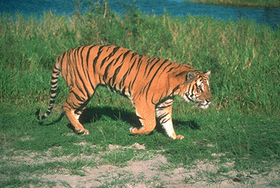
From Pixels to Perception
Water
Grass
outdoor
wildlife
Tiger
Sand
back
Tiger
head
eye
tail
legs
mouth
shadow

Slide 3
The central problems of vision
Object and Scene
Recognition
Grouping /
Segmentation
3D structure/
Figure-Ground
Notes:
Such a linear architecture is of course an oversimplification. Here is a more modern view of visual perception, in which all three components of perception take place simultaneously and interact with one another. Among these three components, there has been a lot of work on object recognition, there has been a lot of work on segmentation, and recently there has also been a lot of work exploring this link between grouping and recognition.

Slide 4
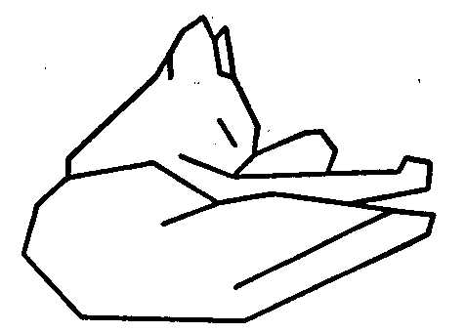
Attneave’s Cat (1954) Line drawings convey most of the information

Slide 5

Boundaries of image regions defined by a number of attributes
Brightness/color
Texture
Motion
Stereoscopic depth

Slide 6

Curvilinear Grouping
Boundaries are smooth in nature!
A number of associated visual phenomena
Good continuation
Visual completion
Illusory contours
Notes:
Curvilinear grouping is based on a simple but fundamental fact, that boundaries of objects in nature are smooth and continuous. There are a few visual phenomena associated with it, such as good continuation, visual completion, or illusory contours. Without going into details of these phenomena, it suffices to say that this is a well studied problem in psychophysics, and generally considered to be an important part of perception.
But, from a practical point of view, what do we care about this?

Slide 7
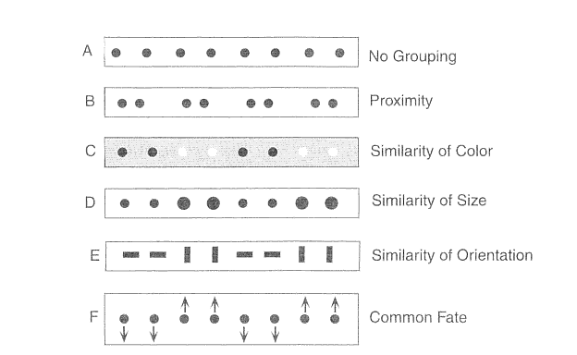
Gestalt Grouping factors

Slide 8
Contours and junctions are fundamental…
Key to recognition, inference of 3D scene properties, visually- guided manipulation and locomotion…
This goes beyond local, V1-like, edge-detection. Contours are the result of perceptual organization, grouping and figure/ground processing

Slide 9

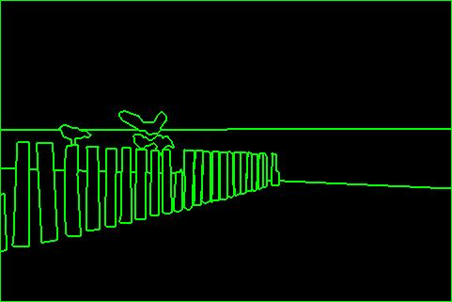
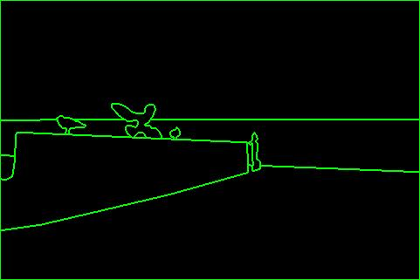
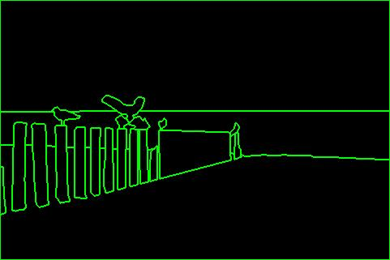
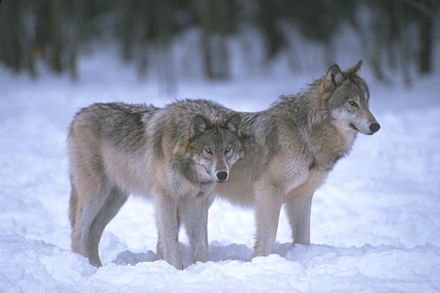
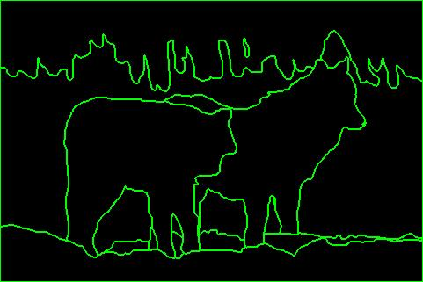
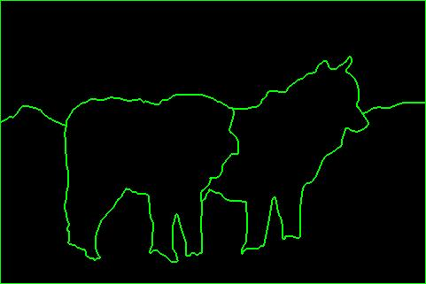
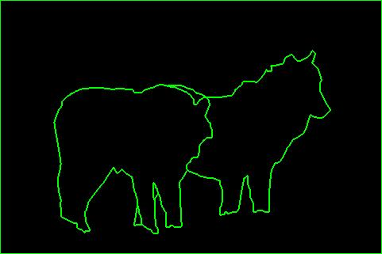

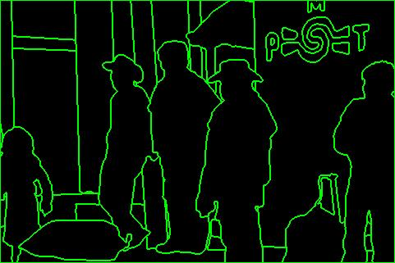



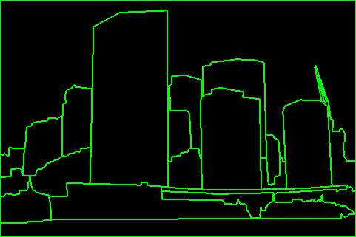
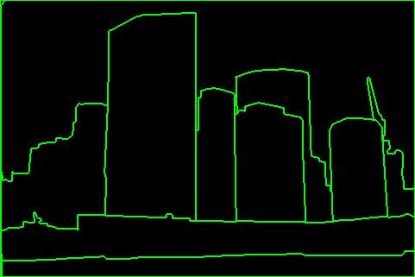
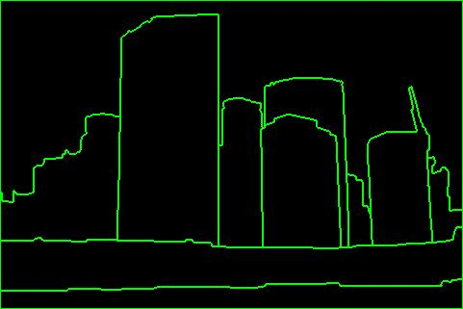
Berkeley Segmentation DataSet [BSDS]
D. Martin, C. Fowlkes, D. Tal, J. Malik. "A Database of Human Segmented Natural Images and its Application to Evaluating Segmentation Algorithms and Measuring Ecological Statistics", ICCV, 2001

Slide 10
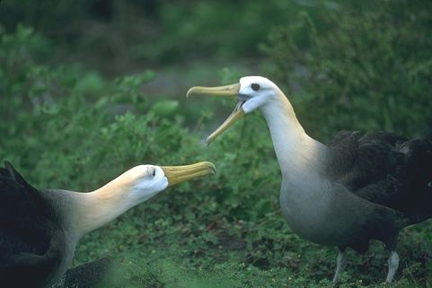
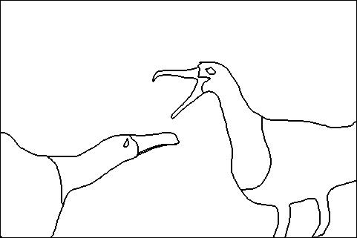
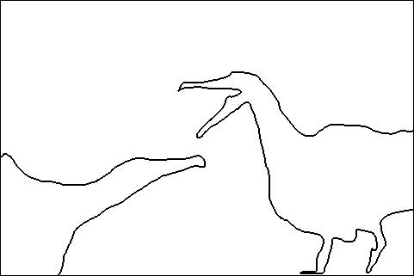
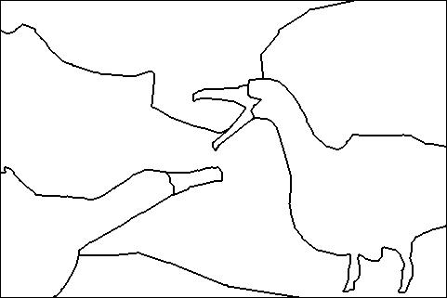
Consistency
A
Perceptual organization forms a tree:
Image
BG
L-bird
R-bird
B
C
grass
bush
far
beak
body
beak
body
eye
head
eye
head
Two segmentations are
consistent when they can be
explained by the same
segmentation tree (i.e. they
could be derived from a single
perceptual organization).
A,C are refinements of B
A,C are mutual refinements
A,B,C represent the same percept
Attention accounts for differences

Slide 11
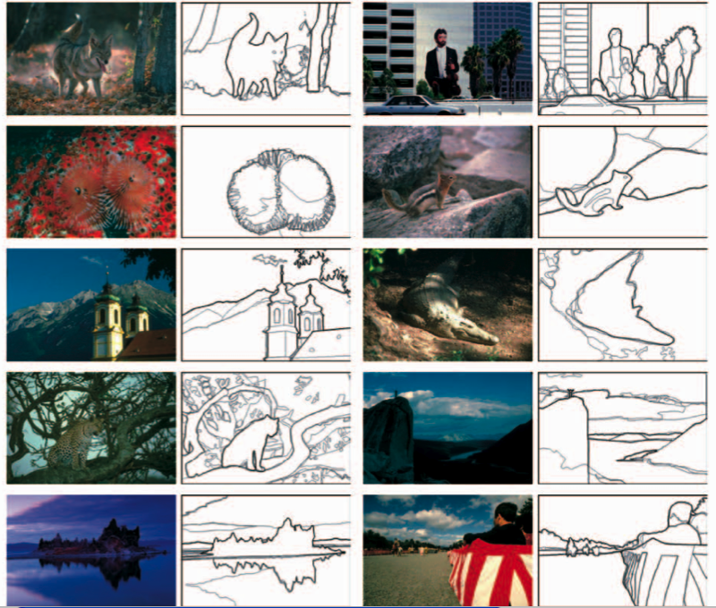

Slide 12
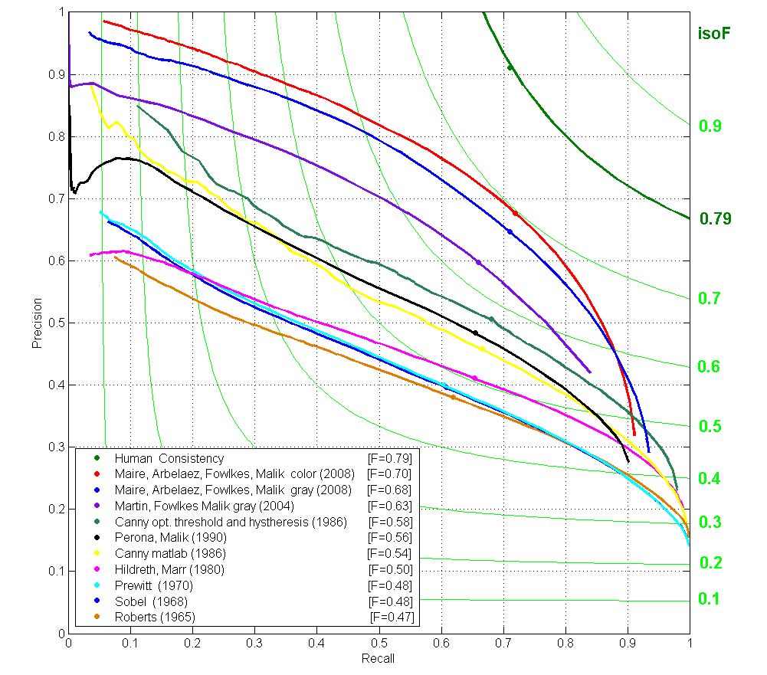
Contour detection ~2008 (color)
12

Slide 13
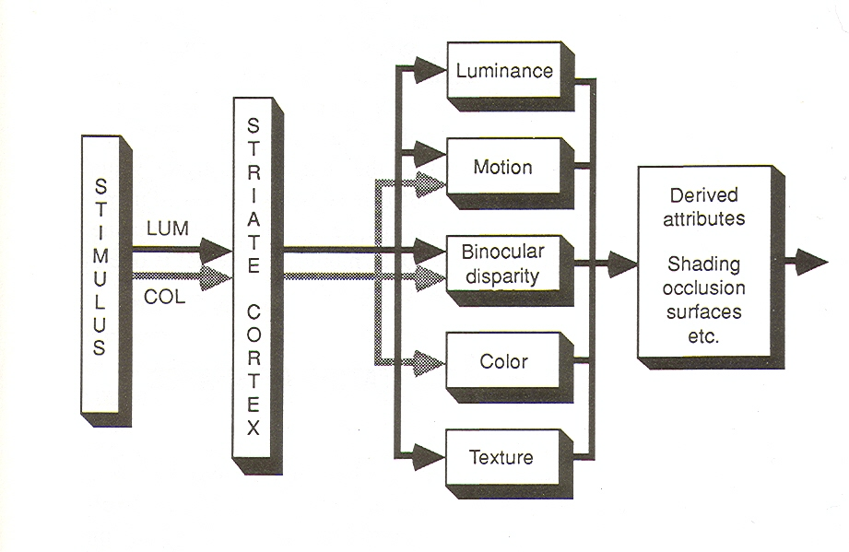
Contours can be defined by any of a number of cues (P. Cavanagh)

