Slide 1
A Clock-Independent, Time-Domain
Rapid Calibration Method for
Memristor-based
Analog Computing AI Processors
Chen, Junzhe (JC)
20/Oct/2026, Bristol, UK

Slide 2
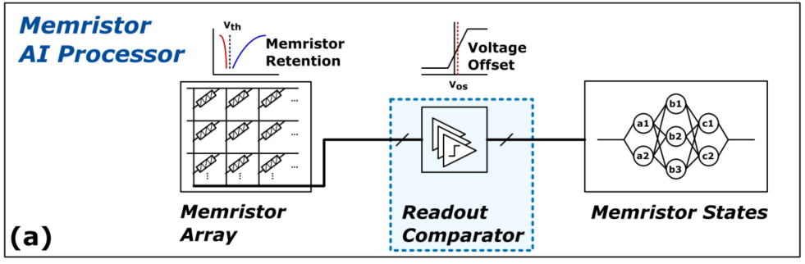
System

Slide 3
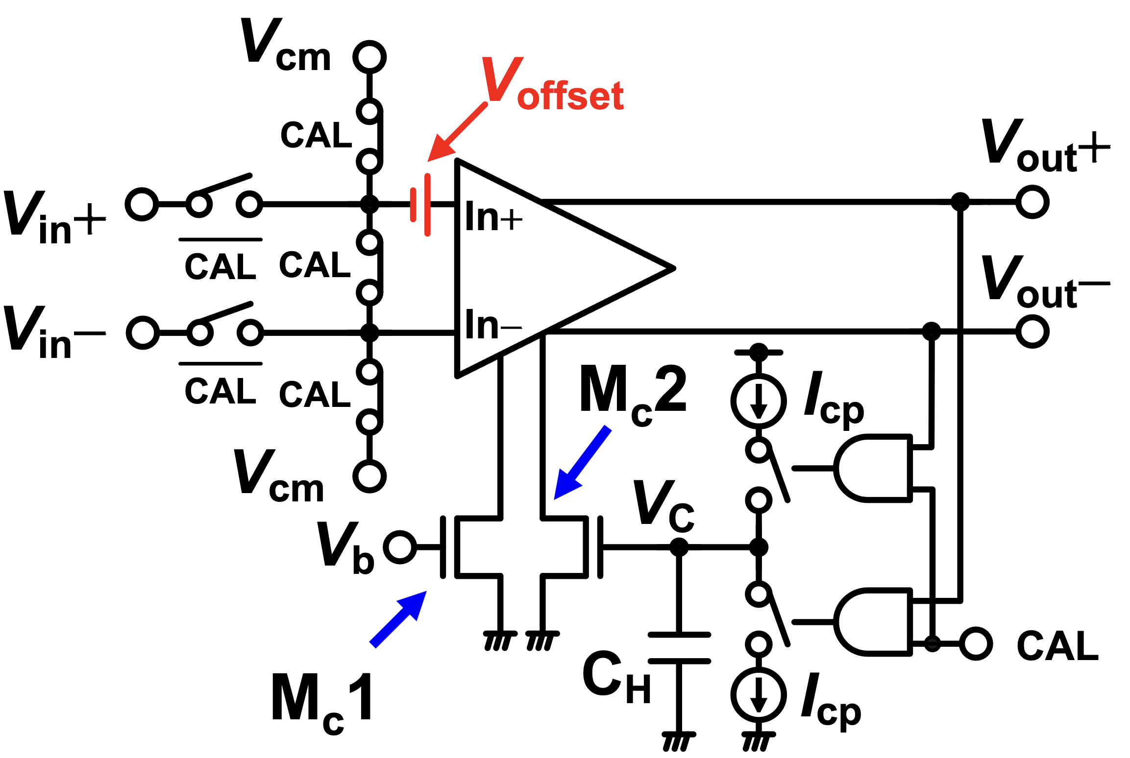
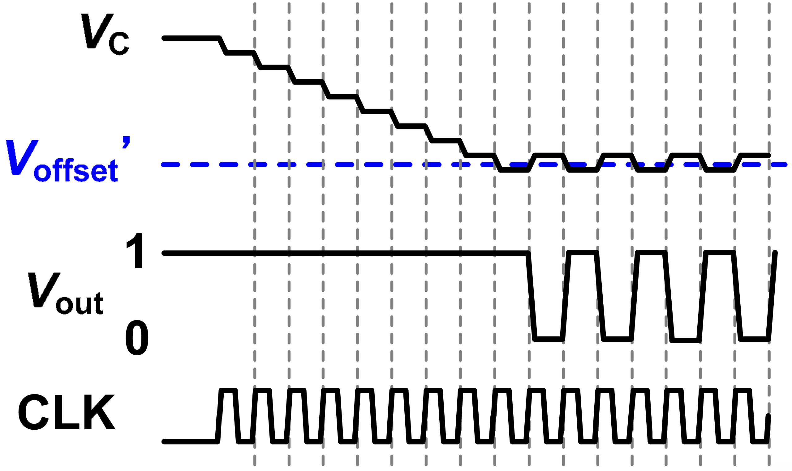
Miyahara [1]

Slide 4
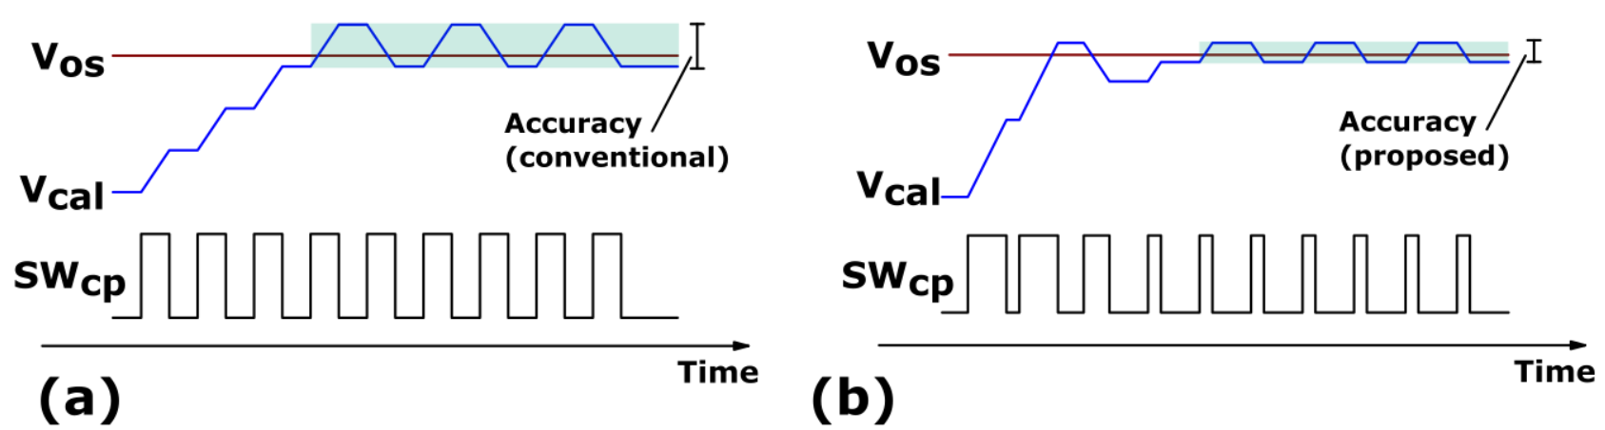
Accuracy bottleneck
Accuracy limited by CLK speed
Pulse instead of CLK

Slide 5
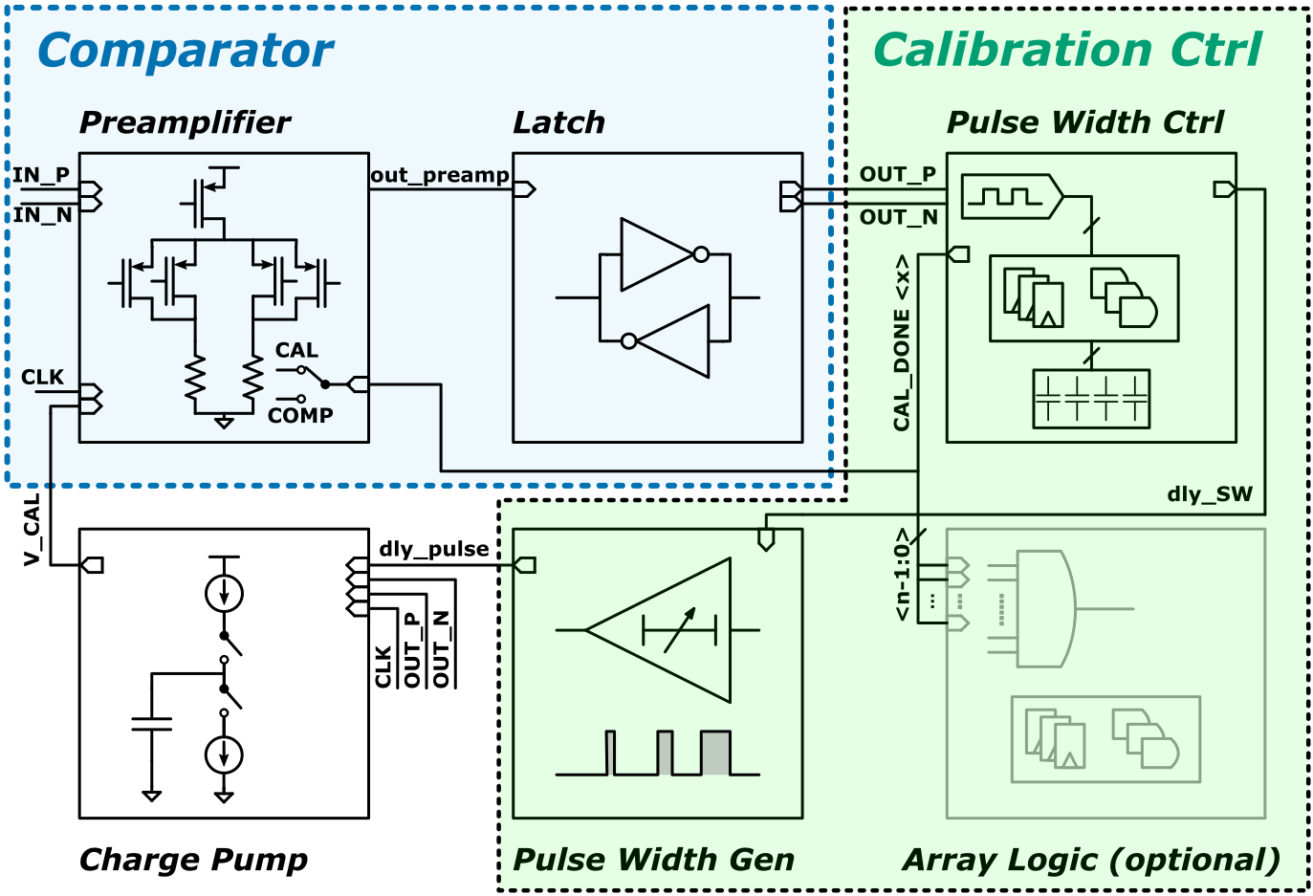
Proposed method

Slide 6
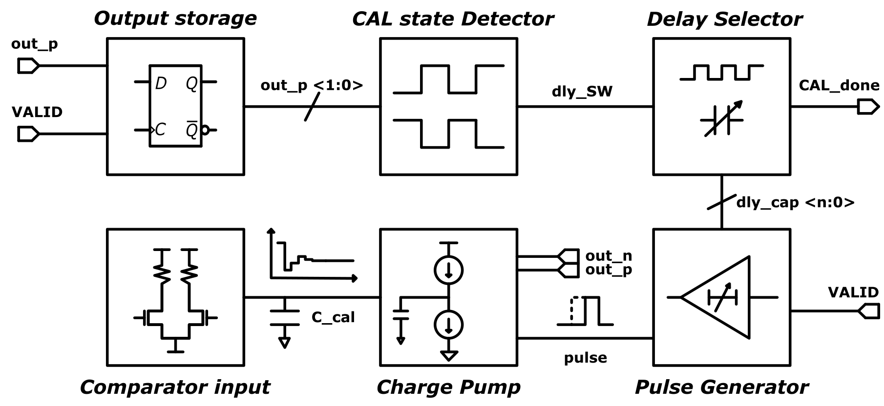
Calibration

Slide 7
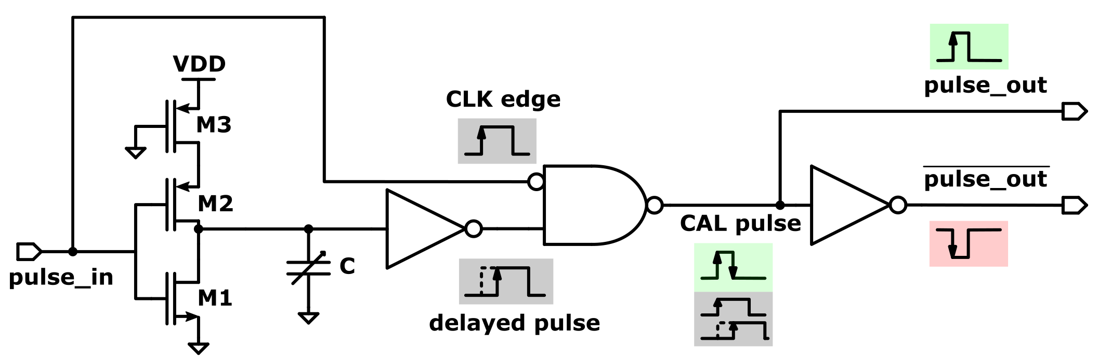
Pulse

Slide 8
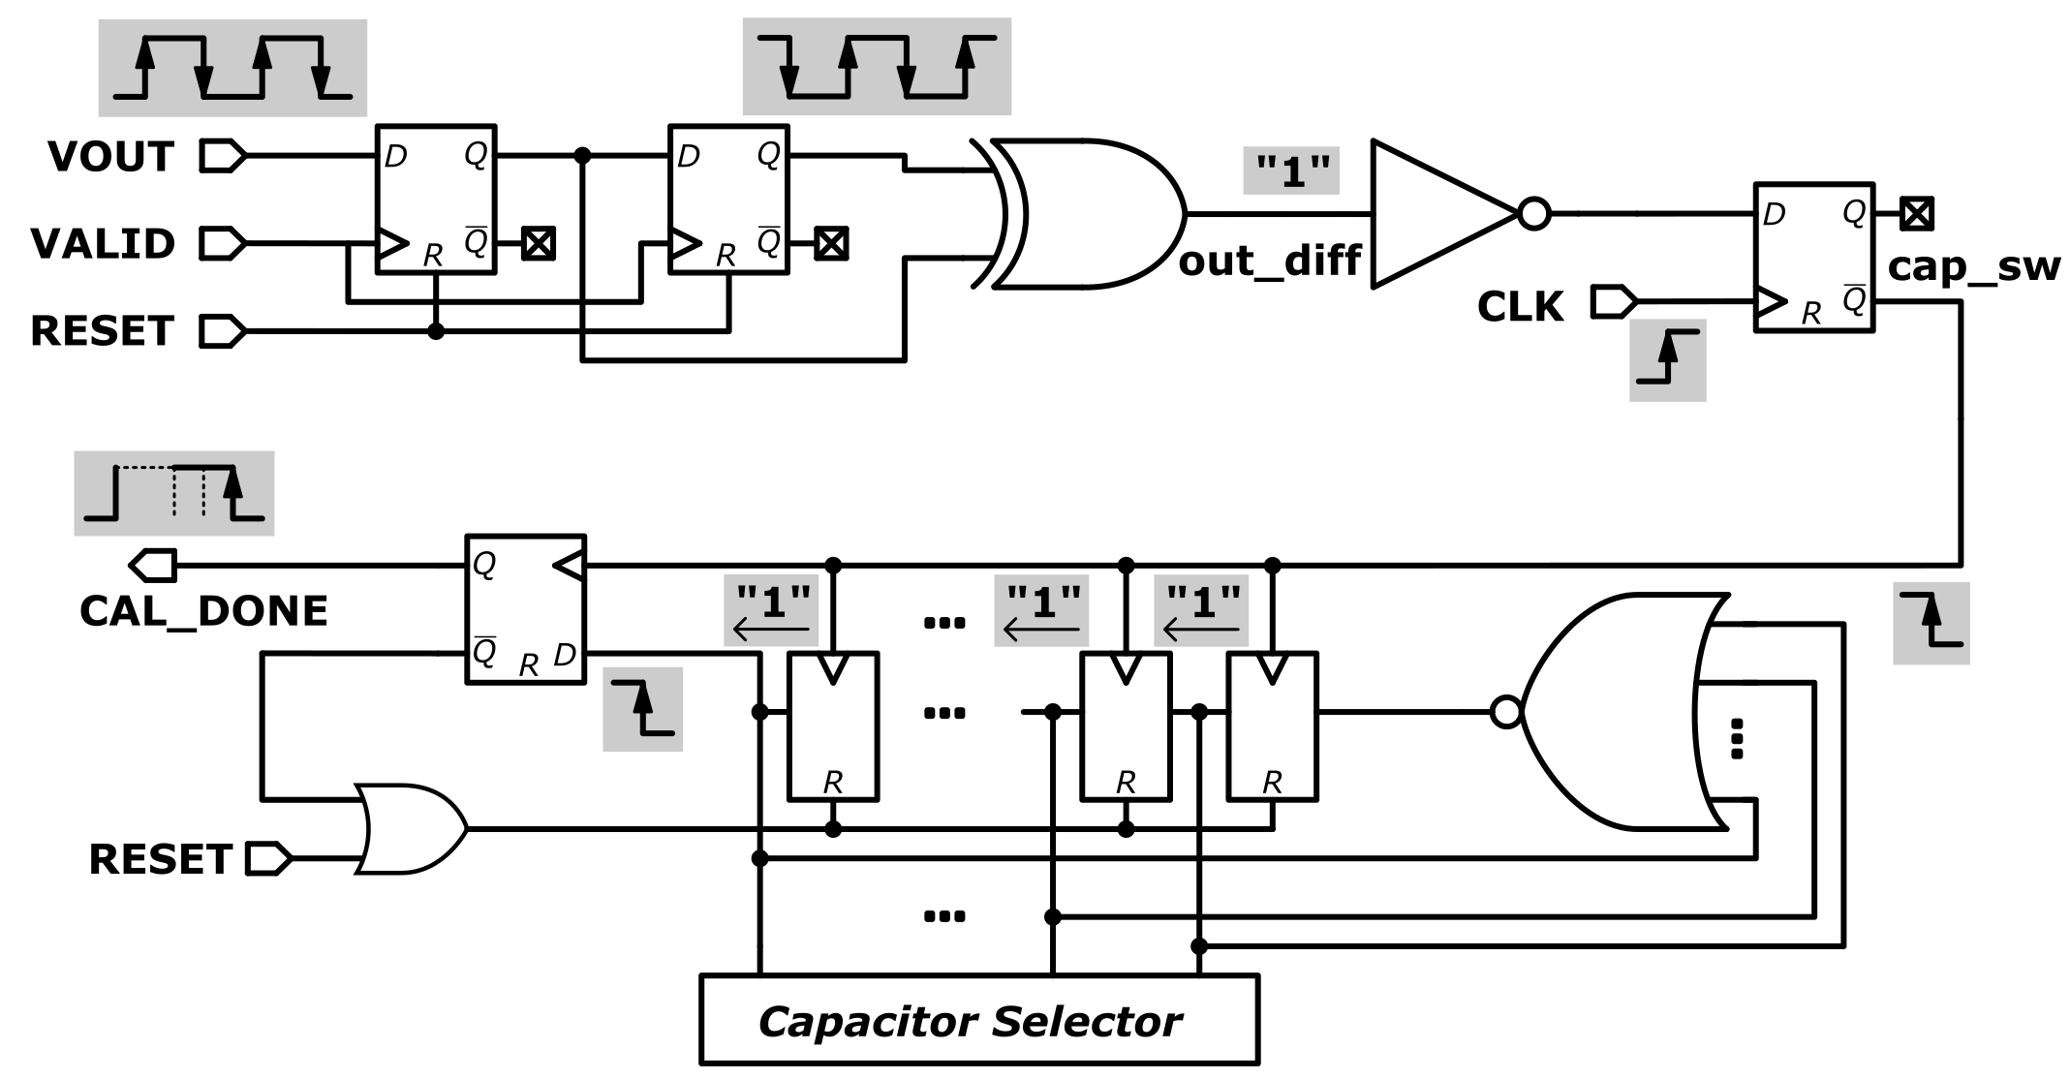
Control

Slide 9
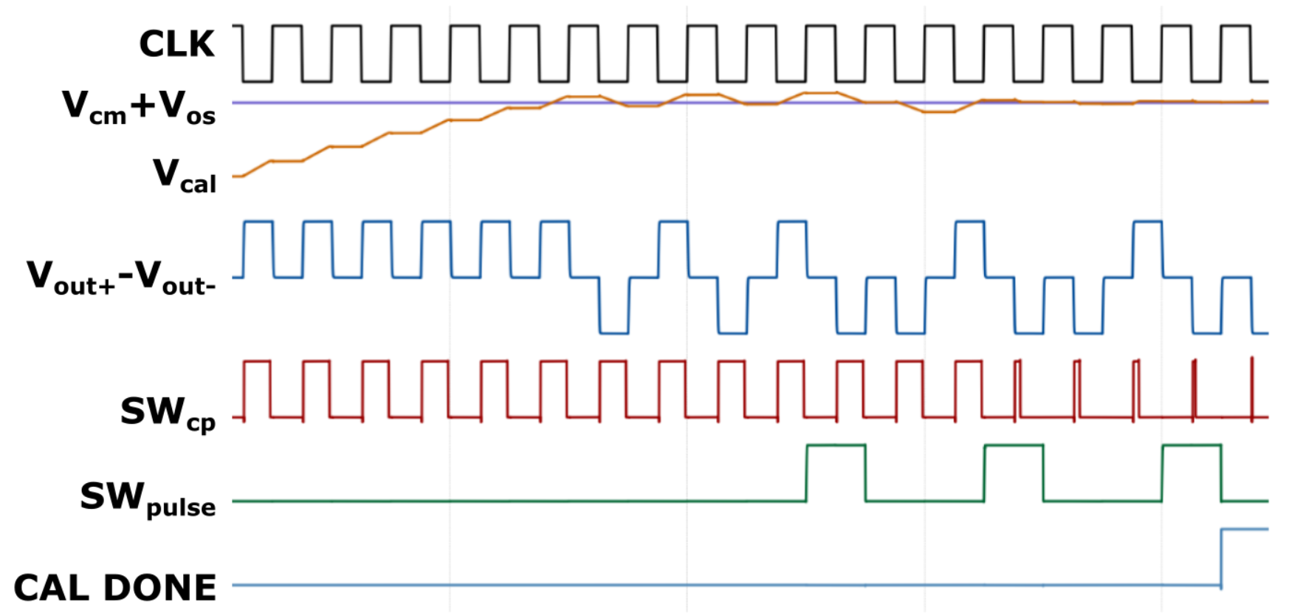
Timing

Slide 10
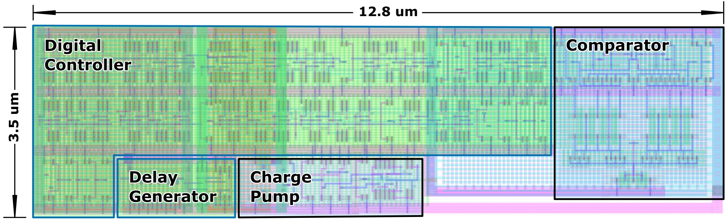
Layout

Slide 11
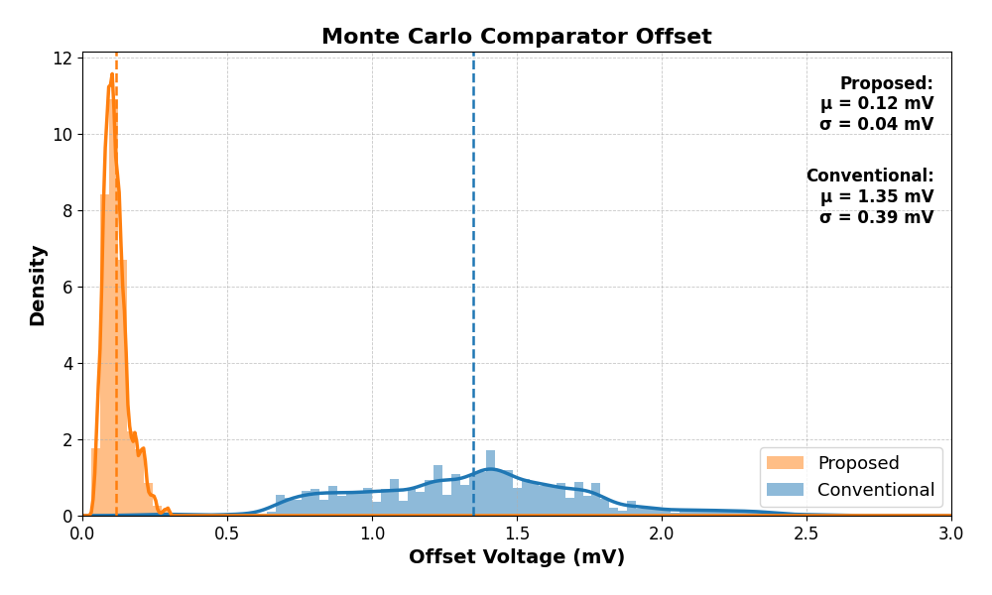
Result: offset

Slide 12
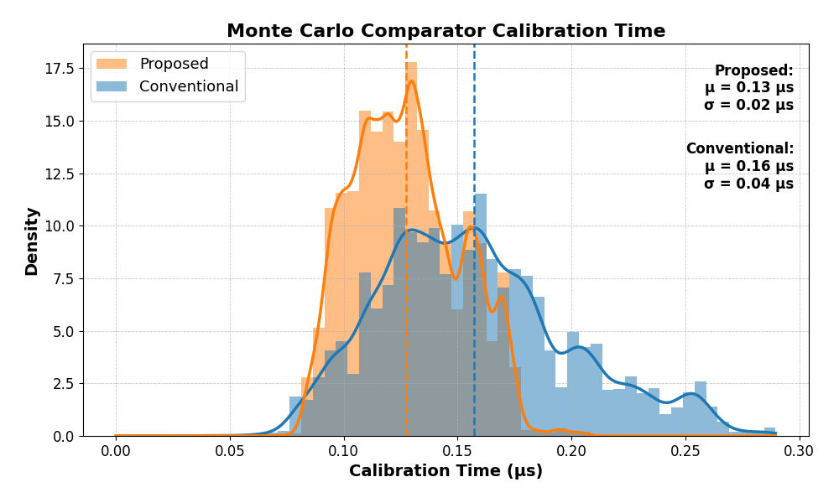
Result: calibration time

Slide 13
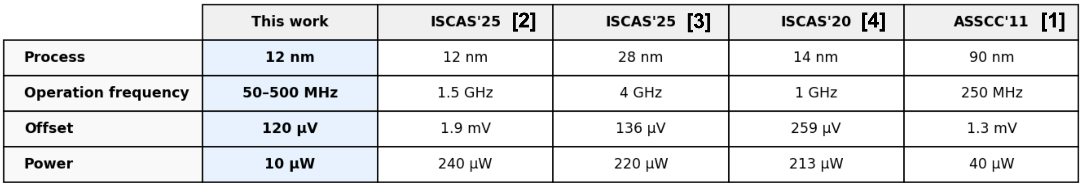
Result: comparison

Slide 14
References
[1] M. Miyahara, Y. Asada, D. Paik, and A. Matsuzawa, “A low-noise self-calibrating dynamic comparator for high-speed adcs,” in 2008 IEEE Asian Solid-State Circuits Conference, pp. 269–272, 2008.
[2] Yang et al.“A high-speed high-precision comparator with offset calibration for sha less pipeline adcs,” in 2025 IEEE International Symposium on Circuits and Systems (ISCAS)
[3] Xu et al. “A low-noise high-precision dual-mode offset calibration for high-speed dynamic comparators,” in 2025 IEEE International Symposium on Circuits and Systems (ISCAS)
[4] Lee et al. “An effective transconductance controlled offset calibration for dynamic comparators,” in Proceedings of the IEEE International Symposium on Circuits and Systems (ISCAS)

