Slide 1
Chapter 9 TRAP Routines and Subroutines

Slide 2
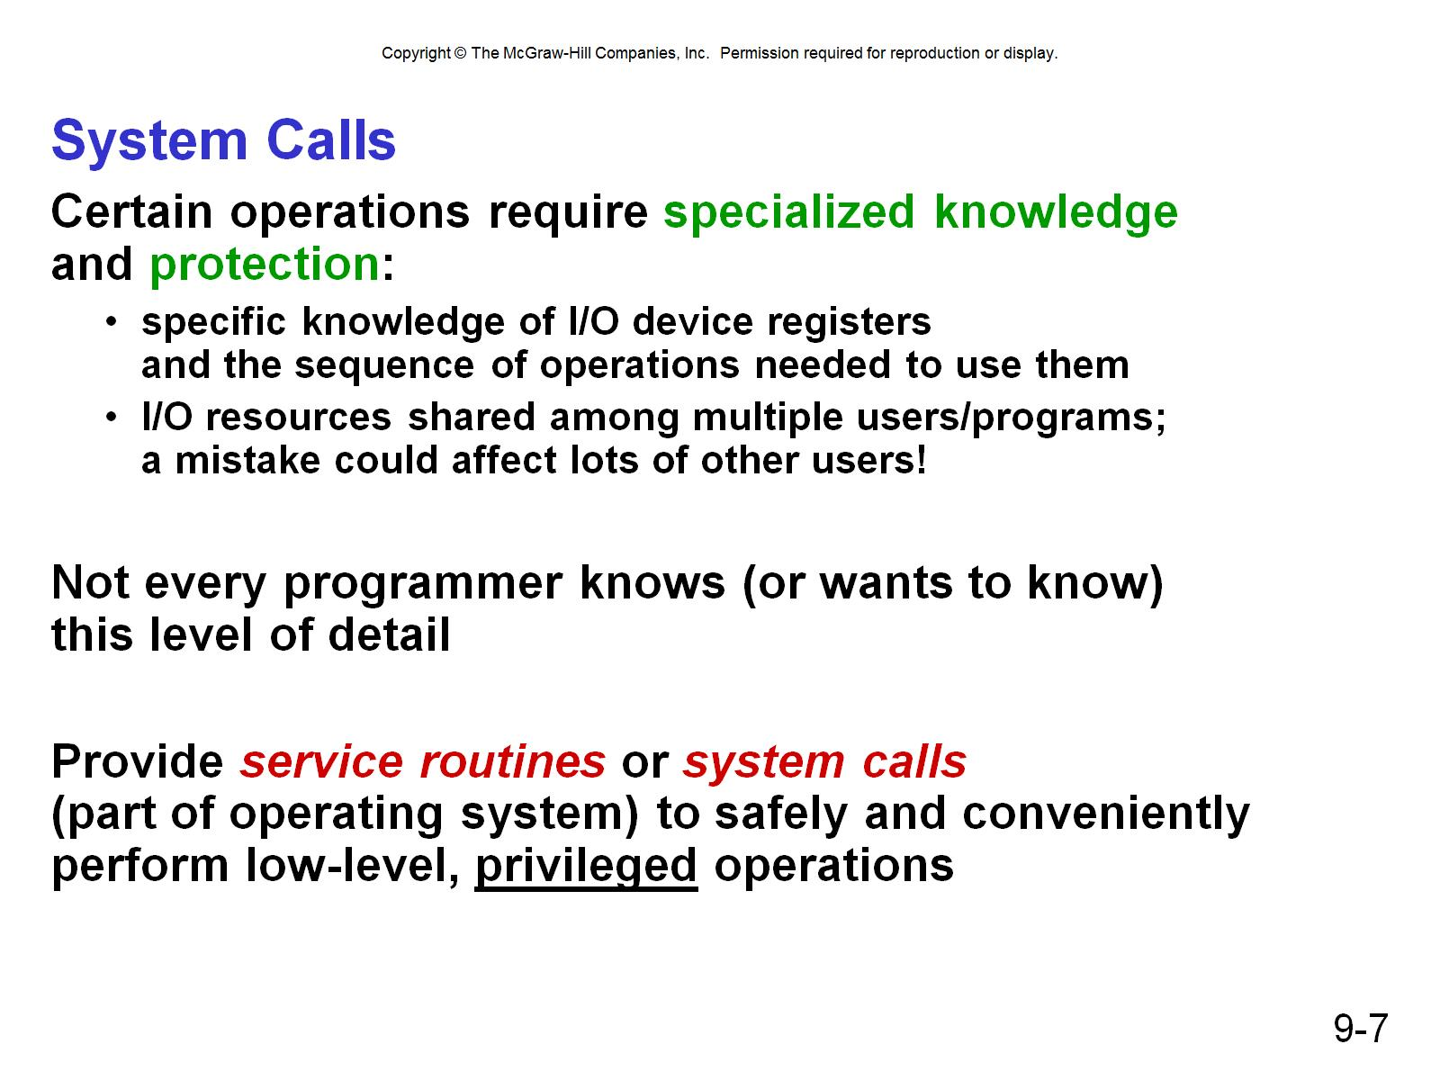
System Calls

Slide 3
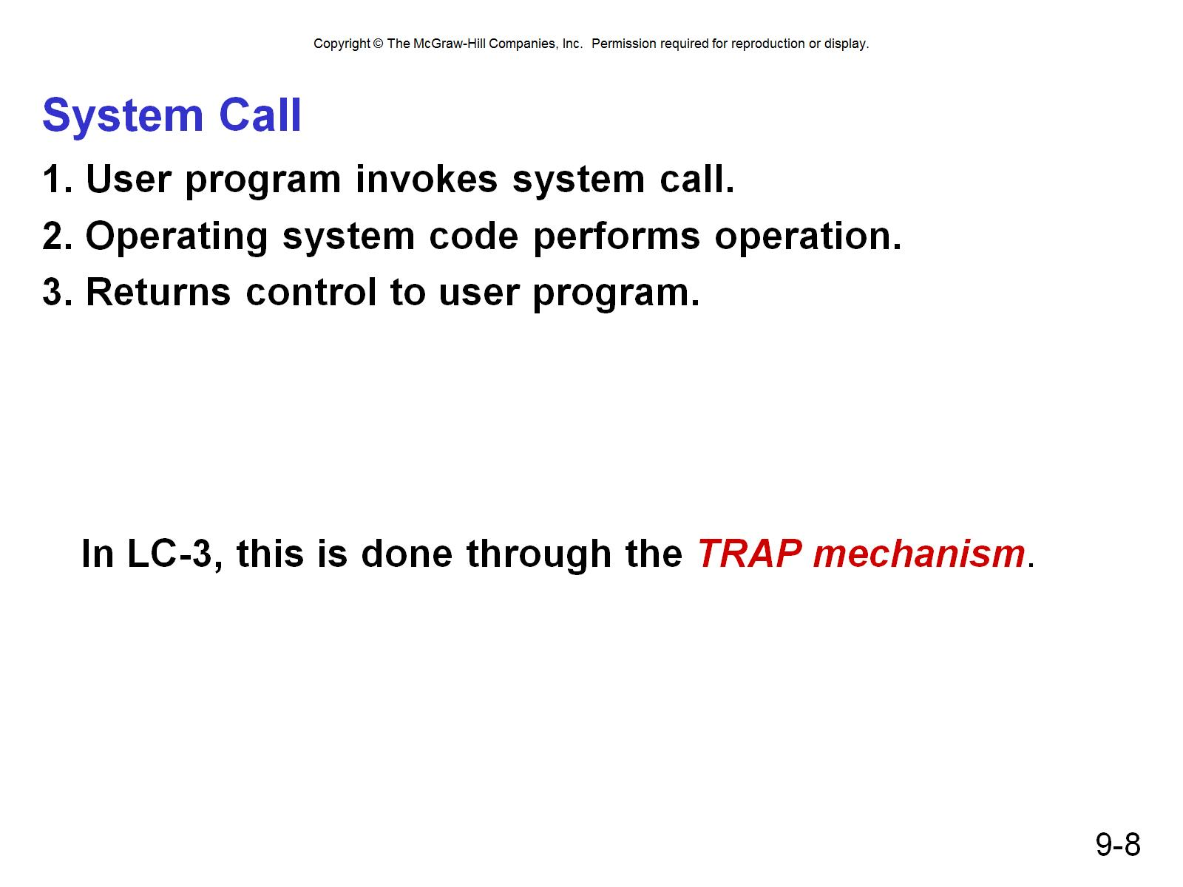
System Call

Slide 4
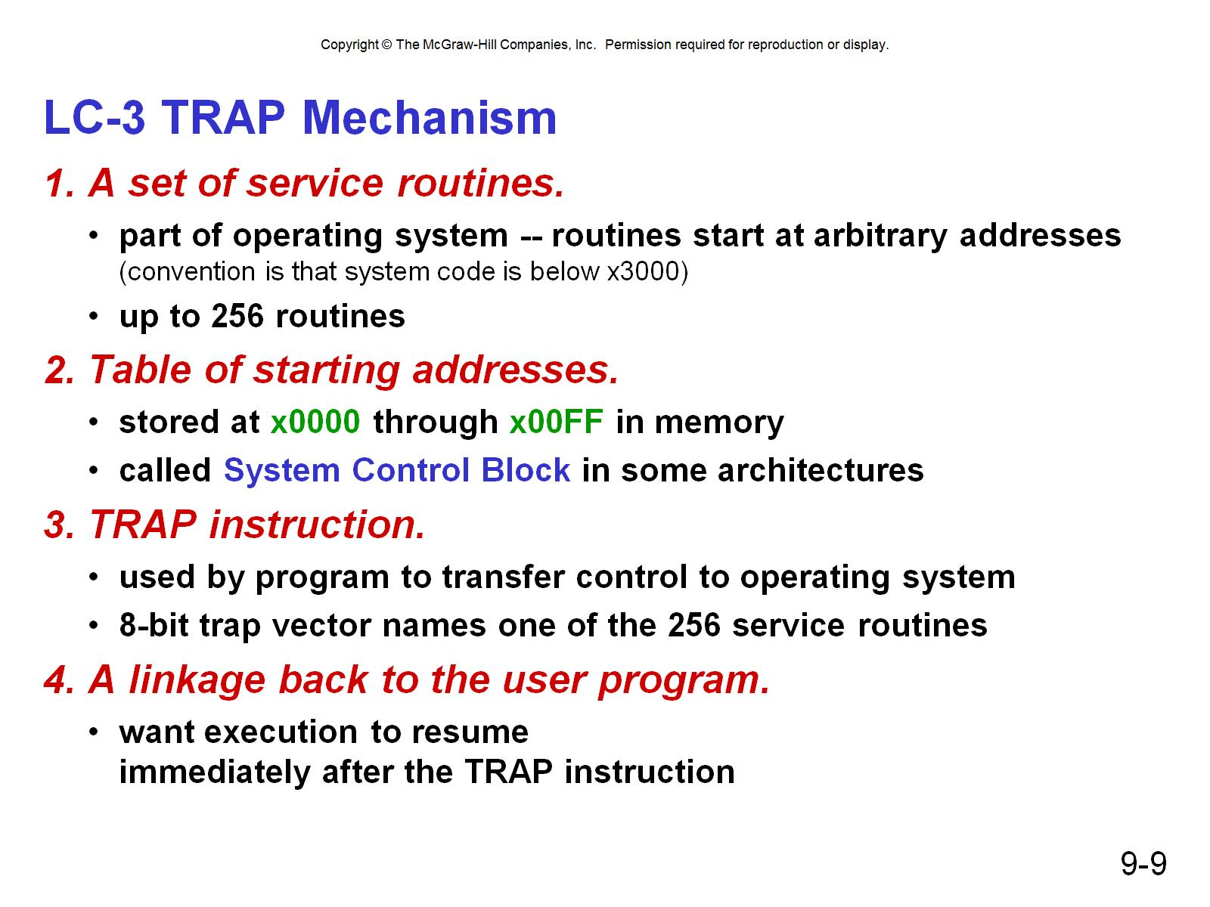
LC-3 TRAP Mechanism

Slide 5
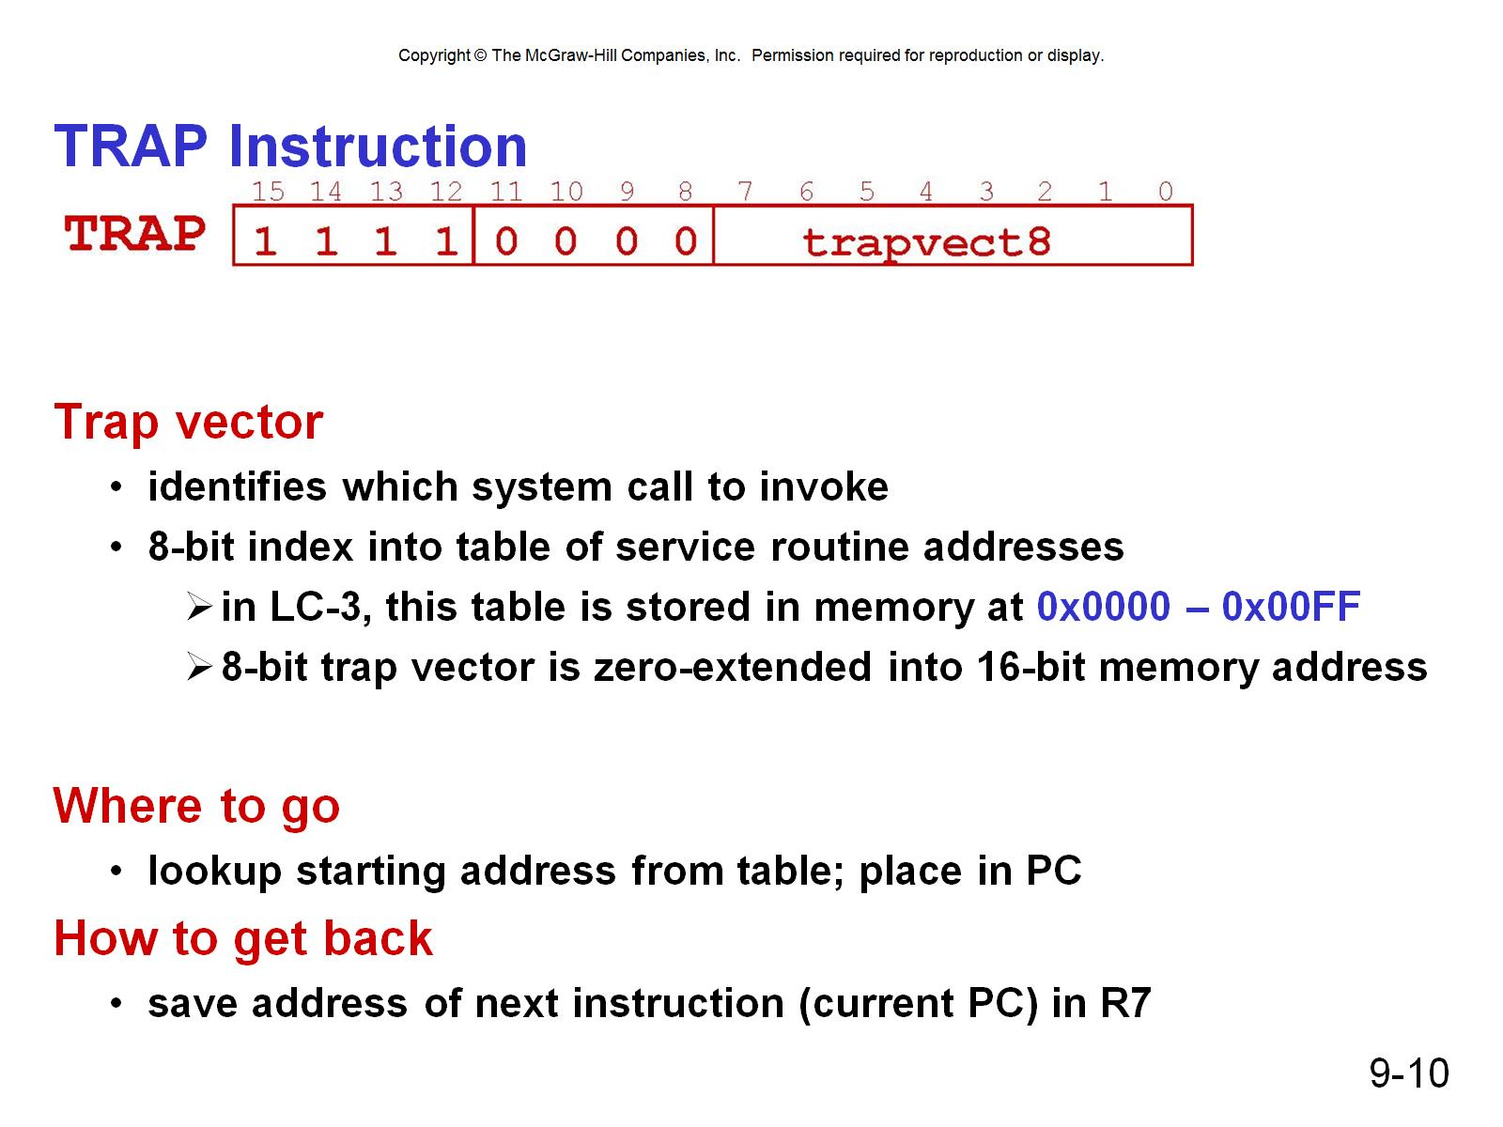
TRAP Instruction

Slide 6
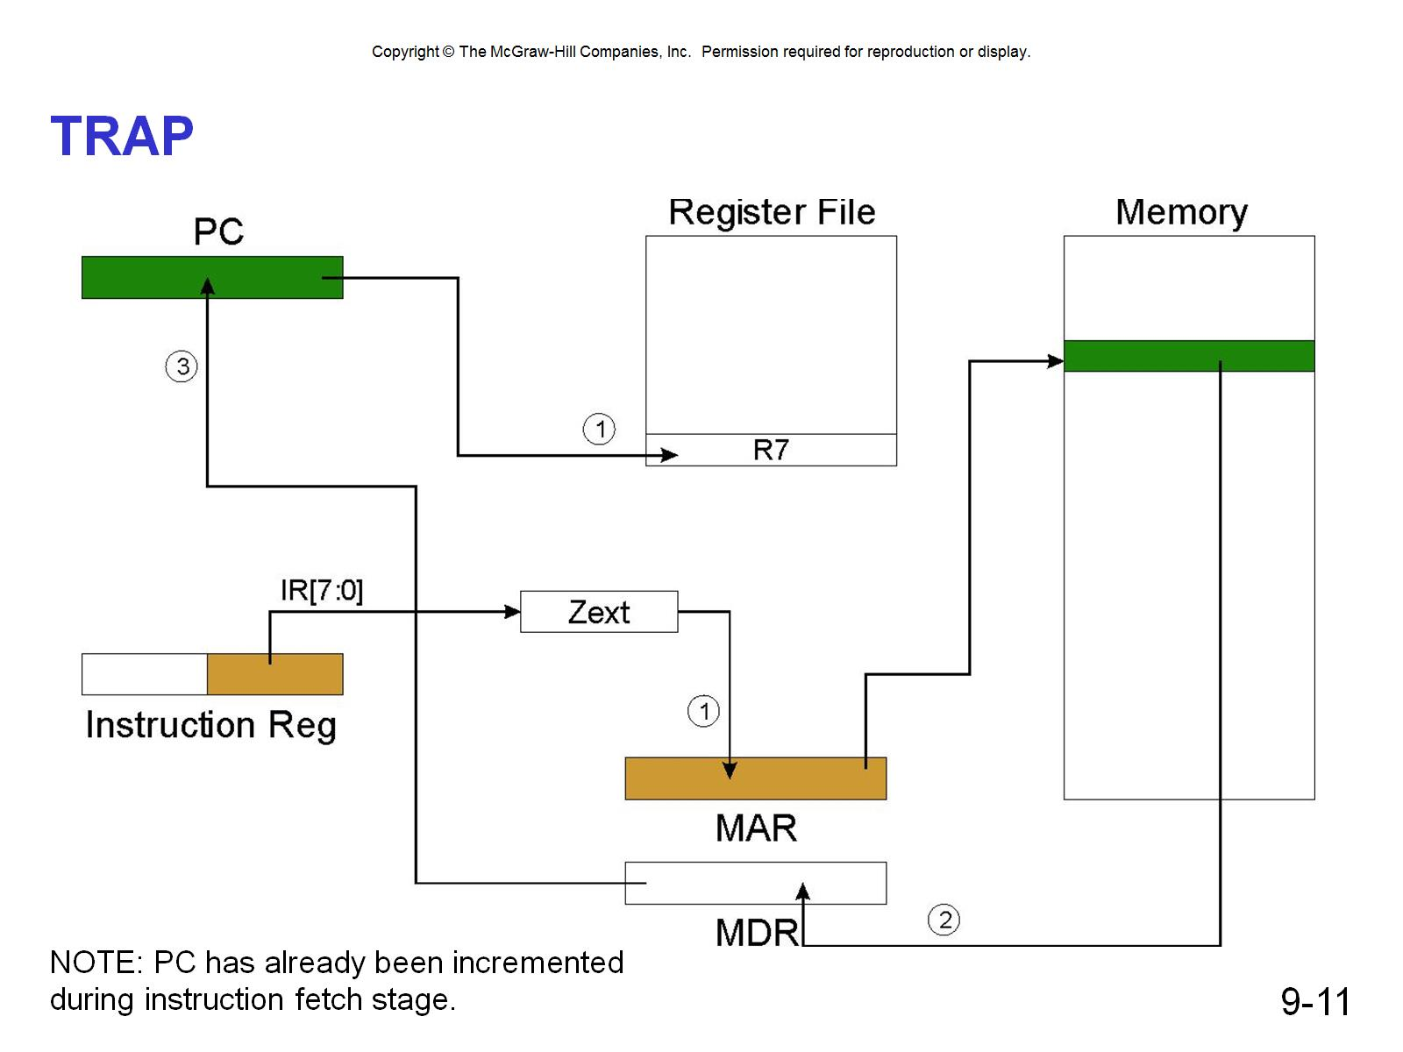
TRAP

Slide 7
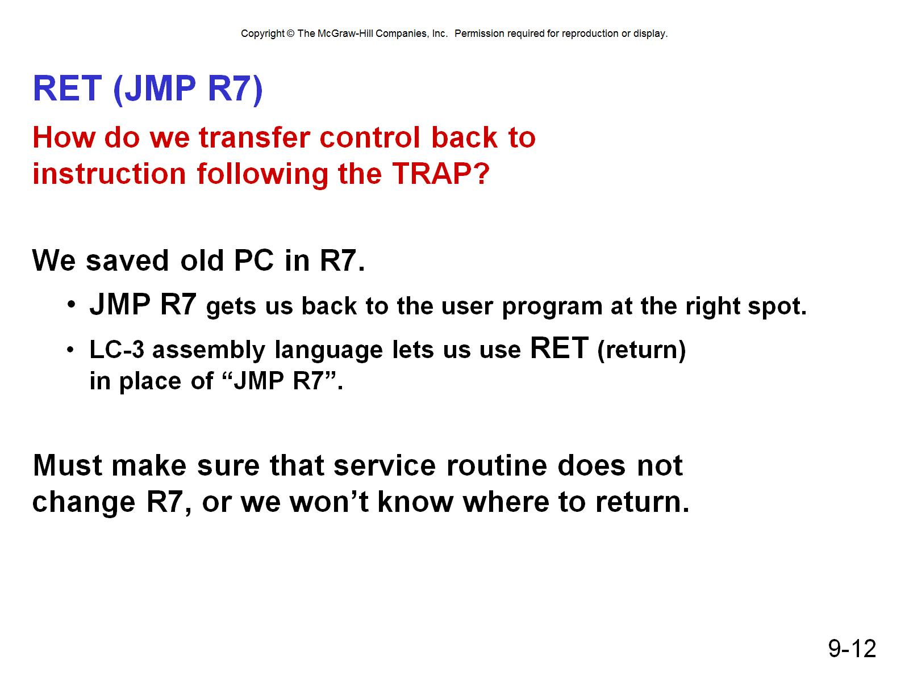
RET (JMP R7)

Slide 8
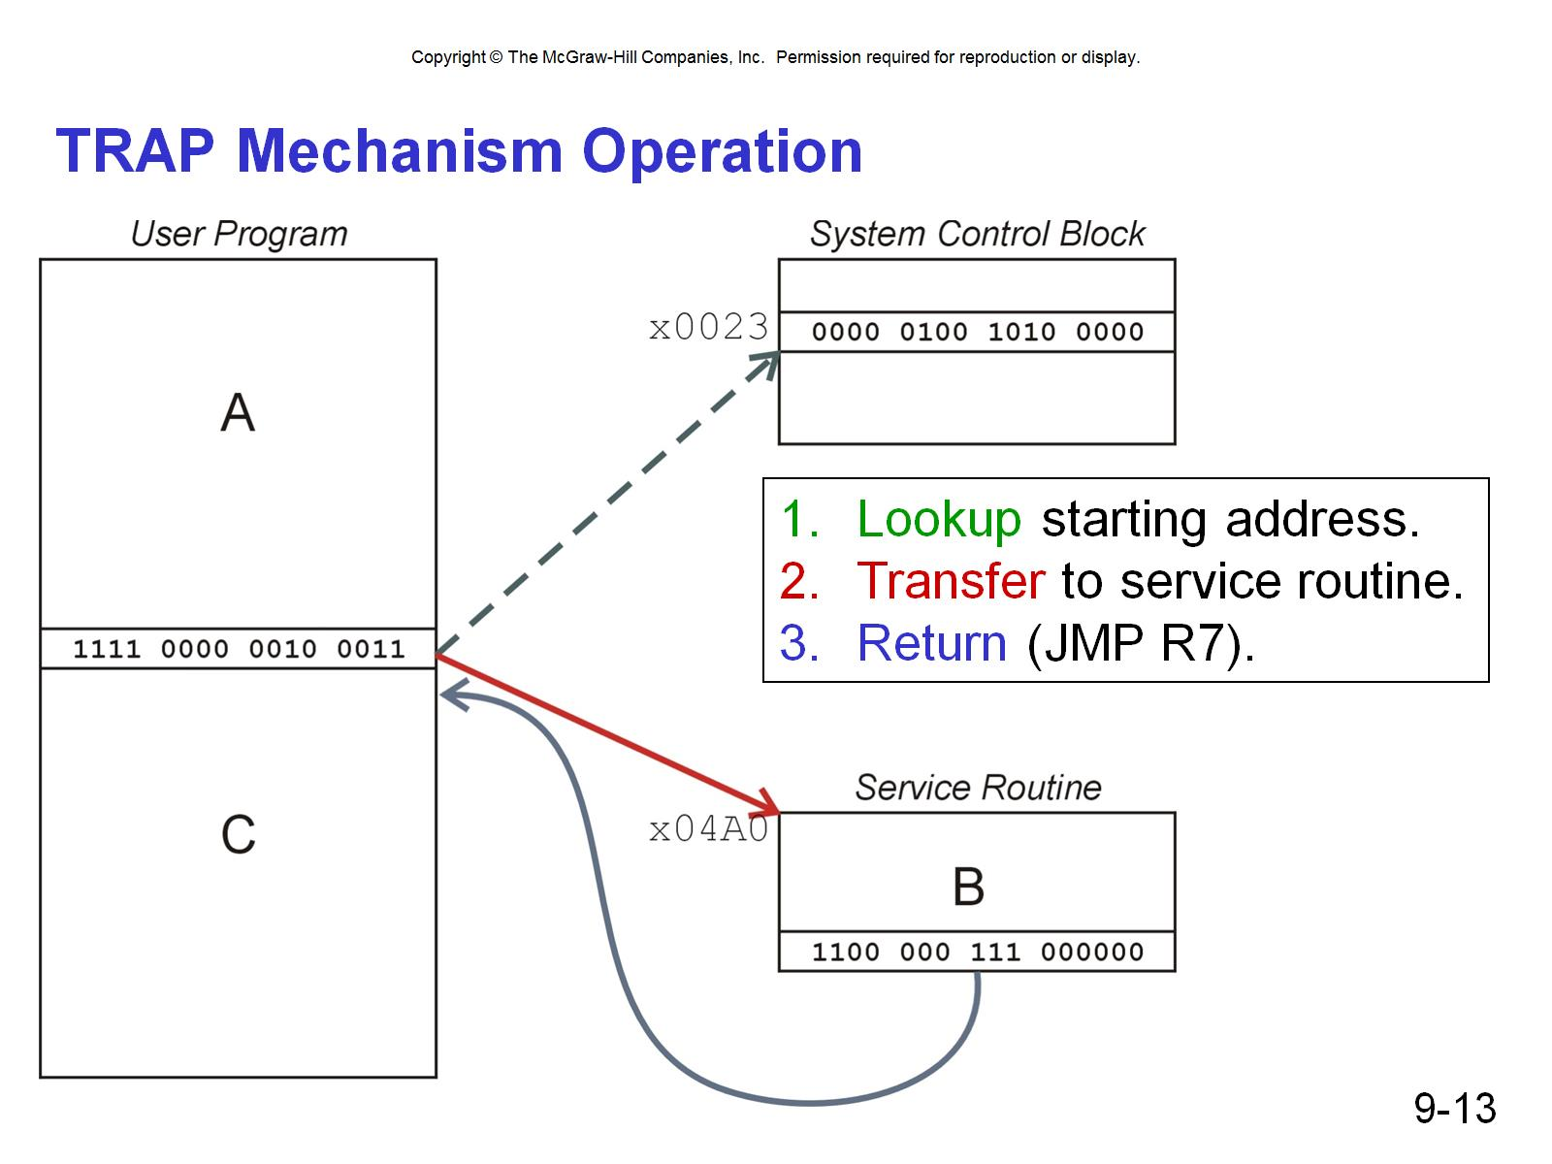
TRAP Mechanism Operation

Slide 9
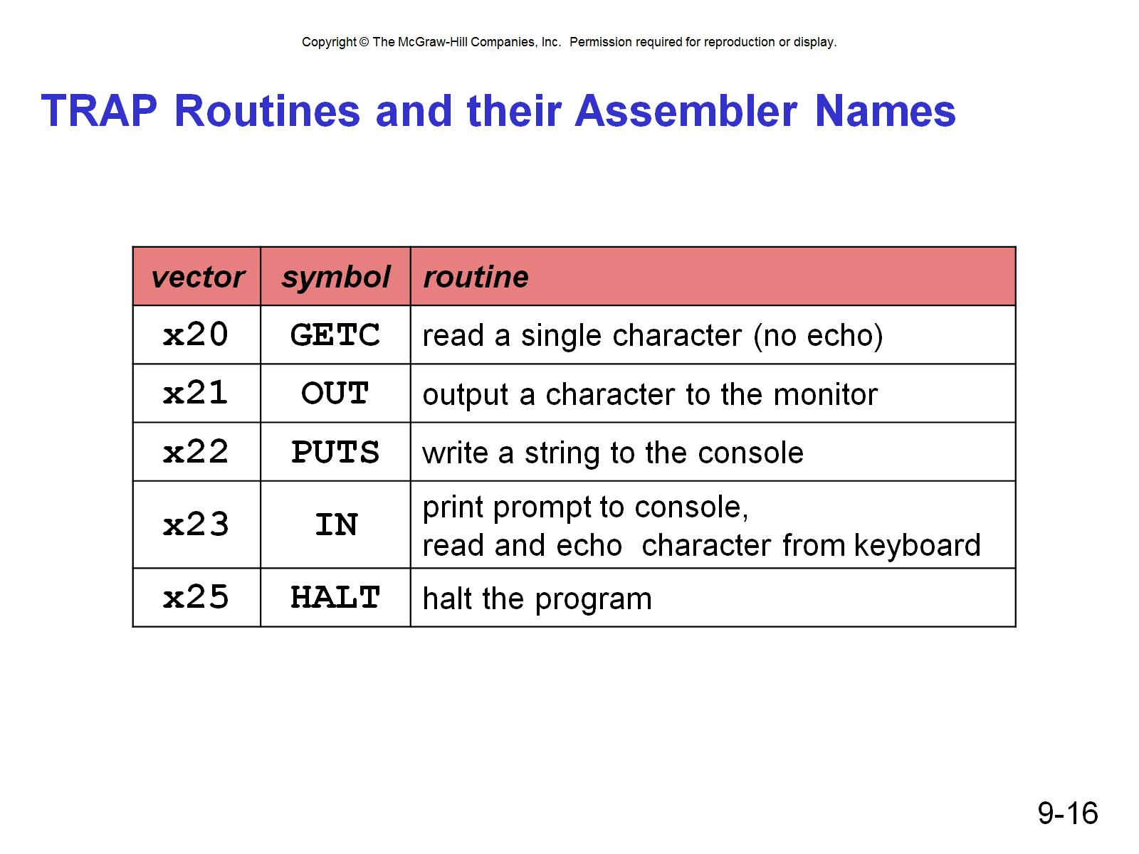
TRAP Routines and their Assembler Names

Slide 10
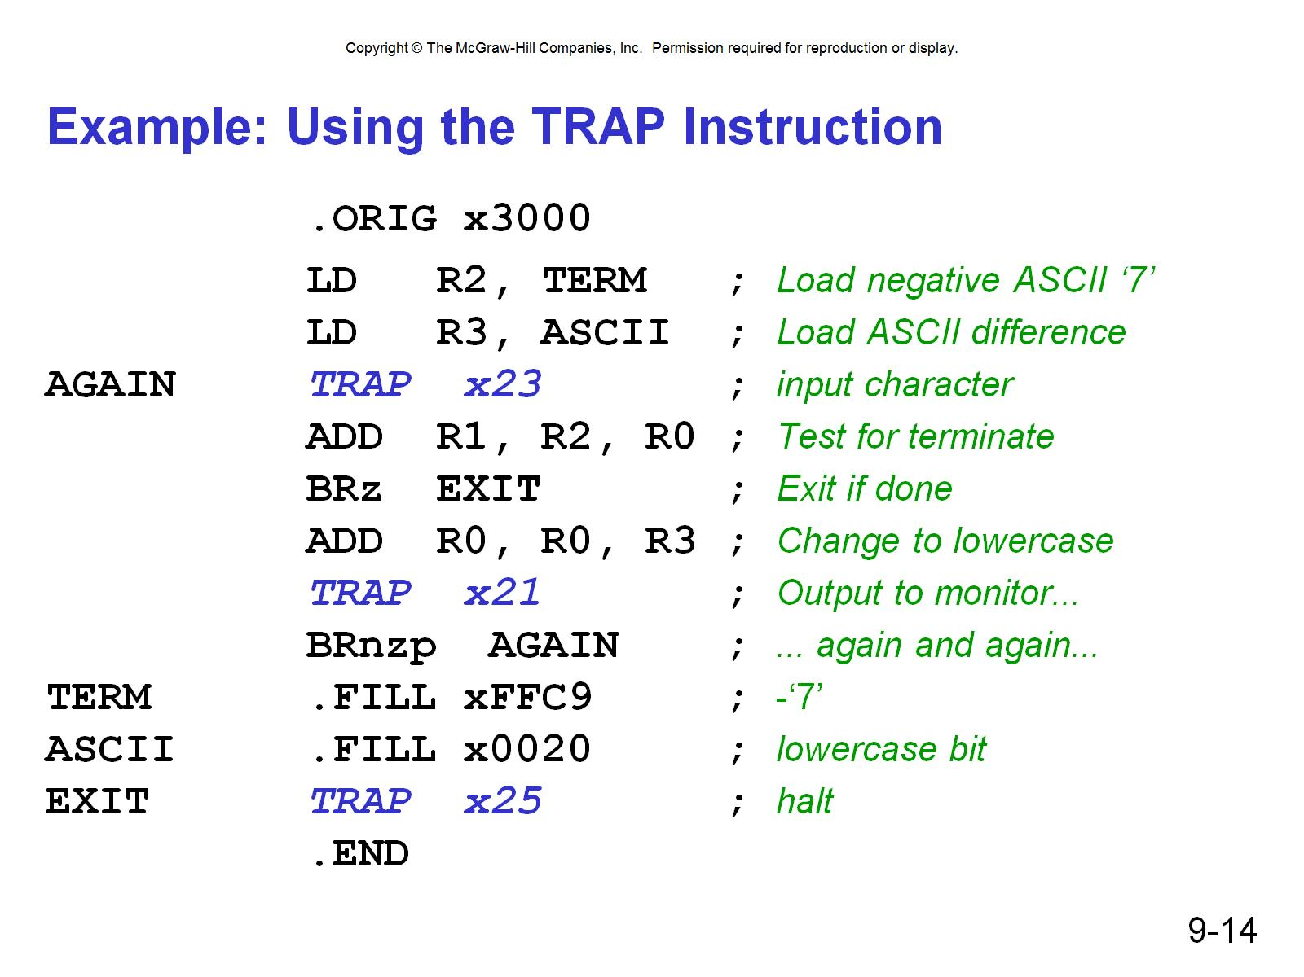
Example: Using the TRAP Instruction

Slide 11
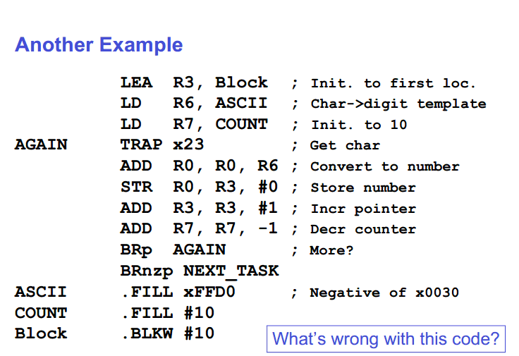

Slide 12
Example: Output Service Routine
TRAP_PUTS
ST R0,OS_SAVE_R0 ; save R0, R1, and R7
ST R1,OS_SAVE_R1
ST R7,OS_SAVE_R7
ADD R1,R0,#0 ; move string pointer (R0) into R1
TRAP_PUTS_LOOP
LDR R0,R1,#0 ; write characters in string using OUT
BRz TRAP_PUTS_DONE
OUT
ADD R1,R1,#1
BRnzp TRAP_PUTS_LOOP
TRAP_PUTS_DONE
LD R0,OS_SAVE_R0 ; restore R0, R1, and R7
LD R1,OS_SAVE_R1
LD R7,OS_SAVE_R7
RET
stored in table, location x22

Slide 13
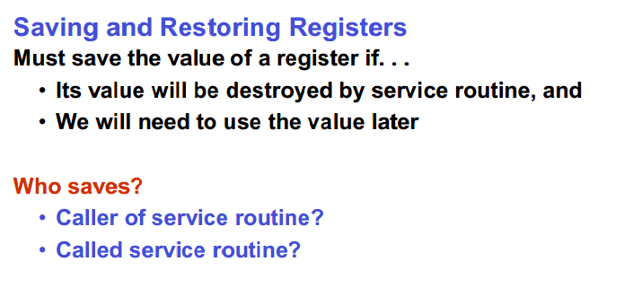

Slide 14
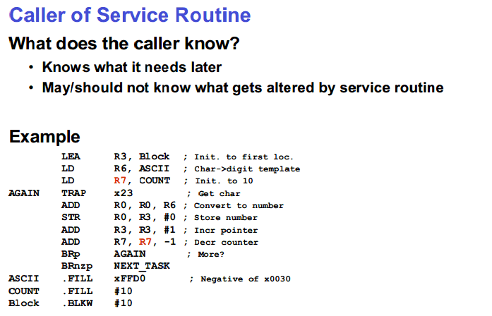

Slide 15
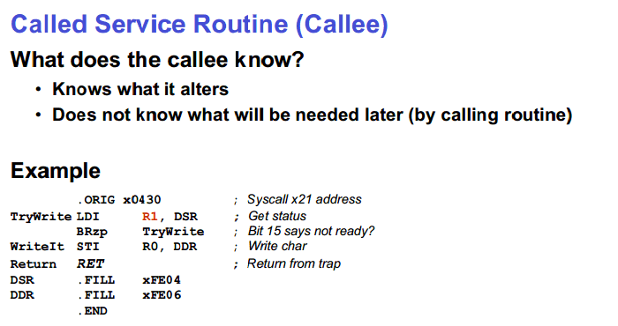

Slide 16
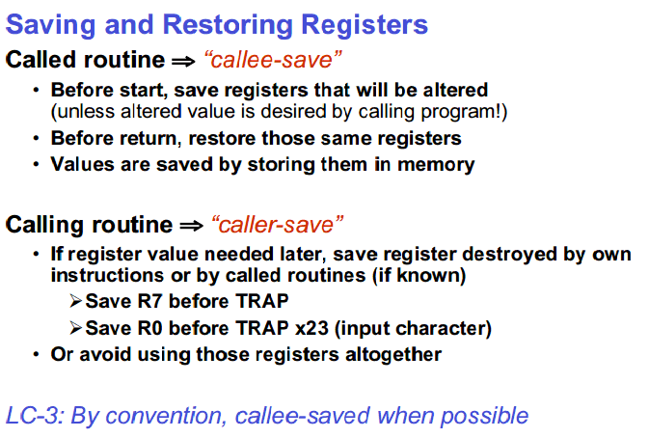

Slide 17
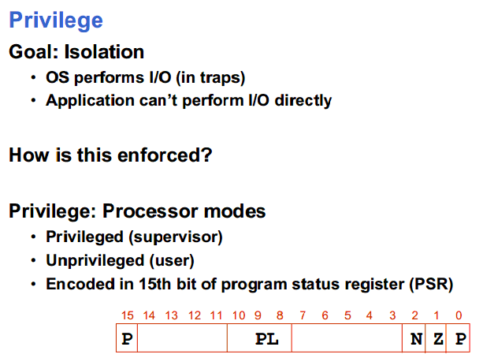

Slide 18
