Slide 1

Radar-Vision Fusion for Enhanced Depth Estimation in Autonomous Driving
Department of Computer Science
Junzhou Chen

Slide 2
Outline
01
Motivation
02
Meaning
03
Methodology
04
Expected Result

Slide 3
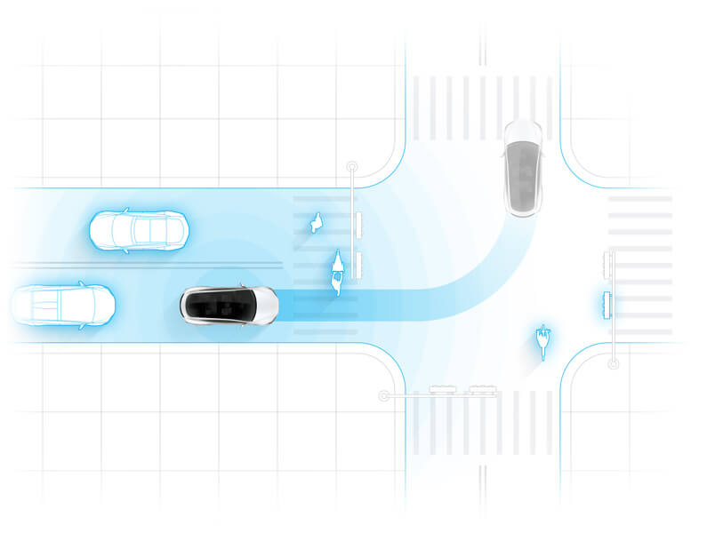



1.1
Development of Autonomous Vehicles (AVs)
3
Notes:
Recently, with the vast improvements in computing technologies and the broad deployment of communication mechanisms /mekənɪzəm/, the advent of technology company's product, such as Tesla’s Autopilot, Google’s Waymo, and Baidu’s Apollo has propelled /prəˈpeld/ autonomous vehicles advanced. However, it is generally accepted that the existing deep learning-based methods for autonomous vehicles heavily rely on existing data. In the context of corner cases, deep learning-based systems often fail to respond accurately.

Slide 4
1.2
The Limitations of a Purely Vision-Based Solution
Lighting Conditions
In low light, strong light, fog, rain, or nighttime, camera performance low, leading to blurry or overexposed images.
Occlusion Issues
Cameras cannot capture objects behind obstructions, increasing the risk of perception failure.
Limited Long-Range Perception
Depth estimation of distant objects is inaccurate, especially in high-speed environments
4

Slide 5
1.3
Limitations of combining Vision and LiDAR Solution
High cost:
LiDAR sensors are expensive, particularly high-precision systems, making large-scale commercial deployment a significant economic barrier
Weather sensitivity
LiDAR is vulnerable to extreme weather conditions (e.g., heavy rain, fog, snow), where laser signals may scatter or reflect, leading to unreliable perception data.
Sensor alignment:
Precise alignment for LiDAR and camera data is required, including time and spatial calibration.
High computational load
Multi-sensor fusion increases complexity.
Delays in real-time applications.
5

Slide 6
Outline
01
Motivation
02
Meaning
03
Methodology
04
Expected Result

Slide 7
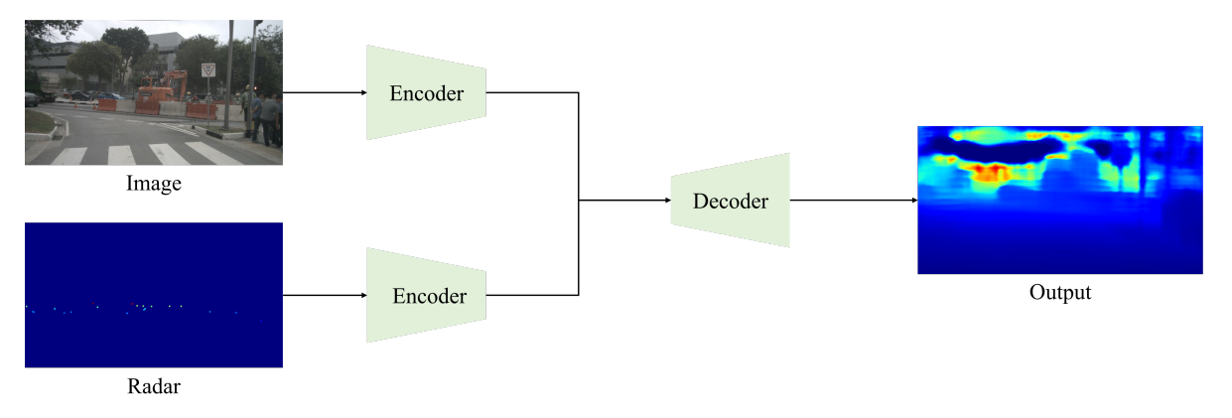
Radar-Vision Fusion for Enhanced Depth Estimation
2
Improved Robustness
Enhance Long-Range Sensing
Improved Accuracy
Cost Efficiency and System Efficiency
System Safety and Fault Tolerance
7

Slide 8
Outline
01
Motivation
02
Meaning
03
Methodology
04
Expected Result

Slide 9
Methodology
3
Proposed a Deep Learning Modal for Radar-Vision Depth Estimation
Radar Depth Estimation Module.
Vision Depth Estimation Module.
Multi-modal Feature Alignment and Fusion.
Optimize Modals for Autonomous Driving
Reduce computational complexity and delay
Maintain high accuracy
Experimental design and expected results
Using public dataset: nuScenes (include vision, RADAR and LiDAR data)
Evaluation metrics: root mean square error (RMSE), and relative error (REL)
Discuss the limitation and future prospects of Radar-Vision Depth Estimation in Autonomous Driving
9
Notes:
Multi-modal Feature Alignment and Fusion: Both radar and vision data are aligned through the Encoder in a multi-modal Transformer. Features are extracted and fused within the Encoder to enhance depth estimation, allowing better integration of both data sources.

Slide 10
Outline
01
Motivation
02
Meaning
03
Methodology
04
Expected Result

Slide 11
Expected Result
2.1
Enhancing the robustness of environmental perception in autonomous driving
Improving the system's perception capabilities in complex environments
Providing a cost-effective solution
Providing a more cost-effective method for depth perception
Suitable for large-scale commercial deployment of autonomous vehicles
Technological innovation
Innovating in multi-modal fusion methods
Feature extraction and model fusion.
11

Slide 12
Q & A
jchen57@wm.edu
Department of Computer Science
Junzhou Chen

