Slide 1
Prueba t

Slide 2


Slide 3

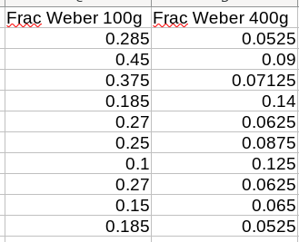



Slide 4





Slide 5
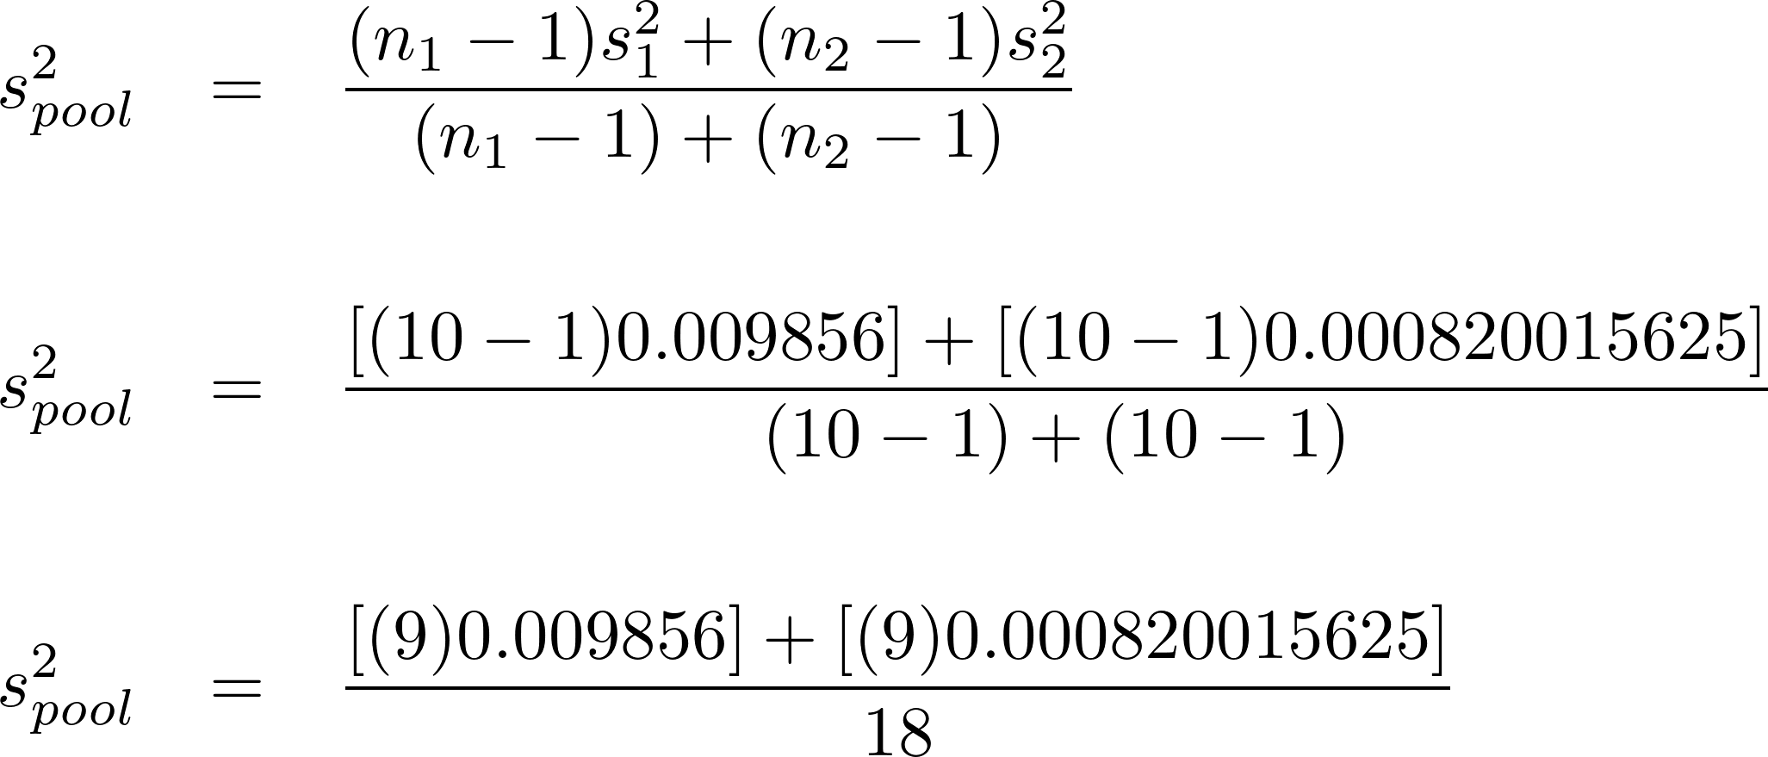

Slide 7
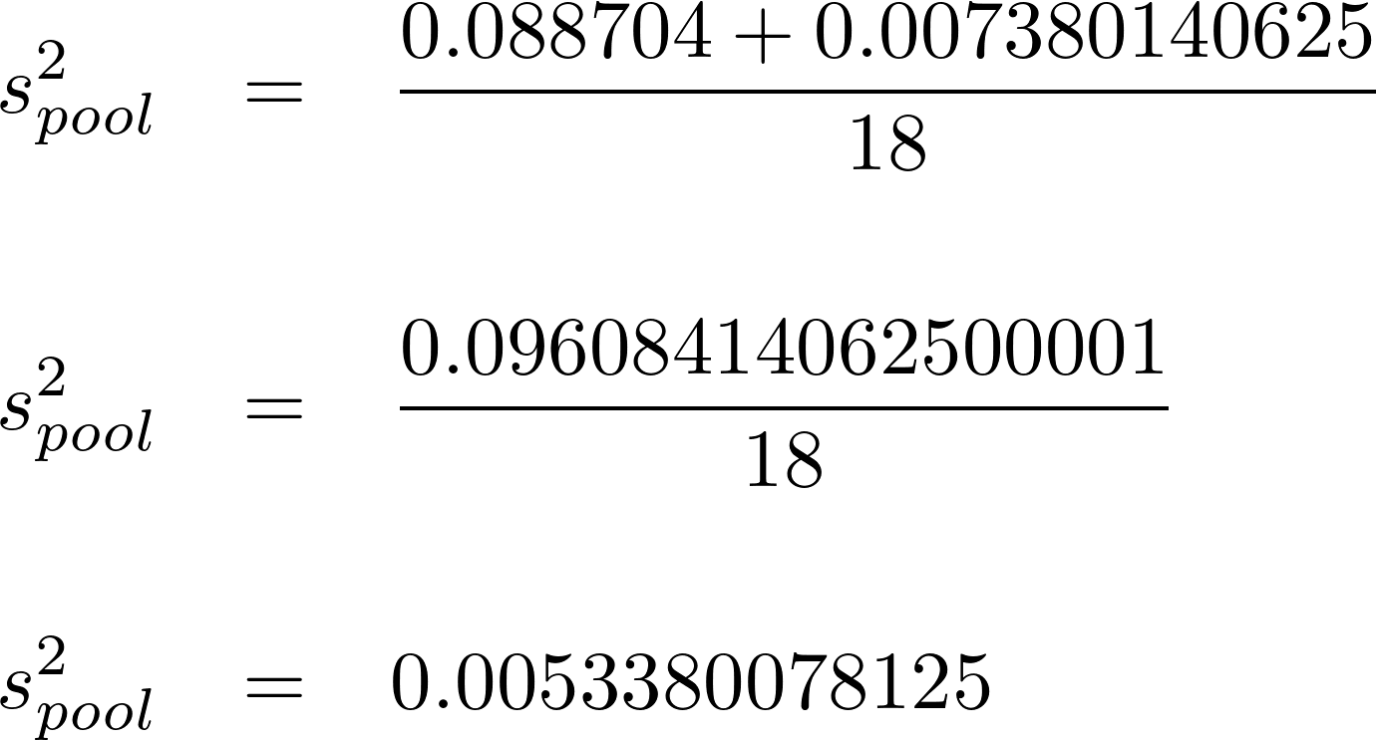

Slide 8
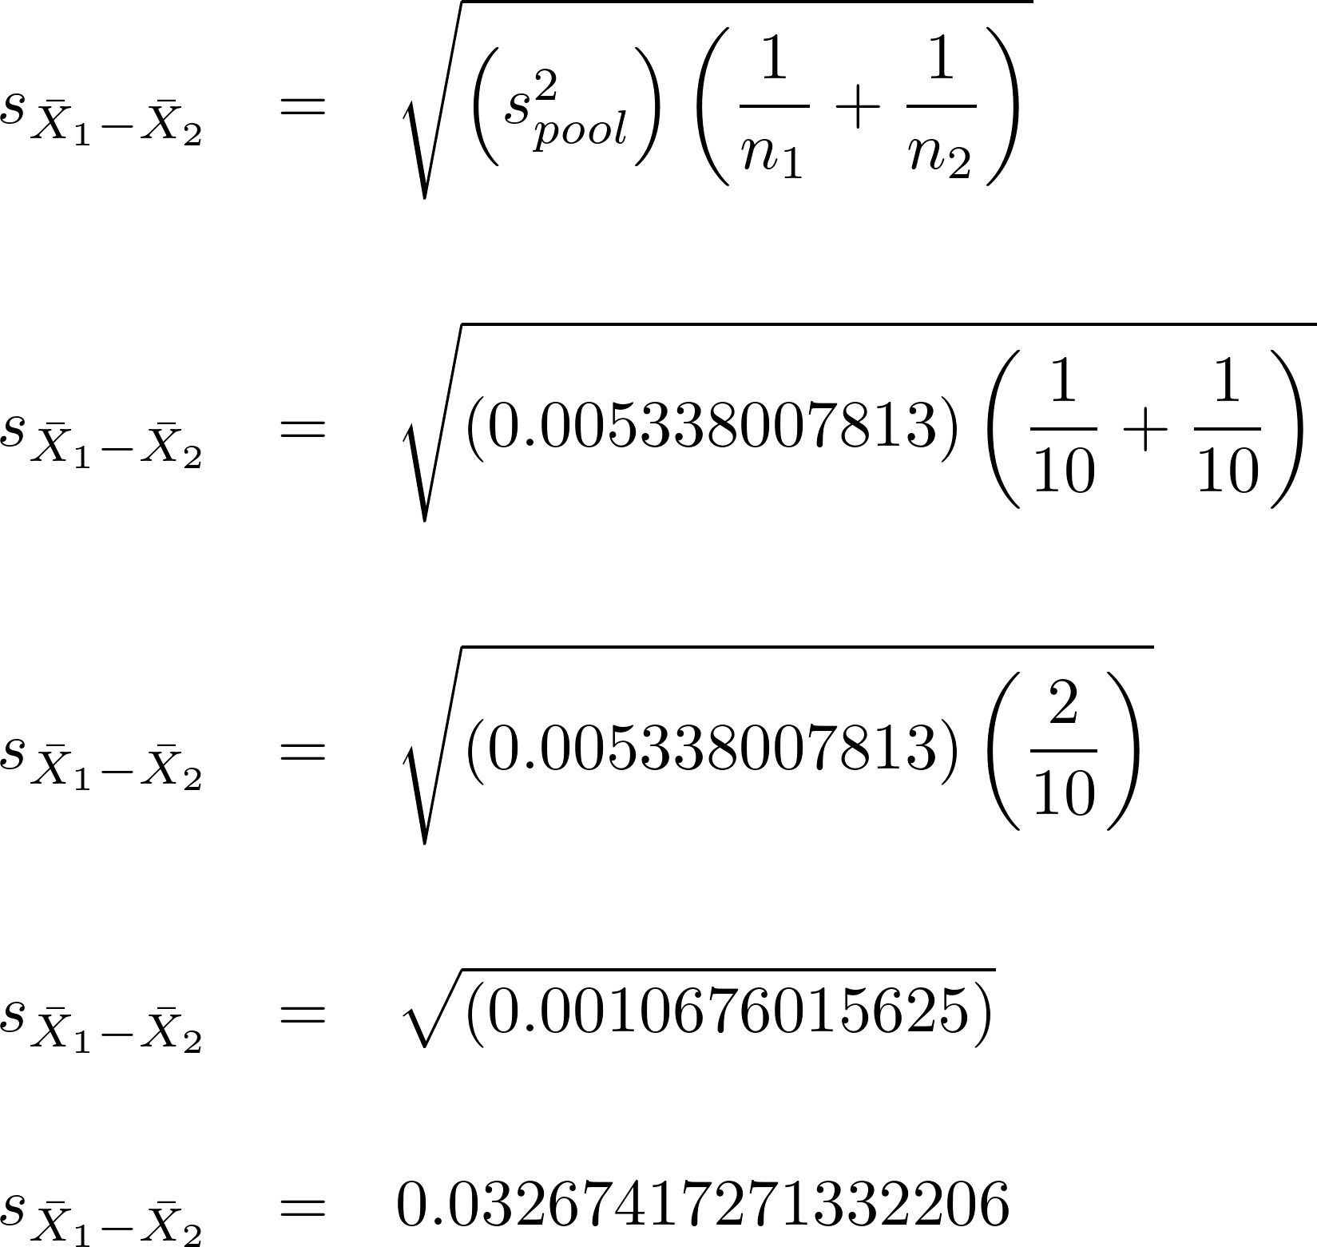

Slide 10
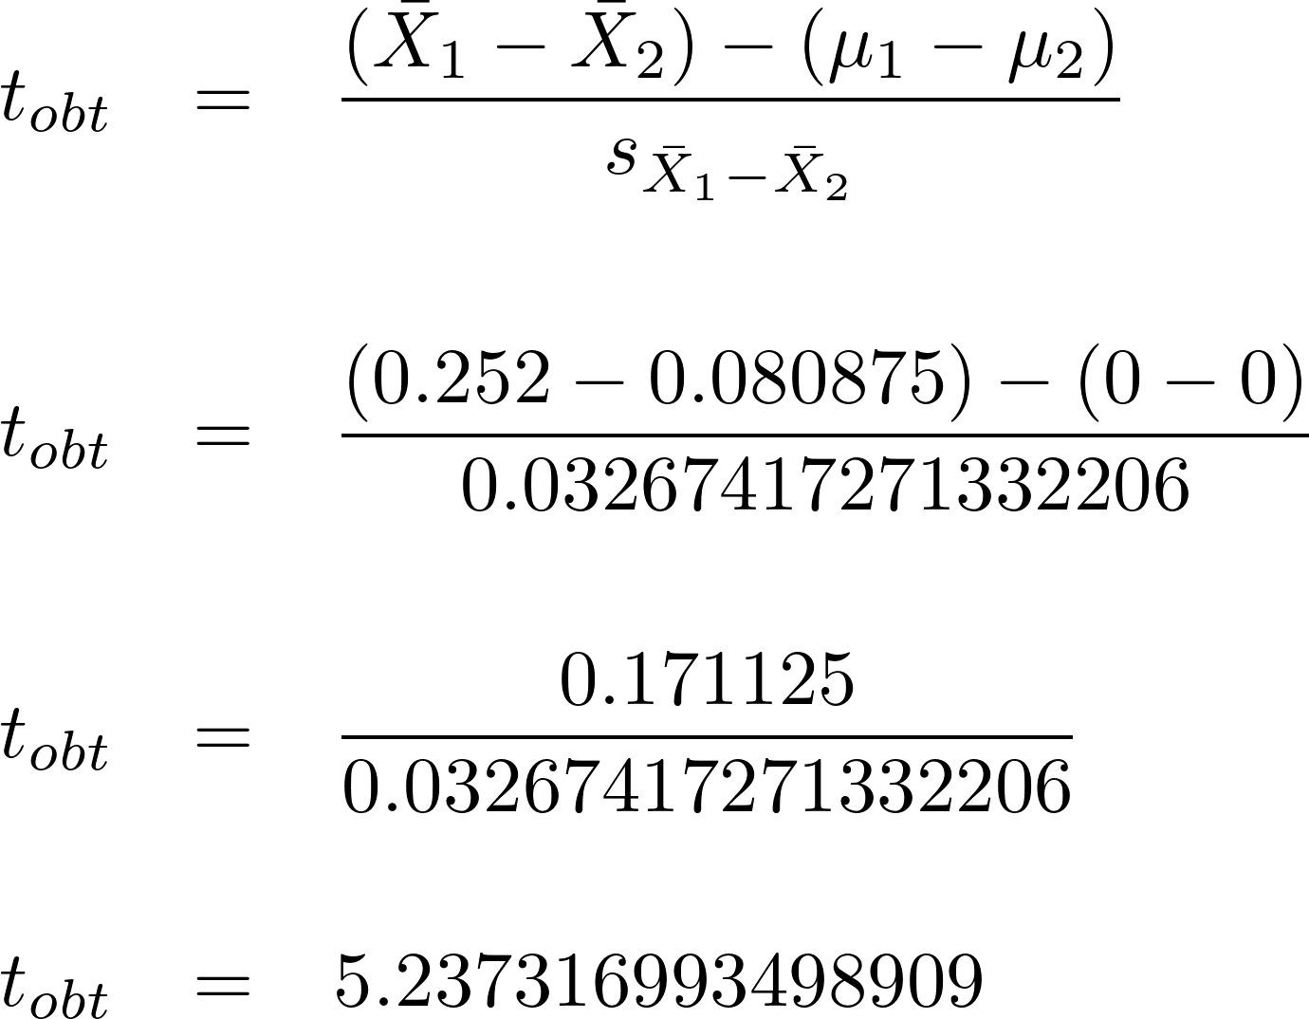

Slide 12
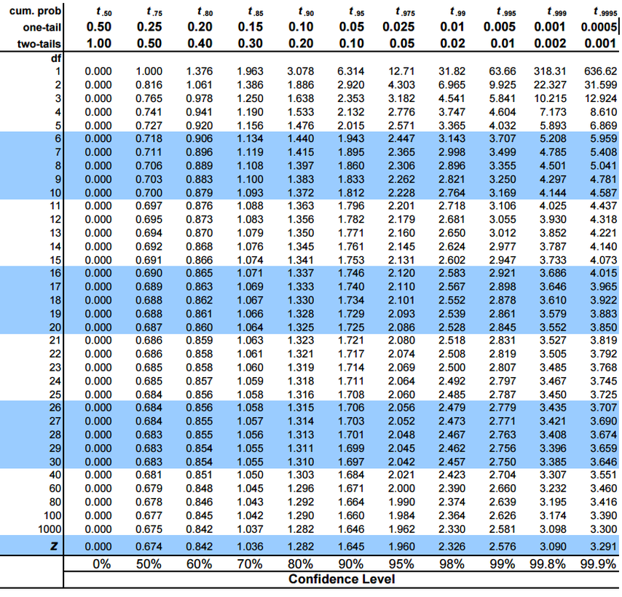

Slide 13
https://www.graphpad.com/quickcalcs/ttest1/?format=SD

