Slide 1

Mathematical modelling of a gas-gas ejector in MATLAB.
Thomas Abraham
(22JE1018)

Slide 2
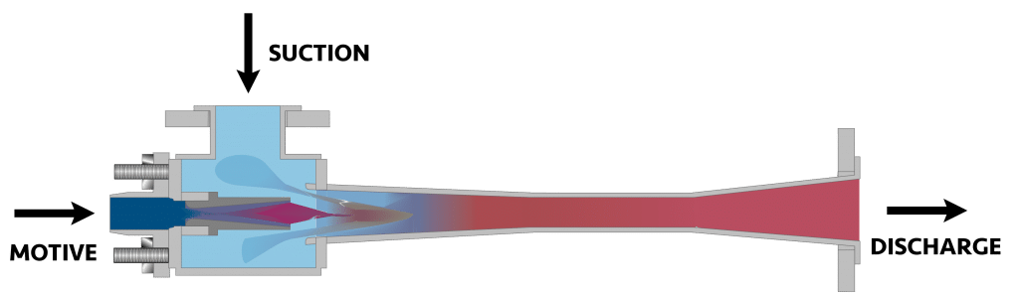
Gas-Gas Ejector:
A gas ejector, also known as a gas-gas ejector or jet pump, is a device that uses a high-pressure gas stream to entrain and compress a lower-pressure gas. It accelerates the motive gas through a converging nozzle creating a vacuum that sucks in and entraps the secondary fluid. The mixture is then expanded through a diverging nozzle. Gas ejectors are commonly used in industrial processes for applications such as vacuum generation, gas compression, and mixing. They have no moving parts, making them highly reliable, low-maintenance, and suitable for use in harsh environments.

Slide 3
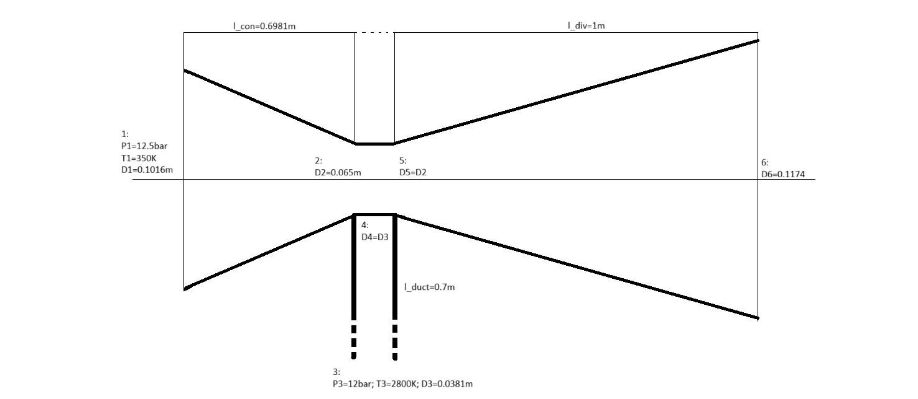
The Ejector to be Modelled:

Slide 4
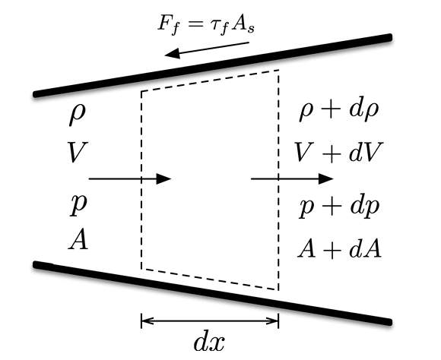
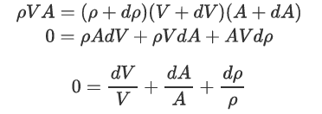
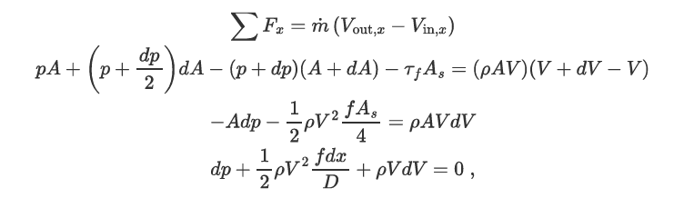
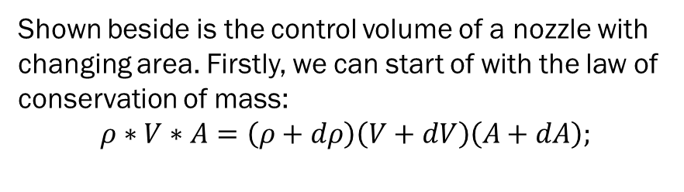
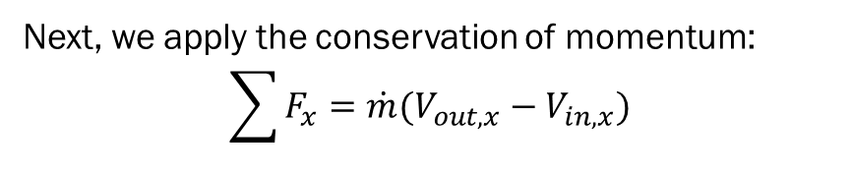
Adiabatic Flow with area change and friction:
Shown beside is the control volume of a nozzle with changing area. Firstly, we can start of with the law of conservation of mass:
$$ρ∗V∗A=\left(ρ+dρ\right)\left(V+dV\right)\left(A+dA\right);$$
---(i)
Next, we apply the conservation of momentum:
$$\sum{F_{x}=\dot{m}(V_{out,x}−V_{in,x})}$$
---(ii)

Slide 5


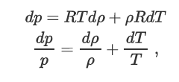
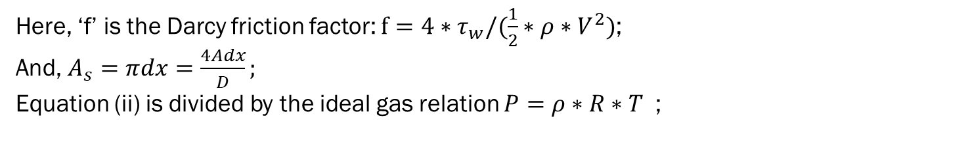
Here, ‘f’ is the Darcy friction factor: $f={4∗τ}_{w}/(\frac{1}{2}∗ρ∗V^{2})$;
And, $A_{s}=πdx=\frac{4Adx}{D};$
Equation (ii) is divided by the ideal gas relation $P=ρ∗R∗T$ ;
From the Mach number relation, we can write: $RT=\frac{V^{2}}{γ∗M^{2}}$
---(iii)
On taking the differential of the ideal gas law and dividing that result by the ideal gas equation:

Slide 6


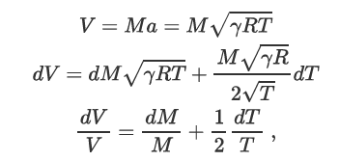
Using this result in Equation (iii):
The term “$dρ/ρ$” can be eliminated by using the result we derived from the conservation of mass, equation (i):
To eliminate the “$\frac{dV}{V}$” term , we differentiate the Mach number relation for ideal gases to get:

Slide 7
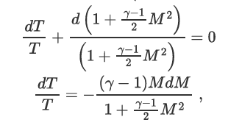
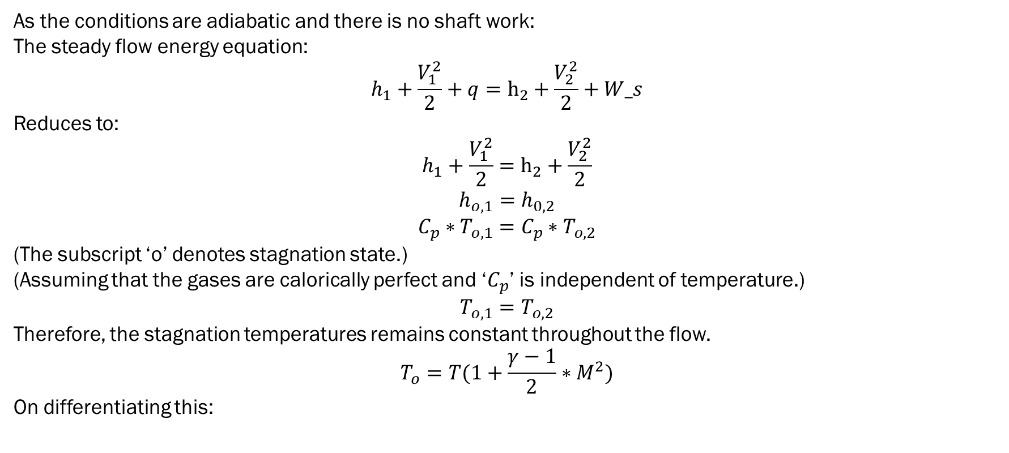
As the conditions are adiabatic and there is no shaft work:
The steady flow energy equation:
$$h_{1}+\frac{V_{1}^{2}}{2}+q=h_{2}+\frac{V_{2}^{2}}{2}+W_s$$
Reduces to:
$$h_{1}+\frac{V_{1}^{2}}{2}=h_{2}+\frac{V_{2}^{2}}{2}$$
$$h_{o,1}=h_{0,2}$$
$$C_{p}∗T_{o,1}=C_{p}∗T_{o,2}$$
(The subscript ‘o’ denotes stagnation state.)
(Assuming that the gases are calorically perfect and ‘$C_{p}$’ is independent of temperature.)
$$T_{o,1}=T_{o,2}$$
Therefore, the stagnation temperatures remains constant throughout the flow.
$$T_{o}=T(1+\frac{γ−1}{2}∗M^{2})$$
On differentiating this:

Slide 8

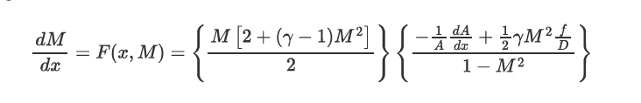
This lets us eliminate ‘$\frac{dT}{T}$’. Thus eliminating ‘$\frac{dT}{T}$’ and ‘$\frac{dV}{V}$’, gives us:
On dividing the above equation by ‘$dx$’ , we obtain a differential equation that describes the change in Mach number due to area change and friction. A final re-arrangement gives us:
----(iv)

Slide 9

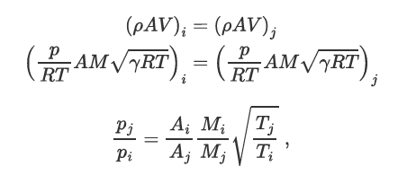

Utilising the fact that the stagnation temperature for any adiabatic flow with no shaft work remains the same across the flow:
$$T_{o}=T\left(1+\frac{γ−1}{2}∗M^{2}\right)=const.$$
For any two points ‘$i$’ and ‘$j$’, their temperatures can be related as:
---(v)
Now, to relate the pressures between these two points, we turn to the conservation of mass:

Slide 10
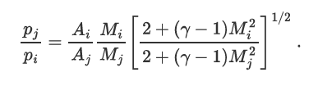
Substituting the relation for temperatures, we get the relationship between the pressures of any two points,‘$i$’ and ‘$j$’ along the flow:
---(vi)

Slide 11
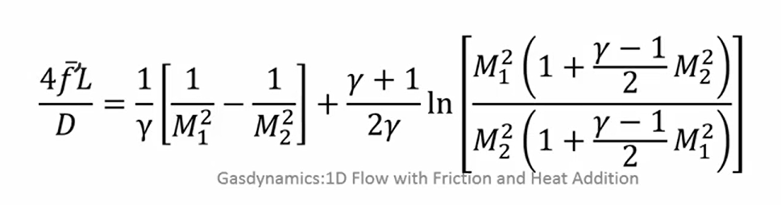
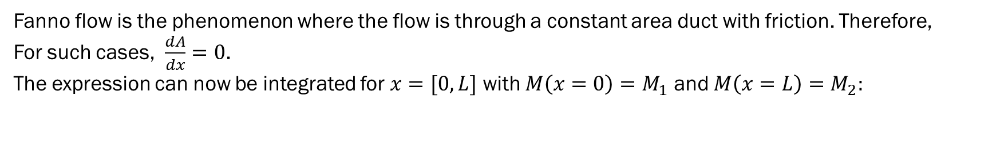
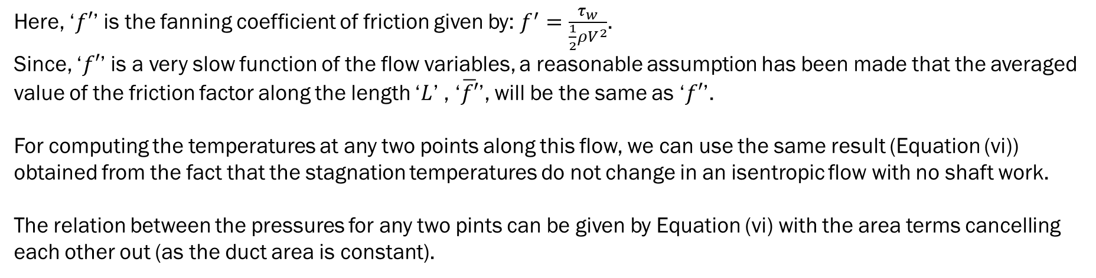
Fanno flow is the phenomenon where the flow is through a constant area duct with friction. Therefore,
For such cases, $\frac{dA}{dx}=0$.
The expression can now be integrated for $x=[0,L]$ with $M\left(x=0\right)=M_{1}$ and $M\left(x=L\right)=M_{2}:$
Here, ‘$f′$’ is the fanning coefficient of friction given by: $f^{′}=\frac{τ_{w}}{\frac{1}{2}ρV^{2}}$.
Since, ‘$f′$’ is a very slow function of the flow variables, a reasonable assumption has been made that the averaged value of the friction factor along the length ‘$L$’ , ‘$\overline{f′}$’, will be the same as ‘$f′$’.
For computing the temperatures at any two points along this flow, we can use the same result (Equation (vi)) obtained from the fact that the stagnation temperatures do not change in an isentropic flow with no shaft work.
The relation between the pressures for any two pints can be given by Equation (vi) with the area terms cancelling each other out (as the duct area is constant).

Slide 12
Modelling the Converging And Diverging Sections Of the Nozzle:
Equation (iv) has been solved using ODE45 (a solver that uses the Runge-Kutta method to approximate solutions to ODEs with a high degree of accuracy.)
%computing the MachNo.
dM_dx=@(x,M,gamma)((M*(2+(gamma-1)*M^2))/2)*(((-1/A(x))*(dA_dx_result(x))+0.5*gamma*M^2*f/D(x))/(1-M^2));
odeFun=@(x,M)dM_dx(x,M,gamma_nh3);
sol=ode45(odeFun,[0,l_con],machNo_1);
[x,M]=ode45(odeFun,[0,l_con],machNo_1);
“sol=ode45() “ returns a struct that can be used with the ‘deval’ command to return the Mach number at any point in the interval. Thus, effectively, we have the Mach number at point within the converging section.
Using, Equation (vi), we can find the pressure at any point within (as we have the inlet Mach number and the Mach number of the said point can be solved for from the above procedure.

Slide 13
In code, the procedure looks as follows:
%Function of pressure along the converging nozzle:
P_con=@(gamma,x)P_1*((machNo_1/deval(sol,x))*((((2+(gamma-1)*machNo_1^2))/(2+(gamma-1)*(deval(sol,x))^2))^(1/2))*(A(0)/A(x)));
The above snippet makes use of Equation (vi).
The pressure at any point in the converging nozzle can thus be calculated.
Similarly, armed with the ability to solve for the Mach number at any point within the domain of the converging nozzle and with the inlet Temperature and Mach number as a reference, we can use Equation (v) to evaluate for the temperature at any point. The function defined for this purpose is as follows:
%isentropic realtion between temperatures (general relationship):
T=@(gamma,T_k,M,M_k)T_k*(2+(gamma-1)*M_k^2)/(2+(gamma-1)*M^2);
In this manner, we have all the primitive variables (P,M,T) in the computational domain of the converging nozzle.
The modelling of the diverging nozzle takes the same approach (we are solving for the same equations and relations).
%Function of pressure along the converging nozzle:
P_con=@(gamma,x)P_1*((machNo_1/deval(sol,x))*((((2+(gamma-1)*machNo_1^2))/(2+(gamma-1)*(deval(sol,x))^2))^(1/2))*(A(0)/A(x)));
%isentropic realtion between temperatures (general relationship):
T=@(gamma,T_k,M,M_k)T_k*(2+(gamma-1)*M_k^2)/(2+(gamma-1)*M^2);

Slide 14
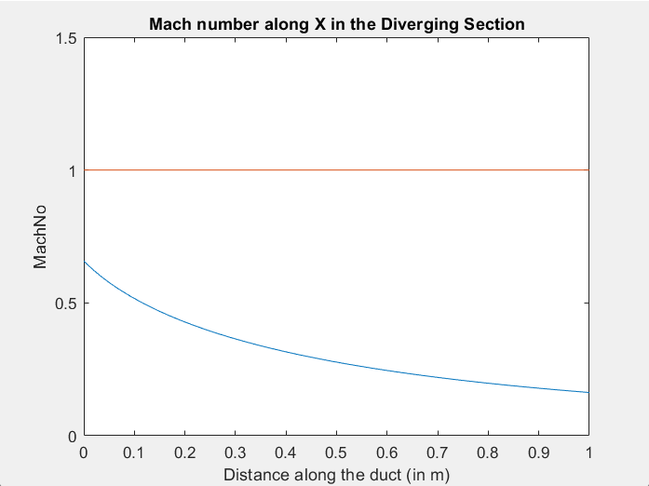
Mach Number Variation in the Converging Nozzle

Slide 15
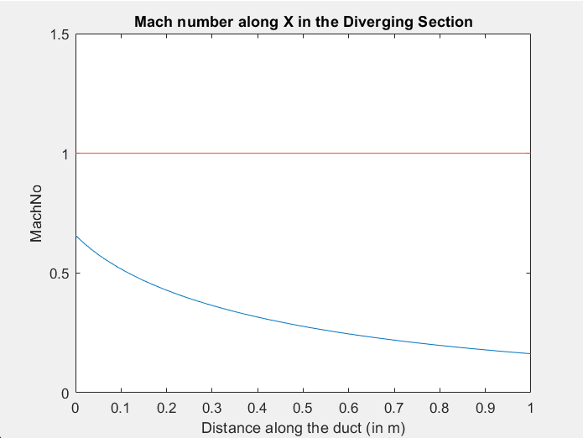
Mach Number Variation in the Diverging Nozzle

Slide 16
Modelling the Duct for the Flue Gas:
To solve for the Mach number at the exit of the duct for the flue gases, we have to solve for Equations (vii) and (vi).
The known values are the length of the duct, the pressures at the entry and exit of the duct, the diameter of the duct (thus by extension, also its area), and gamma for the flue gases.
The two equations can thus be solved to obtain the Mach numbers at entry and exit of the duct.
Being a complicated system of non linear equation to solve, “fsolve” was employed to numerically solve for the solutions. In code, the procedure looks as follows:
%Solving the machNos for 3 and 4;
eqn = @(M) [
(D_duct/(4*f_fanning))*((1 / gamma_flue) * ((1 / M(1)^2) - (1 / M(2)^2)) + ((gamma_flue + 1) / (gamma_flue * 2)) * log((M(1)^2 * (1 + ((gamma_flue - 1) / 2) * M(2)^2)) / (M(2)^2 * (1 + ((gamma_flue - 1) / 2) * M(1)^2))))-l_duct;
(M(1) / M(2)) * (((2 + (gamma_flue - 1) * M(1)^2) / (2 + (gamma_flue - 1) * M(2)^2))^(1/2))-P_2/P_3;
];
guess=[1 1];
solutionMach=fsolve(eqn,guess);
machNo_3=solutionMach(1);
machNo_4=solutionMach(2);

Slide 17
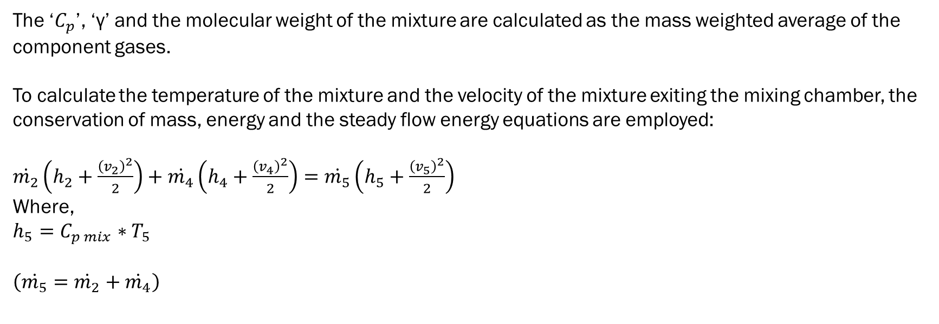
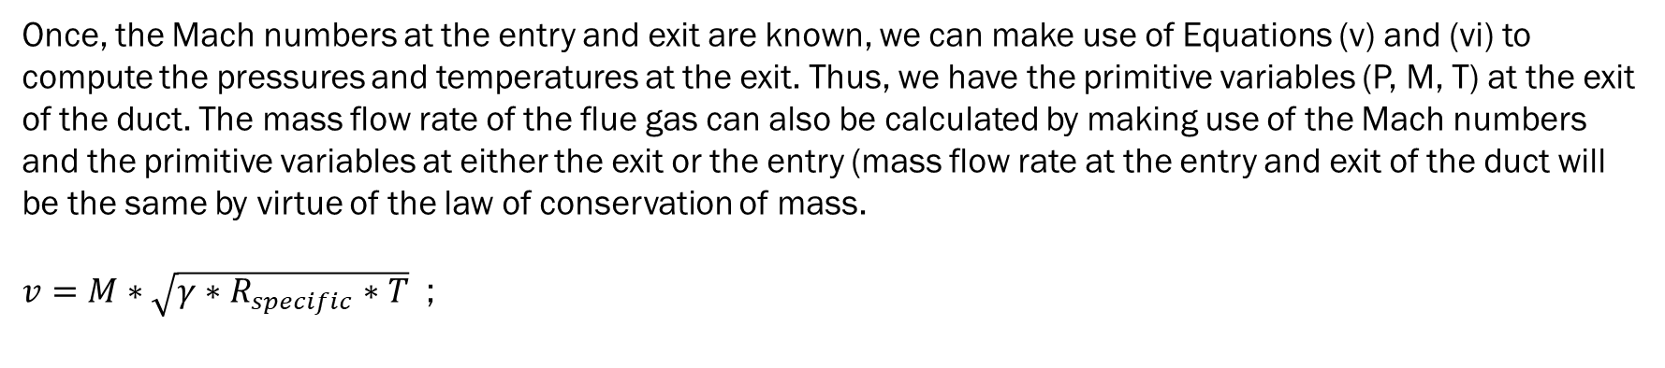
Once, the Mach numbers at the entry and exit are known, we can make use of Equations (v) and (vi) to compute the pressures and temperatures at the exit. Thus, we have the primitive variables (P, M, T) at the exit of the duct. The mass flow rate of the flue gas can also be calculated by making use of the Mach numbers and the primitive variables at either the exit or the entry (mass flow rate at the entry and exit of the duct will be the same by virtue of the law of conservation of mass.
$v=M∗\sqrt{γ∗R_{specific}∗T}$ ;
The ‘$C_{p}$’, ‘γ’ and the molecular weight of the mixture are calculated as the mass weighted average of the component gases.
To calculate the temperature of the mixture and the velocity of the mixture exiting the mixing chamber, the conservation of mass, energy and the steady flow energy equations are employed:
$\dot{m_{2}}\left(h_{2}+\frac{{\left(v_{2}\right)}^{2}}{2}\right)+\dot{m_{4}}\left(h_{4}+\frac{{\left(v_{4}\right)}^{2}}{2}\right)=$ $\dot{m_{5}}\left(h_{5}+\frac{{\left(v_{5}\right)}^{2}}{2}\right)$
Where,
$$h_{5}=C_{p mix}∗T_{5}$$
$$\left(\dot{m_{5}}=\dot{m_{2}}+\dot{m_{4}}\right)$$
The mixture temperature (T₅) and velocity (V₅) are computed by solving the mass and energy conservation equations simultaneously using MATLAB’s ‘fsolve’ function from the Optimization Toolbox.
This approach ensures both equations are satisfied to machine precision, yielding consistent thermodynamic states for the mixed stream.

Slide 18
In code:
Cp_mix=((mass_frac_nh3*Cp_nh3)+((1-mass_frac_nh3)*Cp_flue));
totEnergy_2=m_1*(Cp_nh3*T_2+(V_2^(2))/2);
totEnergy_4=m_4*(Cp_flue*T_4+(V_4^(2))/2);
totEnergy_5=totEnergy_4+totEnergy_2;
%T_mix=(totEnergy_5-(m_5*V_5^(2))/2)/(m_5*Cp_mix); %correction1
MW_mix=(mass_frac_nh3*MW_nh3)+((1-mass_frac_nh3)*MW_flue); %Careful! in gram/mol!! versionCopy used chi
gamma_mix=(mass_frac_nh3*gamma_nh3)+((1-mass_frac_nh3)*gamma_flue); %versionCopy used chi
eqn_2=@(t)[totEnergy_5-m_5*(Cp_mix*t(1)+(t(2)^2)/2);
m_5-((P_2*10^5)/((R_univ/(0.001*MW_mix))*t(1)))*A(l_con)*t(2);
];
guess_2=[1 1];
options = optimoptions('fsolve', 'MaxFunctionEvaluations',200);
solution_5=fsolve(eqn_2,guess_2,options);
T_mix=solution_5(1);
V_5=solution_5(2);
Thus, we are able to calculate the primitive variables of the flow at the entry of the diverging nozzle.

