Slide 1










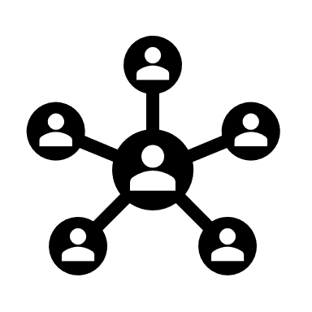


Register Different Redirect URL for different roles in Azure AD
Terraform Apply
Terraform
Azure AD & MFA
AWS EKS
Cloud Watch
& Cloud Trail
AWS Lamba
Splunk HTTP
Event Collector
Logs & Reports
Redirect URL
Admin Service
SSO Login Flow
Roles/Actors
1. Team
2.PlatfoAdminrm Team
3.User/System
Snowflake
REST API over
HTTPS
Platform Service
User
Internet
Self Service Portal (SPA)
S3 Bucket
API Gateway
Network And Internet Access Control
Angular Client
Pub & Sub Service
Cloud Front
Email
Amazon SNS
Notification

