Slide 1
CS110 Introduction to Computing
Assignment#1 Sketches

Slide 2
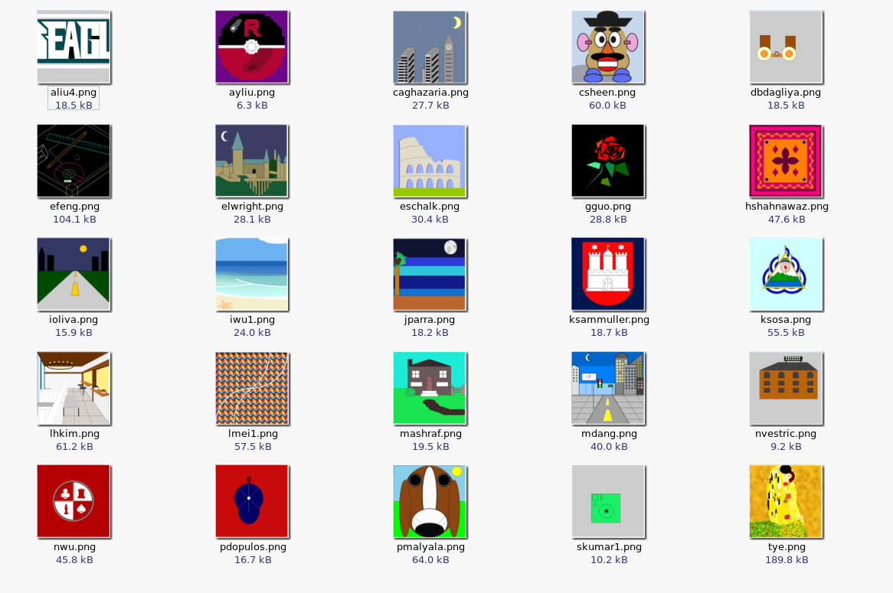
Notes:
<number>

Slide 3

Department:
Computer Science
Course:
CS110
Introduction to Computing
Professor:
Blank
Art created:
September 2015
Artist: aliu4
CS110 Assignment #1 - Fall 2015
Notes:
<number>

Slide 4

Department:
Computer Science
Course:
CS110
Introduction to Computing
Professor:
Blank
Art created:
September 2015
Artist: ayliu
CS110 Assignment #1 - Fall 2015
Notes:
<number>

Slide 5

Department:
Computer Science
Course:
CS110
Introduction to Computing
Professor:
Blank
Art created:
September 2015
Artist: caghazaria
CS110 Assignment #1 - Fall 2015
Notes:
<number>

Slide 6

Department:
Computer Science
Course:
CS110
Introduction to Computing
Professor:
Blank
Art created:
September 2015
Artist: csheen
CS110 Assignment #1 - Fall 2015
Notes:
<number>

Slide 7
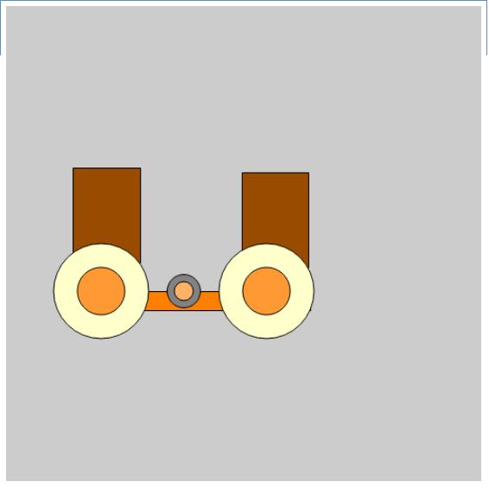
Department:
Computer Science
Course:
CS110
Introduction to Computing
Professor:
Blank
Art created:
September 2015
Artist: dbdagliya
CS110 Assignment #1 - Fall 2015
Notes:
<number>

Slide 8
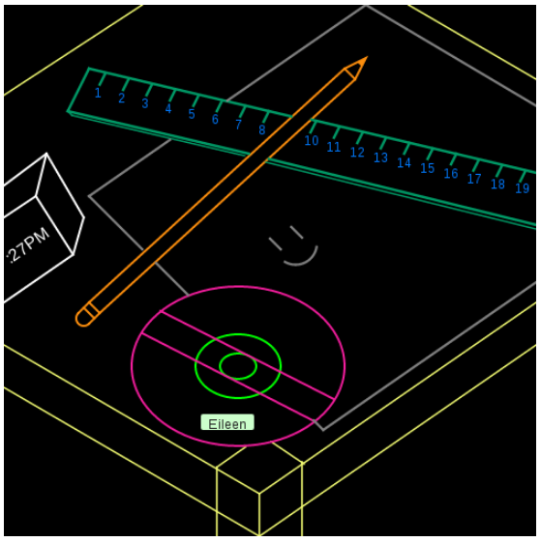
Department:
Computer Science
Course:
CS110
Introduction to Computing
Professor:
Blank
Art created:
September 2015
Artist: efeng
CS110 Assignment #1 - Fall 2015
Notes:
<number>

Slide 9

Department:
Computer Science
Course:
CS110
Introduction to Computing
Professor:
Blank
Art created:
September 2015
Artist: elwright
CS110 Assignment #1 - Fall 2015
Notes:
<number>

Slide 10

Department:
Computer Science
Course:
CS110
Introduction to Computing
Professor:
Blank
Art created:
September 2015
Artist: eschalk
CS110 Assignment #1 - Fall 2015
Notes:
<number>

Slide 11

Department:
Computer Science
Course:
CS110
Introduction to Computing
Professor:
Blank
Art created:
September 2015
Artist: gguo
CS110 Assignment #1 - Fall 2015
Notes:
<number>

Slide 12

Department:
Computer Science
Course:
CS110
Introduction to Computing
Professor:
Blank
Art created:
September 2015
Artist: hshahnawaz
CS110 Assignment #1 - Fall 2015
Notes:
<number>

Slide 13

Department:
Computer Science
Course:
CS110
Introduction to Computing
Professor:
Blank
Art created:
September 2015
Artist: ioliva
CS110 Assignment #1 - Fall 2015
Notes:
<number>

Slide 14

Department:
Computer Science
Course:
CS110
Introduction to Computing
Professor:
Blank
Art created:
September 2015
Artist: iwu1
CS110 Assignment #1 - Fall 2015
Notes:
<number>

Slide 15
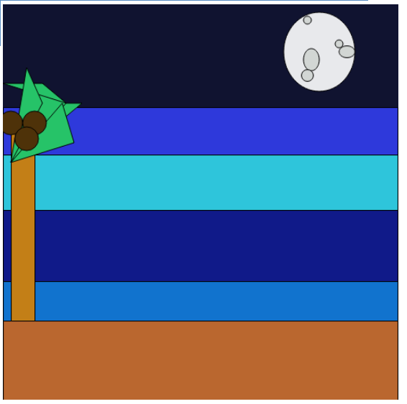
Department:
Computer Science
Course:
CS110
Introduction to Computing
Professor:
Blank
Art created:
September 2015
Artist: jparra
CS110 Assignment #1 - Fall 2015
Notes:
<number>

Slide 16

Department:
Computer Science
Course:
CS110
Introduction to Computing
Professor:
Blank
Art created:
September 2015
Artist: ksammuller
CS110 Assignment #1 - Fall 2015
Notes:
<number>

Slide 17

Department:
Computer Science
Course:
CS110
Introduction to Computing
Professor:
Blank
Art created:
September 2015
Artist: ksosa
CS110 Assignment #1 - Fall 2015
Notes:
<number>

Slide 18
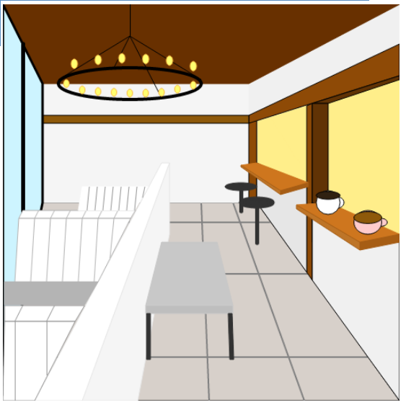
Department:
Computer Science
Course:
CS110
Introduction to Computing
Professor:
Blank
Art created:
September 2015
Artist: lhkim
CS110 Assignment #1 - Fall 2015
Notes:
<number>

Slide 19
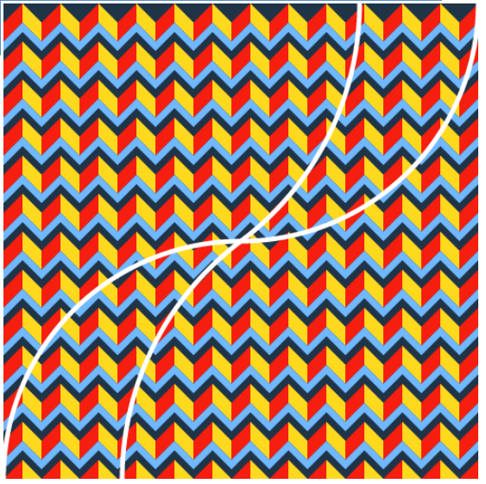
Department:
Computer Science
Course:
CS110
Introduction to Computing
Professor:
Blank
Art created:
September 2015
Artist: lmei1
CS110 Assignment #1 - Fall 2015
Notes:
<number>

Slide 20

Department:
Computer Science
Course:
CS110
Introduction to Computing
Professor:
Blank
Art created:
September 2015
Artist: mashraf
CS110 Assignment #1 - Fall 2015
Notes:
<number>

Slide 21
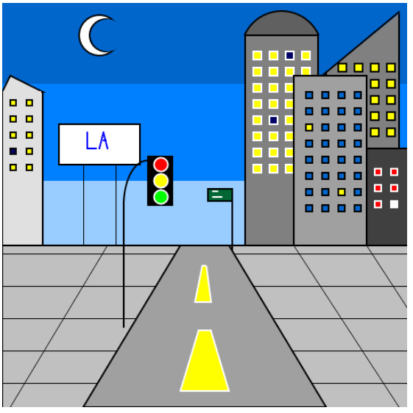
Department:
Computer Science
Course:
CS110
Introduction to Computing
Professor:
Blank
Art created:
September 2015
Artist: mdang
CS110 Assignment #1 - Fall 2015
Notes:
<number>

Slide 22
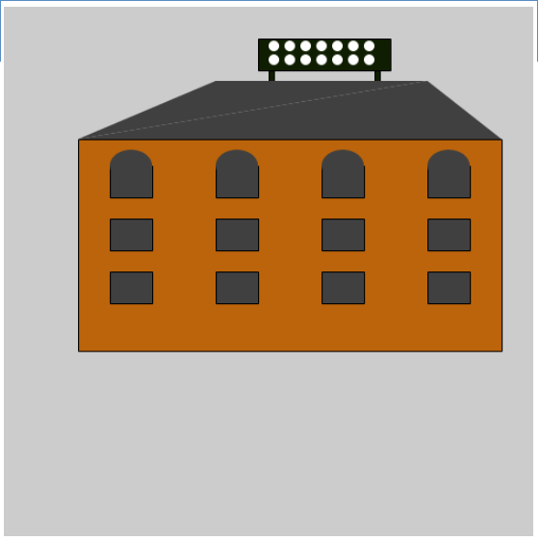
Department:
Computer Science
Course:
CS110
Introduction to Computing
Professor:
Blank
Art created:
September 2015
Artist: nvestric
CS110 Assignment #1 - Fall 2015
Notes:
<number>

Slide 23

Department:
Computer Science
Course:
CS110
Introduction to Computing
Professor:
Blank
Art created:
September 2015
Artist: nwu
CS110 Assignment #1 - Fall 2015
Notes:
<number>

Slide 24
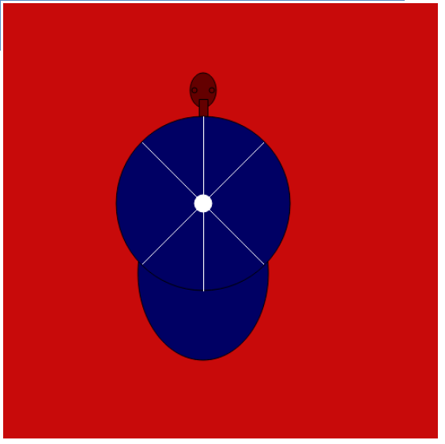
Department:
Computer Science
Course:
CS110
Introduction to Computing
Professor:
Blank
Art created:
September 2015
Artist: pdopulos
CS110 Assignment #1 - Fall 2015
Notes:
<number>

Slide 25

Department:
Computer Science
Course:
CS110
Introduction to Computing
Professor:
Blank
Art created:
September 2015
Artist: pmalyala
CS110 Assignment #1 - Fall 2015
Notes:
<number>

Slide 26
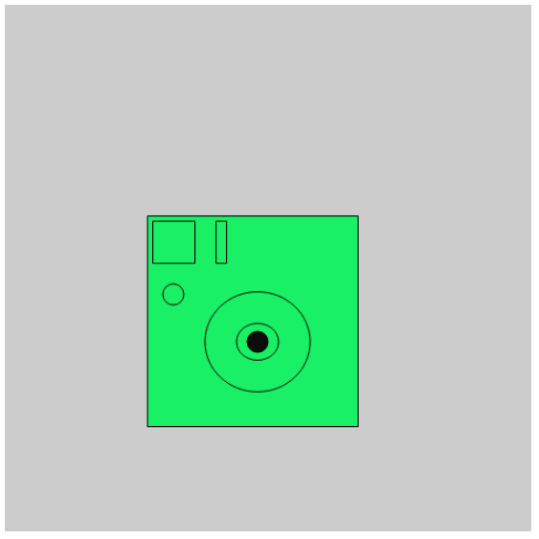
Department:
Computer Science
Course:
CS110
Introduction to Computing
Professor:
Blank
Art created:
September 2015
Artist: skumar1
CS110 Assignment #1 - Fall 2015
Notes:
<number>

Slide 27
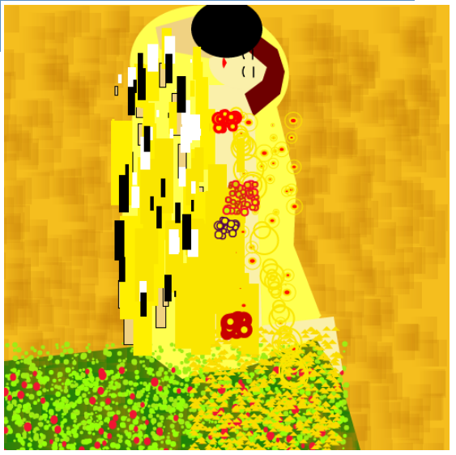
Department:
Computer Science
Course:
CS110
Introduction to Computing
Professor:
Blank
Art created:
September 2015
Artist: tye
CS110 Assignment #1 - Fall 2015
Notes:
<number>

