Slide 1
Common Rails model anti-patterns
Dominik Mačković
Senior Full Stack Engineer
Mews

Slide 2


Slide 3
What are anti-patterns
Ineffective solutions to recurring problems
Examples of anti-patterns:
Spaghetti code
God object
Accidental complexity
Anti-patterns tend to:
Increase complexity and maintenance costs
Increase technical debt
Decrease code readability
Decrease team productivity

Slide 4
Solution to anti-patterns
Use proven design patterns and best practices
Factory pattern
Template pattern
Decorator
Don’t reinvent the wheel

Slide 5
Rails model anti-patterns
Voyeuristic model
Fat model
Spaghetti SQL
Code duplication
Future proof model

Slide 6
Voyeuristic model
Issues
“Knows” too much about other models’ implementation
Takes responsibility from other models
Solutions
Follow the Law of Demeter
Use finders on correct models

Slide 7
Follow Law of Demeter
Principle of least knowledge
Component should have limited knowledge about other components and should not reach another object’s internal details
Communicate only with immediate neighbours
Assume as little as possible about other models to reduce binding and improve maintainability

Slide 8
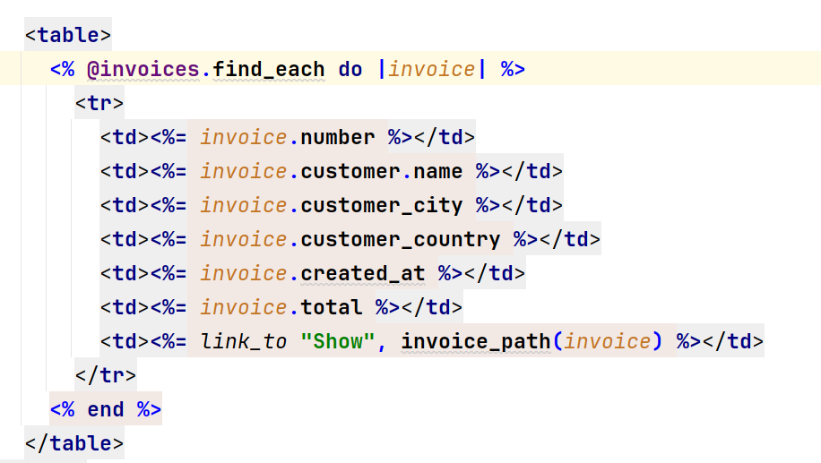
Follow Law of Demeter

Slide 9
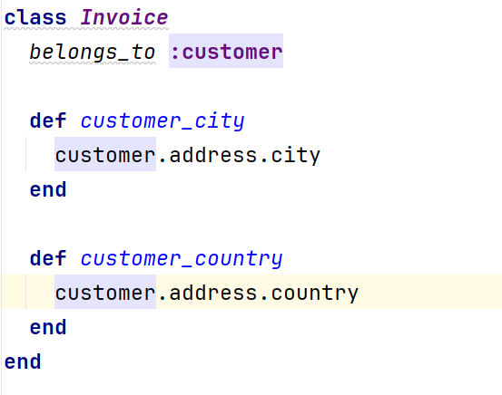
Follow Law of Demeter

Slide 10
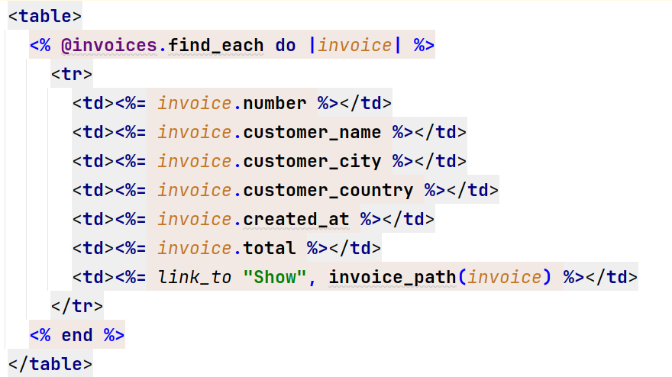
Follow Law of Demeter

Slide 11
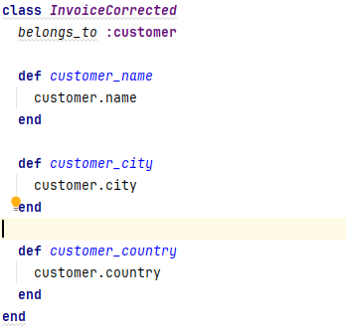
Follow Law of Demeter

Slide 12
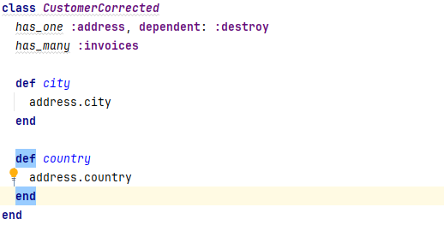
Follow Law of Demeter

Slide 13
Use finders on correct models
Move finders from views and controllers
Create a method or scope
Follow the Law of Demeter and place the methods into correct model

Slide 14
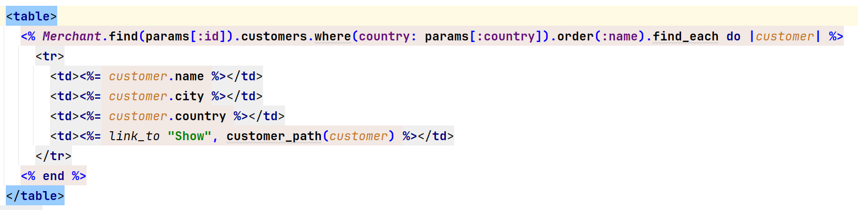
Use finders on correct models

Slide 15
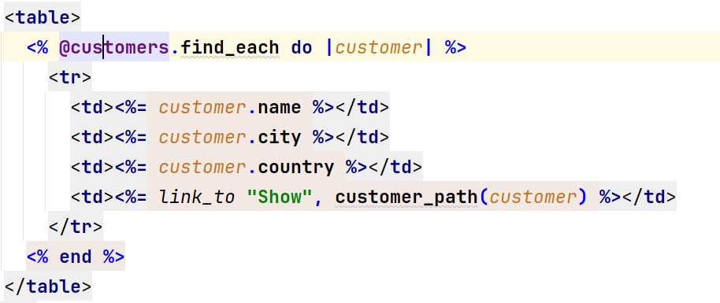
Use finders on correct models

Slide 16
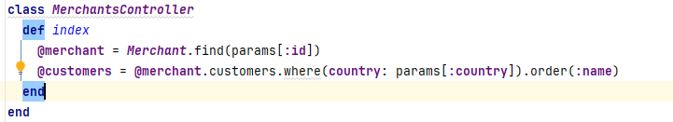
Use finders on correct models

Slide 17
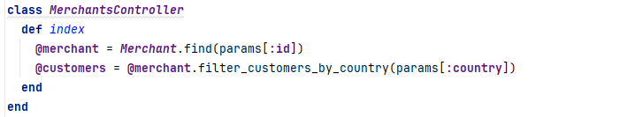
Use finders on correct models

Slide 18
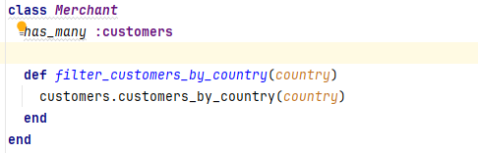
Use finders on correct models

Slide 19
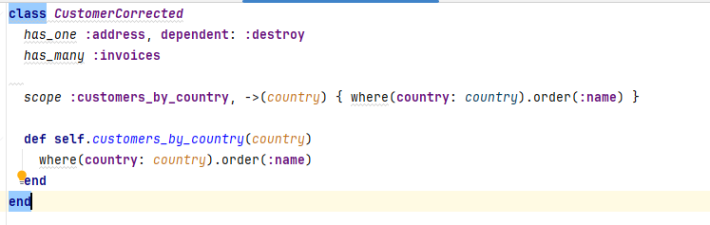
Use finders on correct models

Slide 20
Fat models
The more methods model has less readable it is
Models should follow Single Responsibility Principle
There should never be more than one reason for a class to change.
Solutions
Move code to modules/classes
Template module

Slide 21
Move code to modules/classes
Move methods to modules and include them in models
Once modules grow too big move to specialized classes
Have Single Responsibility Principle in mind

Slide 22
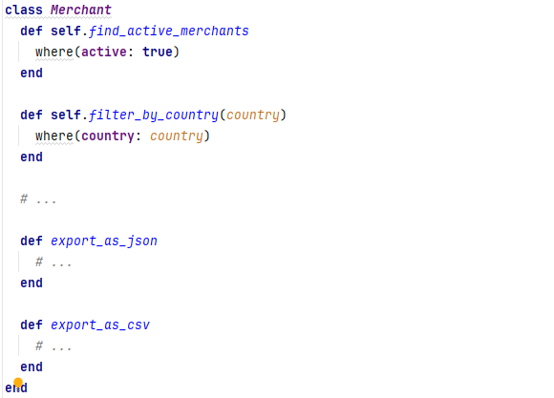
Move code to modules/classes

Slide 23
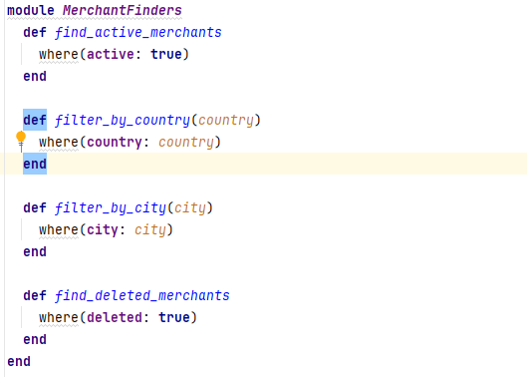
Move code to modules/classes

Slide 24
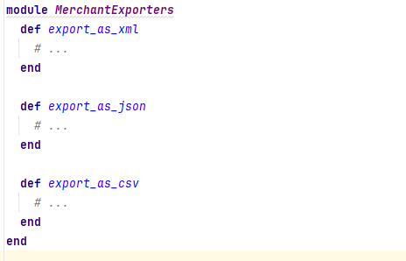
Move code to modules/classes

Slide 25
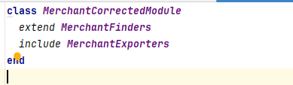
Move code to modules/classes

Slide 26
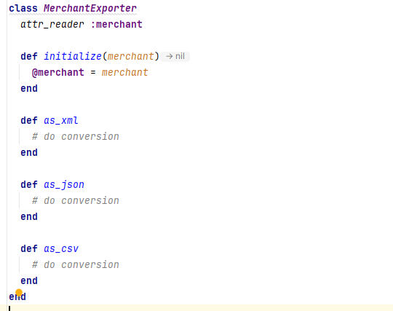
Move code to modules/classes

Slide 27
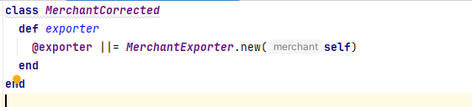
Move code to modules/classes

Slide 28
Template module
Can be used in template pattern
Abstract methods in the model need to throw exception
Contains only core methods

Slide 29
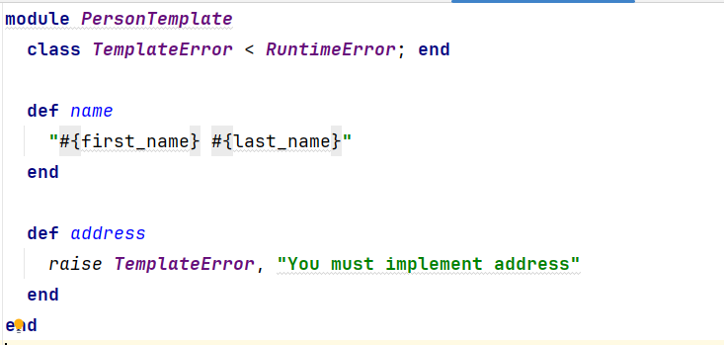
Template module

Slide 30
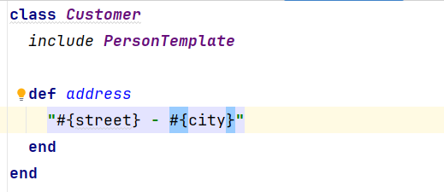
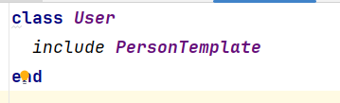
Template module

Slide 31
Spaghetti SQL
Not all ActiveRecord functionalities are used
Identical query conditions are used in multiple places
Solutions:
Use scope
Use class methods
In case both get out of control extract into specialized query object

Slide 32
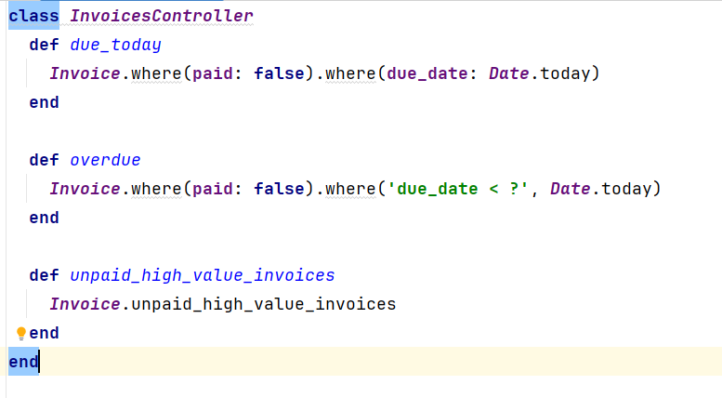
Spaghetti SQL

Slide 33
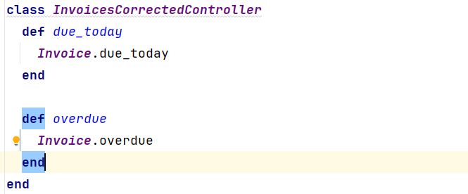
Spaghetti SQL

Slide 34
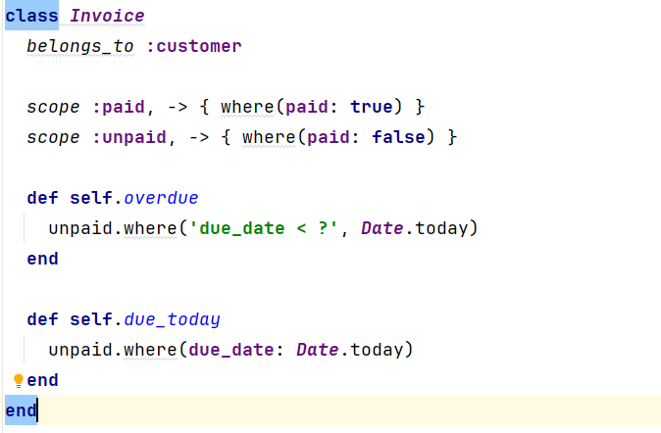
Spaghetti SQL

Slide 35
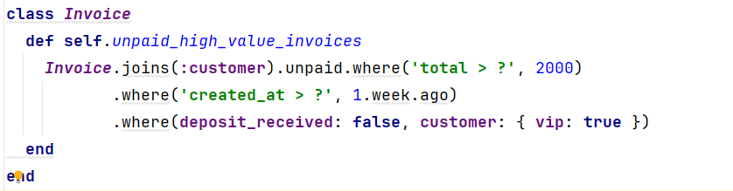
Spaghetti SQL

Slide 36
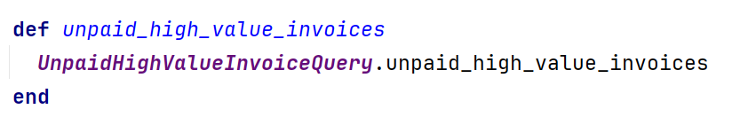
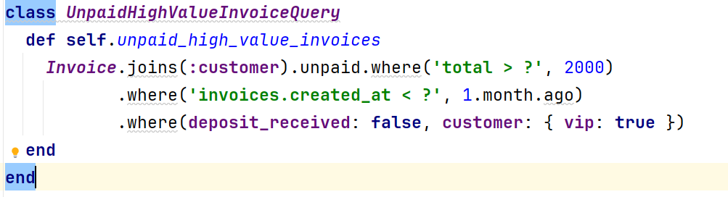
Spaghetti SQL

Slide 37
Code duplication
Same methods defined in multiple places
Checker methods for different model states
Cause issues when logic changes need to be made
Solution:
Move code to module/classes
Use meta-programming

Slide 38
Use meta-programming
When model has multiple states (defined in an array) finder for each needs to be defined
Using meta-programming we can put all the finders in one place
All changes need to be done in array

Slide 39
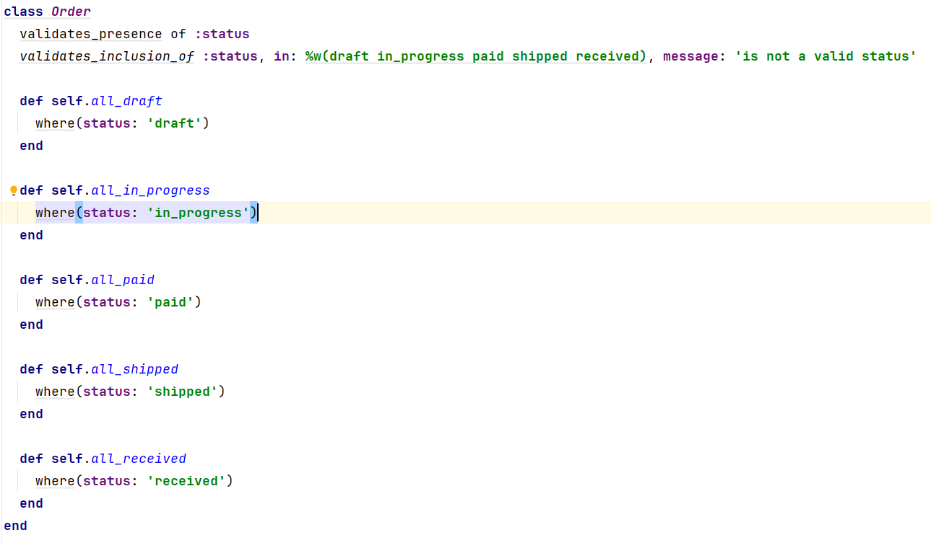
Use meta-programming

Slide 40
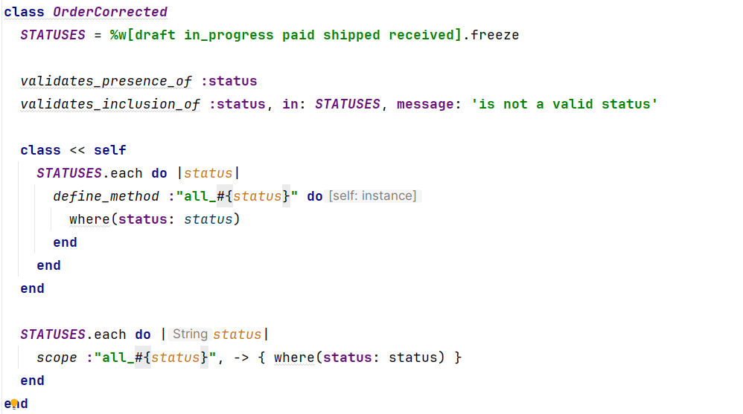
Use meta-programming

Slide 41
Future proof model
Methods that are never used and make code less readable
In some cases, model is not even necessary
Recommendations:
Don’t write code not required by the specification
Check is model required
If there is no UI data manipulation model should not be created

Slide 42
Conclusion
Avoid mentioned pitfalls
Learn new patterns
Use functionalities that language offers

Slide 43
Resources
Rails AntiPatterns: Best Practice Ruby on Rails Refactoring, Chad Pytel, Tammer Saleh
7 Patterns to Refactor Fat ActiveRecord Models | CodeClimate Blog
Ruby on Rails Model Patterns and Anti-patterns | AppSignal Blog

Slide 44
Q&A

