Slide 1
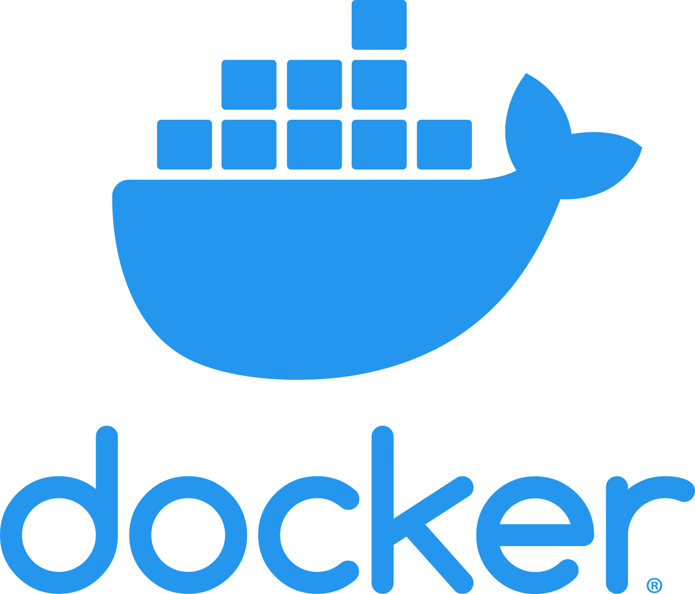








Slide 2
What is Docker?
Containerized Applications
open-source software
automates the deployment of software applications inside containers
additional layer of abstraction and automation
OS-level virtualization
allows user to package an application with all its dependencies into a standardized unit
App A
App B
App C
App D
Docker
Host Operating System
Infrastructure

Slide 3
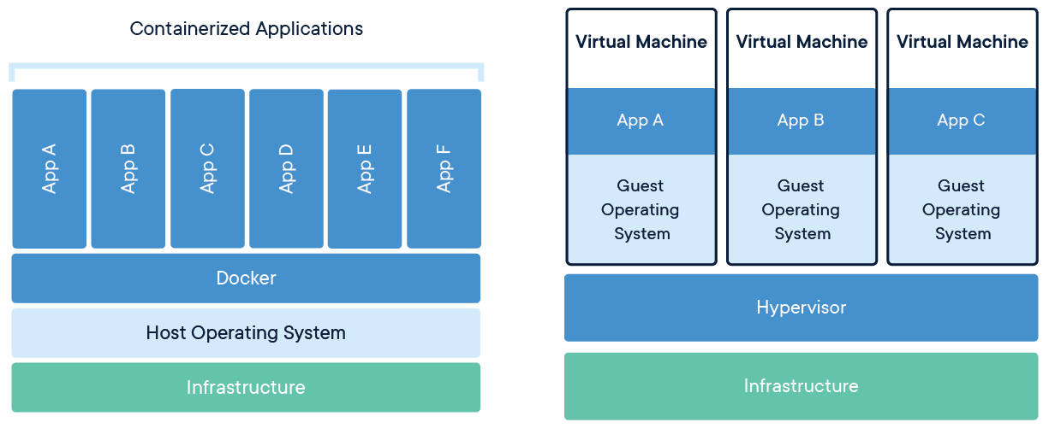
Docker vs VM

Slide 4
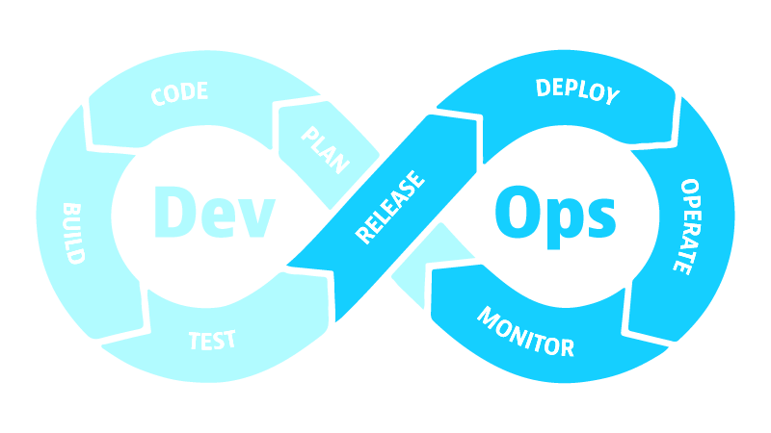
Development & Deployment

Slide 5
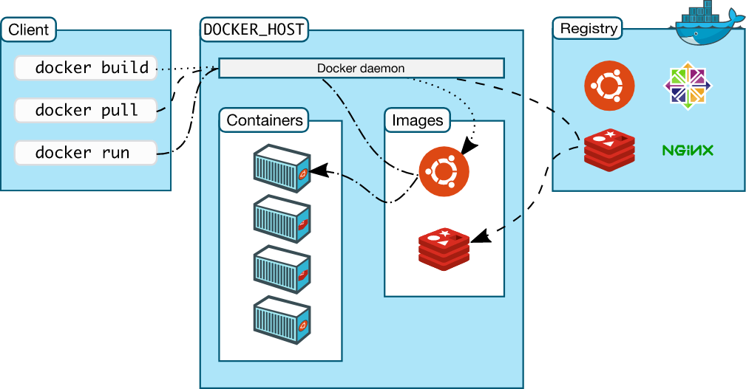
Docker architecture
Docker Engine
Client
Docker CLI
REST API
Server
Docker Daemon

Slide 6


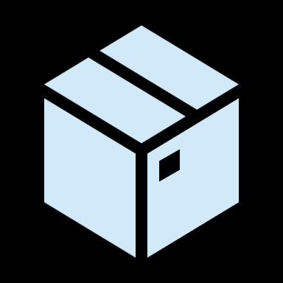
Docker File, Image & Container
docker build
docker run
DOCKER FILE
DOCKER IMAGE
DOCKER CONTAINER

Slide 7
Thank you for your attention!!
UP NEXT: practical demo
https://github.com/JurajSlivka/srobarka-kvalita-ovzdusia
© Petra Jankurová

