Slide 1
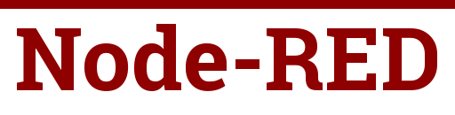
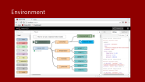
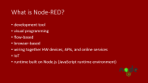

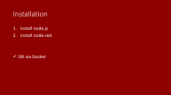


Slide 2
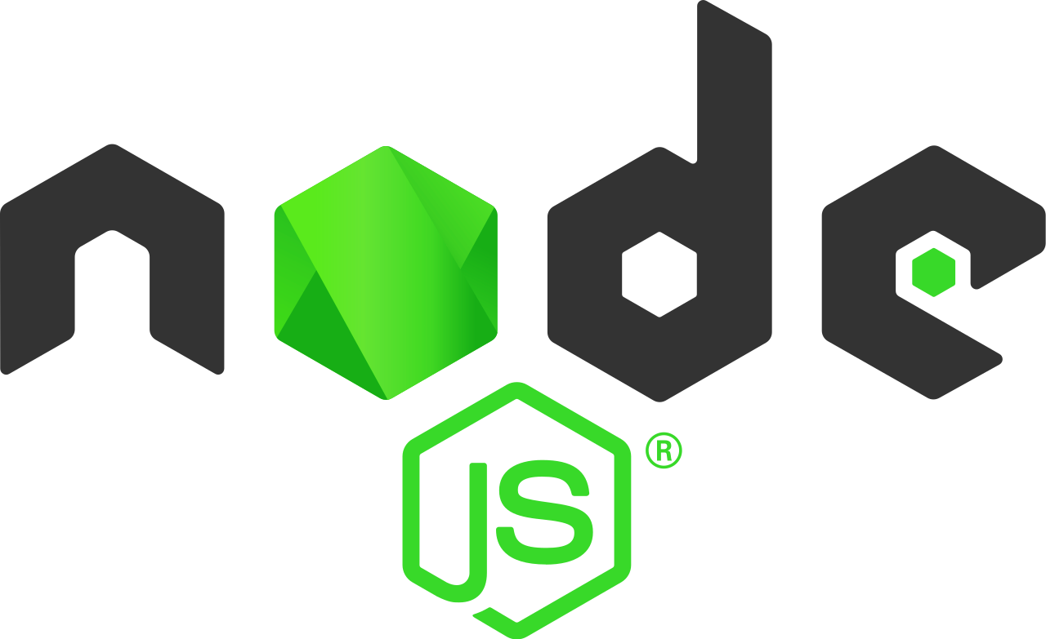
What is Node-RED?
development tool
visual programming
flow-based
browser-based
wiring together HW devices, APIs, and online services
IoT
runtime built on Node.js (JavaScript runtime environment)

Slide 3
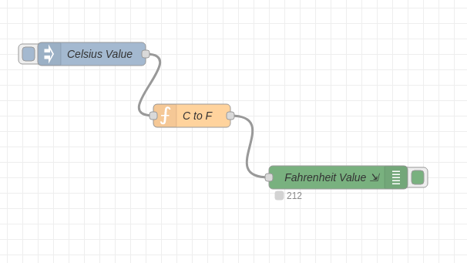
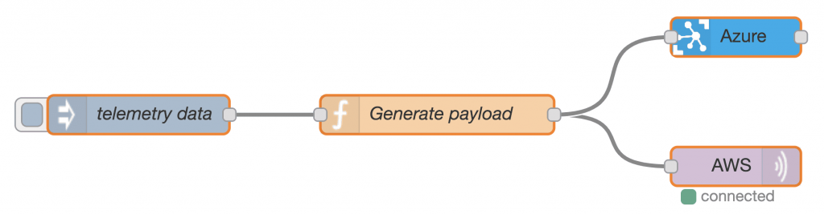
How it works
node
functionality
inputs/outputs
a node can receive data and pass it to other nodes
nodes can be connected this way

Slide 4
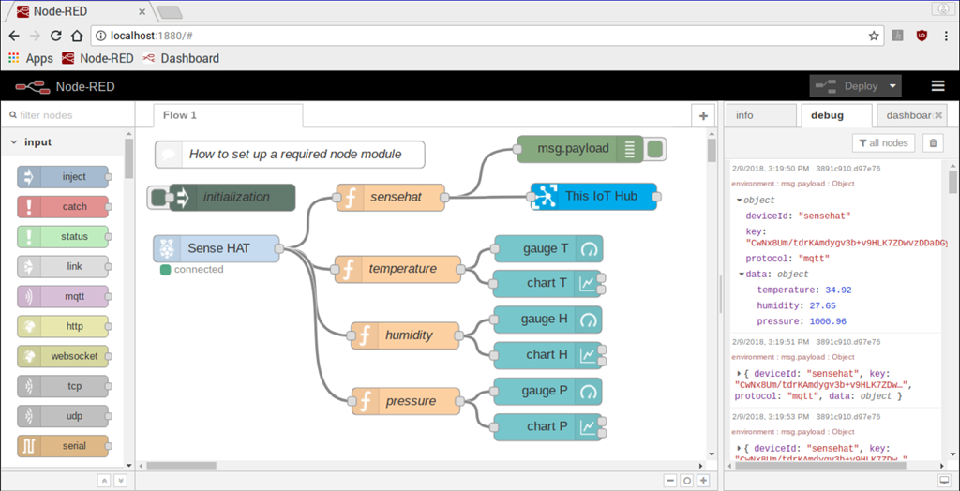
Environment

Slide 5
Installation
install node.js
install node.red
OR via Docker

Slide 6


Slide 7
What is MQTT?
messaging protocol
publish/subscribe based
bidirectional
lightweight
avoids direct connections between devices by relaying the data through a central server (broker)
easy to add new devices without having to change the existent infrastructure
no need for compatibility between the clients

Slide 8

Publish & Subscribe
a device can publish messages to other devices
a device can subscribe to a topic to receive messages from it
SUBSCRIBE
PUBLISH

Slide 9
Message
information exchanged between devices – commands or data
MESSAGE
MESSAGE

Slide 10



Topic
the way you register interest for incoming messages or specify where you want to publish your messages
represented with strings separated by slashes “/” - slashes indicate the topic level
e.g.: home/office/lamp
DEVICE SUBSCRIBED TO TOPIC A
TOPIC A MESSAGE
DEVICE SUBSCRIBED TO TOPIC B
TOPIC B MESSAGE

Slide 11


Broker
receives all messages, filters messages, publishes the messages to all subscribed clients
public/private
e.g.: Mosquitto broker
DEVICE A
BROKER
DEVICE B

Slide 12

How it works
SUBSCRIBE
PUBLISH
PUBLISH
SUBSCRIBE
PUBLISH

Slide 13
MQTT Quality of Service
value represents an agreement between the sender of a message and the receiver of a message
defines the guarantee of delivery for a specific message
3 possible values
0 – at most once
1 – at least once
2 – exactly once

Slide 14
Thank you for your attention!!
Petra Jankurová

