Slide 1
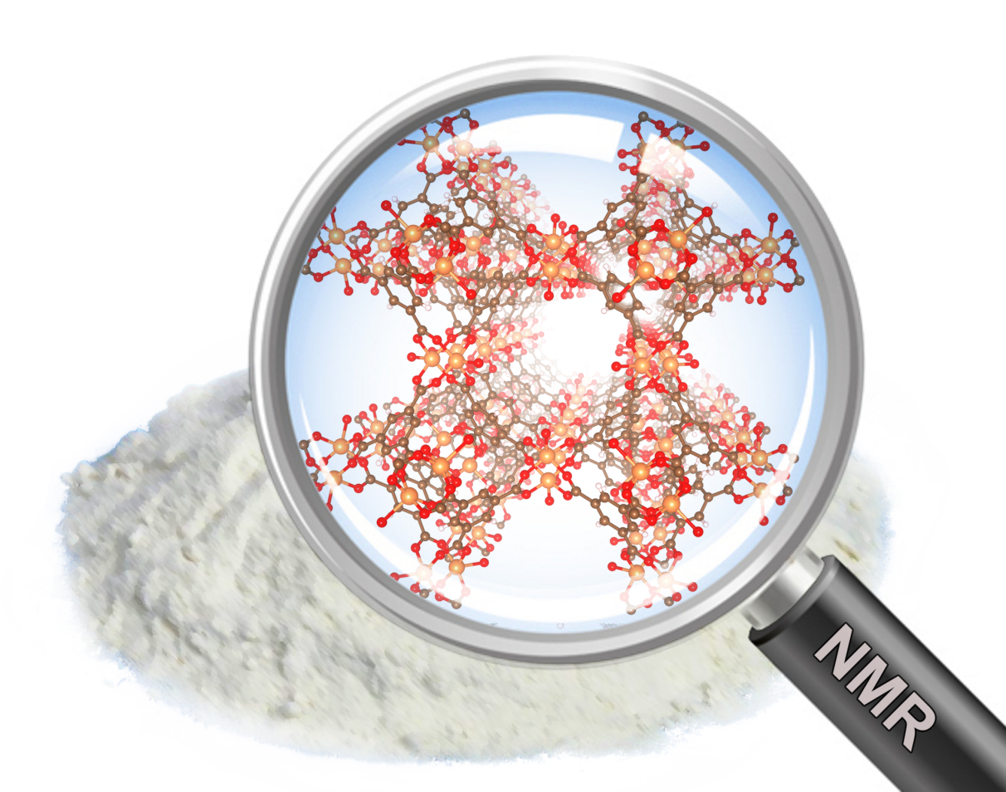

Calculation of electronic structure and NMR parameters in organo-metallic materials
Gregor Mali, Andraž Krajnc, Jure Lapajne
Dirk De Vos, Bart Bueken, …

Slide 2
NMR crystallography of paramagnetic catalysts
Measurement
fast spinning
variable temperature
echo, low B₀
Computation
calculation of chemical and hyperfine shifts
model systems, test computational approaches
Comparison
assignment of measured and calculated signals
causes of discrepancy

Slide 3
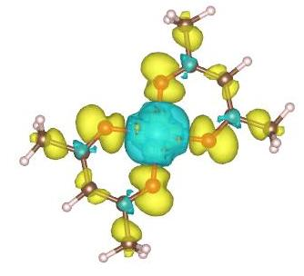
nuclei are sensitive probes for local environment
they detect local magnetic field
isotropic shift depends on induced electric currents around a nucleus (chemical shift) and on spin density at the position of a nucleus (hyperfine coupling)

Slide 4
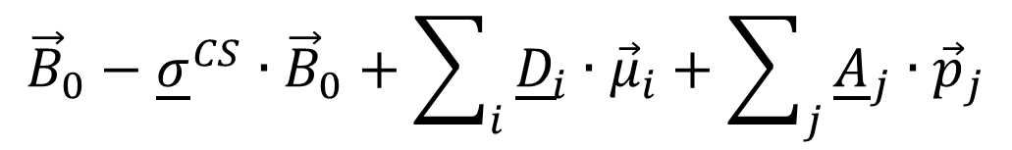
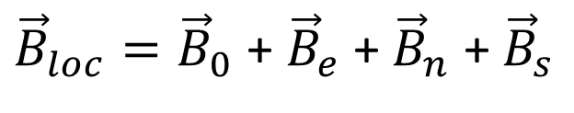
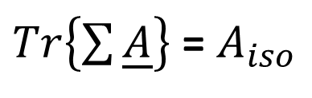
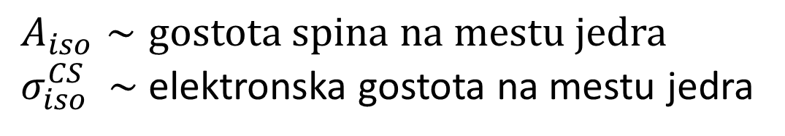
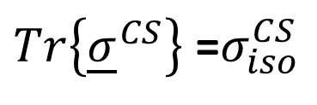
nuclei are sensitive probes for local environment
${\vec{B}}_{loc}={\vec{B}}_{0}$ + ${\vec{B}}_{e}$ + ${\vec{B}}_{n}$ + ${\vec{B}}_{s}$
$${\vec{B}}_{0}−{\underline{σ}}^{CS}∙{\vec{B}}_{0}+\sum_{i}{{\underline{D}}_{i}∙{\vec{μ}}_{i}+\sum_{j}{{\underline{A}}_{j}∙{\vec{p}}_{j}}}$$
$Tr\left\{{\underline{σ}}^{CS}\right\}$ =$σ_{iso}^{CS}$
chemical shift
hyperfine coupling
$Tr\left\{\sum{\underline{A}}\right\}$ = $A_{iso}$
$A_{iso}∼gostota spina na mestu jedra$
${ σ}_{iso}^{CS}$ $∼$ elektronska gostota na mestu jedra

Slide 5
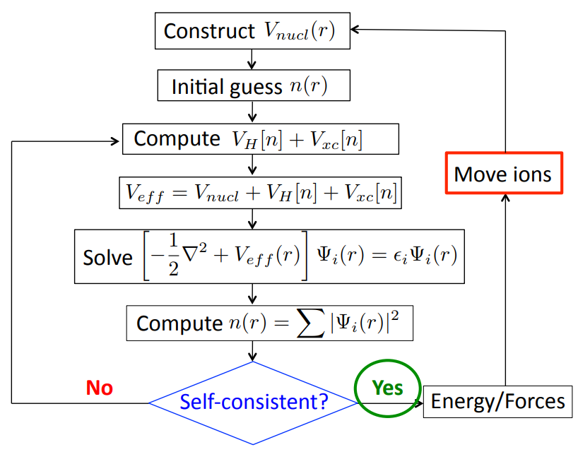
DFT = density functional theory
pure dft: energy functional depends only on particle (electron) density n
hybrid dft: adds interactions between psi functions

Slide 6
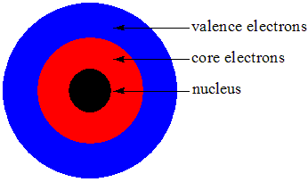
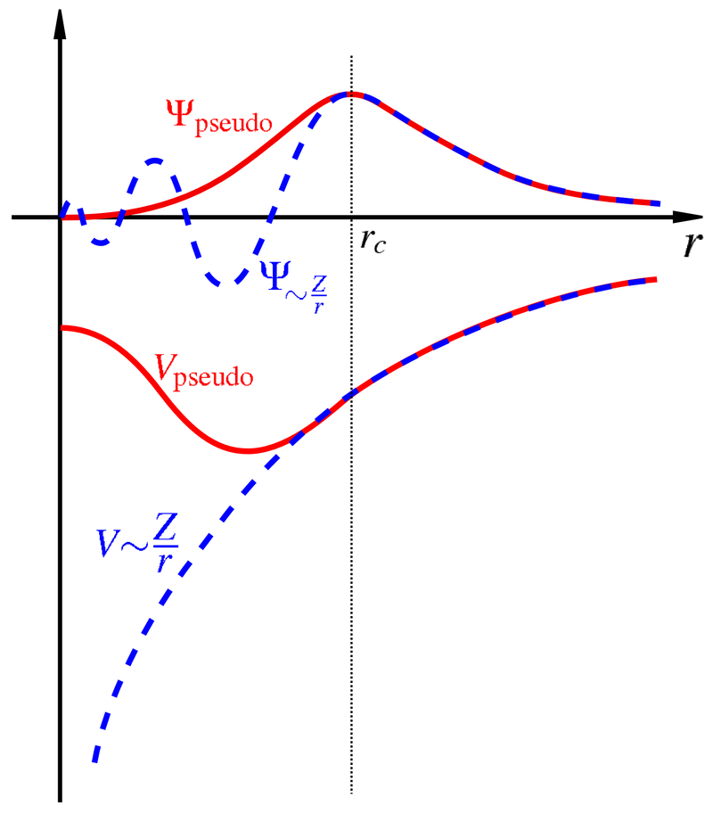
Calculations of Aiso on model systems
Quantum espresso:
periodic lattice
plane waves
core electrons -> pseudopotential
Orca:
single molecule or model structure
all-electron calculation
CP2K:
Mixture of above: plane waves + localized orbitals
Other well know packages:
Q-chem, Nwchem, Gaussian, Castep, Abinit,...

Slide 7
Model systems
Cu(acac)₂ CuMOF-2 HKUST-1

Slide 8
NMR in model systems: HKUST-1
228 ppm
3
1
-50 ppm
2
853 ppm
experimental | calculated
853 ppm | 802 ppm
228 ppm | 219 ppm
-50 ppm | -77 ppm

Slide 9
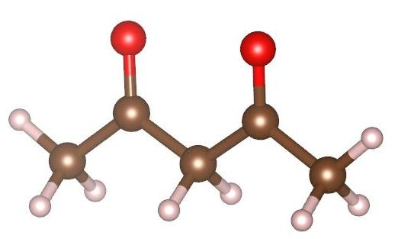
NMR in model systems: Cu(acac)2
S=1/2
1
3
2
experimental | calculated
108 | 211
97 | 185
-53 | 79
Simple error checking:
diamagnetic acac
S=0
experimental | calculated
59 | 69
202 | 213
31 | 33
2
1
3

Slide 10
Future work:
Compare planewave methods with all-electron methods
Test different energy functionals
Apply gained knowledge to test new molecules

