Slide 1
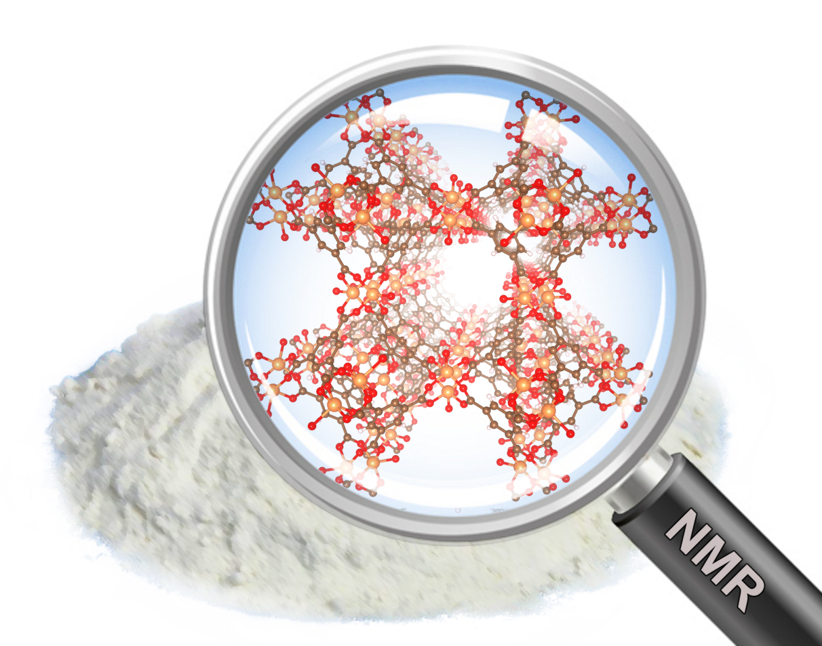

Advanced solid state NMR methods for dealing with paramagnetism and short range disorder in catalytic materials (FWO-ARRS)
Gregor Mali, Andraž Krajnc, Jure Lapajne
Dirk De Vos, Bart Bueken, …

Slide 2
Work Packages
NMR crystallography of paramagnetic catalysts
Detailed NMR study of dehydrogenative coupling reactions, catalyzed by Cu-containing paramagnetic porous catalysts
NMR crystallography of heterogeneous catalysts
Study of the spatial distribution of catalytic sites in MOFs and other porous materials

Slide 3
Work Packages
NMR crystallography of paramagnetic catalysts
Challenges:
Measurement fast spinning, variable temperature, echo, low B₀ (Andraž, Gregor)
Assignment of measured signals = calculation of isotropic shifts model systems, test computational approaches (Jure, Gregor)

Slide 4
nuclei are sensitive probes for local environment
they detect local magnetic field
isotropic shift depends on induced electric currents around a nucleus (chemical shift) and on spin density at the position of a nucleus (hyperfine coupling)

Slide 5
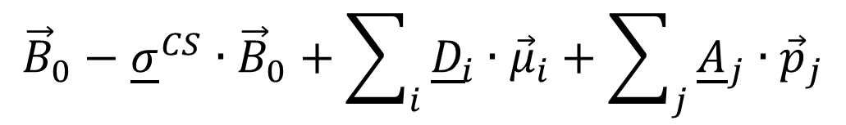
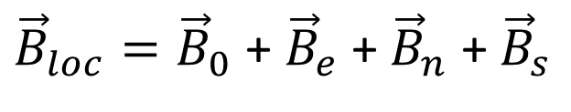
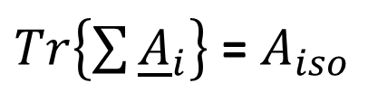
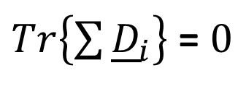
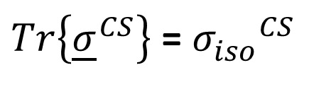
nuclei are sensitive probes for local environment
${\vec{B}}_{loc}={\vec{B}}_{0}$ + ${\vec{B}}_{e}$ + ${\vec{B}}_{n}$ + ${\vec{B}}_{s}$
$${\vec{B}}_{0}−{\underline{σ}}^{CS}∙{\vec{B}}_{0}+\sum_{i}{{\underline{D}}_{i}∙{\vec{μ}}_{i}+\sum_{j}{{\underline{A}}_{j}∙{\vec{p}}_{j}}}$$
$Tr\left\{{\underline{σ}}^{CS}\right\}$ = ${σ_{iso}^{}}_{}^{CS}$
chemical shift
hyperfine coupling
$Tr\left\{\sum{{\underline{D}}_{i}}\right\}$ = $0$
$Tr\left\{\sum{{\underline{A}}_{i}}\right\}$ = $A_{iso}$
isotropic shift depends on induced electric currents around a nucleus (chemical shift) and on spin density at the position of a nucleus (hyperfine coupling)

Slide 6
Model systems
Cu(acac)₂ CuMOF-2 HKUST-1

Slide 7
NMR in model systems
HKUST-1
3
1
2

Slide 8
NMR in model systems
Cu(acac)₂
1
2
3

Slide 9
NMR in model systems
CuMOF-2
DMF
1
2
3

Slide 10
Calculations of A_{iso} on model systems
plane waves (Quantum espresso)
DFT + basis of localized atomic orbitals (Orca)
plane waves + localized orbitals (CP2K)
periodic structure : isolated motif, size of the motif
treatment of spins, heavy atoms, …

Slide 11
Work Packages
3. NMR crystallography of heterogeneous catalysts
Challenges:
How to quickly build structural models with different arrangements of organic components easy-to-use routine, CIF of a single-component MOF as input, structural models with various linker distributions or missing-linker arrangements as output, calculated spin-diffusion curves (Andraž, Jure)

Slide 12


