Slide 1
GIT basics
Jurgis Šidlauskas, Software Engineer

Slide 2
Agenda
Git esentials
1.1 Remote
Extra content
2.1 Branching
2.2 Undoing
Bonus practice

Slide 3

1. Git essentials

Slide 4
What is git?
Distributed version control
Users keep entire code and history on their location machines
Users can make any changes without internet access
(Except pushing and pulling changes from a remote server)
https://git-scm.com/docs/

Slide 5
Configure Git
git config --global user.name "[name]"
Sets the name you want attached to your commit transactions
git config --global user.email "[email address]"
Sets the email you want attached to your commit transactions

Slide 6
Create Repositories
git init [project-name]
Creates a new local repository with the specified name
git clone [url]
Downloads a project and its entire version history

Slide 7
Check changes
git status
Lists all new or modified files to be committed
git log
Show commit logs

Slide 8
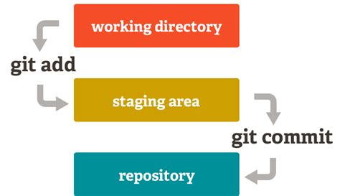
Make changes
git add [file]
Snapshots the file in preparation for versioning
git commit -m "[descriptive message]"
Records the file snapshots permanently in version history

Slide 9
Practice

Slide 10
Install git
Linux
sudo apt-get install git
sudo yum install git
Mac
http://git-scm.com/download/mac
Windows
http://git-scm.com/download/win

Slide 11
Task #1
Initialize a new git project
Create a new file “readme.txt”
Commit changes to local repo

Slide 12
1.1. Remote

Slide 13
Synchronize Changes
git remote add [remote-name] [url]
Add a new remote git repository as a shortname
git remote -v
Lists all remote git repositories

Slide 14
Synchronize Changes
git push [alias] [branch]
Uploads all local branch commits to remote repo branch
git push -u [alias] [branch]
Sets upstream and uploads all local branch commits to remote repo branch (used only first time pushing a new branch)
git pull
Fetches and merges any commits from the tracking remote branch

Slide 15
Synchronize Changes
git fetch
Download objects and refs from another repository
git pull
Fetches and merges any commits from the tracking remote branch

Slide 16
Practice

Slide 17
Create GitHub account
www.github.com

Slide 18
Task #2
Create a new repository in GitHub
Setup remote in your local git project
Push changes to GitHub

Slide 19
2. Extra content

Slide 20
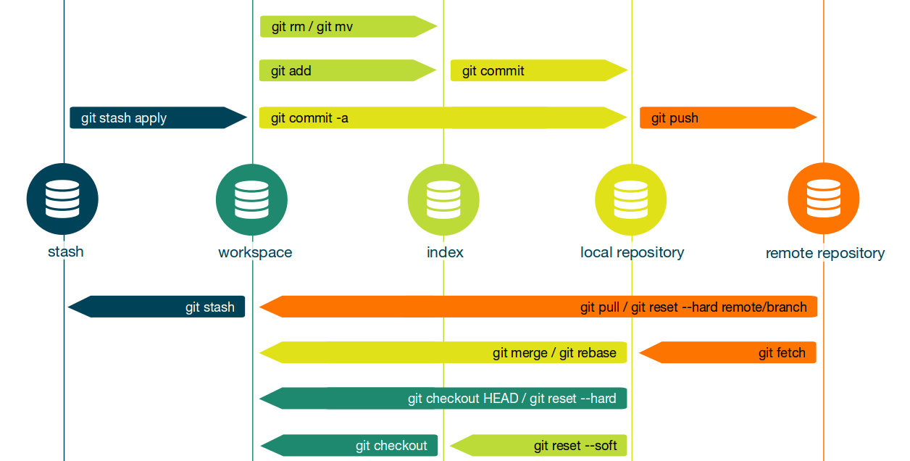
Git workflow

Slide 21
.gitignore
.gitignore – file, that tells git which files (or patterns) it should ignore. It's usually used to avoid committing transient files from your working directory that aren't useful to other collaborators, such as compilation products, temporary files IDEs create, etc.

Slide 22
Configure Tooling
git config --add --system core.editor notepad
sets notepad as a default editor (directed to windows users)

Slide 23
Semantic Commit Messages
feat: (new feature for the user, not a new feature for build script)
fix: (bug fix for the user, not a fix to a build script)
docs: (changes to the documentation)
style: (formatting, missing semi colons, etc; no production code change)
refactor: (refactoring production code, eg. renaming a variable)
test: (adding missing tests, refactoring tests; no production code change)
chore: (updating grunt tasks etc; no production code change)

Slide 24
Practice

Slide 25
Task #3
Create a new directory “unwanted”
Create a new directory “important”
Create new files in each directories “file.txt”
Ignore “unwanted” dir
Commit changes to local repo

Slide 26
2.1. Branching

Slide 27
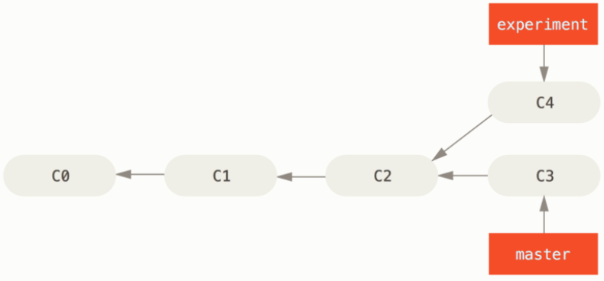
Group Changes
git branch [branch-name]
Creates a new branch
git checkout [branch-name]/[commit-id]
Switches to the specified branch/commit and updates the working directory

Slide 28
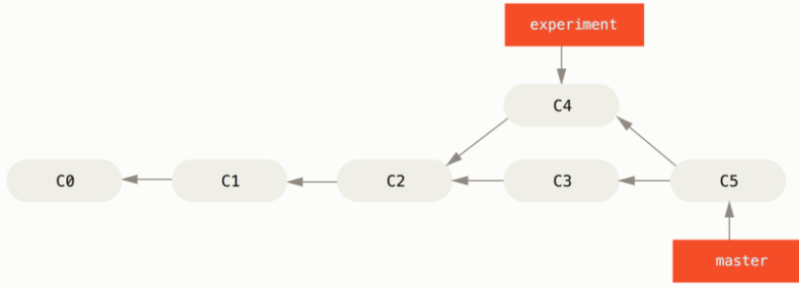
Group Changes
git merge [branch]
Combines the specified branch's history into the current branch

Slide 29
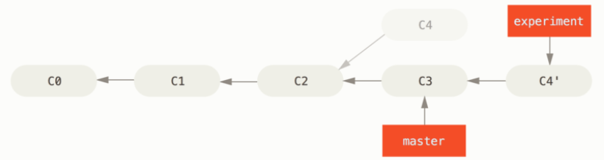
Group Changes
git rebase [branch]
Rebases specified branch's history into the current branch
git rebase --continue
Continue to the next conflict

Slide 30
Synchronize Changes
git merge [alias]/[branch]
merges a remote branch into your current branch to bring it up to date

Slide 31
Practice

Slide 32
Task #4
Create a new branch “feature”
Make some changes in that branch
Merge master with branch

Slide 33
Task #5
Create a new branch “conflicts” from master
Create conflicting commits in master and new branch
Merge master with branch (resolve conflict)

Slide 34
Task #5 bonus
Create another conflicting commit in master and “conflicts” branch
Rebase master with branch

Slide 35
2.2. Undoing

Slide 36
Redo commits
git reset [commit]
Undoes all commits after [commit], preserving changes locally
git reset --hard [commit]
Clears staging area, rewrites working tree from specified [commit]

Slide 37
3. Bonus practice

Slide 38
Task #6 (using Intellij IDE)
Create a new “Hello world!” project in Intellij
Run it!
Init git repo
Ignore compiled files including the directories they’re in
Commit changes

Slide 39
Task #7 (using Intellij IDE)
Create a new branch “feature”
Make some changes in that branch
Merge master with branch

Slide 40
Task #8 (using Intellij IDE)
Create a new branch “conflicts” from master
Create conflicting commits in master and new branch
Rebase master with branch (resolve conflict)

Slide 41
Task #9 (using Intellij IDE)
Share project on GitHub
Create some changes on a new branch
Create a pull request
Merge PR (in the browser)

Slide 42
Task #10
Clone your colleagues GitHub repo
Make your colleague a collaborator in your project
Create a new branch from “master” in git bash – “collaborate”
Change something
Push it to remote “collaborate” branch
Create a pull request
Review and merge the pull request in your GitHub project

