Slide 1
Persuasive Messages
and
Sales

Slide 2
Three-Step Writing Process
Step 1
Step 2
Step 3
Planning
Writing
Completing
Notes:
Chances are you will compose numerous routine and positive messages during the typical business day. In fact, most of a typical employee’s communication is about routine matters: orders, information, company policies, claims, credit, employees, products, operations, and so on. Such messages are rarely long or complex. Even so, to produce the best messages possible, you’ll want to apply the three-step writing process:
Even though planning routine and positive messages may take only a few minutes, the four tasks of planning still apply. First, analyze the situation, making sure that your purpose is clear and that you know enough about your audience to craft a successful message. Second, gather whatever information your audience needs to know. Third, select the right medium for the message and the audience. Both routine and positive messages are often sent via e-mail and instant messaging, but printed memos and letters are still common. Fourth, organize your information effectively.
Start the writing phase by adapting your approach to your audience. Be sensitive to your audience’s needs by maintaining a “you” attitude, being polite, emphasizing the positive, and using bias-free language. To strengthen your relationship with your audience, establish your credibility and project your company’s image. Also, even though your tone is usually conversational, some messages may need to be more formal than others. You’ll want to use plain English and make your writing as active as possible.
No matter how brief or straightforward your message, completing the message properly is important. Therefore, give yourself plenty of time to revise, produce, proofread, and distribute it. First, revise your message by evaluating content and organization to make sure you’ve said what you want to in the order you want to say it. Review your message’s readability. Edit and rewrite to make it concise and clear. Second, design your document to suit your purpose and your audience. Next, proofread the final version of your message, looking for typos, errors in spelling and mechanics, alignment problems, poor print quality, and so on. Finally, choose a distribution method that balances cost, convenience, time, security, and privacy.

Slide 3

The Indirect Pattern for Persuasion
AIDA Approach:
Gain attention
Build interest
Reduce resistance to create desire
Motivate action
Your goal is to ask for something the reader is likely to oppose.
You must develop a strategy that will convince the reader to comply.

Slide 4
Attention
Interest
AIDA PLAN
Action
Desire
Notes:
Most persuasive messages follow the AIDA plan: an organizational plan that goes beyond the indirect approach used for negative messages. The opening does more than serve as a buffer; it grabs your audience’s attention. The explanation section does more than present reasons, and it’s expanded to two sections. The first incites your audience’s interest, and the second changes your audience’s attitude. Finally, your close does more than end on a positive note with a statement of what action is needed; it emphasizes reader benefits and motivates readers to take specific action.
Attention. Make your audience want to hear about your problem or idea. Write a brief and engaging opening sentence, with no extravagant claims or irrelevant points. Find some common ground on which to build your case.
Interest. Explain the relevance of your message to your audience. Continuing the theme you started with, paint a more detailed picture with words. Get your audience thinking.
Desire. Make audience members want to change by explaining how the change will benefit them. Reduce resistance by thinking up and answering in advance any questions the audience might have. If your idea is complex, explain how you would implement it. Back up your claims.
Action. Suggest the action you want readers to take. Make it more than a statement such as “Please send me a refund.” Remind readers of the benefits of taking action, and make taking action easy.

Slide 5

Making Persuasive Requests

Slide 6
Gaining Attention & Building Interest
Gaining Attention:
  Begin with a attention getting statement that is : personalized, you oriented, straightforward and relevant. You can use compliment, unexpected fact, stimulating question, readers’ benefit, summary of the problem, or candid plea for help.
Build interest:
  Prove the accuracy and merit of your request with facts, figures, expert opinion, examples, and details.
  Suggest direct and indirect benefits for the receiver.
  Example:
    Direct Benefit: If you accept our invitation to speak, you will have an audience of 50 potential customers for your products.
    Indirect Benefit: Your appearance would prove your professionalism and make us grateful for your willingness to give something back to our field.

Slide 7
Reducing Resistance
Identify possible obstacles; offer counter arguments.
Demonstrate your credibility by being knowledgeable.
In requesting favors or making recommendations, show how the receiver or others will benefit.
Example: Although your gift to the Neonatal Center is not tax deductible, it would help us purchase an Intensive Care Ventilator that would be put to use immediately in caring for critically ill and premature newborn infants.

Slide 8
Motivating Action
Ask for specific action confidently.
Include an end date, if appropriate.
Repeat a key benefit.
End the message with the request or with words that recall the appeal.
Example: Please respond by May 1 so that we may add your photograph to our announcement.

Slide 9

Persuasive Invitation
Notes:
43

Slide 10
Persuasive Invitation: “After” Version
Dear Dr. Thomas:
Your book Beyond Race and Gender stimulated provocative discussion across the nation and on our campus when it appeared last spring.
Business students at Georgia State University now consider you the nation’s diversity management guru, and for that reason they asked me to use all my powers of persuasion in this invitation. Because we admire your work, we’d like you to be our keynote speaker at the GSU Management Society banquet May 5.
As students at an urban campus in a metropolitan area, we’re keenly aware of diversity issues. In your words,

Slide 11
Persuasive Invitation: “After” Version
America is no longer a melting pot of ethnic groups; it is now an “American mulligan stew.” We’d like to hear more about the future workforce and how managers can maximize the contribution of all employees.
Although we can’t offer you an honorarium, we can promise you a fine dinner at the GSU Faculty Club and an eager and appreciative audience of over 100 business students and faculty. Speakers in the past have included the Reverend James R. Jones and Vice Mayor Rebecca A. Timmons.
The evening includes a social hour at 6:30, dinner at 7:30, and your remarks from 8:30 until 9 or 9:15. So that you

Slide 12
Persuasive Invitation: “After” Version
won’t have to worry about transportation or parking, we will arrange a limousine for you and your guest.
Please make this our most memorable banquet yet. Just call our adviser, Professor Alexa North, at 356-9910 before April 1 to accept this invitation.
Sincerely yours,

Slide 13
Good Strategy in a Persuasive Request (1 of 4)
Opening
Dear Ms. McLaughlin:
You’ll agree, I’m sure, that college teachers of business communication need to be in touch with business leaders in the field. Established leaders like you can give the teachers that input from reality that is so very important in all practical coursework.

Slide 14
Good Strategy in a
Persuasive Request (2 of 4)
Body
For this reason I believe that you can make a vitally important contribution to the national meeting of the Association for Business Communication, which will be held in New Orleans at the Sheraton Hotel, October 28-31. Specifically, I want you to speak to us Friday afternoon from 2:00 to 2:45 p.m.

Slide 15
Good Strategy in a
Persuasive Request (3 of 4)
Body continued
What I’d like you to do is describe what you do as a correspondence supervisor at Winn Dixie. Whatever you can tell us that would help us as teachers is what you should include. Especially would the members like to hear about the writing problems of business people and what you think we should be doing in the colleges to correct them. I suggest that you speak for about 30 minutes, leaving the final 15 minutes for questions.

Slide 16
Good Strategy in a
Persuasive Request (4 of 4)
Closing
Will you please accept this major part on our program, Ms. McLaughlin? By so doing you will be helping to improve instruction at the colleges represented by our 1,500 members. As I must have the program completed by the 15th, may I have your answer before the 10th?
Sincerely,

Slide 17
Why Write Sales Messages?
Sales messages are helpful in training you because
  Sales techniques are useful in your other activities.
    in writing other messages
    in actual sales work
    in selling yourself

Slide 18
Preliminary Steps to Sales Writing
Learn the product or service you sell.
  how it is made
  how it works
  what it will do
Learn about the prospective customers.
  their economic status
  their nationalities
  their ages
  etc.

Slide 19
Determining the Appeal (1 of 3)
Two broad categories:
Emotional
  appeals to the senses (feeling, tasting, smelling, hearing)
Rational
  appeals to the thinking mind (saving money, making money, doing a better job, getting better use)

Slide 20
Determining the Appeal (2 of 2)
Select the appeals that fit product or service.
  Some better suited to emotional
    music
    cosmetics
    fancy foods
  Some better suited to rational
    Banking product
    Digital product, solutions
    industrial goods

Slide 21
Organization of the Sales Message
Many variations are used.
  whatever works
But there is this conventional pattern:
  gain attention
  create desire
  cover all necessary information
  drive for the sale
  possibly add a postscript

Slide 22
Gaining Attention (Sales Msg)
Offer something valuable, promise a significant result, or describe a product feature.
Present a testimonial, make a startling statement, or show the reader in an action setting.
  Describe a problem.
Six of our computers were recently infected with the
“Melissa” virus, and we lost at least 25 work hours trying
to repair the problem.
  Present an unexpected statement.
If you checked carefully, you’d probably find that 20 percent of
your customers account for 80 percent of your profits.

Slide 23
Building Interest
Describe the product in terms of what it does for the reader.
Show how the product or service saves or makes money, reduces effort, improves health, produces pleasure, or boosts status.
  Example: Our computer-based training program teaches your employees what behavior is acceptable and unacceptable, while showing you steps that can be taken to reduce the risk of employer liability.
  Suggest reader benefits:
    Now you can immediately protect all your computers from the latest viruses with our online anti-virus program.
  Pay a compliment:
    Because no one generates as much audience enthusiasm as you do in your presentations, we are asking you to speak . . . .
  Supply facts and figures:
    Currently 16,000 known computer viruses are in existence, and the number increases by 300 to 400 each month.
  Give examples:
    One company lost valuable data and had no recent backup disks to replace infected files.

Slide 24
Building Interest
Cite expert opinion.
“Hostile code can hit without warning,” says virus specialist Dr. Tony Timm, “so companies must have a virus antidote or they risk all their operations.”
Provide specific details.
In a test comparing six of the leading anti-virus programs, our program was flawless in virus detection, easy to use, and low in ownership cost.

Slide 25
Building Interest
Mention direct benefits.
Our anti-virus program can protect you from subtle corruptions of data that may go unnoticed for months.
Mention indirect benefits.
Your company continues to be a pacesetter in the health care industry by setting an example for other organizations who are bewildered by the growing number of viruses.

Slide 26
Reducing Resistance
Counter reluctance with testimonials, money-back guarantees, attractive warranties, trial offers, or free samples.
Build credibility with results of performance tests, polls, or awards.
Example: This important investment in sexual harassment prevention comes with a money-back guarantee. If you are not satisfied, your entire training costs are returned.

Slide 27
Motivating Action
Close with repetition of the central selling point and clear instructions for an easy action to be taken.
Prompt the reader to act immediately with a gift, incentive, limited offer, or deadline.
Put the strongest motivator in a postscript.
Example: Sign up now and you receive a free 60-day trial. Call, fax, or e-mail us today to receive a free demo disk. You can’t lose!

Slide 28
A Rational Sales Message (1 of 4)
Opening
Would you like to save up to 12 cents
a gallon on your bill for fuel oil?
Does your monthly oil bill make you wince? Wouldn’t you like to beat the high cost of heating--cut your annual fuel bill by as much as 30-40 percent? Then, I think you’ll be interested in our Catalytic Carburetor Assembly. Complete details are yours for the asking . . . as explained below.

Slide 29
A Rational Sales Message (2 of 4)
Body
Installed on your present oil burner, the Catalytic Carburetor Assembly permits burning of the present type of catalytic fuel oil at highest efficiency . . . and with a clean fire. What’s more, it easily pays for itself in fuel oil savings and brings your burner completely up to date. A little simple arithmetic with your current oil bill will show you how substantial these savings are. Figure you might save up to 12 cents on every gallon, and see what a difference that makes.

Slide 30
A Rational Sales Message (3 of 4)
Body continued
But there’s no need to take our say-so about the savings you can make--because we back our Catalytic Carburetor Assembly with a written money-back guarantee. Your can’t lose--you either get the savings we guarantee, or the assembly is removed and your money refunded in full.
Scores of satisfied users throughout the state are enjoying more efficient, more economical heating--thanks to the Catalytic Carburetor Assembly. We believe that you, too, would benefit by installing this device on your oil burner.

Slide 31
A Rational Sales Message (4 of 4)
Closing
To receive full information on the Catalytic Carburetor and how it can save fuel dollars, just check the enclosed postage-paid card for correctness and drop it in the mail. I’ll see to it that you get complete details right away . . . without cost or obligation.
Sincerely,

Slide 32
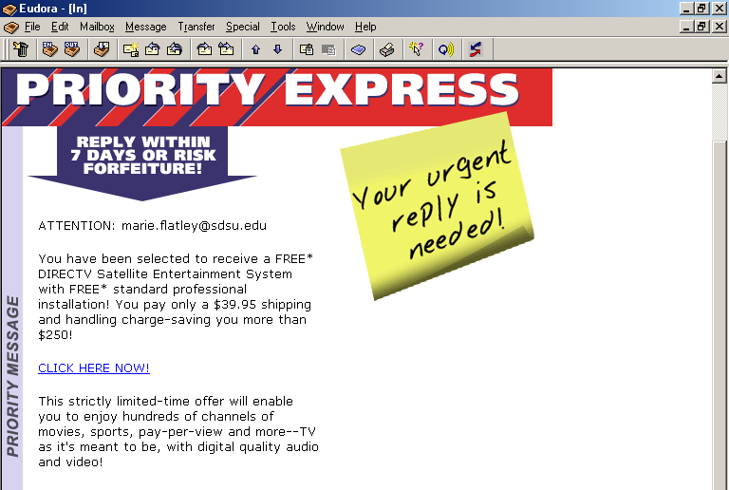
Opens with an attention-getter
Reasons stress reader benefit

Slide 33
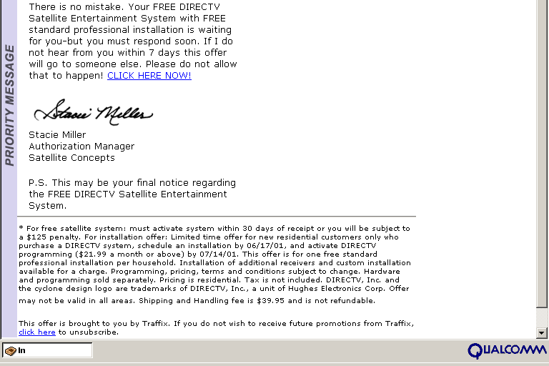
Call for action is clear and easy
Postscript adds that extra punch
Opt-out message included

Slide 34
“If you want to succeed, you should strike out on new paths rather than travel the worn paths of accepted success.”
--John D. Rockefeller

