Slide 1
Writing Routine, Good-News and Goodwill Messages
Avijit Mallik
Assistant Professor,
IBA, University of Dhaka
Ch. 9, Slide <number>

Slide 2
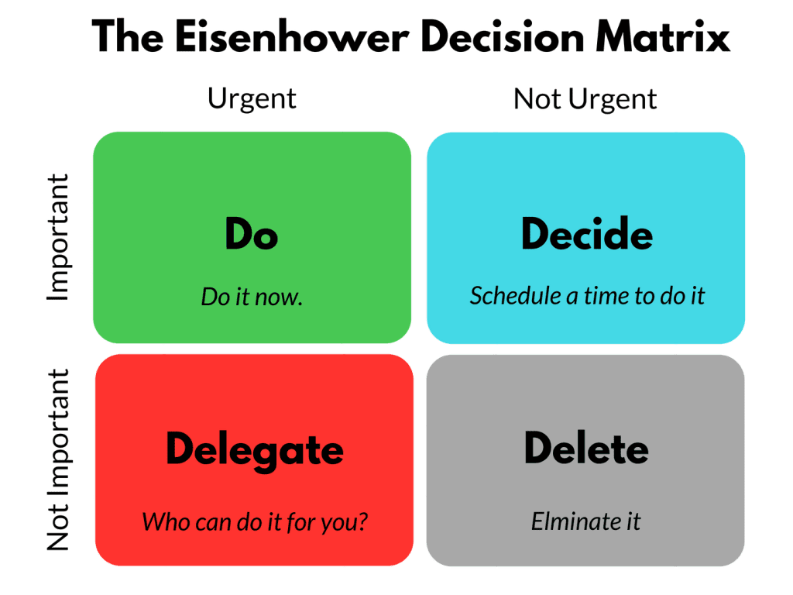
Before we start, lets explore task management approach
Ch. 9, Slide <number>

Slide 3
Selecting Writing Approach
When ever you are writing a message, properly assess the reader’s reaction;
  If the reaction is negative, indirect order is your likely choice
  If it is positive or neutral, you probably will want directness
Ch. 9, Slide <number>

Slide 4

Writing Routine, Good-News and Goodwill Messages
Directness is likely choice

Slide 5
The Direct Pattern
Begin with the objective (Tell immediately why you are writing)
Explain in the body
Be specific and courteous in the closing.
Ch. 9, Slide <number>

Slide 6
Routine, Good-News and Goodwill Messages Includes-
Routine requests:
  Asking for information, action, products, making claims and requesting adjustments, requesting recommendations and references, placing orders
Routine Responses:
  Sending informative messages, granting requests for information and action, granting claims and requests for adjustments, providing recommendations and references
Ch. 9, Slide <number>

Slide 7
Routine, Good-News and Goodwill Messages Includes (Contd.)-
Announcing Good News:
  About employment, about products and operations
Sending Goodwill Messages:
  Congratulations, Message of Appreciation
Ch. 9, Slide <number>

Slide 8

Requesting Information and Action
Ch. 9, Slide <number>

Slide 9
Opening
Routine requests begin asking a question or issue with a polite command (Will you please supply me with information about the products you supply. )---No question mark.
Ch. 9, Slide <number>

Slide 10
Body
Include necessary information whenever fits (explain your purpose and provide details)
If a number of questions are involved, ask them. Make the questions stand out (using bullet, numbering, paragraphing)
Express questions in parallel form.
To elicit the most information, use open-ended questions (What training programs do you recommend?) rather than yes-or-no questions (Are training programs available?).
Suggest reader benefits, if possible.
Ch. 9, Slide <number>

Slide 11
Closing
State specifically, but courteously, the action you wish to be taken (We will appreciate having your answers for our October 3 staff meeting).
Set an end date, if one is significant, and explain why.
Avoid cliché endings (Thank you in advance for your cooperation). Show appreciation but use a fresh expression (We would appreciate hearing from you this week. You can reach me by calling 989 during business hours.
Make it easy for the receiver to respond.
Ch. 9, Slide <number>

Slide 12
Routine Inquiry--Good Example
Dear Mr. Robin:
Will you please help us to serve you better by answering the following questions.
When you returned merchandise at our store recently:
1. Were you served promptly and courteously?
2. Was the adjustment satisfactory and in accordance with your wishes?
3. Did the salesperson offer to assist you in selecting other merchandise?
Please write your answers--and any other comments you may wish to make about the service of this store and any other HRTex store--on this letter. Then return it in the enclosed stamped and addressed envelope.
We shall be most grateful for your help.
Sincerely,
Ch. 9, Slide <number>

Slide 13

Routine Request
“Before” Version
Ch. 9, Slide <number>

Slide 14
Routine Request: “Before” Version
Dear Sir:
Because we are one of the largest banking systems in the country, we receive hundreds of résumés from job candidates every day. We need help in sorting and ranking candidates by categories, such as job classification, education, work history, skill, and experience.
Recently, I was reading WORKFORCE magazine, and the March issue has a story about your new software program called Resumix. It sounds fascinating and may be the answer to our problem. We would like more information about this program, which is supposed to read and sort résumés.
Ch. 9, Slide <number>

Slide 15
Routine Request: “Before” Version
In addition to learning if the program can sort candidates into the categories mentioned earlier, I’m wondering if the program can read all the different typefonts and formats that candidates use on their résumés. Another important consideration for us is training and troubleshooting. If we need help with the program, would you supply it?
Thank you for your cooperation.
Sincerely,
Ch. 9, Slide <number>

Slide 16

Routine Request
“After” Version
Ch. 9, Slide <number>

Slide 17
Routine Request: “After” Version
Dear Product Manager:
Please send me information about your Resumix software program, which I read about in the March issue of WORKFORCE magazine.
We receive hundreds of résumés daily, and, frankly, we need assistance in processing them. Answers to the following questions would help us determine if Resumix could solve our problem.
1. In terms of fonts and formats, what kinds of résumés can your software read?
2. Can the program help us sort and rank candidates by
Ch. 9, Slide <number>

Slide 18
Routine Request: “After” Version
categories such as job classification, education, work history, skill, and experience?
3. How does your company provide training and troubleshooting service for your software?
I would appreciate your response by April 1 so that we can study the program before the rush of job applications in June.
Sincerely,
Ch. 9, Slide <number>

Slide 19
[Jane Adami, 11:17 AM 11/17/2005 –0800, Confidential report on Ms. Cindy Commons, requested July 2]
Dear Ms. Brown:
Subject: Itemized statement for January
Will you please send me an itemized statement covering my account for January.
According to my invoice file, the amount owed should be $2,374.27. Your statement shows $2,833.74 owed. Perhaps you did not record the $427.17 of merchandise returned on invoice no. 3211C late last week. But even this possible error does not explain all of the difference.
I shall appreciate your usual promptness in clearing up this matter.
Jane Adami, President
Two Sisters Antiques
Ch. 9, Slide <number>
Itemized …

Slide 20

Routine Claim Letters
Ch. 9, Slide <number>

Slide 21
Preliminary Considerations in Writing a Claim Letter
A product or service has given you a problem.
  You are in the right.
  Probably the offending company will want to correct the matter.
  You want to make a strong claim.
These three facts of the case support directness.
Ch. 9, Slide <number>

Slide 22
Directness for a Claim Letter
Opening
Begin directly. Tell what is wrong and what you want.
Explain the facts—enough to permit a decision. Clarify the problem and justify your request.
Seek corrective action, either by
  stating what you want, or
  letting the reader decide what to do.
Include names of individuals and dates of previous actions.
End positively—on a friendly but firm note.
Note: Act promptly in making claims, and keep a copy of your message.
Body
Closing
Ch. 9, Slide <number>

Slide 23

[Helen Toohey, 09:17 AM 9/17/2005 –0800, Wrong billing of shipment under Invoice X13771]
Ms. Jessy:
Subject : Wrong billing of shipment under Invoice X13771
From your invoice of August 7, I see that you have sent my gifts COD I need your friendly help in restoring face.
Please refer to my original order of July 31 (copy attached) to see that the Butterfly jewel box for Ms. Chowdhury and the Piper smoking jacket for Mr. Robin Chowdhury were clearly specified for prepaid shipment. You were to include the bill for these items in the COD shipment of the Black Diamond desk sent to me.
Please correct this embarrassing error right away. I ask that you write each of the recipients of my gifts, refunding their money and explaining what happened. Then send copies of your letters and the total bill to me.
You have my grateful thanks for putting me back in the good graces of the Chowdhury.
Rocky
ORDER731.DOC
Ch. 9, Slide <number>

Slide 24
Inquiries About People
They are a special form of routine inquiry.
They involve two differences:
  Need to respect human rights
  Need to structure around the one job
Ch. 9, Slide <number>

Slide 25
Dear Mr. Bateman:
Subject: Request for some information about Ms. Cindy Commons
Will you please assist me in evaluating Ms. Alice Barron for work as a district sales manager with us. In her application Ms. Barron indicated that she worked for you as a salesperson from early 2001 to 2005. She has authorized this inquiry.
The work for which we are considering Ms. Barron involves supervision a staff of four salespeople plus an office staff of two. While with you, did Ms. Barron show the leadership ability such an assignment requires?
As a manger, Ms. Barron would need to know administration. She would be responsible for running the business end of an office. Do you feel she has the necessary knowledge and ability?
Ms. Barron would also be responsible for managing the sales efforts in her district--activities like setting quotas, working out itineraries, evaluating performance, and coordinating and
Ch. 9, Slide <number>

Slide 26
Ms. Barron would also be responsible for managing the sales efforts in her district--activities like setting quotas, working out itineraries, evaluating performance, and coordinating and stimulating sales efforts. Does she have the ability to do these things?
In addition to the managerial duties, Ms. Barron would spend some time selling Kopy Kat equipment. This is hard selling--and it requires an aggressive, personable, hardworking person. Does Ms. Barron meet this requirement?
Both Ms. Barron and I will appreciate your candid replies to these questions, plus any other information you feel we should have. Of course, I will hold your comments in strict confidence.
Janet Baker, Manager
Human Resources Department
Ch. 9, Slide <number>

Slide 27

Order Letters
Ch. 9, Slide <number>

Slide 28
Opening
Use order language to identify the message (Please send by UPS the following items from your spring catalog).
Name the information source (the May 2 advertisement in the Daily News).
Ch. 9, Slide <number>

Slide 29
Body
List items vertically.
Provide quantity, order number, complete description, unit price, and total price.
Prevent mistakes by providing as much information as possible.
Ch. 9, Slide <number>

Slide 30
Closing
Tell how you plan to pay for the merchandise.
Tell when you would like to receive the goods, and supply any special instructions.
Express appreciation.
Ch. 9, Slide <number>

Slide 31

Direct Reply Letters
Ch. 9, Slide <number>

Slide 32
Directness for a Favorable Response
Opening
Begin with the answer or state you are complying with the request.
Identify the message being answered--incidentally in the beginning or in a subject line.
Continue to give what is wanted in an orderly arrangement.
If negative information is involved, give it proper emphasis. Consider including extras.
End with friendly, adapted words.
Body
Closing
Ch. 9, Slide <number>

Slide 33

Answering a request/action
Ch. 9, Slide <number>

Slide 34
Mr. Andrews:
Subject: Manufacturers’ Directory Assistance
Yes, sir, we’ll gladly help with your manufacturers’ directory, just as you have asked in your April 12 message.
To get the names and classifications up to the “directory” exactness, Mr. Stanley McLaughlin, of our own directory staff, has already started a by-name check of each listed industry. He will label carefully the exact goods produced or processed; and he will mark the sales agents as such. You can expect his report by the 20th, I’m sure.
Your completed online directory will certainly help Louisiana industry get a measure of itself and will help to “sell” Louisiana as a ripe field for many types of new enterprises. It’s a fine job you are taking on. We’ll be glad to see the finished product.
Lisa Brown
Ch. 9, Slide <number>

Slide 35
Granting Claims
Ch. 9, Slide <number>

Slide 36
Granting Claims
Opening
When approving a customer’s claim, announce the good news immediately.
Avoid sounding grudging or reluctant.
Body
Strive to win back the customer’s confidence; consider explaining what went wrong (if you know).
Concentrate on how diligently your organization works to avoid disappointing customers.
Be careful about admitting responsibility; check with your boss or legal counsel first.
Avoid negative language (trouble, neglect, fault).
Don’t blame customers – even if they are at fault.
Don’t blame individuals or departments in your organization.
Don’t make unrealistic promises.
Ch. 9, Slide <number>

Slide 37
Granting Claims (Contd.)
Closing
Show appreciation that the customer wrote.
Extend thanks for past business.
Refer to your desire to be of service.
Ch. 9, Slide <number>

Slide 38
[Albert T. Hamm, 07:12 PM 6/20/2005 –0800, Full credit for suit from Consort]
Mr. McShane:
Subject: Full credit for suit from Consort
Crediting your account for $321.40 is Consort’s way of assuring you that your satisfaction is very important to us.
Because we sincerely want to please, we thoroughly examined the suit you returned to us. Our investigation showed that the likely cause of the fading was accidental contact with some form of chemical. We couldn’t determine precisely what the chemical was or just how contact was made. But we suspect a liquid spill sometime after packaging, either in our warehouse or during shipment. Such unexpected happenings will occur in spite of our best precautions. Anyway, we were relieved to know that Consort’s reputation for quality fabrics and craftsmanship remains good.
We want you to know that we sincerely desire to serve you. And we look forward to serving you with high-quality Consort suits in the years ahead.
Albert T. Hamm, Manager
Consumer Relations
Ch. 9, Slide <number>
Full credit from…

Slide 39

Letters of Recommendation
Ch. 9, Slide <number>

Slide 40
Opening
Name the candidate and position sought.
State that your remarks are confidential.
Describe your relationship with the candidate.
Ch. 9, Slide <number>

Slide 41
Body
Describe the applicant’s performance and potential.
Strive to include statements about communication skills, organizational skills, people skills, ability to work with a team, etc.
Include definite, task-related descriptions (She completed two 50-page proposals instead of She works hard).
Ch. 9, Slide <number>

Slide 42
Body
Include negative statements only if they are objective and supported by facts.
Ch. 9, Slide <number>

Slide 43
Closing
If supportive, summarize candidate’s best points.
Offer ranking of candidate (Of all the accountants I have supervised, she ranks in the top 10 percent).
Offer to supply additional information if needed.
Ch. 9, Slide <number>

Slide 44
[Chris Woods, 09:11 AM 4/9/2005 –0800, Confidential report on Ms. Cindy Commons, requested July 2]
Mr. Villas:
Subject: Confidential report on Ms. Cindy Commons, requested July 2
From December 2002 through February 2005, Ms. Commons worked for Central Grocery, Inc., under my direction. She left us for employment in her hometown. We would welcome her back. While she was with us, she served first as a stock clerk, later as a checkout cashier, and for the last year as my assistant. During this time she learned all aspects of the grocery business. In my judgment, she has the experience and knowledge needed for the job she seeks.
I feel, also, that Ms. Commons has the personal qualities the job requires. She is mature, stable, and personable. She has strong convictions and expresses them firmly--sometimes at the expense of harmony within the work group. But she is also sincere and open-minded. As far as I know, her morals are exemplary.
Ch. 9, Slide <number>
Confidential …

Slide 45
[Chris Woods, 09:11 AM 4/9/2005 –0800, Confidential report on Ms. Cindy Commons, requested July 2]
Confidential report on Ms. Cindy Commons, requested July 2
Answering your question about Ms. Commons’ leadership ability is somewhat difficult for her work with us was primarily in a subordinate position. But from what I have observed, I feel that she has good leadership potential. She appears to like people and to have a genuine concern for them. And she appears to have other characteristics of good leadership--a sense of fairness, good communication ability, loyalty, and dedication to work.
In summary, I feel that Ms. Commons is well qualified for the work she seeks. I would not hesitate to put her in a similar position in this company.
If I can help you further in your evaluation Ms. Commons, please write me again.
Christopher Woods, Manager
Human Resources
Central Grocery
Ch. 9, Slide <number>
Confidential …

Slide 46
Directness for an Order Acknowledgment
Opening
Give the status of order.
Include some goodwill—acknowledging incidentally, reselling, sales talk, or such.
Include a “thank you.”
If there is a problem (vague order, back order)--
  Some businesses report frankly, assuming some problems are expected.
  Others prefer to use tactful approach to get needed information on vague orders, or report back orders.
Close with adapted, friendly words.
Body
Closing
Ch. 9, Slide <number>

Slide 47
[Krystal Benko, 03:17 PM 8/3/2005 –0800, Trevor Hardware Order Confirmation]
Mr. Cotton:
Subject: Trevor Hardware Order Confirmation
By the time you receive this letter, you should have received the assorted pipe you ordered July 15. As you requested we shipped it by Zephyr Freight, and we will bill you on the first.
As you may know, the J-4 Kotter Pipe Joint Clamps have been a very popular item recently. We have marked these clamps for rush shipment to you just as soon as our supplies are replenished. Our plant foreman tells me that his people are working overtime to catch up. He promises that we will have the clamps on the way to you no later than August 12.
Thank you for giving us another opportunity to serve you with quality Kotter products.
Krystal Benko
Office Manager
Ch. 9, Slide <number>
Trevor Hardware…

Slide 48
Now it’s your turn:
Granting a claim
Your organization designed an app for a valued client but the client found it defective as the prospective users found it difficult to use. Subsequently, the client asked you to modify the app without any additional payments. You have modified the app after debugging it and made it user friendly. Write a letter granting the claim of the client. Follow the guidelines mentioned earlier, so that you can restore the client’s faith and maintain a good relationship.
Ch. 9, Slide <number>

Slide 49
End
Ch. 9, Slide <number>

