Slide 1
Convolution Neural Networks in enhancer prediction
Jurijs Nazarovs
UW-Madison
December 13, 2017

Slide 2
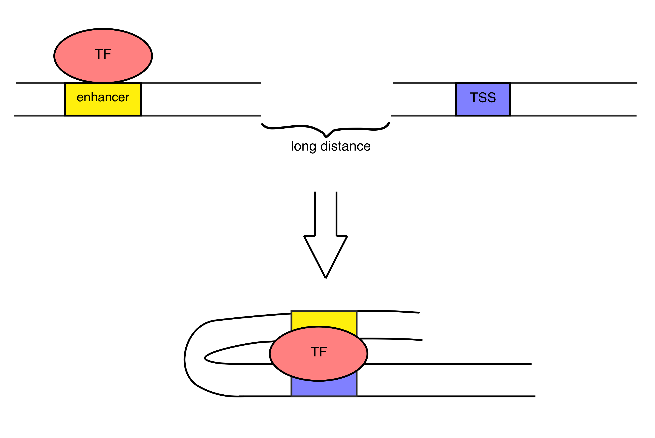
Biological perspective
1. Transcription factor binds to an enhancer
2. DNA strand loops and brings transcription factor to the transcriptional start site of specific gene to activate or suppress

Slide 3
Problem statement
+
Supervised binary
classification
problem
Chromosome 1: 1234 - 1298
-

Slide 4
Data description and preparation
Original data – positive sample:
chromosome, start, end, …
Nucleotide sequence + truncation:
AAACTCCG….
One – hot representation:
A = 1 0 0 0
C = 0 1 0 0
T = 0 0 1 0
G = 0 0 0 1

Slide 5
Negative samples
Random complement of positive samples
Take complement of input region
Sample random interval of adequate length
Nucleotides shuffle in positive samples

Slide 6
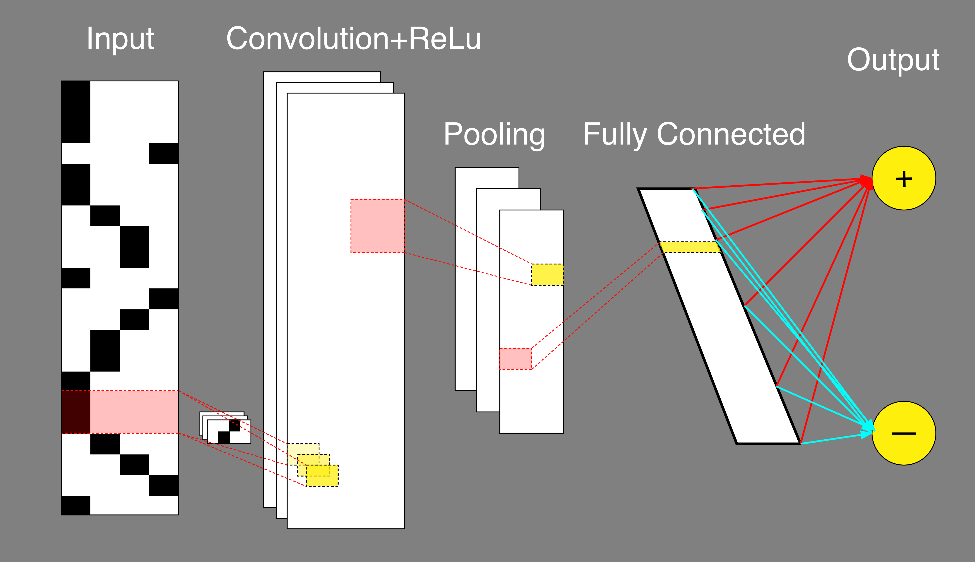
Convolution Network Description

Slide 7
Convolution features
Generated discrete values corresponding to one-hot representation of nucleotides
Tensorflow adaptive features
with continuous values

Slide 8
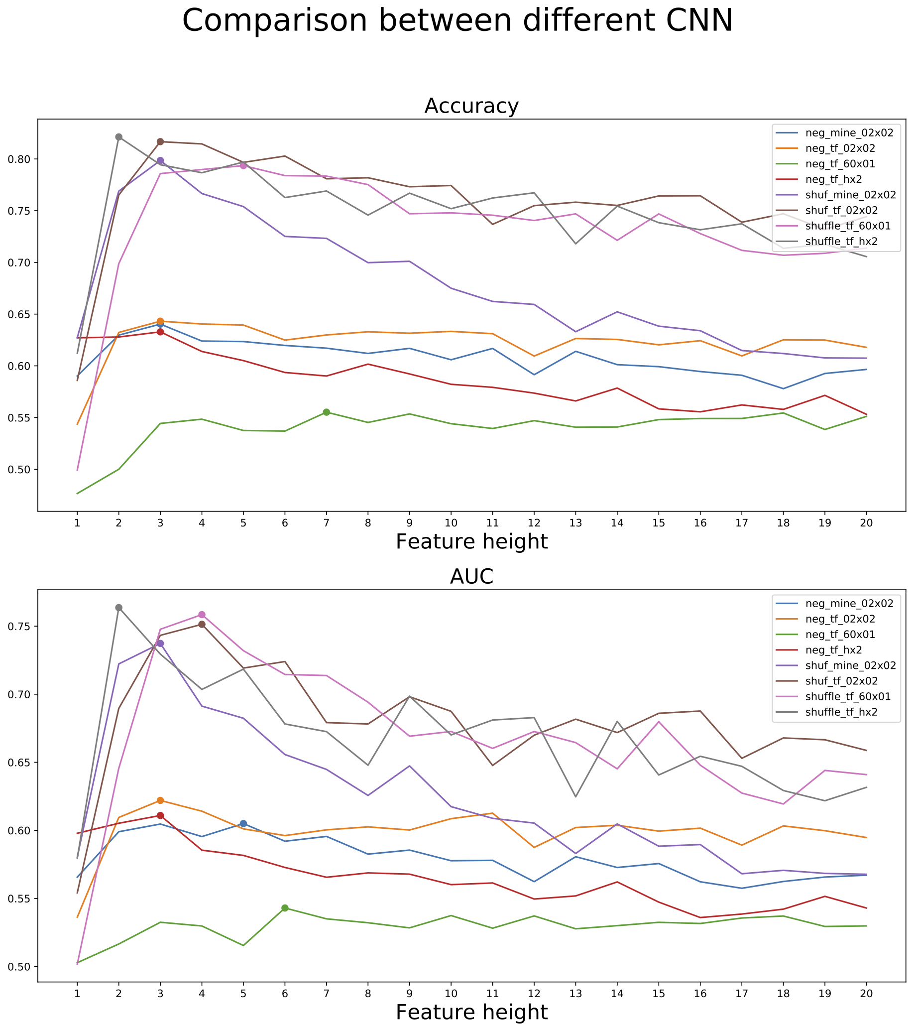
Different CNN comparison
Accuracy best: shuffled nucleotides as negative sample with feature height = 2, 3, 4 and pooling matrix = 2x2
AUC best is the same

Slide 9
Final CNN structure and results
Structure:
1 Layer CNN
Input image size = 60x4
Tensorflow adaptive features
Feature size = 4x4
32 Filters in convolution layer
Pooling size = 2x2
Fully connected: 200
Number of epochs: 200
Accuracy: 83%
AUC: 85%

Slide 10
Final CNN output of layers
Convolution
Maxpool
Fully connected

Slide 11
Comparison
DeepEnchancer - AUC is about 91%
More Layers performed
Negative sample is constructed in a more complicated considering other biological information

