Slide 1

Node.js Boot camp
Day 1

Slide 2
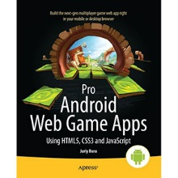

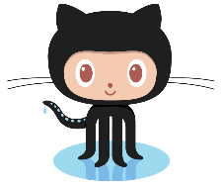
Glad to meet you!
My name’s Juriy Bura
Currently working in EPAM China
Love JavaScript and HTML5
@juriy
https://github.com/juriy

Slide 3
Who are you?
You know JavaScript
You have either none or little experience with Node.js
You want to get a good start with Node.js

Slide 4
Our Plan
Day 1: Basics of Node.js
Day 2: Network & Web development
Day 3: Tools, Testing and Deployment

Slide 5
Day 1

Slide 6
Bird’s eye view on Node.js

Slide 7
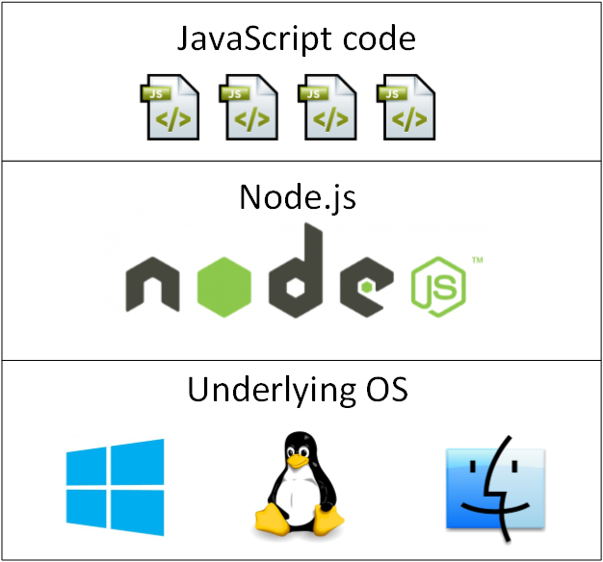
What is Node.js

Slide 8
A brief history of Node.js
Started by Ryan Dahl in early 2009
NPM, started on September 2009 and added to Node.js
November 2010: Node.js moves to Joyent
June 2011, Microsoft partnered with Joyent to make a native Windows port
Notes:
https://www.youtube.com/watch?v=SAc0vQCC6UQ

Slide 9




Faces of Node.js
Ryan Dahl creator of Node.
Isaac Z. Schlueter
NPM author, project lead 2012-2014
Timothy J Fontaine project lead
A company behind Node.js

Slide 10
Facts about Node.js
Used by: Yahoo, LinkedIn, Microsoft, New York Times, PayPal and many others
Trademark belongs to Joyent
MIT licensed
Runs on Windows, Linux, MacOS, SunOS
Windows installer is 5.5 MB
Runs on Raspberry Pi
Active community with many conferences, around 30 published books

Slide 11
Node.js resources
http://nodejs.org
http://www.planetnodejs.com
http://nodeup.com
http://nodeschool.io
https://twitter.com/nodejs

Slide 12
Setting up environment

Slide 13
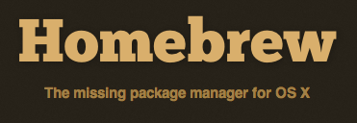

Installing Node.js
Option 1: one-click installers from http://nodejs.org
$ brew install node
$ brew install npm
$ sudo port install nodejs
$ sudo apt-get update
$ sudo apt-get install nodejs
$ sudo apt-get install npm
Notes:
https://www.youtube.com/watch?v=SAc0vQCC6UQ

Slide 14
Installing node.js on Ubuntu
Setup with Ubuntu:
> curl -sL https://deb.nodesource.com/setup | sudo bash -
Then install with Ubuntu:
> sudo apt-get install -y nodejs
https://github.com/joyent/node/wiki/Installing-Node.js-via-package-manager#debian-and-ubuntu-based-linux-distributions

Slide 15


Running Node.js programs
REPL
> node main.js
> node –e 'console.log("Hello World")'
From IDE:

Slide 16
JavaScript run-through

Slide 17
Functions and type casting
var log = console.log; function add(a, b) { return a + b; } log(add('5', 1)); log(add(5, '1')); log(add(5)); log(add()); log(add); log(add(5, 6, 7, 8, 9));

Slide 18
Closure fun
var funcs = []; for (var i = 0; i < 3; i++) { f = function() { console.log(i); }; funcs.push(f); } funcs.forEach(function(f) { f(); });
// Prints 3, 3, 3

Slide 19
Fix: create a new scope
for (var i = 0; i < 3; i++) { f = (function(i) { return function() { console.log(i); }; })(i);
funcs.push(f); } funcs.forEach(function(f) { f(); }); // Prints 0, 1, 2

Slide 20
Hoisting
var name = "Peter"; (function foo() { console.log(name); if (true) { var name = "Henry" console.log(name); } })(); console.log(name);
var name = "Peter"; (function foo() { var name; // Hoisted
console.log(name); if (true) { name = "Henry" console.log(name); } })(); console.log(name);
// Prints: undefined, Henry, Peter

Slide 21
this keyword
var counter = { cnt: 0, inc: function() { this.cnt++; } }; counter.inc(); setTimeout(counter.inc, 10); setTimeout(counter.inc, 20); setTimeout(function() {console.log(counter.cnt);}, 30);

Slide 22
apply(), call(), bind()

Slide 23
Prototypes
var creature = { name: '<some creature>', log: function () { console.log(this.name); } } var goblin = Object.create(creature); goblin.log();
goblin.name = 'Grokk'; goblin.log();

Slide 24

Prototype chain

Slide 25
OOP - defining a class
// Constructor function Creature(x, y) { this._x = x; this._y = y; } // Static method Creature.getRandomCreature = function() { /* some smart code here */ } // Instance method Creature.prototype.getPosition = function() { return {worldX: this._x, worldY: this._y}; };

Slide 26
OOP - inheritance
// Constructor function Goblin(x, y, name) {
// Super constructor call Creature.call(this, x, y); this._name = name; } // Extends Goblin.prototype = Object.create(Creature.prototype, { constructor: { value: subConstructor, enumerable: false, writable: true, configurable: true }); // Super call Goblin.prototype.printPosition = function() { console.log(this._name + Creature.prototype.printPosition.call(this)); };

Slide 27
A word on code conventions
camelCaseVariables
UpperCamelCaseClasses
UPPER_CASE_CONSTANTS
_underscoredPrivateFields
Indents are up to you
80 characters limit
Better write few more clear lines than one cryptic line

Slide 28
Node.js architecture

Slide 29
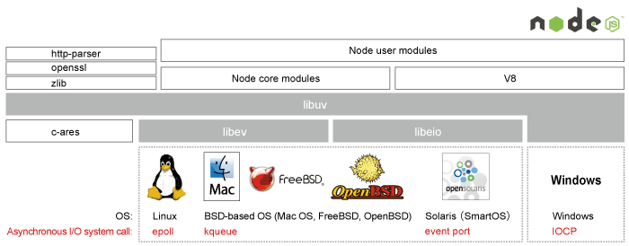
Closer look
Notes:
https://www.youtube.com/watch?v=SAc0vQCC6UQ

Slide 30
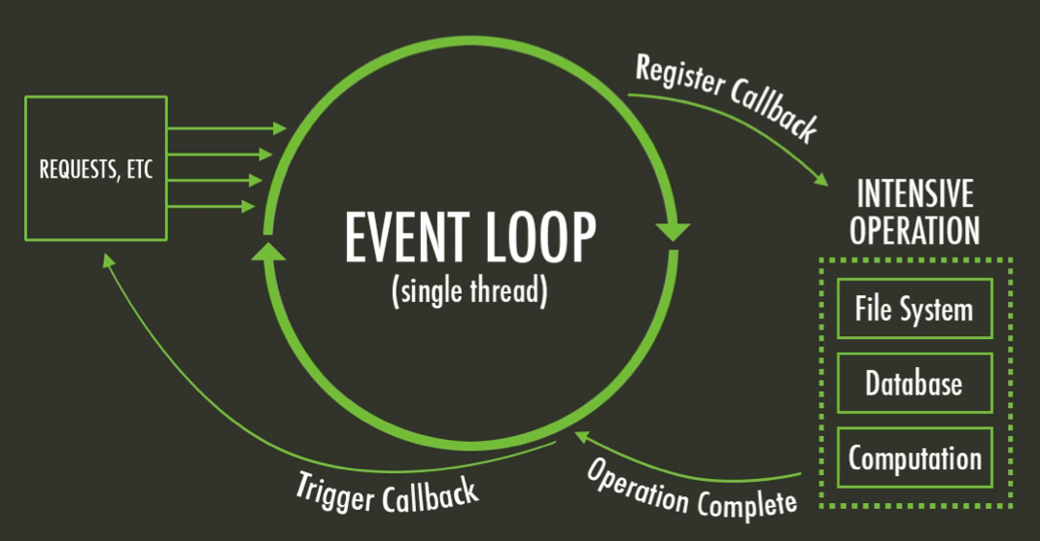
Event Loop
Notes:
https://www.youtube.com/watch?v=SAc0vQCC6UQ

Slide 31
Event Loop as a code
while there are still events to process:
e = get the next event
if there is a callback associated with e:
call the callback
Examples of events
Socket has new data
Directory has been created
File was written

Slide 32
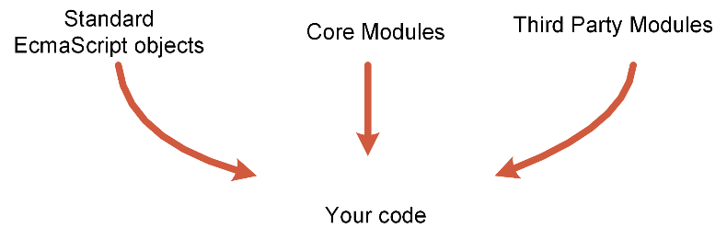
Modules

Slide 33
Core modules: File System
http://nodejs.org/api/fs.html

Slide 34
Functions to work with FS
readFile
writeFile
chmod
chown
mkdir
rmdir
rename
truncate

Slide 35
Code example
// Save folder structure to a file var fs = require('fs'); var folder = 'c:/dev'; var report = 'c:/dev/report.txt'; var arr = fs.readdirSync(folder); var text = arr.join('\n'); fs.writeFileSync(report, text); console.log('Listing saved');

Slide 36
Not a Node.js way! The async way is…
var fs = require('fs'); // Save folder structure to a file var folder = 'c:/dev'; var report = 'c:/dev/report.txt'; var arr = fs.readdir(folder, function(err, data) { var text = data.join('\n'); fs.writeFile(report, text, function(err) { console.log('Listing saved'); }); });

Slide 37
Buffer object
http://nodejs.org/api/buffer.html

Slide 38
Object for working with binary data
Non-resizable reference to memory outside of V8 heap
Each element is byte (0-255)
new Buffer(5)
new Buffer('Hello')
new Buffer([1, 2, 3, 4])
buf.toString('utf-8'); buf.slice(1, 5);
buf.write('abc', 10);

Slide 39
Modules

Slide 40
The problem of modules in JavaScript
There’s no standard way organize modules as of ES-262 ed. 5
Three different aspects of modules are:
Isolating global scope
Dependency management
Transport

Slide 41
Isolation of a global scope
// The class defined in Math API function Utils() {} Utils.prototype.add = function(x, y) { return x + y; }; // The class defined in Strings API function Utils() {} Utils.prototype.add = function(x, y) { return x + "" + y; };

Slide 42
Introduce namespaces
// The class defined in Mathematics API if (typeof com == "undefined") {com = {};} if (!com.juriy) {com.juriy = {};} if (!com.juriy.math) {com.juriy.math = {};} com.juriy.math.Utils = function () {};
But what about API versioning?

Slide 43
Module pattern
var StringUtils = (function () { function Utils() { }
Utils.prototype.add = function(x, y) { return x + "" + y; };
return Utils; })();

Slide 44
Module standards
AMD
CommonJS
ES-6 Modules

Slide 45
AMD (Asynchronous Module Definition)
define('myModule', ['math', 'graph'], function ( math, graph ) {
return { plot: function(x, y) { return graph.drawPie(math.randomGrid(x,y)); } } }; });
require(['foo', 'bar'], function ( foo, bar ) { // rest of your code here foo.doSomething(); });
Example from: http://addyosmani.com/writing-modular-js/

Slide 46
CommonJS
// package/lib is a dependency we require var lib = require('package/lib'); // some behaviour for our module function foo(){ lib.log('hello world!'); } // export (expose) foo to other modules exports.foo = foo;
Example from: http://addyosmani.com/writing-modular-js/

Slide 47
EcmaScript 6
module math { export function add(a, b) { return a + b; } } module strings { export function add(a, b) { return a + '' + b; } }
module foobar { import {add as mathAdd} from 'lib/math'; import {add as strAdd} from 'lib/strings'; export var value =
mathAdd(4, 5) + strAdd(4, 5); }

Slide 48
Node.js modules

Slide 49
Following CommonJS style
function Animal() { }
var _p = Animal.prototype;
_p.sayHello = function() { console.log('wuff'); };
function makeNewAnimal() { return new Animal(); }
exports.Animal = Animal;
// Client code var Animal = require("./animal").Animal; var hamster = new Animal();

Slide 50

Exporting single object
function Animal() { }
var _p = Animal.prototype;
_p.sayHello = function() { console.log('wuff'); };
function makeNewAnimal() { return new Animal(); }
// Client code var Animal = require("./animal"); var hamster = new Animal();
exports = module.exports = Animal;

Slide 51
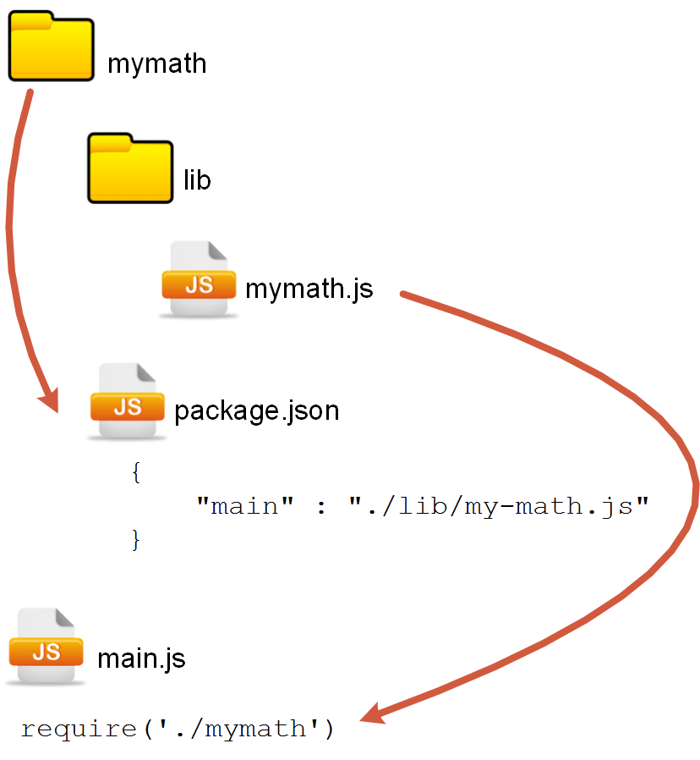
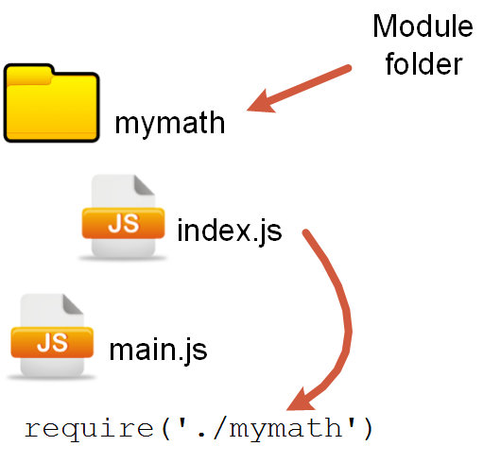
Modules as folders

Slide 52
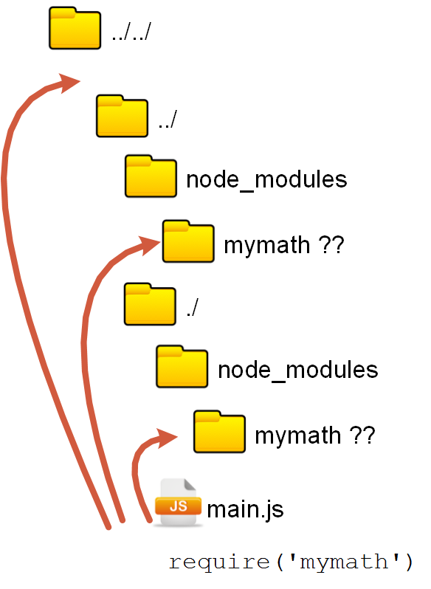
node_modules
A lookup location for modules
Lookup recursively up in FS

Slide 53
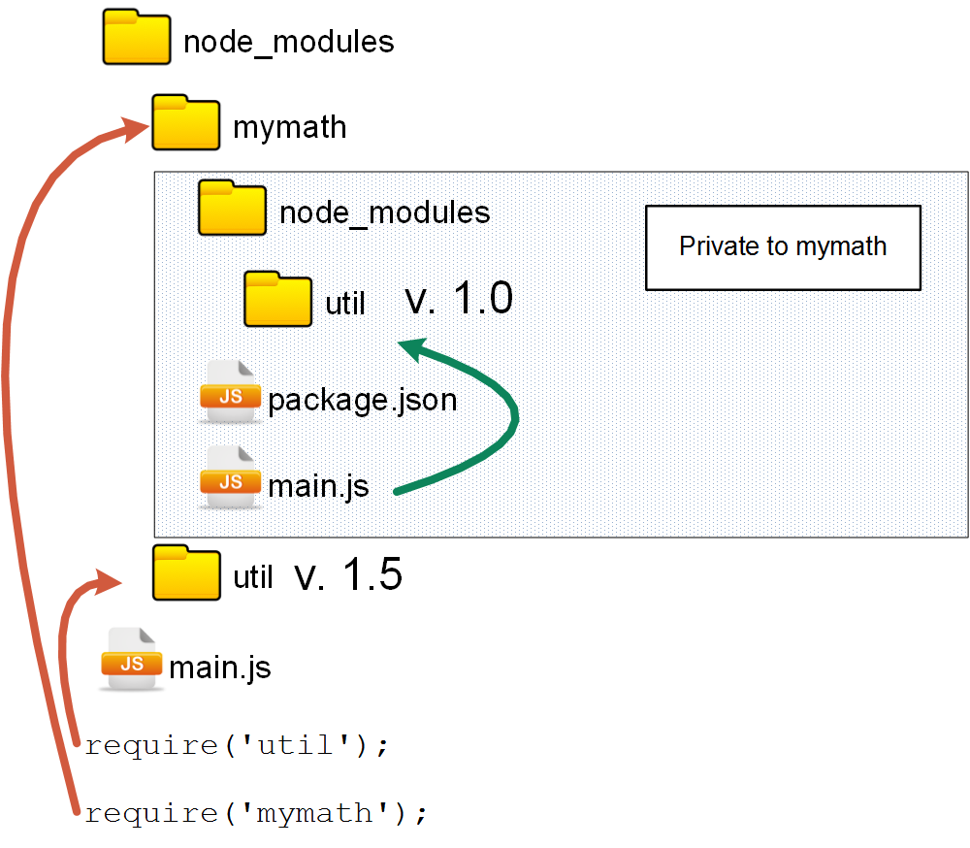
Multiple versions of dependencies

Slide 54
Summary: module discovery
http://nodejs.org/api/modules.html#modules_modules
Notes:
Should make proper shapes on decisions

Slide 55

https://www.npmjs.org/

Slide 56
NPM is
The standard package manager for node
An open registry with almost 100K packages
A module authoring tool
Comes bundled with Node.js

Slide 57
NPM basic walkthrough
$ npm search
$ npm view
$ npm install
$ npm install --production
$ npm ls
$ npm update
$ npm uninstall

Slide 58
Types of modules
Local – used for development, installed in local node_modules
Global – used as command line tools, installed in global NPM folder

Slide 59
Authoring modules: package.json
{ "name": "mytest", "version": "0.0.0", "description": "My sample command line tool", "main": "index.js", "keywords": [ "command", "line", "test"], "author": "Juriy Bura", "license": "ISC" }

Slide 60
Publishing your module
$ npm init
$ npm install --save-dev
$ npm install --save
$ npm adduser
$ npm publish (after init)
$ npm unpublish

Slide 61
Making CLI tool
package.json Tell NPM this is a CLI tool
This is index.js Shebang is required even in Windows
"preferGlobal": true, "bin": { "mytool": "index.js" }
#!/usr/bin/env node console.log('This is my command line test');
$ npm install –g mytool
Install globally, then run as normal cli tool
$ mytool

Slide 62
process
http://nodejs.org/api/process.html

Slide 63
Global object used to work with current process
process.argv // process arguments
process.pid // process pid
process.cwd // working directory
process.env // environment
process.nextTick(fn) // add to event loop
// streams:
process.stdout, process.stdin, process.stderr

Slide 64
Debugging

Slide 65
Ways to debug Node.js application
(Hardcore) non-GUI Core Node.js debugger
Node Inspector
IDE

Slide 66
Hardcore – Core Node.js debugger
$ node debug myscript
$ node debug -p <pid>
$ node debug <URI>
cont, c - Continue execution
next, n - Step next
step, s - Step in
out, o - Step out
pause - Pause running code
http://nodejs.org/api/debugger.html

Slide 67
Enabling debugger on a running app
$ kill -s USR1 2345
> tasklist /FI "IMAGENAME eq node.exe"
> node -e "process._debugProcess(3084)"

Slide 68
Node Inspector
A debugger interface for Node.js applications that uses the Blink Developer Tools (formerly WebKit Web Inspector).
npm install -g node-inspector
https://github.com/node-inspector/node-inspector

Slide 69
Thank you!

