Slide 1
Stable marriage problem
Data bases and programming
2019/2020
Juraj Uhlár
Rastislav Machava

Slide 2



STABLE Marriage problem
You have N men and N women (each with an ordered list of preferences)
Arrange N marriages that are stable
A marriage is not stable if:
A man and a woman like each other more than the people they are currently married to

Slide 3
Solution
TOM | BOB | ROMAN
KATE | SARA | SARA
ASHLEY | KATE | ASHLEY
SARA | ASHLEY | KATE
KATE | ASHLEY | SARA
ROMAN | TOM | ROMAN
BOB | ROMAN | BOB
TOM | BOB | TOM

Slide 4
Solution
TOM | BOB | ROMAN
KATE | SARA | SARA
ASHLEY | KATE | ASHLEY
SARA | ASHLEY | KATE
KATE | ASHLEY | SARA
ROMAN | TOM | ROMAN
BOB | ROMAN | BOB
TOM | BOB | TOM

Slide 5
Solution
TOM | BOB | ROMAN
KATE | SARA | SARA
ASHLEY | KATE | ASHLEY
SARA | ASHLEY | KATE
KATE | ASHLEY | SARA
ROMAN | TOM | ROMAN
BOB | ROMAN | BOB
TOM | BOB | TOM

Slide 6
Solution
TOM | BOB | ROMAN
KATE | SARA | SARA
ASHLEY | KATE | ASHLEY
SARA | ASHLEY | KATE
KATE | ASHLEY | SARA
ROMAN | TOM | ROMAN
BOB | ROMAN | BOB
TOM | BOB | TOM

Slide 7
Solution
TOM | BOB | ROMAN
KATE | SARA | SARA
ASHLEY | KATE | ASHLEY
SARA | ASHLEY | KATE
KATE | ASHLEY | SARA
ROMAN | TOM | ROMAN
BOB | ROMAN | BOB
TOM | BOB | TOM

Slide 8
Solution
TOM | BOB | ROMAN
KATE | SARA | SARA
ASHLEY | KATE | ASHLEY
SARA | ASHLEY | KATE
KATE | ASHLEY | SARA
ROMAN | TOM | ROMAN
BOB | ROMAN | BOB
TOM | BOB | TOM

Slide 9
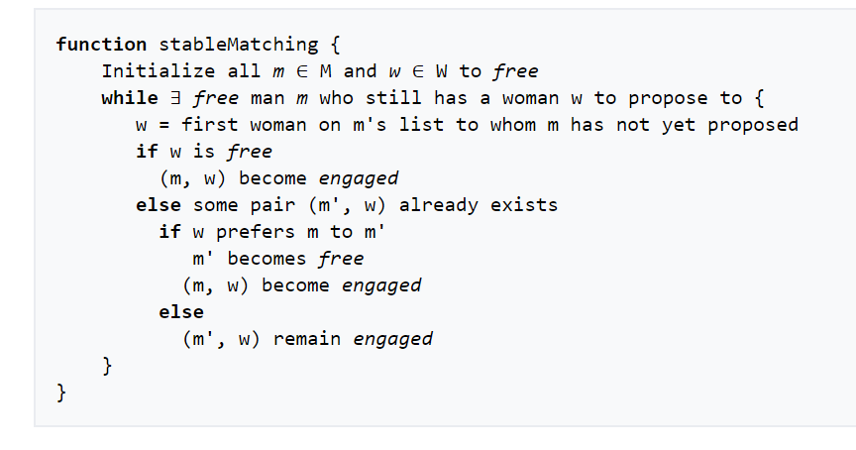
PSEUDOcode

Slide 10
Thank you for attention

