Slide 1
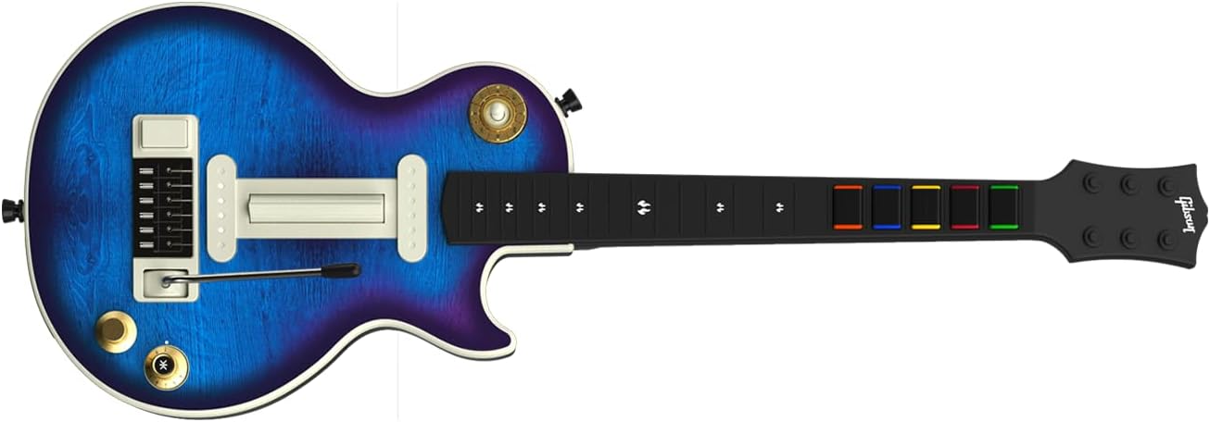
Music Style Selector with Green (A), Red (B) Yellow (C), Blue (D), Orange (Previous), None (Next)
Strumbar
Fil/Breakl Drumbeat
Transpose UP
Chord Buttons / Selector
Guitar Style Selector with Green (Strum), Red (Strum/Bass), Yellow/Blue/Orange (Arpeggios)
Start/Stop Midi/Audio Styles + Backing Track
Volume Control Joystick. Press to reset
Application Selection Green – Arranger (Ketron/Yamaha), Red – Ample Guitar. Yellow – Midi Drummer, Blue – SeqTrak, Orange – MODX/Montage M
Green:Red – Midi Guitar, Green:Blue – Audio Styles, Red:Orange – Nanobox Tangerine, Red:Blue – Akai MPC Sample, Yellow:Orange –Roland SP404 mk2

Slide 2
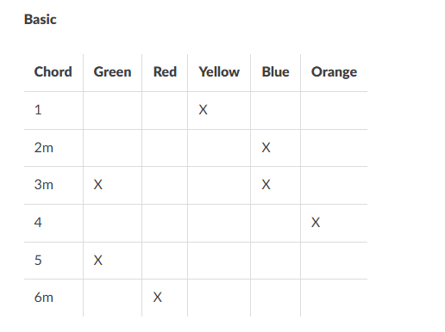

Slide 3
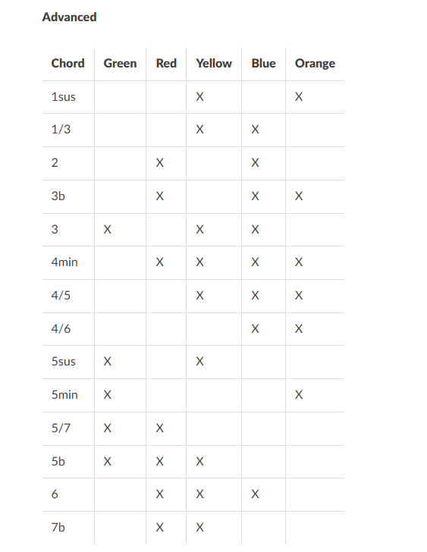

Slide 4
Whammy Bar | Green | Red | Yellow | Blue | Orange
Suspend Play/Notes
Strum Up/Down | X
Strum Up/ Bass Down |  | X
Arpeggio Type 1 |  |  | X
Arpeggio Type 2 |  |  |  | X
Arpeggio Type 3 |  |  |  |  | X
Bass Guitar | X | X
Alto Guitar |  | X | X
Tenor Guitar |  |  | X | X
Mute Guitar |  |  |  | X | X
Mute Style |  |  | X |  | X
Mute Bass Track |  | X |  | X
Mute Chord Track | X |  | X
Mute Drum Track | X |  |  | X
Auto Hold |  | X | X | X
Staccato Mode |  | X |  |  | X

Slide 5
