Slide 1
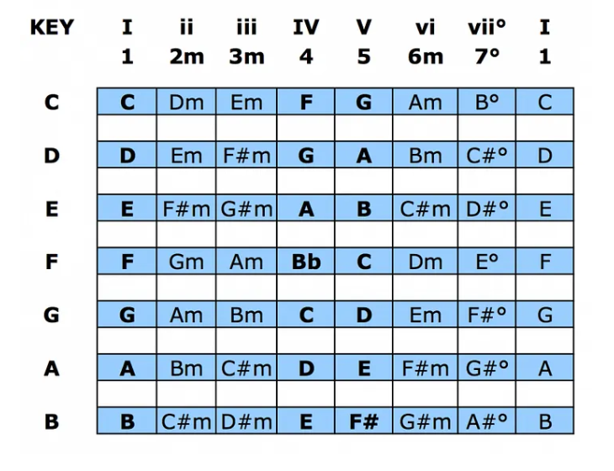

Slide 2
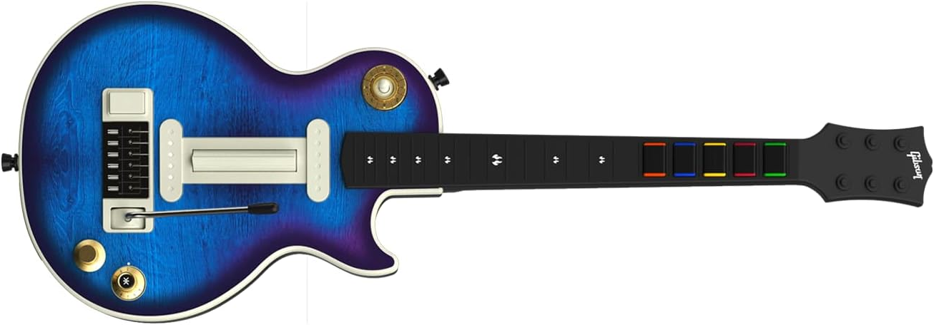
Next Music Style / Music Style Selector with Chord Buttons Green (A), Red (B) Yellow (C), Blue (D)
Strumbar
Fill Drumbeat
Transpose UP / DOWN
Previous Music Style / Guitar Style Selector
Chord Buttons / Selector
Start/Stop
Break Drumbeat
Application Selection Green – Ketron, Red – Ample Guitar. Yellow – Midi Drummer

Slide 3
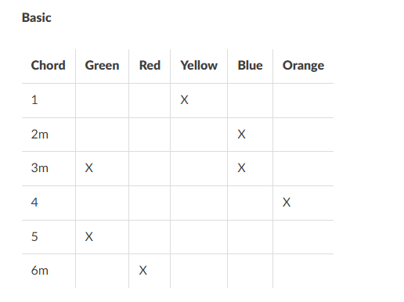

Slide 4
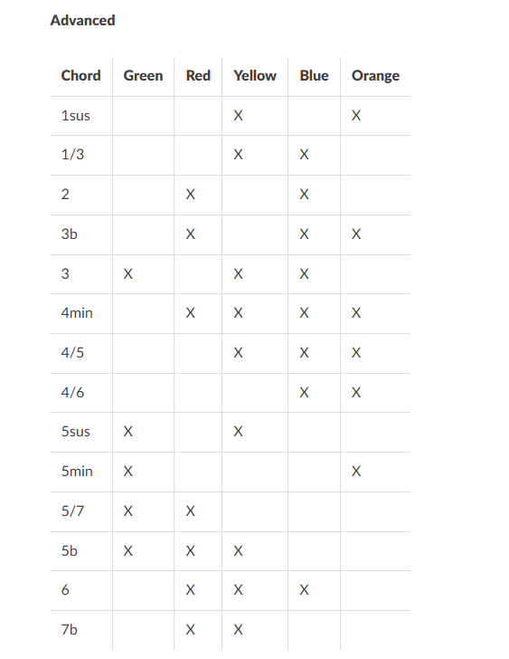

Slide 5
Whammy Bar (prev) | Green | Red | Yellow | Blue | Orange
Strum Up/Down | X
Strum Up/ Bass Down |  | X
Arpeggio Type 1 |  |  | X
Arpeggio Type 2 |  |  |  | X
Arpeggio Type 3 |  |  |  |  | X
Bass Guitar | X | X
Alto Guitar |  | X | X
Tenor Guitar |  |  | X | X
Mute Guitar (No Sound) |  |  |  | X | X

