Slide 1
Everyday Art
Sprint One
Mike, Justin, London, Kc

Slide 2
Sprint Goals
Randomly Generated Challenges
Randomly Generated Ideas
  Completely random ideas
  Genre selected random ideas
  User chosen random ideas

Slide 3
Functional Requirements
Html and CSS
  Layout/Style
Php
  Backend/Functionality
MySql Databases
  11 databases used
  Storing Ideas

Slide 4
Design
Databases store adj, noun, and verb ideas
Random function selects random item for each part of sentence
Enter words adds user defined words to select randomly from
Select genre function uses tags on words in databases to select random genre specific sentences

Slide 5
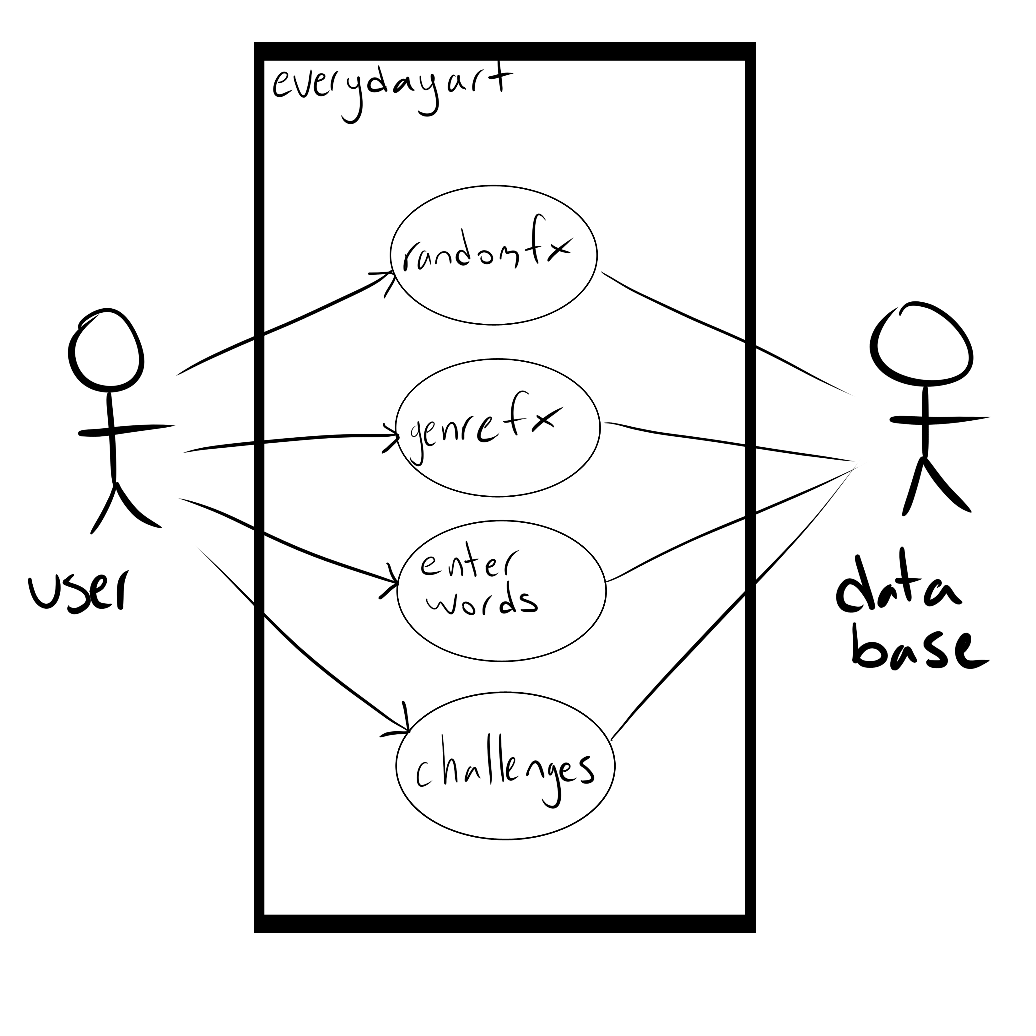
Use Case Diagram

Slide 6
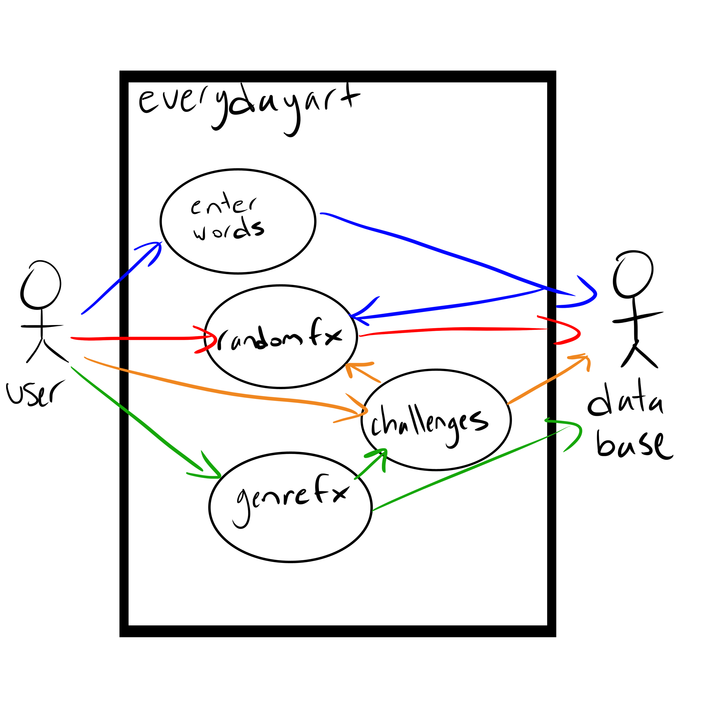
Use Case Diagram

Slide 7
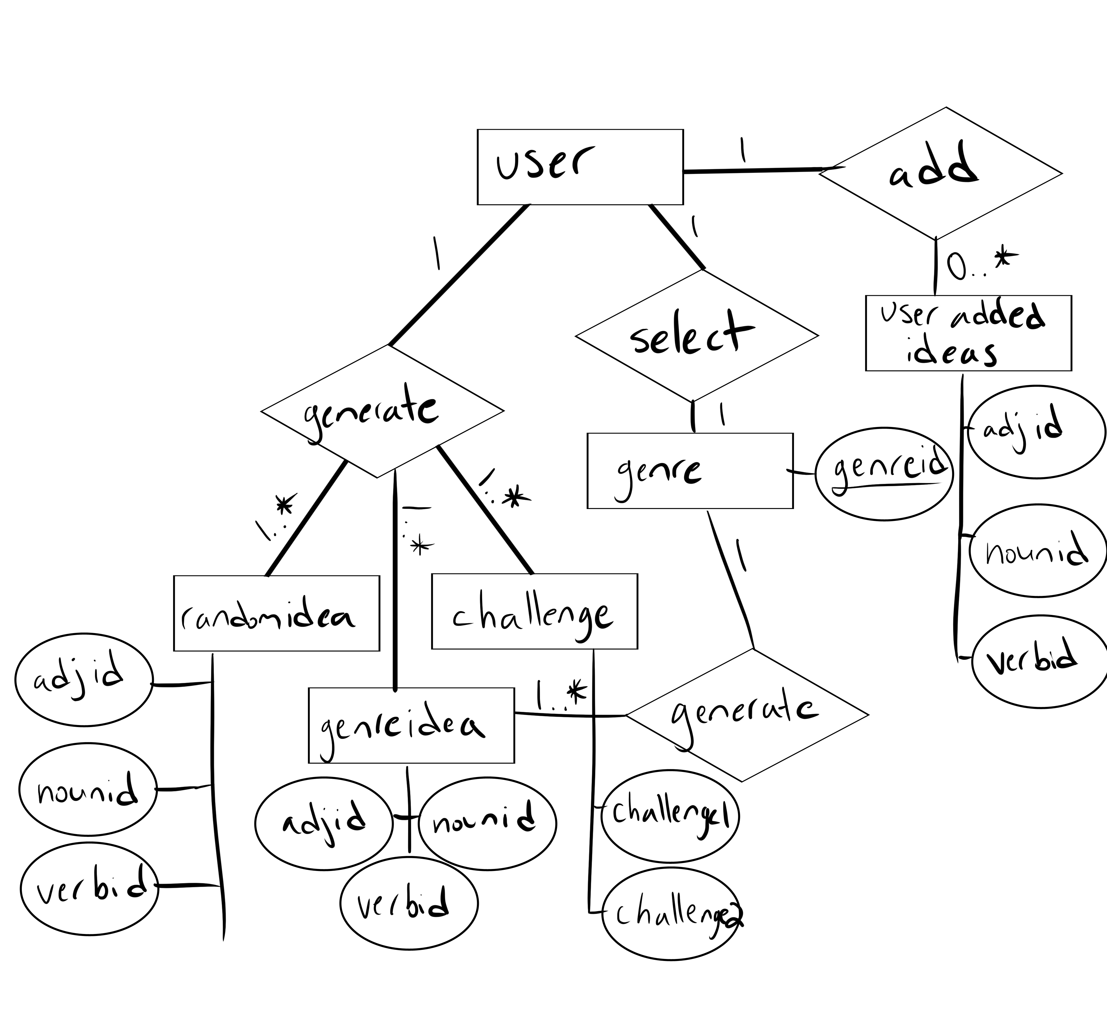
ERD

Slide 8
Test Cases
Choose completely random idea
  Output: sentence with random words
Choose to add words into sets of word banks
  Output: sentence with random words from input word banks
Choose a genre
  Output: sentence with random words in selected genre
Generate a random challenge
  Output: sentence with random words ready for challenge

Slide 9
Sprint Two Goals
Login
User Profile
Point System
Gallery
Voting on Art

