Slide 1
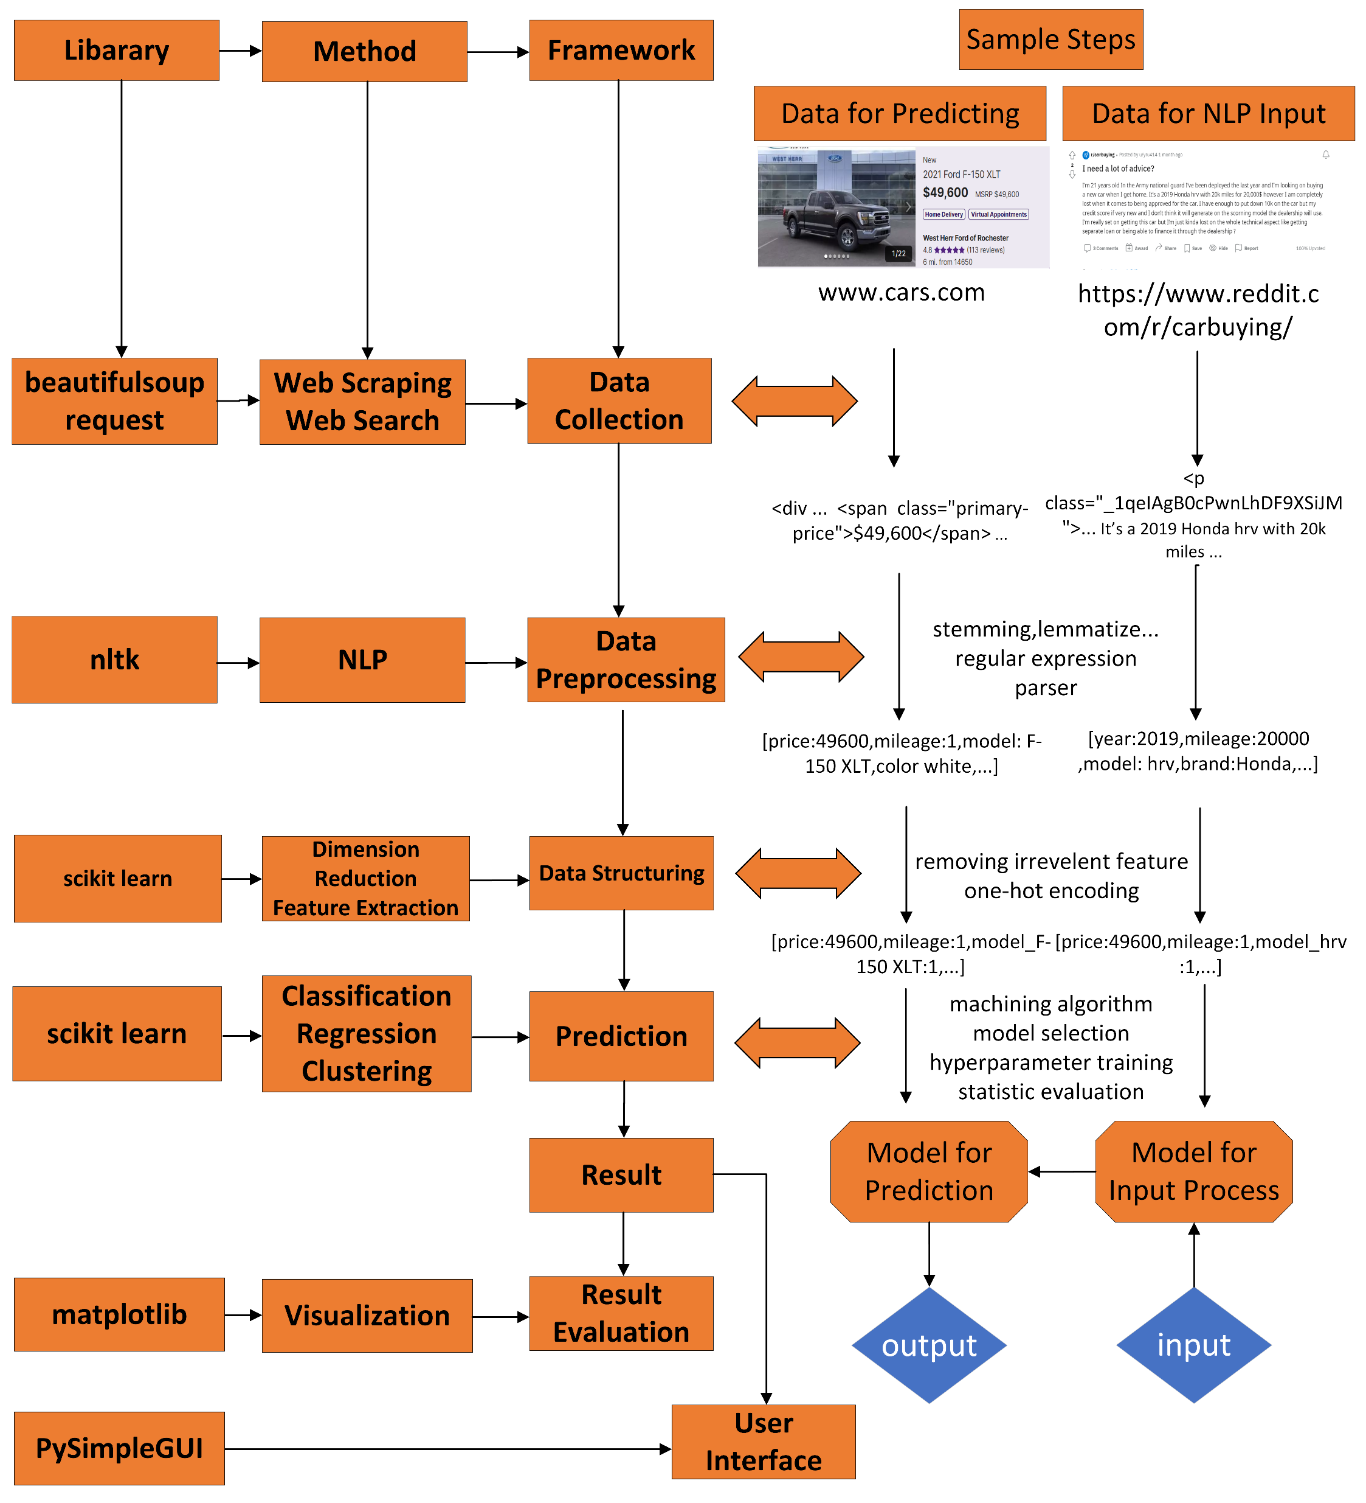
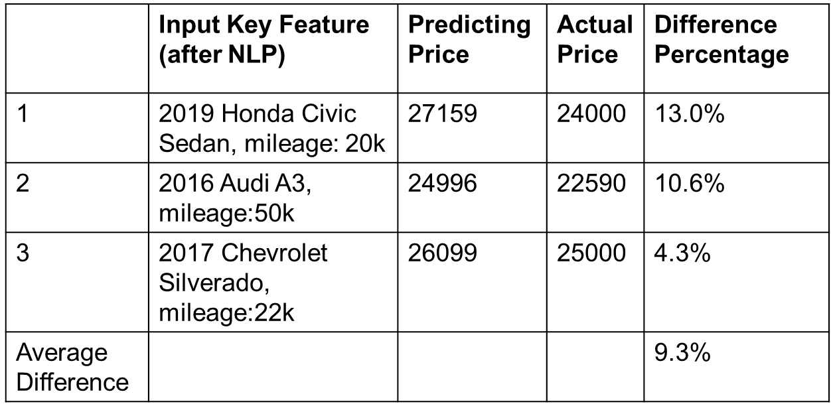
Used Car Price Evaluation System
Handong Chen
Rochester Institute of Technology,
Rochester, New York, USA
hc2157@rit.edu
Chenxuan Li
Rochester Institute of Technology,
Rochester, New York, USA
cl6838@rit.edu
Yujie Zhao
Rochester Institute of Technology,
Rochester, New York, USA
yz3917@rit.edu
RIT
Advisor: Dr. Rajendra K. Raj
Motivation
System
Result
Most used car price evaluation systems focus on data mining and machine learning methods.
Because of the mileage and production year, the value of used cars is hard to estimate.
Developed Solution
NLP extract technical keywords, including production year, mileage, model and brand.
Python web scrapers to collect data based on the keywords extracted by the NLP process.
Classification machine learning algorithm to predict price.
Status and Concluding Remarks
The system can dynamically search data from the Internet based on the input data and output the result depending on the hypotheses scores.
Because of the implementation of data searcher, the system can build corpus in minutes and only keep valuable data.
Future work includes extending data sources, making the estimated price more accurate, and predicting future prices.
Background
The START QA system is a typical system based on matching natural language processing and information retrieval methods.[1]
Another type of QA system is more intelligent and can provide answers based on reasoning.[2]
The linguistic approach tries to understand natural language using NLP techniques such as tokenization, POS tagging and parsing. [3]
The pattern approach tries to match the pattern from the question and the corpus data.[3]
References
[1] | Boris Katz. 1997. Annotating the World Wide Web Using Natural Language. In Computer-Assisted Information Searching on Internet (Montreal, Quebec, Canada) (RIAO ’97). 136–155
[2] | Yuyu Zhang, Hanjun Dai, Zornitsa Kozareva, Alex Smola, and Le Song. 2018. Variational Reasoning for Question Answering with Knowledge Graph. In The Thirty-Second AAAI Conference on Artificial Intelligence (AAAI-18). New Orleans, Louisiana, USA, 6069–6076.
[3] | Sanjay K. Dwivedi and Vaishali Singh. 2013. Research and Reviews in Question Answering System. Procedia Technology 10 (2013), 417–424. https://doi.org/10. 1016/j.protcy.2013.12.378

