Slide 1
Smart Technology in the Home … Time saving, or privacy invading?
JUSTYNA ROSIAK

Slide 2
Summary
Smart Tech at home – how it looks like.
PROS and CONS of smart home.
Conclusions.

Slide 3
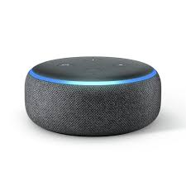
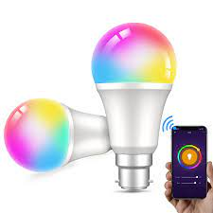
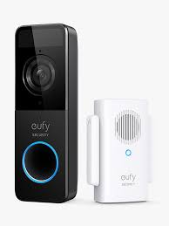
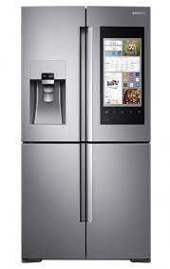
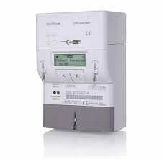
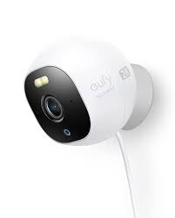
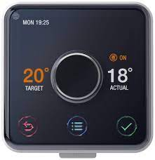
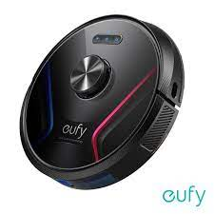
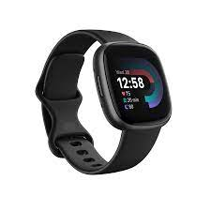
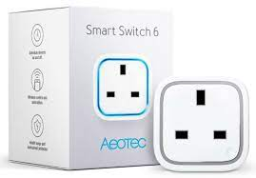
Internet of things (IoT)

Slide 4

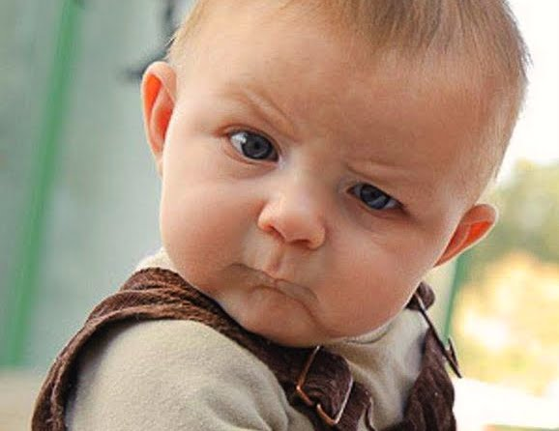
Notes:
Pure excitement because smart devices are
time and energy savers
Convenient
Automate mundane household tasks
help you also to monitor various things within the house, which could lead to improved security
concerns and risks
each of them collects data – so what’s happening with security and privacy?
What if data falls into wrong hands?
Smart devices usually are weak points in the home cybersecurity so it is easier to find gaps in their security systems in order to get access to sensitive data,
The more smart devices in our homes the more prone we are to getting hacked
Some people may say if that’s the matter of choice just accept risks associated with your choice but what if it is no longer a choice

Slide 5

Time saving?
Privacy invading?
Notes:
Data security
Data privacy
Misuse of data already collected
– personal data can be indirectly gathered from a non sensitive data
Data is being collected without the users consent as often is deeply buried into the users agreement or in order to be able to use the product we have to agree to their privacy policy, so there is no really the choice
There’s no control of the data already gathered
Some companies are tying customers to use their product only by creating their own eco system

Slide 6
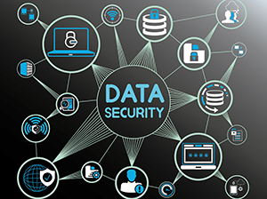
What can a consumer do?
Read the data/product use agreement carefully and opt out of data sharing with 3rd parties if possible
Consider convenience over risks
Is it necessary to connect the appliance to the internet in order to use it?
Notes:
Data security
– personal data can be indirectly gathered from a non sensitive data
Data is being collected without the users consent as often is deeply buried into the users agreement or in order to be able to use the product we have to agree to their privacy policy, so there is no really the chocuie
There’s no control of the data already gathered
Some companies are tying customers to use their product only by creating their own eco system

Slide 7

WHAT can be DONE?
There is a need for some sort of laws and regulations that would protect consumers data - not only the sensitive ones.
Should there be a professional code of conduct for data scientists/analysts?
If not, are we leaving the decision to individuals hoping the conscientiousness and moral principles win over financial and power gain.
Notes:
Customers should be able to consent to what data will be collected and how and for how long the data will be stored and used ( can this be regulated in some ways?)
collected and how and for how long the data will be stored and used ( can this be regulated in some ways?)
Data could/should be anonymised by the company ( can this be guaranteed by some regulations?)
Better security features should be a priority to companies that own the product
DATA SCIENTISTS/DATA ENGINEERS /DATA ANALYSTS
Should there be a professional code of conduct developed or are we leaving the decision to individual hoping the conscientiousness and moral principles win over financial and power gain?

Slide 8
Thank you!
Any questions???

